Slide 1
MATRICULATION EXAM RESULT PROJECT
2019 Internship Students

Slide 2
About the System
The idea is to produce a system for viewing Matriculation Exam Result online.
Hope to replace traditional way of viewing result at the respective high schools in the future.
Aim to produce a system that is easy to access and convenient to use.

Slide 3
About the System
There’ll be a total of (10) screens in our system.
- Exam Result List
- Exam Result Detail
- User Login
- Admin Login
- Password Change
- Admin Home
- User Management
- Township Management
- Result Management
- Error

Slide 4
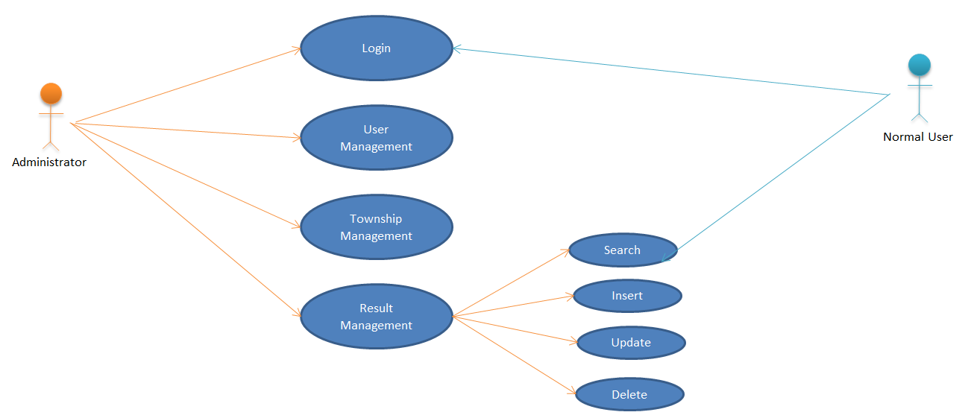
Functional Requirement

Slide 5
System Architecture
Exam Result List
Admin Login
User Login
Admin Home
Password Change
Result Data
Error
User Management
Township Management
Result Management

Slide 6



Development Tools
Eclipse
Maven project manager
Apache tomcat Server

Slide 7






Language, Frameworks and Database
HTML/ CSS/JS
Thymeleaf
BootStrap
Jquery
Spring Framework
MySQL

Slide 8
Exam Result List
Overview
Firstly , users can view by the latest year of exam result’s list.
System show pass ,fail and distinction of each student.
User can search result of each student according to name or roll number or year.
User can view result detail of each student by clicking detail link.
Technical Usage
Thymeleaf for data evaluation(eg. Pass,Fail and destinction)
Autocomplete and validation
Javascript for data table(eg. Pagination, show data list)
There are three query for search function
1.binded maximum year from database
2.result list with student name or roll no or year
3.result list with only for year

Slide 9
Exam Result List(cont’)
Problems | Solutions
Data are binded with list string from jpa repository because we use database query. So we use javascript for evaluating data result in layout. As a problem,we cannot use pagination. | We change model query and binded data From model. So we use thymeleaf for evaluating data result in layout.
Auto pagination cannot be use for native query. | So we use data table for pagination.

Slide 10
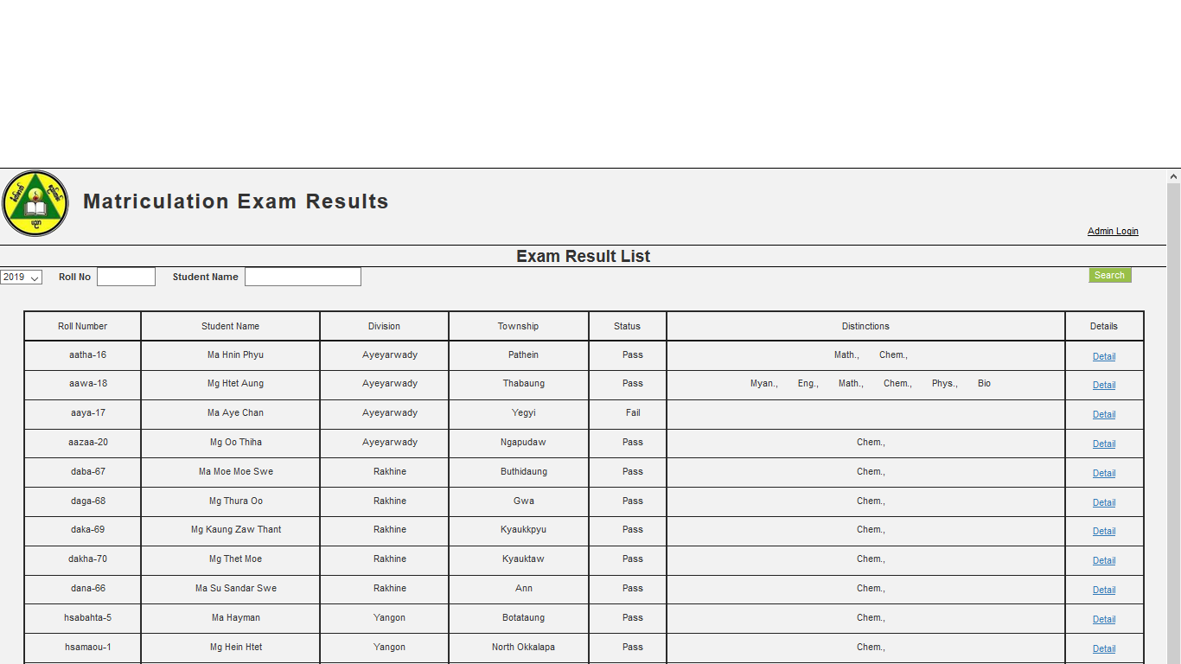
Exam Result List

Slide 11
Exam Result Detail
After logging in with respective user accounts, students can view their result in detail.
Each student can view their scores in every subject whether they “Pass”, “Fail” or get a “Distinction”.
The total score of results is also displayed.
After viewing it online, if students wish to get a copy of it, they are allowed to print their Result Detail using the provided “Print” button.

Slide 12
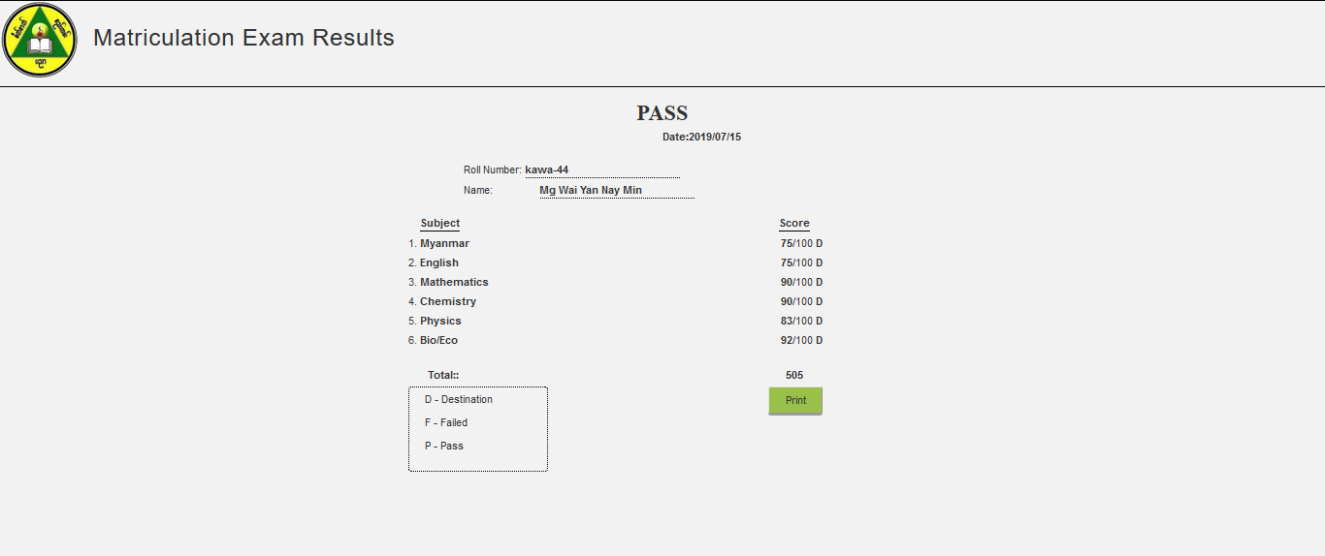
Exam Result Detail

Slide 13
Admin Login And User Login
Spring Security
a framework which provides various security features
targets two major areas of application
authentication and
authorization
Authentication
the process of knowing and identifying the user that wants to access.
Authorization
the process to allow authority to perform actions in the application.

Slide 14
Con’t
Spring Security supports integration with all of these technologies
HTTP BASIC authentication headers
HTTP Digest authentication headers
HTTP X.509 client certificate exchange
LDAP (Lighweight Directory Access Protocol)
Form-based authentication
OpenID authentication
Automatic remember-me authentication

Slide 15
Form-based authentication
Form-based authentication allows the developer to control the look and feel of the login authentication screens by customizing the login screen and error pages that an HTTP browser presents to the end user.

Slide 16
Con’t
When form-based authentication is declared, the following actions occur.
A client requests access to a protected resource.
If the client is unauthenticated, the server redirects the client to a login page.
The client submits the login form to the server.
The server attempts to authenticate the user.
If authentication succeeds, the server redirects the client to the resource by using the stored URL path.
If authentication fails, the client is forwarded or redirected to an error page.

Slide 17
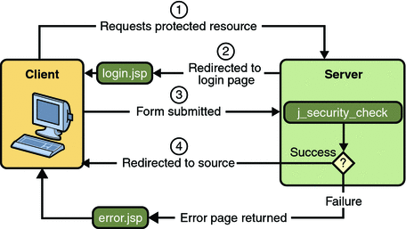
Form-Based Authentication

Slide 18
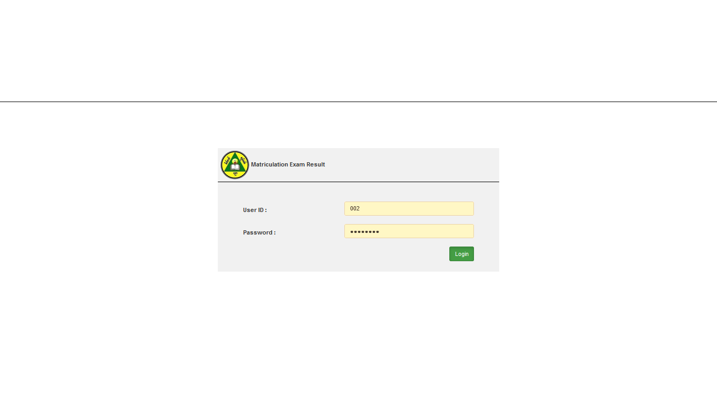
Admin Login And User Login

Slide 19
Admin Home Page
This is the main page for Admins that will navigate to the other Management pages namely
- User Management
- Township Management
- Result Management

Slide 20
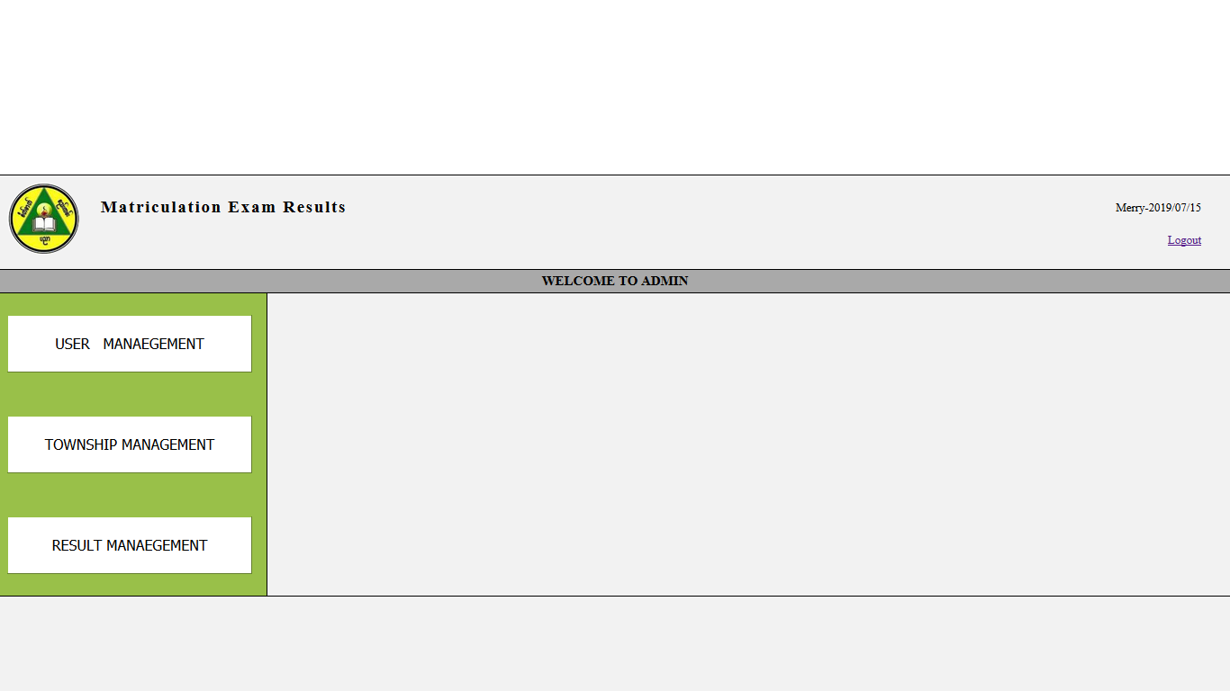
Admin Home Page

Slide 21
User Management
Manage the user(Student) data.
Admin Can Access the page.
System Functions
Insert/Update/Delete.
View user list.
Export user table as PDF.
Validation.
Filtering the user table.

Slide 22
User Management
Technology Overview
Ajax call is used to get the corresponding township of the selected division.
Datepicker function from the jqueryUi libraries for the calendar.
Thymeleaf object accepts the input form and respond to the controller.
Datatable is used for pagination and filtering the student table.
Sytling with Bootstrap and CSS.

Slide 23
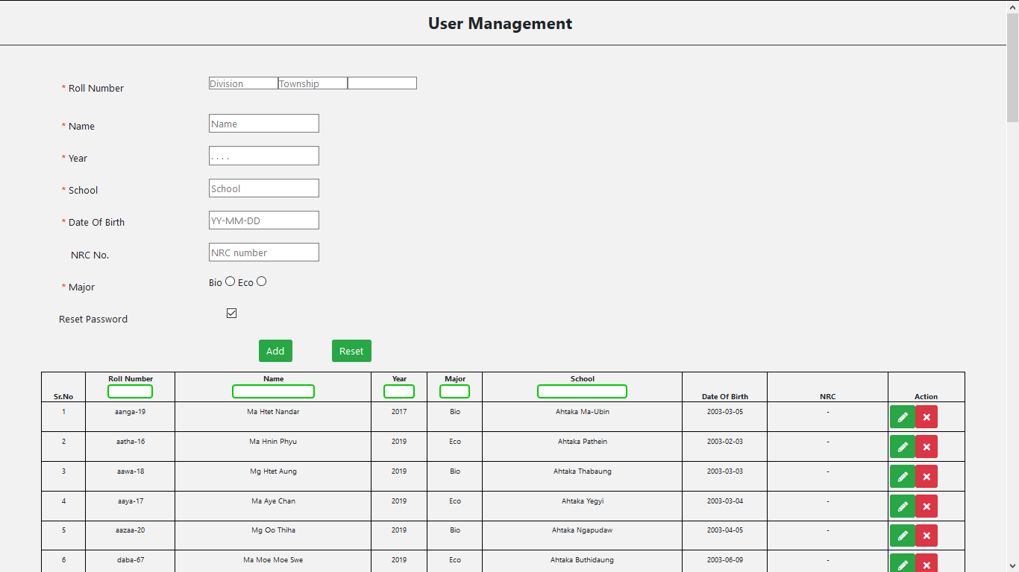
User Management

Slide 24
Township Management
Township Management Screen shows division name , township name and township code data
Admin can manage division and township data
Main Functions
Insert/Update/Delete
Export township data as PDF
Search data according to division name , township name and township code
Validation

Slide 25
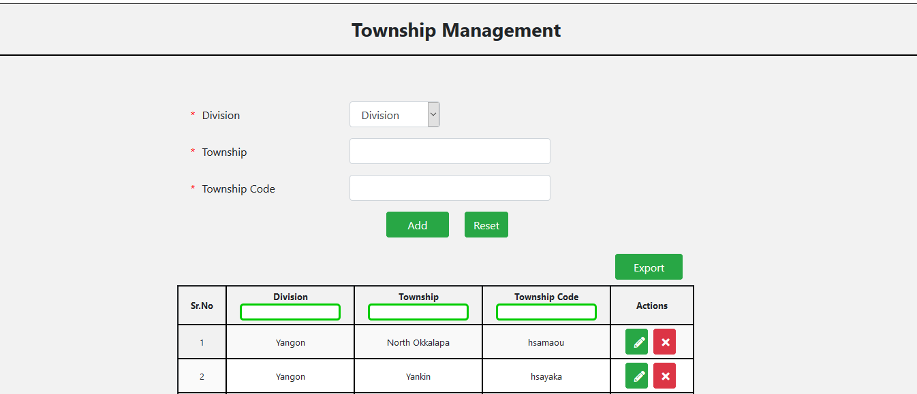
Township Management

Slide 26
Result Management
Main Functions
Insert, Update, Delete, Search, Export
Main Problems
To get Name from selected Year and selected Roll Number with Ajax
Validation

Slide 27
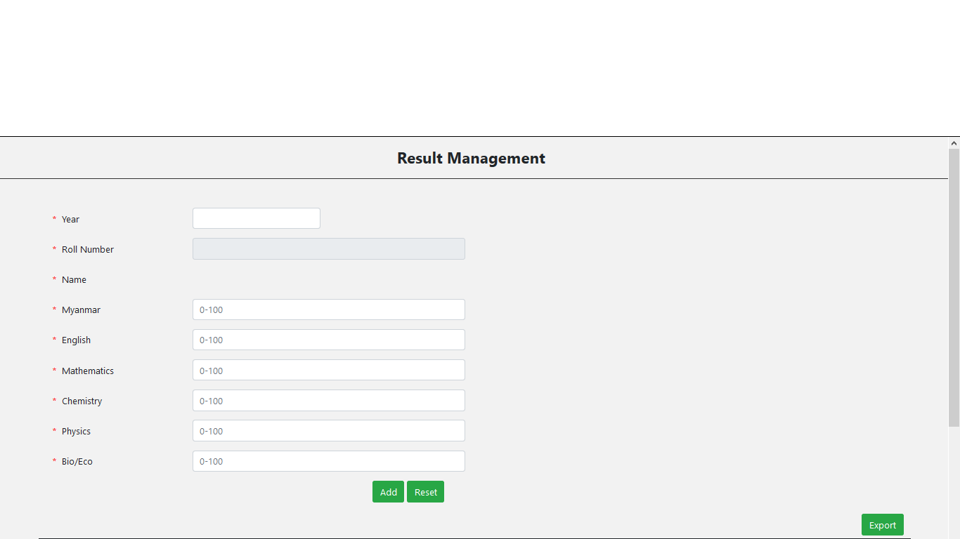
Result Management

Slide 28
Error Page
This page will be redirected to if there are following errors involved in the previous pages
- Duplicate Login Error
- Session Timeout Error
- System Error

Slide 29
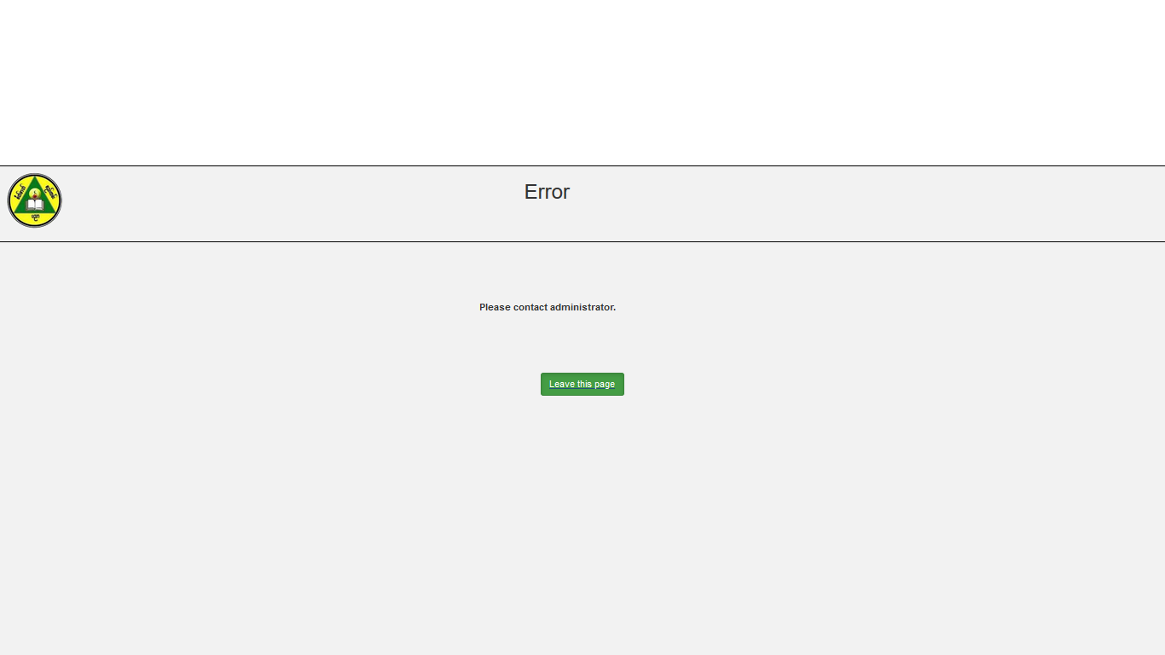
Error Page

Slide 30
Challenges
User(Students) doesn’t own or manage their account.
Every record(Result, student) must be manually inserted to the database.
The print-out certificates are not certified to be authentic.

Slide 31
Future plans
Mobile version(Mobile app) for more convenience.
Analytical view for more useable information(Top student list, average scores etc.) , for each layer of management.
Create API based outlets for other applications to use the student and result data.

Slide 32
Thank You

