Slide 1
Aziz Poultry
Farm Management System - Client Review
Complete Application Screenshots - 11 Pages

Slide 2
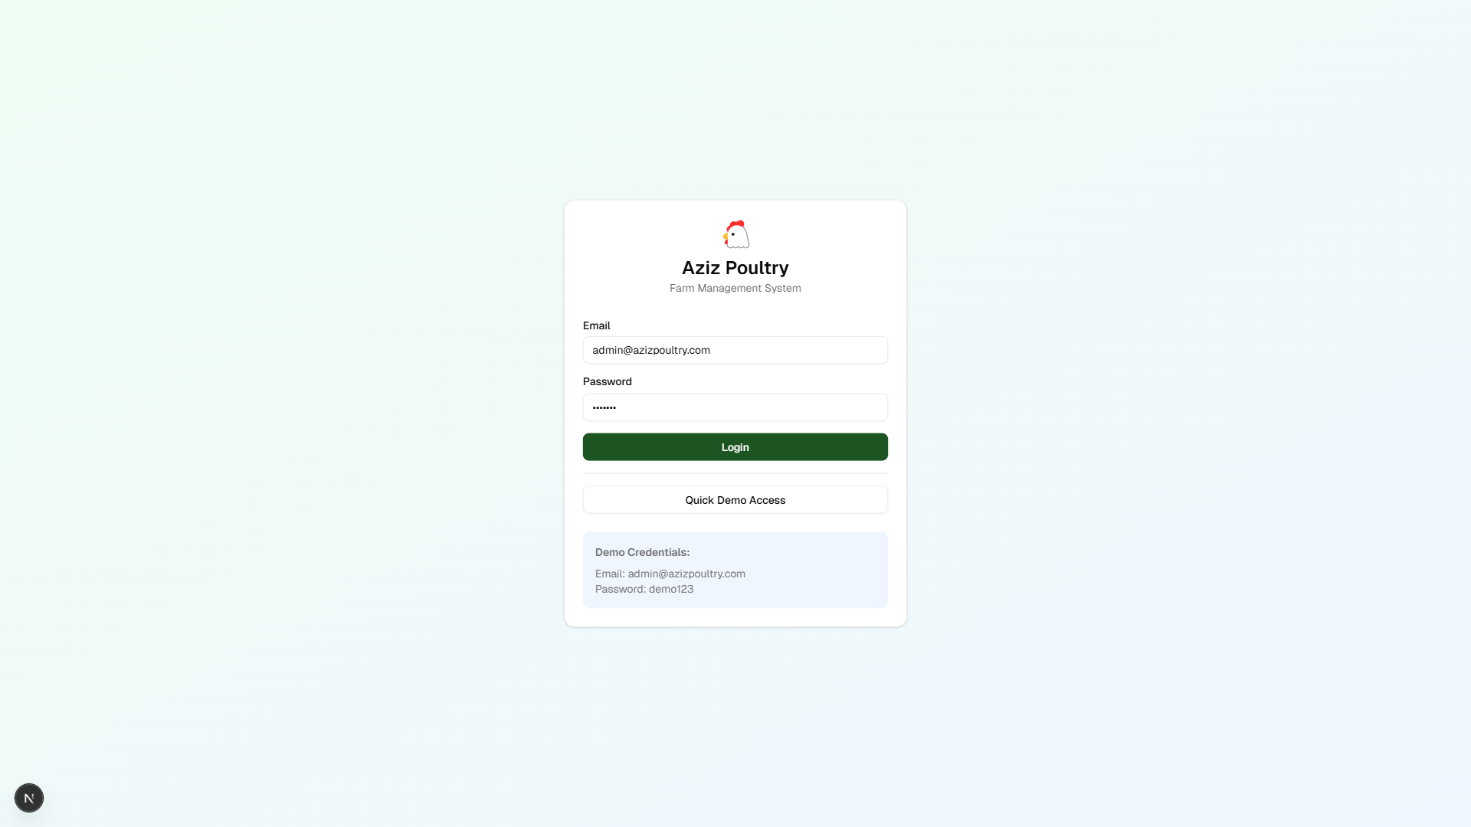
Login
User authentication and login page

Slide 3
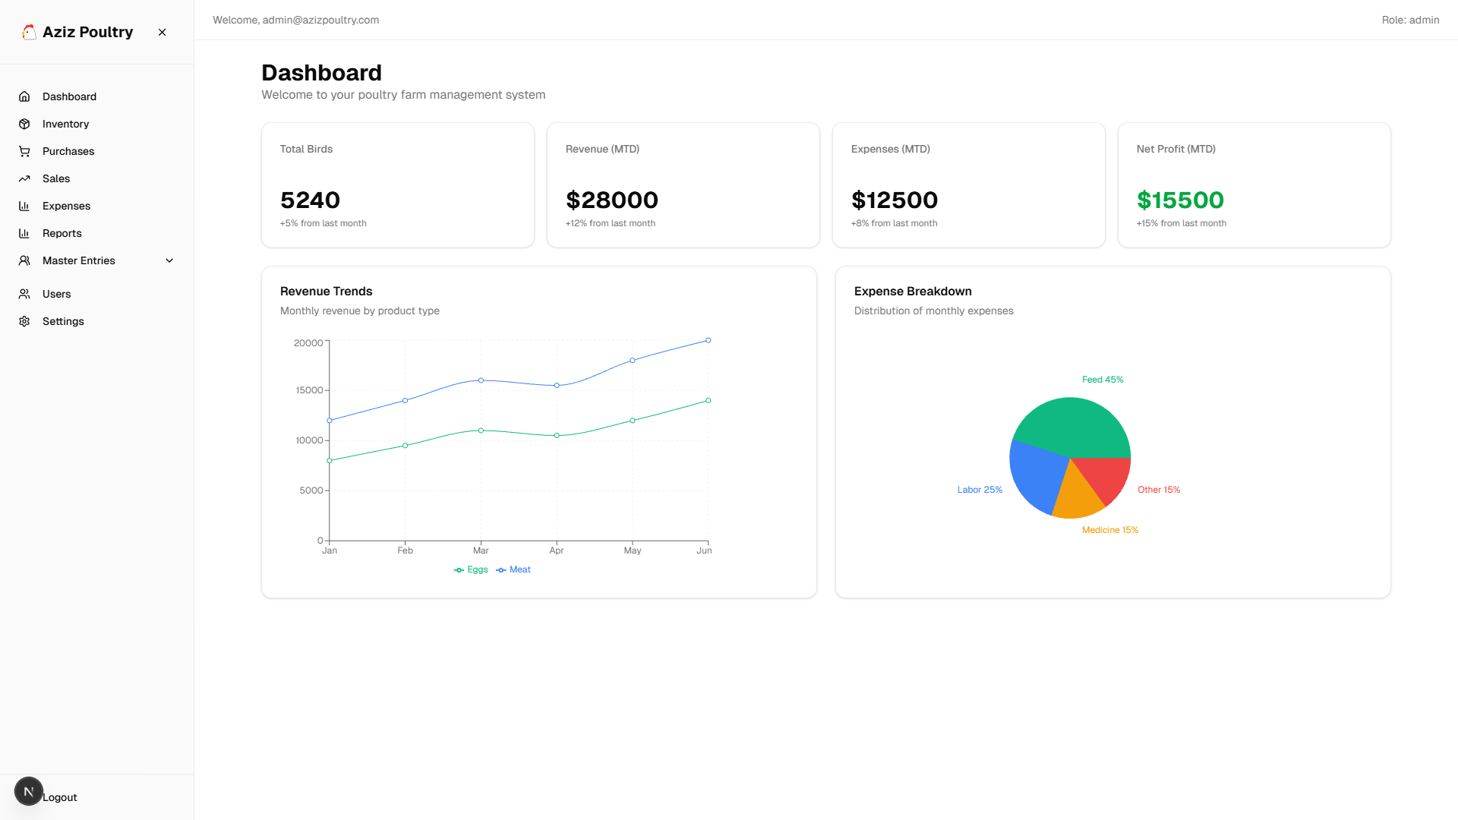
Dashboard
Main dashboard with KPIs, charts, and analytics

Slide 4
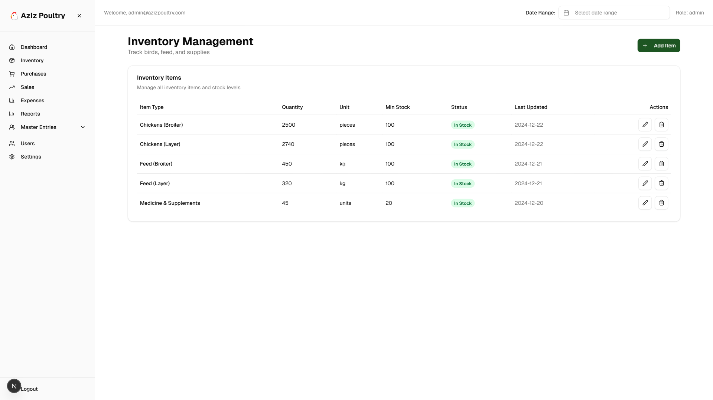
Inventory Management
Track birds, feed, and supplies with date filtering

Slide 5
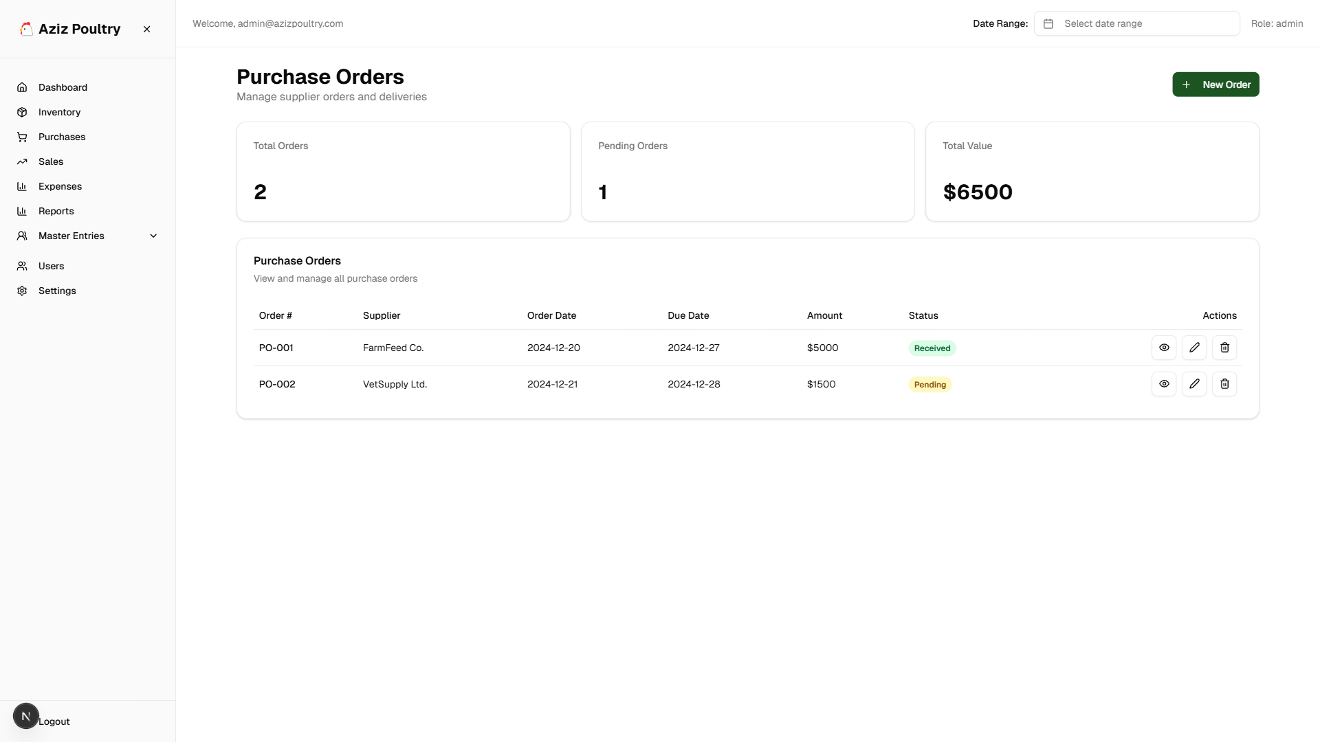
Purchase Orders
Manage supplier orders and deliveries

Slide 6
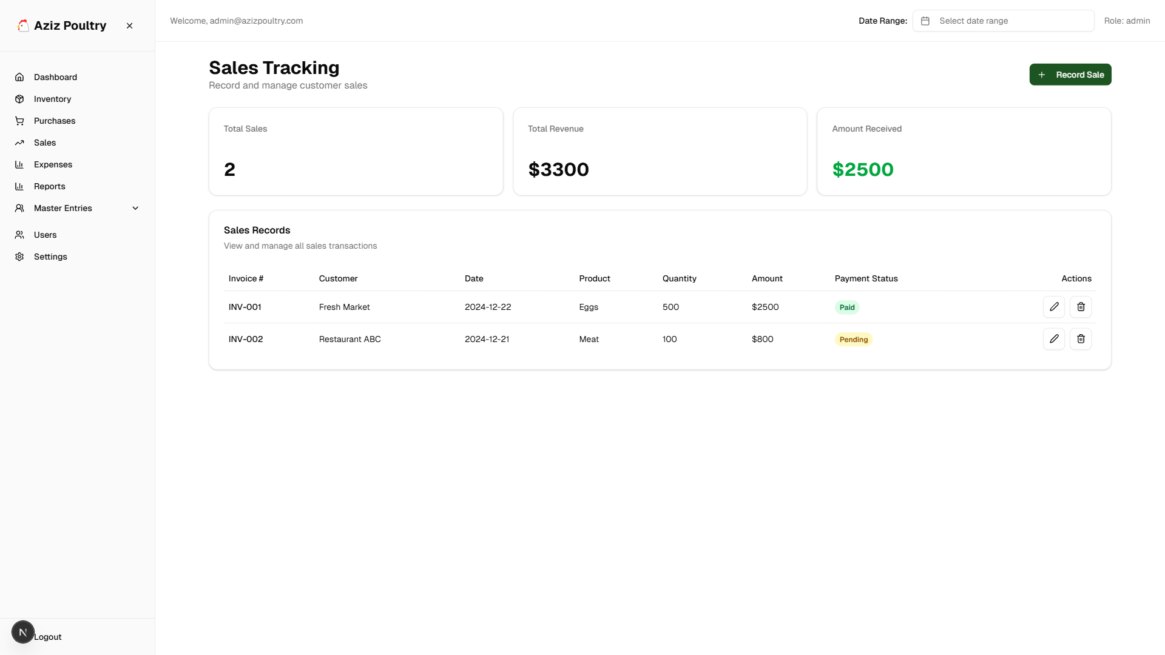
Sales Tracking
Record and track customer sales and revenue

Slide 7
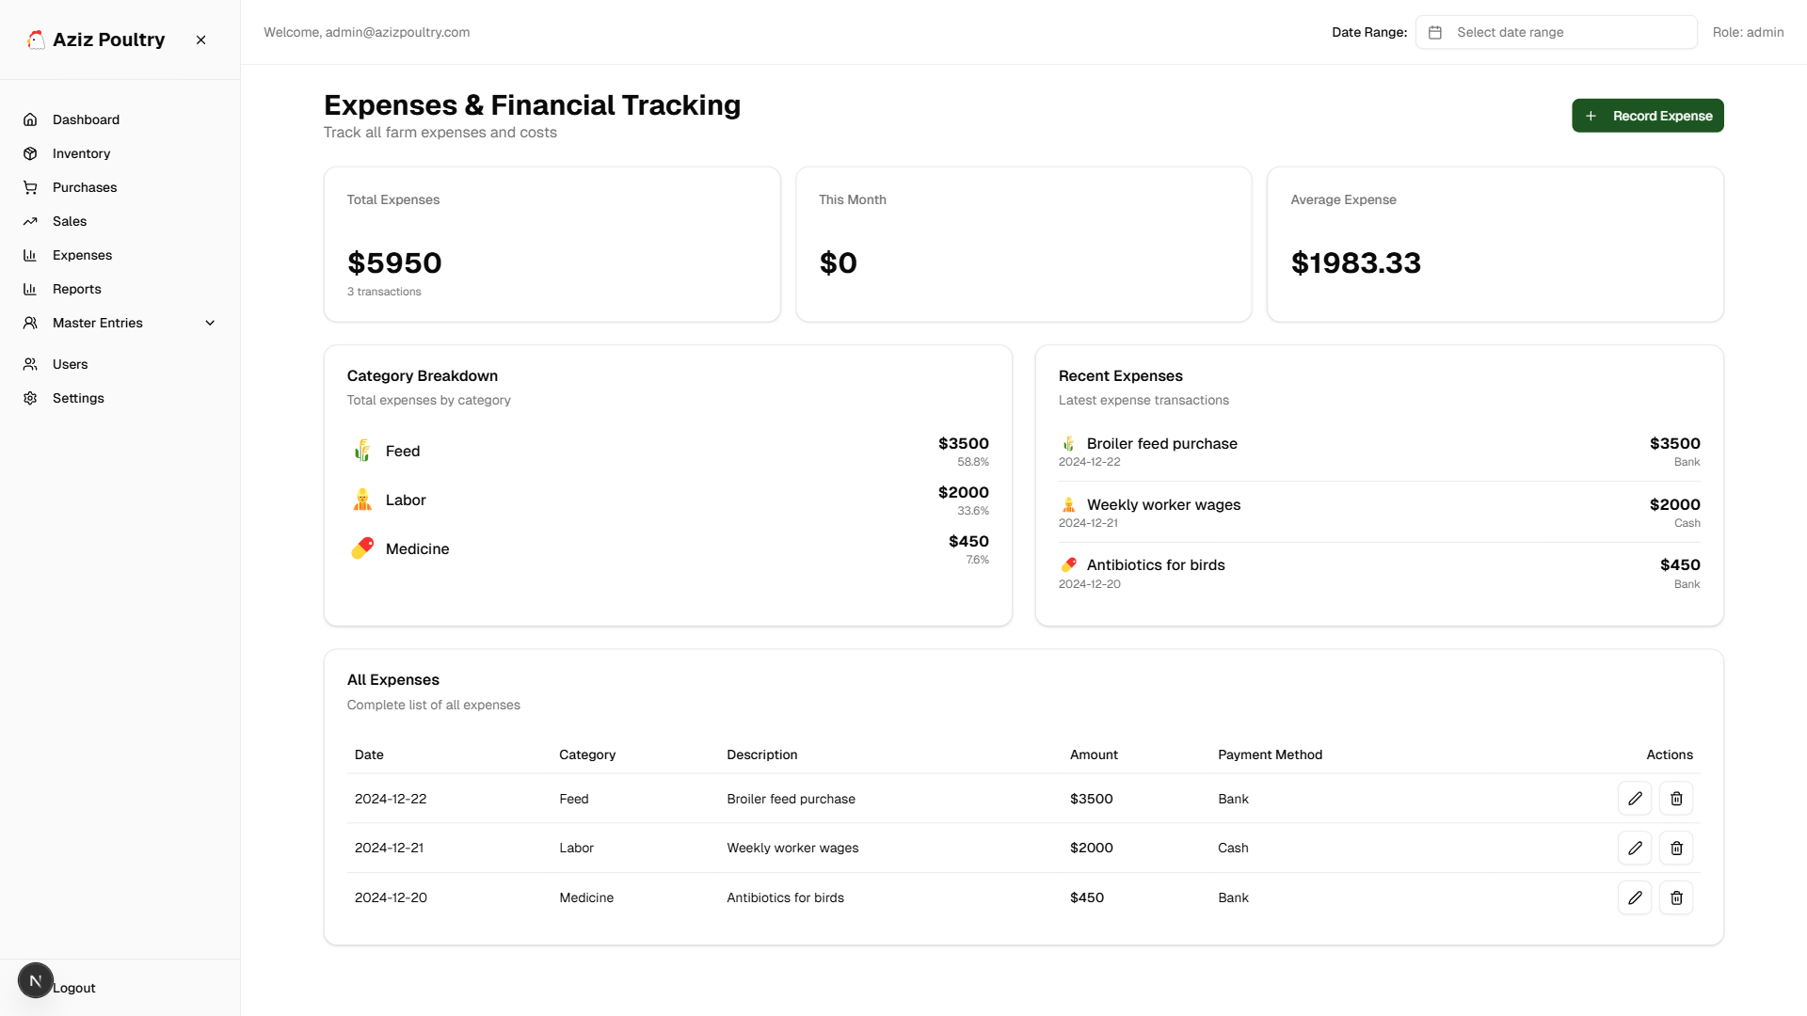
Expense Management
Track expenses by category with analytics

Slide 8
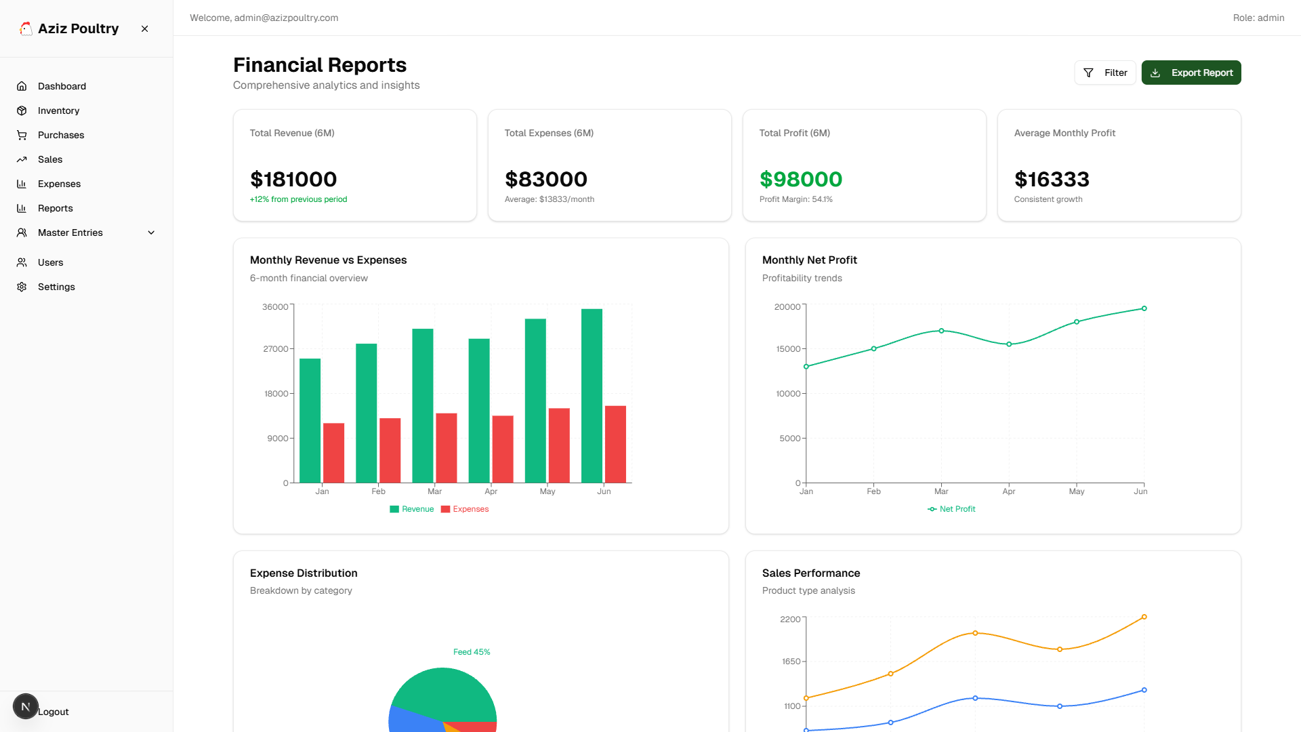
Financial Reports
Comprehensive financial reports and analytics

Slide 9
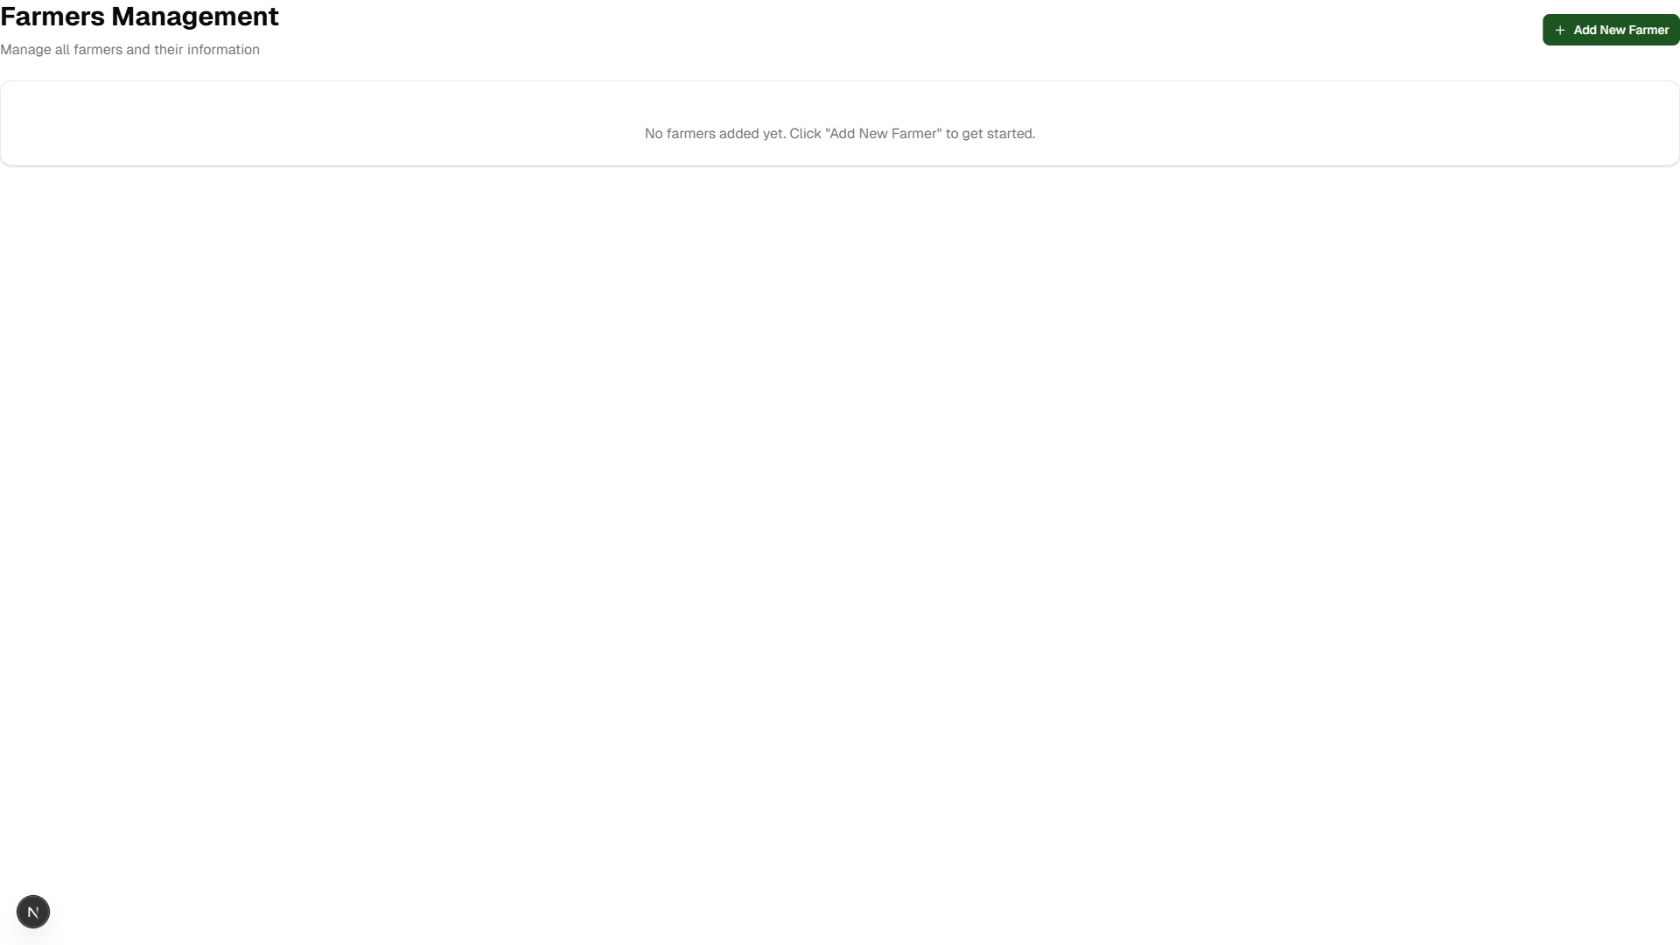
Farmers Management
Manage farmer master data

Slide 10

Retailers Management
Manage retailer master data

Slide 11
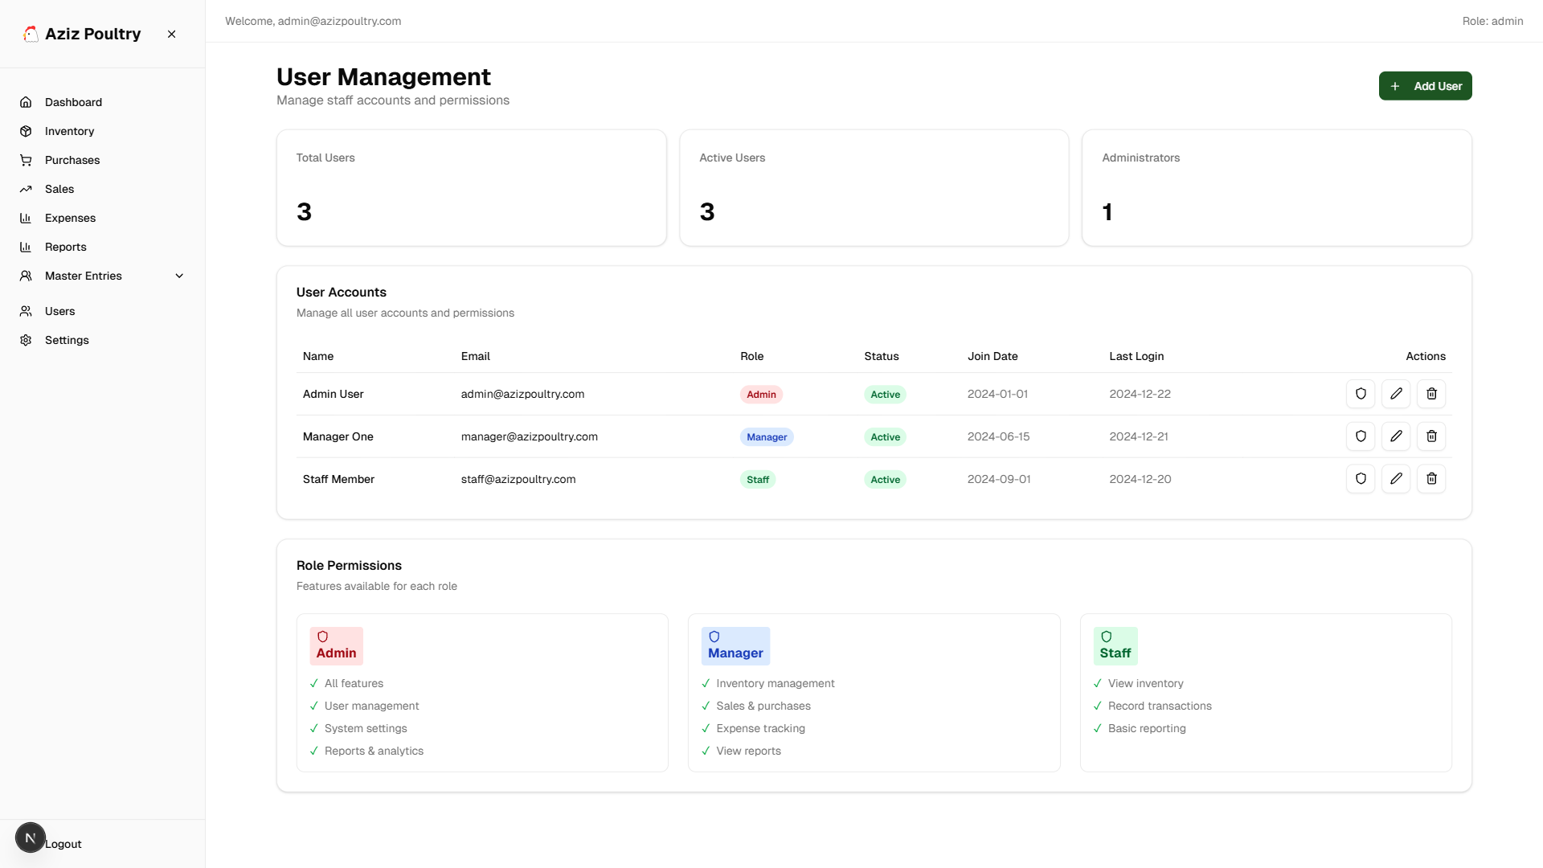
User Management
Manage system users and roles

Slide 12
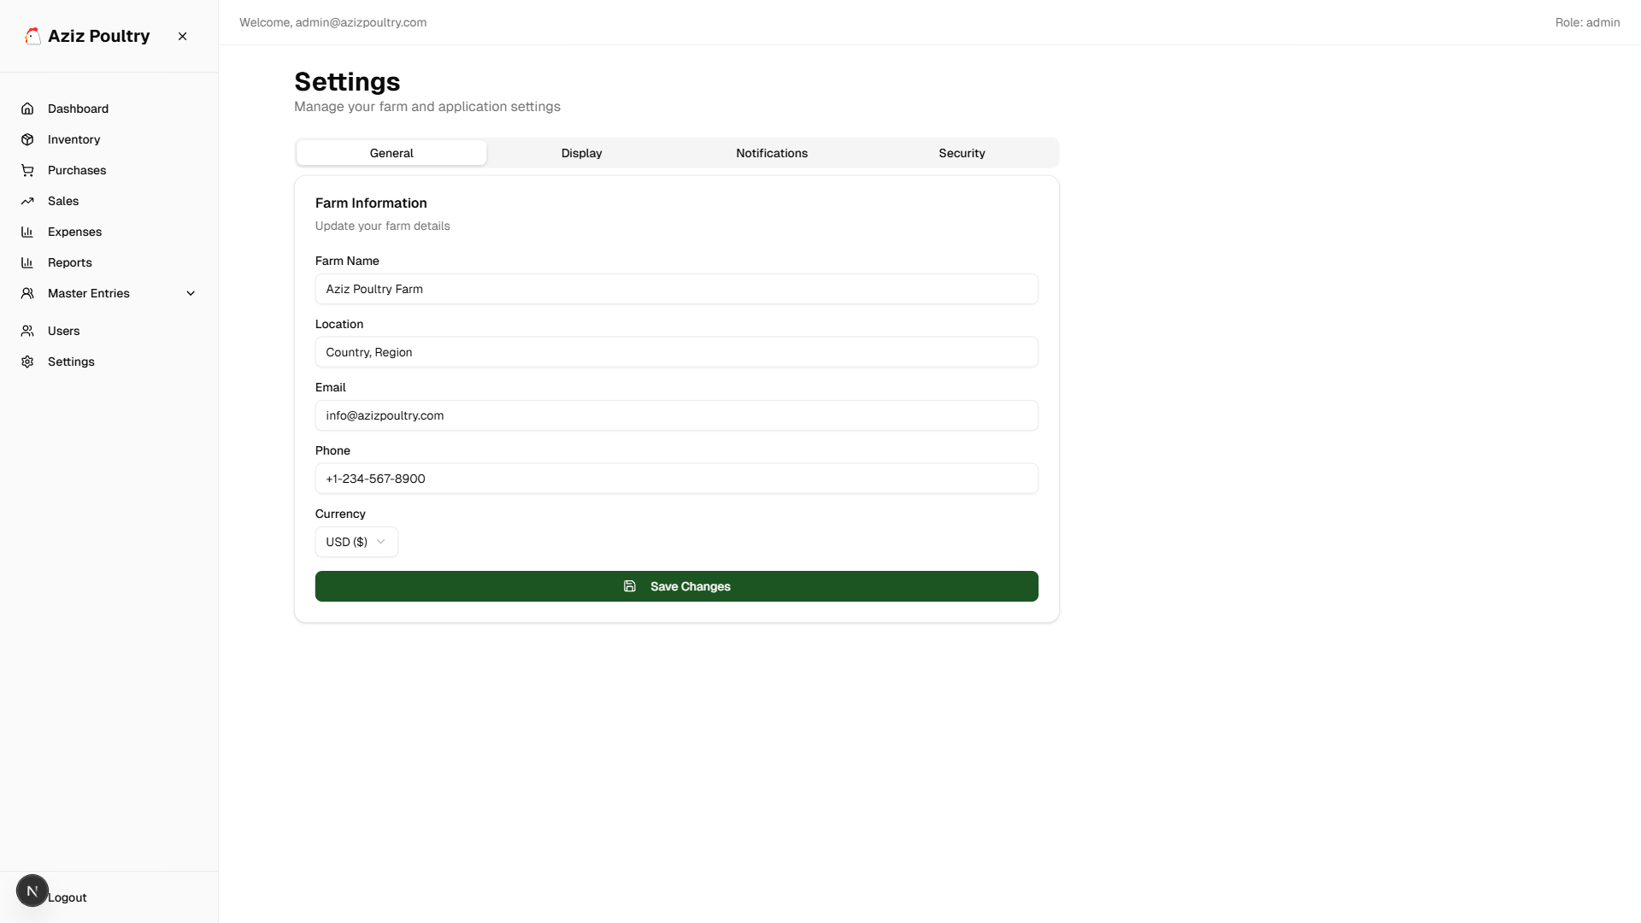
Settings
System settings and configuration

