Slide 1
CSE4019 Image Processing
SIGN LANGUAGE INTERPRETER FOR THE DEAF AND MUTE
Prof: Geetha S

Slide 2
TEAM MEMBERS
Faraz Suhail [19BCE1525]
Hardik Govil [19BCE1530]
Zara Iqbal [19BCE1710]

Slide 3
ABSTRACT
Communication for the majority of people is not difficult. It should be the same way for the deaf and mute people. Inability to speak is indeed a true disability and such people use different modes to communicate with others. There are a number of methods available for their communication and one such method of communication is sign language.
Developing an Indian sign language application for deaf and mute people can prove to be vital, as they’ll be able to communicate easily with even those who don’t understand sign language. Our project offers a platform for bridging the communication gap between speaking people and deaf and dumb people with the help of sign language. The project deals with designing and implementing a user-friendly and more intuitive way of communication.

Slide 4
LITERATURE SURVEY

Slide 5
Naglot, D., & Kulkarni, M. (2016, August). Real time sign language recognition using the leap motion controller. In 2016 International Conference on Inventive Computation Technologies (ICICT) (Vol. 3, pp. 1-5). IEEE.
Signs of American Sign Language were captured using new digital sensor called “Leap Motion Controller” which is 3D non-contact motion sensor that tracks and detects hands, fingers, bones and finger-like objects. The proposed system used Multi-Layer Perceptron (MLP) neural network with Back Propagation (BP) algorithm to build a classification model which takes feature set as input. Multi-Layer Perceptron (MLP) neural network is used to recognize different signs. Recognition rate of the proposed system is 95%.
Limitation:
MLP includes too many parameters because it is fully connected. Each node is connected to another in a very dense web — resulting in redundancy and inefficiency.

Slide 6
Bodda, S. C., Gupta, P., Joshi, G., & Chaturvedi, A. (2020). A new architecture for hand-worn Sign language to Speech translator. arXiv preprint arXiv:2009.03988.
Designing and implementation of Smart glove is described in this project, a hand-worn hardware device capable of translating American Sign Language gestures into English speech by tracking the finger’s orientation, gestures and hand motion. It uses hardware sensors like the Flex, the Accelerometer and gyroscope and intelligent software to capture and translate the gestures into speech.
Limitation:
Usage of so many hardware sensors make it cost ineffective, difficult in maintaining and the device cannot recognize object(hand) moving at a constant velocity.

Slide 7
Raghuveera, T., Deepthi, R., Mangalashri, R., & Akshaya, R. (2020). A depth-based Indian sign language recognition using microsoft kinect. Sādhanā, 45(1), 1-13.
The system captures hand gestures through Microsoft Kinect. The dataset includes single-handed signs, double-handed signs and fingerspelling, totaling to about 4600 images. The hand region was accurately segmented and hand features are extracted using Speeded Up Robust Features, Histogram of Oriented Gradients and Local Binary Patterns to recognize the hand posture. The system ensembles the three feature classifiers trained using Support Vector Machine to improve the average recognition accuracy up to 71.85%. The system then translates the sequence of hand gestures recognized into the best approximate meaningful English sentences.
Limitation:
Does not work well when the reaction is under 0.5 seconds, the detection depth is limited and the Kinect camera is very sensitive to sunlight.

Slide 8
Rastgoo, R., Kiani, K., & Escalera, S. (2020). Video-based isolated hand sign language recognition using a deep cascaded model. Multimedia Tools and Applications, 79, 22965-22987.
The purpose of this project was to classify signed American Signed Language letters using simple images of hands taken with a personal device such as a laptop webcam. Make a future implementation of a real time ASL-to-oral/written language translator. Project was structured into 3 distinct functional blocks: Data Processing, Training, Classify Gesture. Compiled dataset of American Sign Language (ASL) called the ASL Alphabet from Kaggle was the primary source of data for this project. Data preprocessing was done using the PILLOW library and sklearn.decomposition library, which is useful for its matrix optimization and decomposition functionality. Adam optimizer and Cross Entropy Loss were used to train the modules.
Limitation:
It tends to converge faster, performance measurement may not be accurate, training on the required amount of data is computationally expensive due to the cost of propagating high dimensional inputs through the network and problem of gradient being vanished exists

Slide 9
Sawant, S. N. (2014). Sign language recognition system to aid deaf-dumb people using PCA. Int. J. Comput. Sci. Eng. Technol.(IJCSET), 5(05).
Here vision-based approach has been used. This paper presents design and implementation of real time Sign Language Recognition system to recognize 26 gestures from the Indian Sign Language using MATLAB. The signs are captured by using web cam. These signs are pre-processed for feature extraction using HSV colour model. The obtained features are compared by using Principal Component Analysis (PCA) algorithm. Minimum Euclidean distance is calculated for sign recognition, after comparing features of captured sign with testing database minimum. The recognized gesture is then converted into voice and text format.
Limitation:
Background Subtraction wasn’t implemented and the accuracy of it was very low.

Slide 10
Badhe, P. C., & Kulkarni, V. (2015, November). Indian sign language translator using gesture recognition algorithm. In 2015 IEEE International Conference on Computer Graphics, Vision and Information Security (CGVIS) (pp. 195-200). IEEE.
A system named "Indian Sign Language (ISL) Translator using Gesture recognition algorithm" has been implemented in this paper. The system basically translates gestures made in Indian Sign Language into English. The gestures that have been translated include numbers, alphabets and few phrases. Data acquisition is first performed by the algorithm, then to track hand movement, the pre-processing of gestures is performed using a combinational algorithm, and recognition is done using template matching.
Limitation:
Histogram needs to be set every time the lighting conditions change.

Slide 11
Author | Title | Methodology | Limitation
Ghali Upendra[1], Kokkiligadda Bhuvanendra [2], D Gayathri [3]. | Sign Language Interpreter using Convolution Neural Network | The recognition of hand gestures is done using Convolution Neural Network. The gesture made by the hand inside the recognition area in each frame is matched with the pre-classified data available in the dataset and when a match is declared, the corresponding alphabet/number is given as a text output, easily understandable by a normal person who doesn’t know the sign language. | Despite using 2 models for similar looking alphabets, they have no background subtraction, is not focused on preprocess and works at 98% accuracy.

Slide 12
Author | Title | Methodology | Limitation
Saha, D. | Sign-Language – A very simple CNN project. | Created 44 gesture samples using OpenCV. Then created a CNN which looks a lot similar to MNIST classifying model using both Tensorflow and Keras. Then used the model which was trained using Keras on a video stream. | Working with Histograms was an unnecessary overhead, every time there was a change in lighting conditions! This was the biggest turndown when we compared it with a simple OpenCV functions-based system. So, we bent towards the process of filtering with a mask and then blurring. It was a fast and smooth method and gave even better results.

Slide 13
PROPOSED SYSTEM (PROJECT METHODOLOGY)

Slide 14
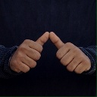
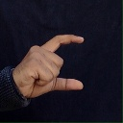
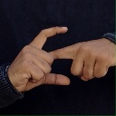

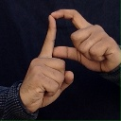
DATASET
MNIST data set consisting of 26 alphabets of Indian Sign Language and 9 numbers. Data set consists of 1200 images for each character.
Sample Data:-

Slide 15
PROBLEM STATEMENT (NOVELTY)
Main contributions of the study to the Indian Sign Language Recognition field:
Improving the pre-processing to predict gestures in low light conditions with a higher accuracy.
Reduce the time-consuming overhead of the histogram dependence for changing lighting conditions.
The main focus of our work was to create a vision-based system to identify Indian sign language gestures, keeping resource intensity of the application bare minimum. The research paper primarily focuses on increasing the overall efficiency of the algorithm for Indian Sign Language recognition by leveraging Machine Learning to accurately predict.
We have implemented the autocorrect feature for words in which we verify the spellings and predict the closest possible word which is more relevant in the sentence.

Slide 16
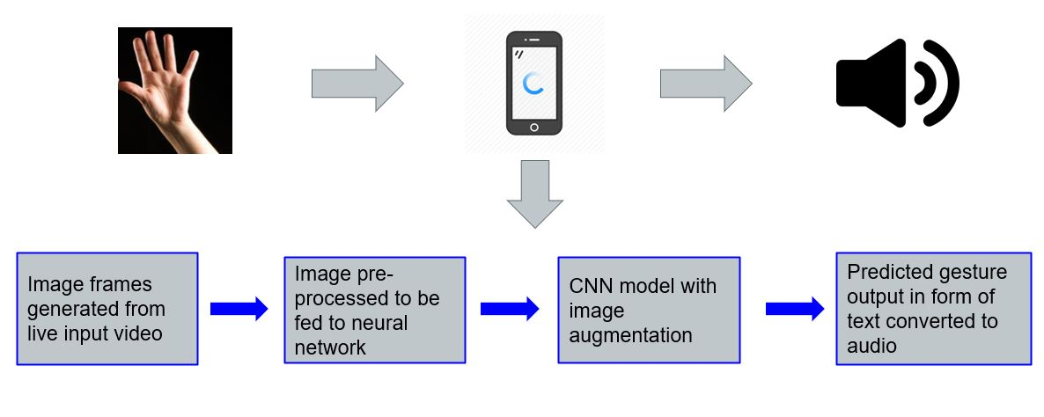

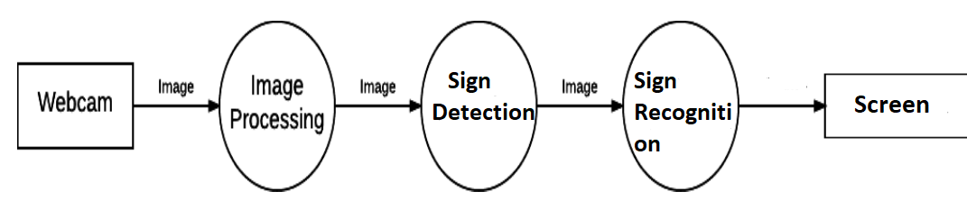
DESIGN DIAGRAMS
Data Flow Diagram Level 1
Sign

Slide 17
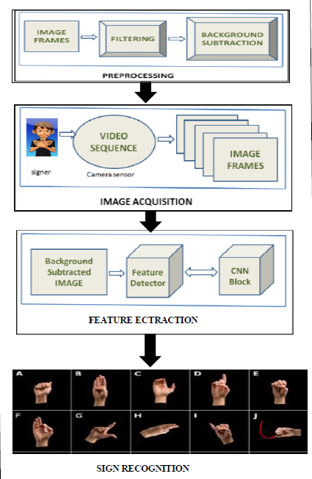
FLOWCHART OF THE SYSTEM
The system is trained using 35 classes and 50 epochs to attain the accuracy.
After the training, the system is able to detect only the relevant parts from the camera window and subtract the background to remove the irrelevant objects from the image.
Lastly, the web camera starts capturing the gestures and displays the corresponding alphabets and words on the screen.

Slide 18
PROPOSED MODULES

Slide 19
1. IMAGE CAPTURING
The system detects only the relevant parts from the camera window, filtering out the hand from the background. By applying hand detection, the system disregards the region which is not required and thus reduce the amount of calculation needed during training and testing of the system.
2. IMAGE PROCESSING & TRAINING
Image pre-processing is done to improve the image data suppressing unwilling distortions and to enhance some image features important for further processing. Images are pre-processed both during training stage and recognition stage. After processing, the images are trained against CNN model.

Slide 20
3. FEATURE EXTRACTION
Background subtraction will remove the irrelevant background pixels from the window. The system computes the location of the hand by adjusting the range on the trackbars.
4. RECOGNITION OF GESTURE
This processed image is passed to the CNN model for prediction and if a letter is detected for more than 90 frames then the letter is printed and taken into consideration for forming the word. The word is checked for grammatical errors and corrected with the closest possible word.

Slide 21
THANK YOU

