Slide 1
Lighthouse Labs Statistical Modelling Project
Zara Faraz

Slide 2
Approach
Capture Data
Understand Data
Create SQLite DB
Regression Model
CityBikes
Foursquare
Yelp
Data join
Visualization
Results

Slide 3
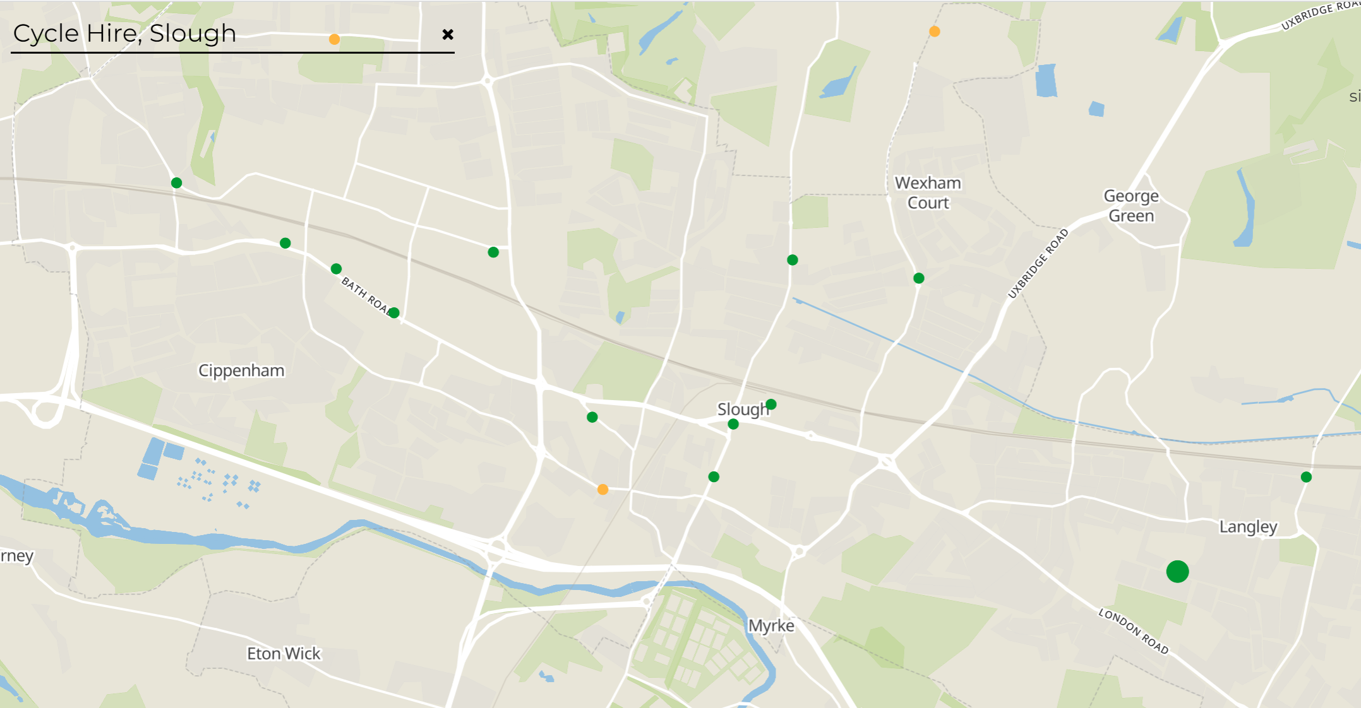
CityBikes map of Slough

Slide 4
Data Capture – Slough, GB
CityBikes
Foursquare
Restaurant only within 1000 meter radius of each bike station
Number of Restaurant (141)
Yelp
Restaurant only within 1000 meter radius of each bike station
Number of Restaurant (188)
16 stations
Free Bikes = 267
Analysis
We can see that the results from both API have different results (141 and 188).
Even the top 10 restaurants in both data sets yield different restaurants with a 1000 mile radius of the stations.
Top 10 Restaurants with ratings from Foursquare and Yelp
Source | Station | Restaurant Name | Rating
Foursquare | 1 Slough Train Station | Krispy Kreme | 7.1
 |  | Roosters Piri Piri | 6.8
 | 10 Chalvey High Street | Roosters Piri Piri | 6.8
 | 12 Windsor Road | Roosters Piri Piri | 6.8
 | 15 The Curve | Krispy Kreme | 7.1
 |  | Roosters Piri Piri | 6.8
 | 6 O2 | Greggs | 6.9
 | 8 Yarmouth Road | Greggs | 6.9
 | 9 Bath Road Shopping Centre | Greggs | 6.9
 | 3 Slough Trading Estate | Greggs | 6.9
Yelp | 1 Slough Train Station | Caribbean Experience | 4.5
 |  | The Chip Box | 4.5
 | 16 Langley | The Tummy Fillers | 5.0
 | 2 Burnham Train Station | Burnham Fish and Chips | 5.0
 |  | The Kais | 5.0
 | 3 Slough Trading Estate | Chicken Delite | 5.0
 | 5 Trelawney Avenue | The Tummy Fillers | 5.0
 | 8 Yarmouth Road | Chicken Delite | 5.0
 | 9 Bath Road Shopping Centre | Burnham Fish and Chips | 5.0
 | 9 Bath Road Shopping Centre | The Kais | 5.0

Slide 5
Joining Data
Foursquare 141
Yelp Data
188
Merged Data
329
Data Cleaning
After merging the data from 2 different sources there might be a chance that some of the records are duplicate. So for this reason we need to perform data cleaning to further proceed in our analysis.
There are a total of 179 duplicate records so we drop those from our merged dataframe
There are now a total of 150 unique records and we created a new dataframe (unique_merge1) to save them for further analysis.

Slide 6
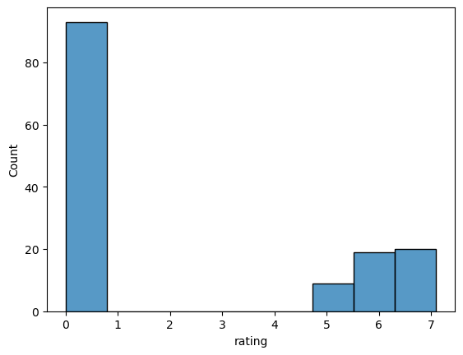
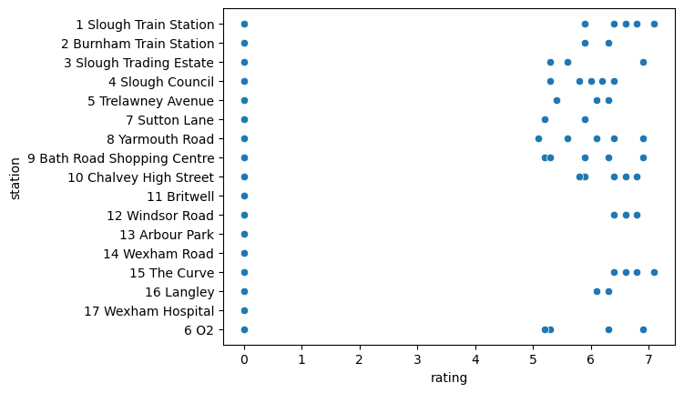
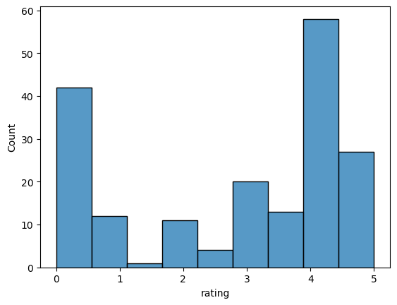
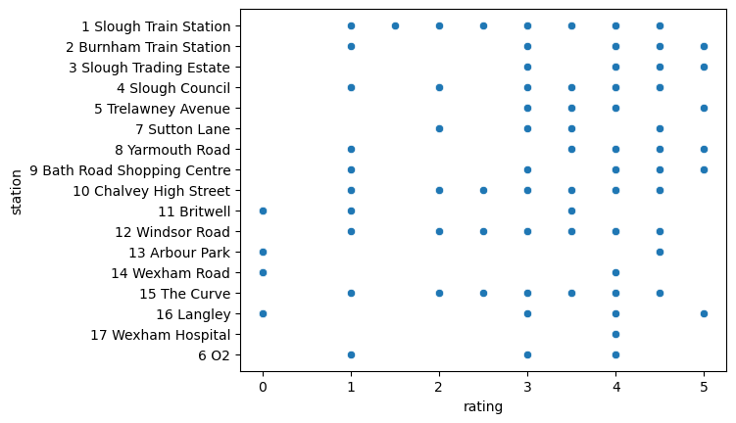
Visualizations
Data Source | Histogram | Scatterplot | Visual Analysis
Foursquare |  |  | Rating range is between 0 to 7 There are higher ratings given to restaurants within the dataset (5,6 & 7) There are no restaurants with lower ratings within this dataset
Yelp |  |  | Rating range is between 0 to 5 Ratings here are more spread out with restaurants having all types of ratings

Slide 7
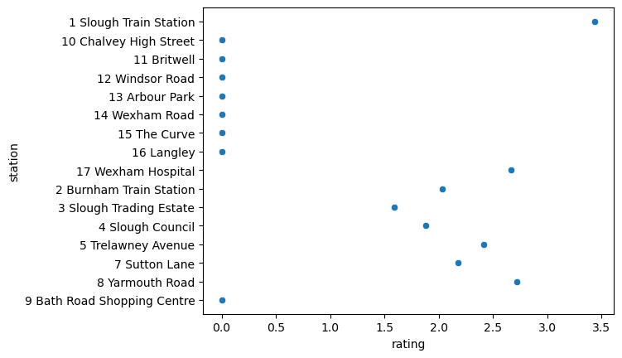
Visualization
This scatterplot is from the unique records of the merged data.
It displays the average rating restaurants present within a 1000 mile radius of each shown station.
On average, the station ‘1 Slough Train Station’ has the highest average, which might suggest that this station is a really good food culture and people are more likely to eat out around this area.
There are some stations that have on average zero ratings, which suggest that, restaurants near these stations might:
Not have enough virtual presence
People are not leaving rating/reviews for them
Or the rating is actually 0 and suggest bad food

Slide 8
SQLite DB
SMP_db
Table: CityBikes
Table: Yelp
Table: Foursquare
Table: unique_merge1

Slide 9
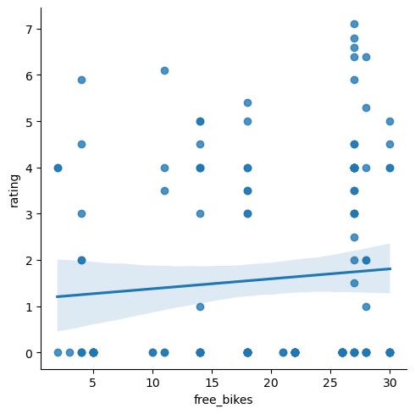
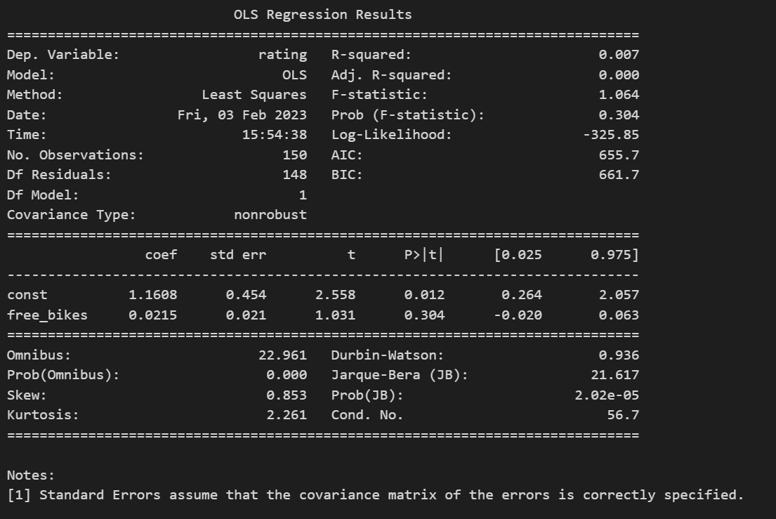
Model Building
Simple linear regression
Y → Dependent Variable = Rating
X → Independent Variable = Free Bikes
Objective: Study the relationship between restaurant rating and free bikes on stations within the area of Slough, GB.
Results
Based on the value of Adjusted R-square, the model is a poor fit as the value is 0.000
The value for the constant of the coefficient (y-intercept) shows a value of 1.1608. This means that if there are 0 free bikes on a station the restaurant ratings would be at least 1.1608
free_bikes coefficient represents the change in the output Y (rating) due to a change of one unit in the rating (everything else held constant). 4. P >|t| is your p-value. A p-value of less than 0.05 is considered to be statistically significant.
In our model the p-value is 0.304 which is higher than 5%. The model is statistically insignificant

Slide 10
Hypothesis Testing
Correlation values between free_bikes and rating = 0.304083025915890370338701131913694553077220916748046875000000
Hypothesis
H0: There is no relationship between free_bikes and rating
H1: There is a relationship between free_bikes and rating
p-value is > 0.05, Accept H0 and Reject H1. There is no significant correlation between the two variables.

Slide 11
Challenges
Overall the project was extremely difficult. Particularly the part where we had to call the API for foursquare and yelp. With time I spent on capturing/understanding the data with no material to reference from was a lot.
It would have been better if there was a proper guidance on how to do it, so I could have spent more time on analysis and regression modelling.
No idea why we had to create a sqlite database as even after numerous attempts I wasn’t able to use it for model building.
I understand that using API’s is a key skill with real world data and LHL’s teaching material should include it in greater detail.
The poor results from the model suggest that the data source can be improved. There might be good data sources available with a better reference to understand data structure, APIs etc.
The greater part of the effort for this project was spent on data capture rather than modelling and analysis.
Future Goals
In the future I would like to attempt developing a model with a good data source.

