Slide 1
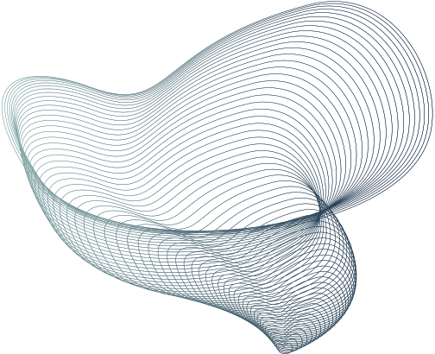

KALDEROS
HEALTHCARE
REIMBURSEMENT
MODEL
ZARAK SHAH

Slide 2
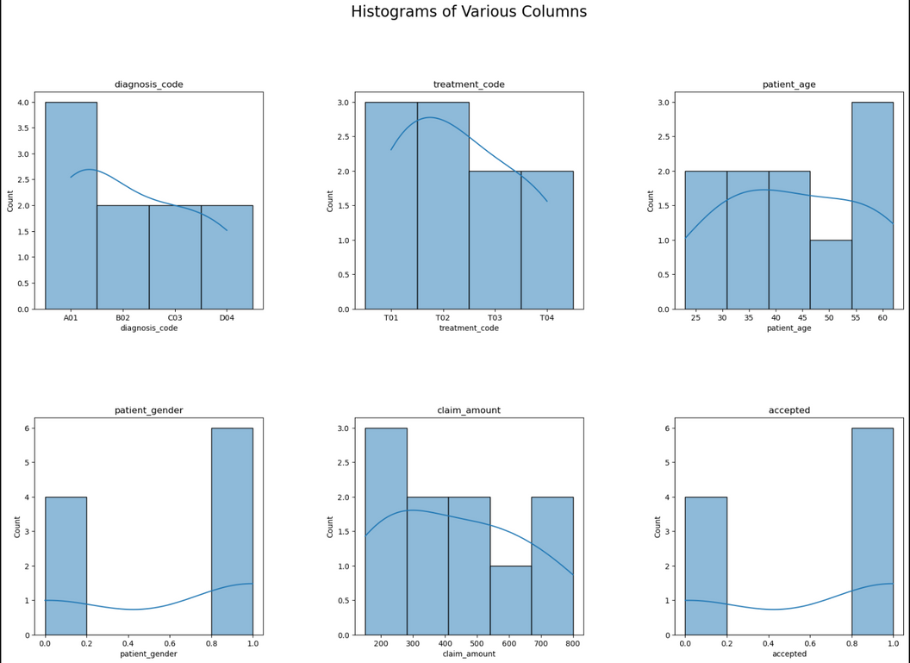
KEY ANALYTICAL STEPS
Increase of data size: Very small dataset given. More samples are needed to improve model generalization
Model Selection:
RandomForestClassifier for non-linearity handling, feature importance, handling of categorical features, cross-validation performance
Though the very small dataset size made me use LogisticRegression as well for simplicitiy, helping getting clear insights and being less prone to overfitting where RandomForest can overfit on small datasets
The data suggests that younger patients, particularly females, tend to have higher acceptance rates for claims, and lower claim amounts are more likely to be approved.

Slide 3
Evaluation Metrics
Accuracy:
Cross- Validation Scores:
Random Forest : 0.0
Logistic Regression: 0.0
Reason: Only two samples in the test set
Random Forest : 0.6 (60%)
Logistic Regression: 0.8 (80%)
Reason: Different subsets of the data are used here during training
Confusion Matrix:
Mean Accuracy:
Random Forest : [[0 2]
[0 0]]
Logistic Regression: [[0 2]
[0 0]]
Models predicted all instances as class 1, leading to no correct predictions.
Random Forest : 0.6 (60%)
Logistic Regression: 0.7 (70%)
Both models performed better during cross-validation than on the test set.
THESE DISCREPANCIES SUGGESTS THAT THE MODELS MAY NOT GENERALIZE WELL TO UNSEEN DATA OR THAT THE TEST SET MAY NOT BE REPRESENTATIVE OF THE TRAINING DATA.

Slide 4
WHY THESE MODELS AND EVALUATION METRICS
Random Forest Classifier
For handling non-linearity in health related datasets, random forest might be a better choice
Logistic Regression
For interpretability and simplicity, logistic regression may be the better choice.
CROSS VALIDATION:
Generalizes well to new data, and is not simply fitting noise in the training set and also mitigates overfitting reducing variance in performance estimates

Slide 5
THANK YOU

