Slide 1
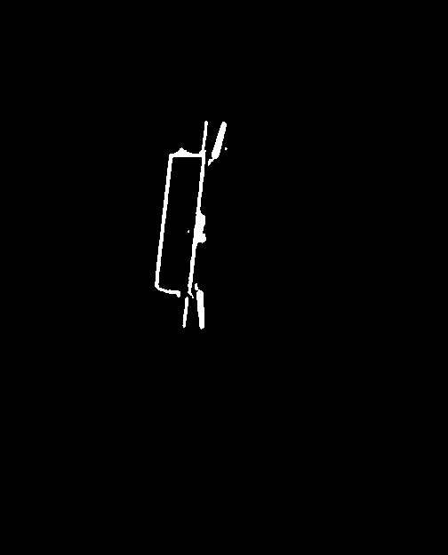
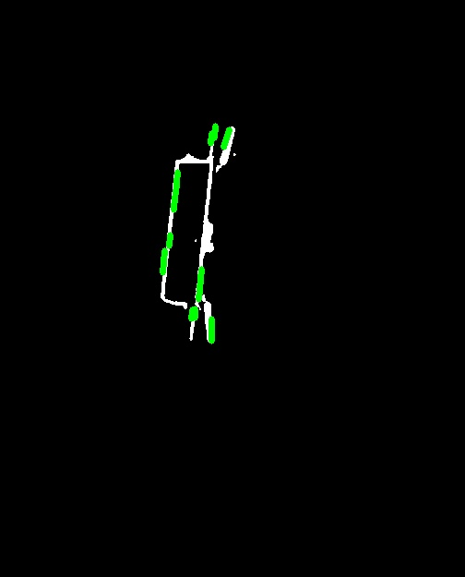
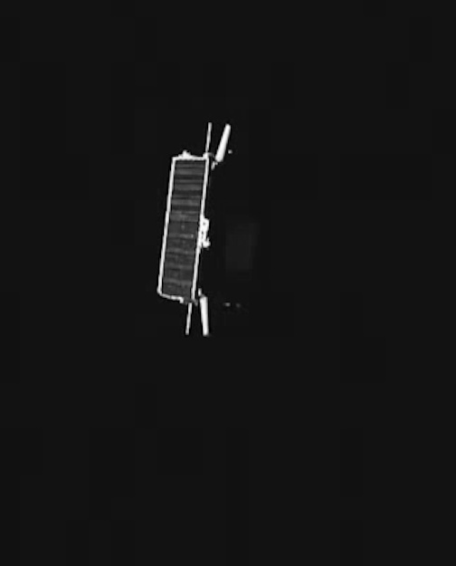

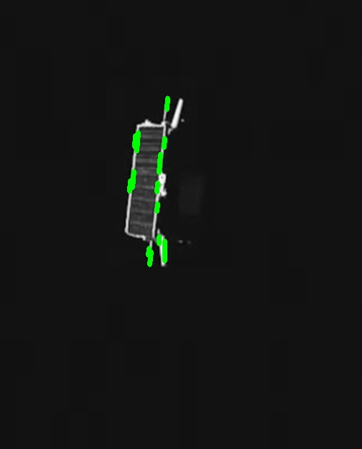
Additional Steps:
”Merge” lines by concatenating the line segments from the threshold images and the line segments from only the blurring.
”Purify” lines by deleting the extra segments that occur when a double edge is detected.
”Connect” lines by grouping together segments by slope. If two adjacent segments have roughly the same slope, merge them by creating a new, longer line connecting their endpoints
”Extend” the longer lines by connecting their endpoints to the nearest corners. Corner detection algorithm is max Harris Corner Detector
”Cleanse” by removing lines that don’t form polygons (antennas, accessory features). Determine this by iterating through corner points. If a pair of corner points are connected by a line, but they are not connected to any other corner, then this will be removed.
Otsu Thresholding
Hough Transform
Grayscale
Gaussian Blur
Hough Transform

