Slide 1

5.2 Final Project
Sarah Hinojosa – Ty Adams – David Crouch – Jeffrey Reigel – Steve Woods

Slide 2
1
2
3
4
5
6
7
8
9
10

Slide 3
Problem Statement
The project we decided to redesign is craigslist. The changes we decided to make were to fix have the search bar float at bottom, have two columns of buttons for ease of use, and to simplify the color scheme.
The problem statement was:
“The craigslist website is very dull and outdated which leaves it overshadowed by better looking and organized websites like Ebay.”

Slide 4
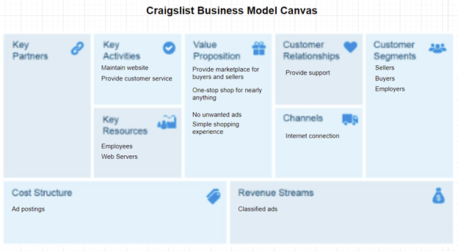
Business Model Canvas

Slide 5
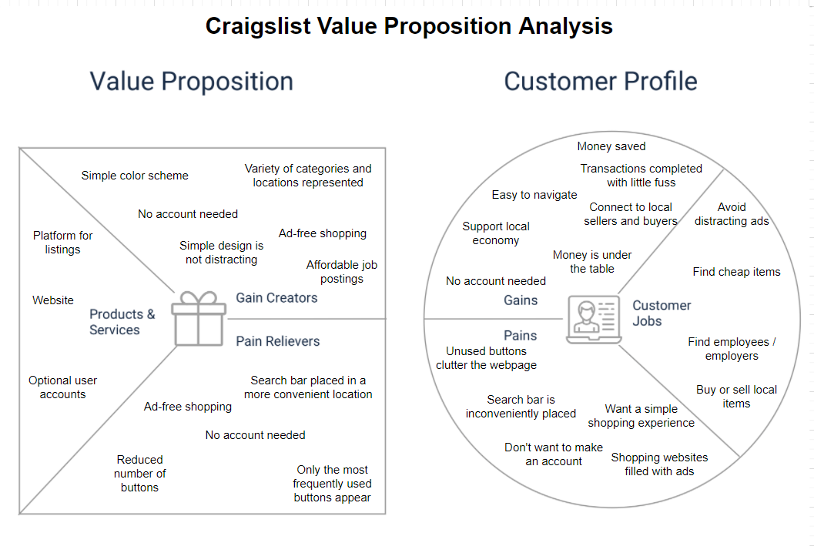
Value Proposition Analysis

Slide 6
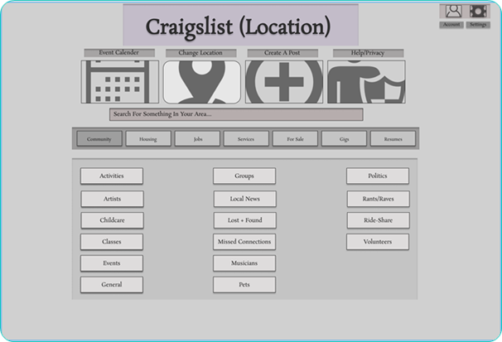
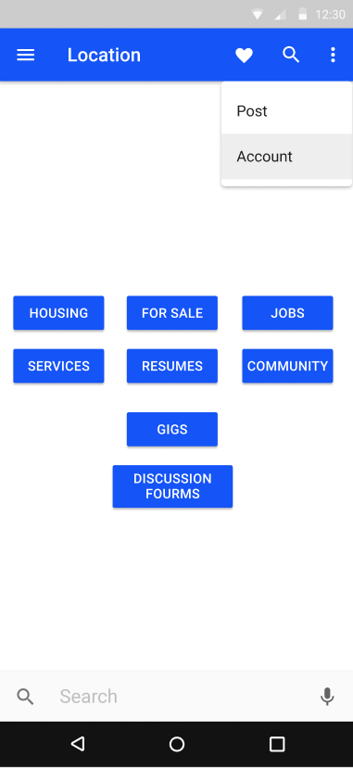
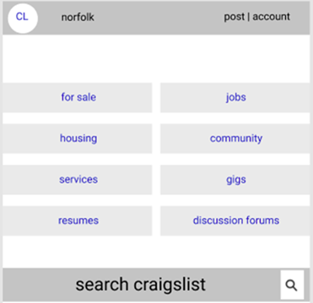
High fidelity - steven

Slide 7
Materials design figma - steven

Slide 8
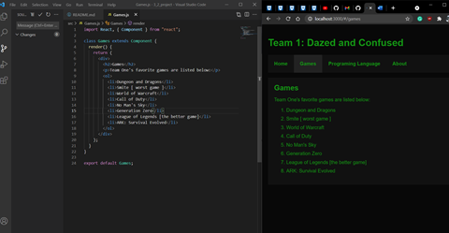
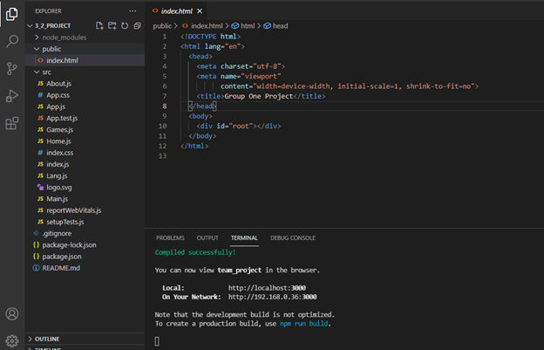
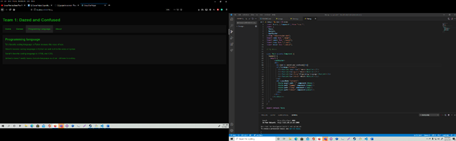
React Shopping Cart Project
For the shopping cart project, we made a react website that used components and JSX

Slide 9
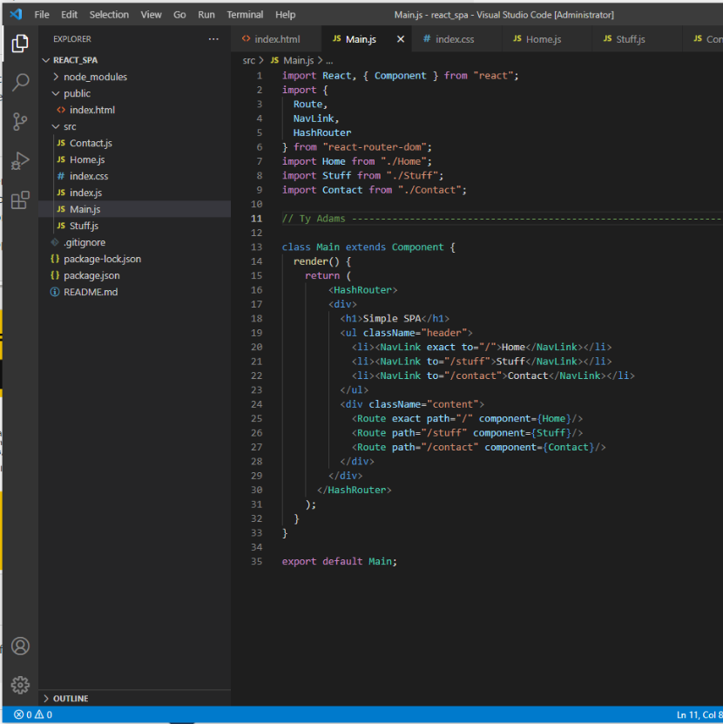
Inserting React Components
React is a JavaScript framework, that allows you to import libraries or components they are premade code that does something the way you import them is to import at the top of your code like another library.

Slide 10
Peer Review
Steven Woods-
Ty Adams- I liked how well the group worked together, and how quick we were to just work. The thing we could improve on is sleep our group was tired a lot.
David Crouch- Overall we were efficient and delegated work well to team members. My greatest concern was how quickly we could get off topic and then remain off topic for quite a while.
Sarah Hinojosa-
Jeffrey Reigel-

Slide 11
Github - Ty

Slide 12
Conclusion
Holy balls we are awesome
Like, seriously

