Slide 1



Problem Statement 3:
Carbon and Energy Calculator for Steelmaking
CarbonSpark
Presenting:
Notes:
Title.

Slide 2




1
PROBLEM
Every tonne of stainless carries a carbon cost
Energy- and emissions-intensive
Melting, refining and rolling stainless use a lot of power and heat.
Two choices set the number
Carbon per tonne depends heavily on the input mix (scrap vs virgin) and the energy source.
Nobody can see it
There's no simple way to see the emissions effect of a choice before it's made.
WHAT A GOOD TOOL MUST DELIVER
1
A reasonable emissions model
2
Clear input → result
3
Interactive and simple
Net Zero by 2050
The industry's commitment, and the clock every choice now runs against.
4
Useful optimisation
5
A measurable reduction
Notes:
Problem, from the brief (Problem Statement 3). Stainless steelmaking is energy- and emissions-intensive, and carbon per tonne depends heavily on the input mix and the energy source. With Net Zero by 2050 as the commitment, what's missing is a simple tool that makes the emissions effect of each choice visible and helps find lower-carbon combinations that stay practical. The five boxes are the brief's own key considerations, which is what we built against.

Slide 3
2
INSIGHTS
Two levers carry the tonne
35 kg
CO₂e saved per tonne for every extra point of scrap
0.11 t
saved per tonne for every 0.1 kg/kWh off the grid
< 0.05 t
saved by technology and haulage combined
Reference EAF stainless plant (68% scrap, coal-heavy grid). Right: each lever moved alone to a buildable limit.
Notes:
What the model tells us. Left: holding the grid and route fixed, scrap from 40% to 100% takes the tonne from 3.86 to 1.77, a straight line at about 35 kg per percentage point, because the upstream carbon of virgin ferrochrome, nickel and iron units disappears with scrap. Right: each lever moved on its own to what a plant could buy or build within a year. The grid is worth 0.352 t/t and scrap 0.244; technology and rail together are under 0.05. That ranking is what the tool should put in front of a planner first.

Slide 4
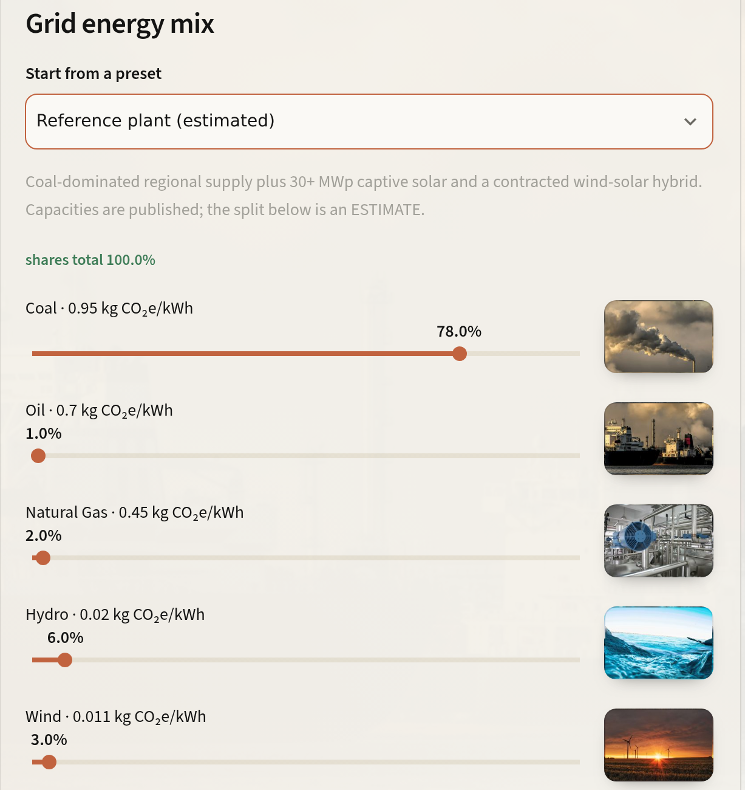
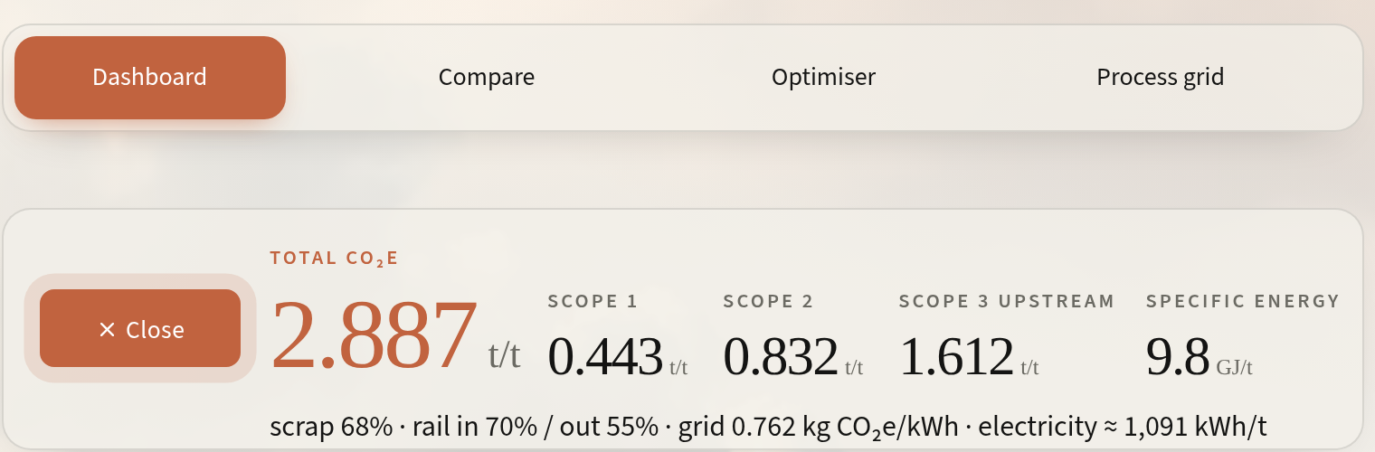
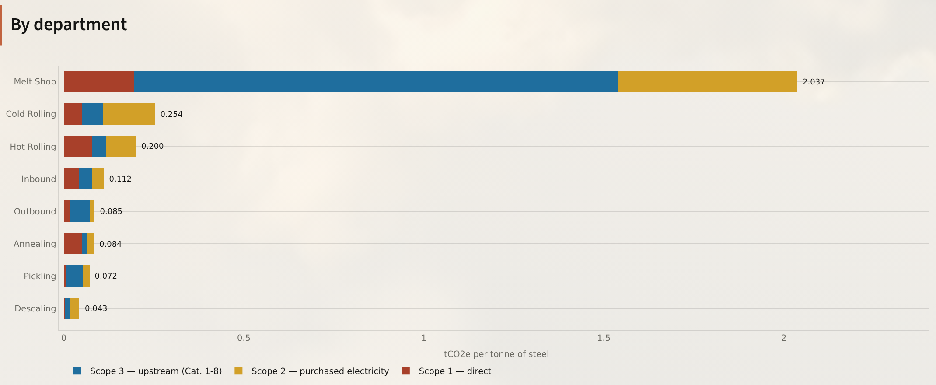
3
PROPOSED SOLUTION
Meet CarbonSpark
A web calculator that prices every choice behind a tonne of stainless, live as you move it.
1
Set the inputs
2
Read the tonne
3
See where it sits
Notes:
Introduce CarbonSpark as a flow the eye can follow. One: set the inputs, here the grid energy mix, seven sources each with its emission factor. Two: read the tonne; the readout splits it into Scope 1, 2 and 3 and specific energy, and moves as a slider is dragged. Three: see where it sits, by department. Everything is computed from a 67-step accounting grid.

Slide 5
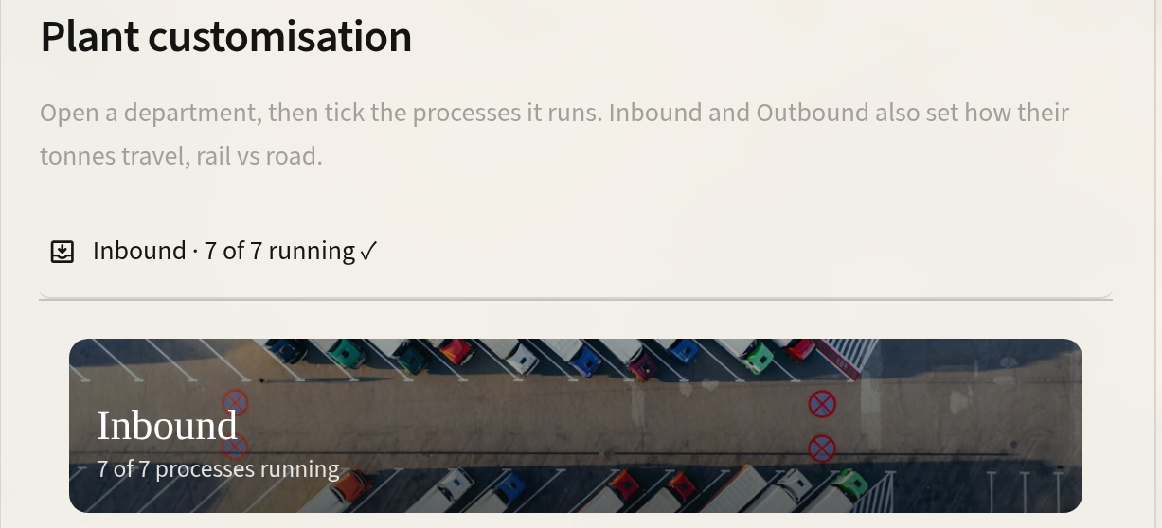
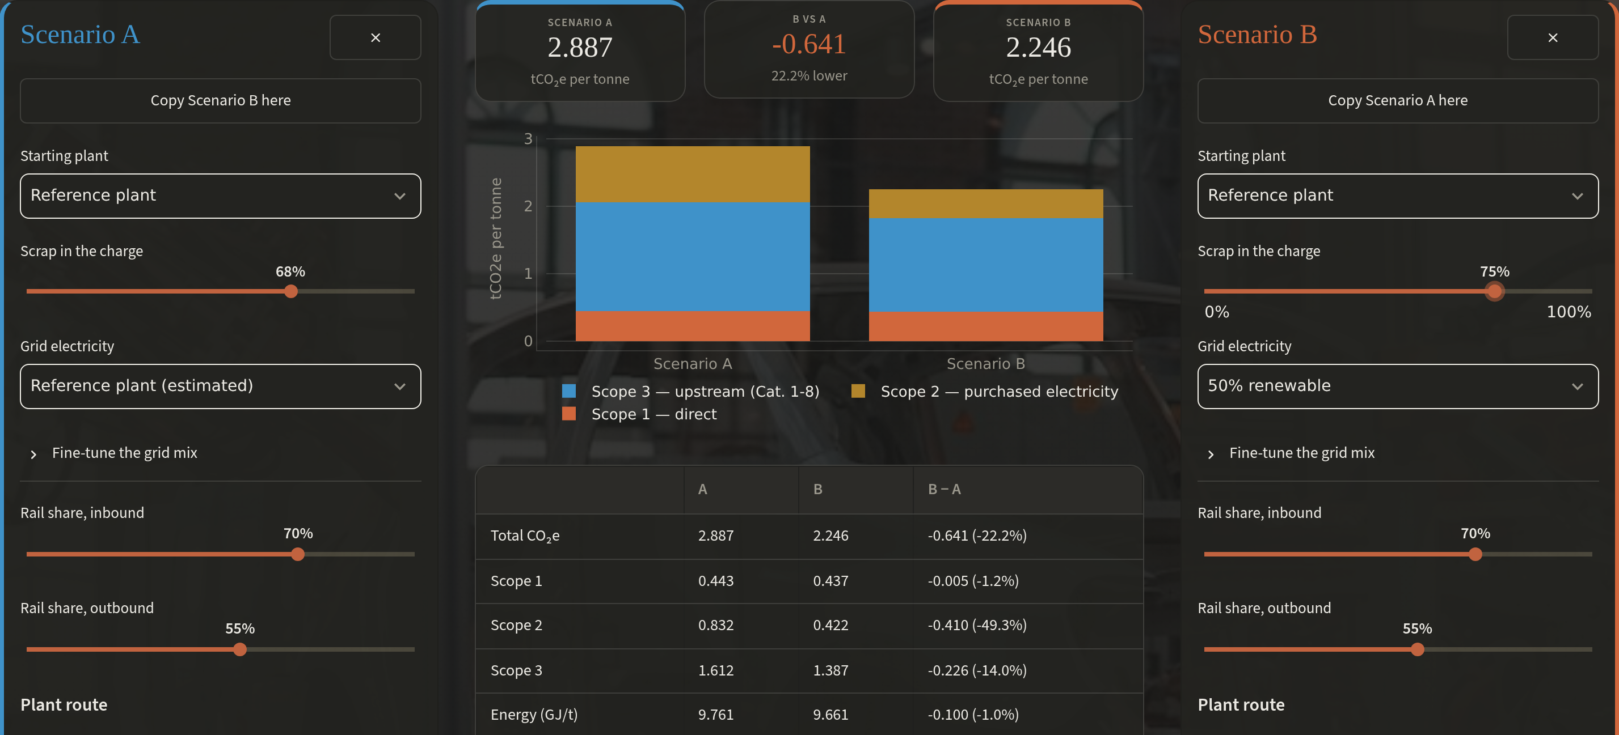
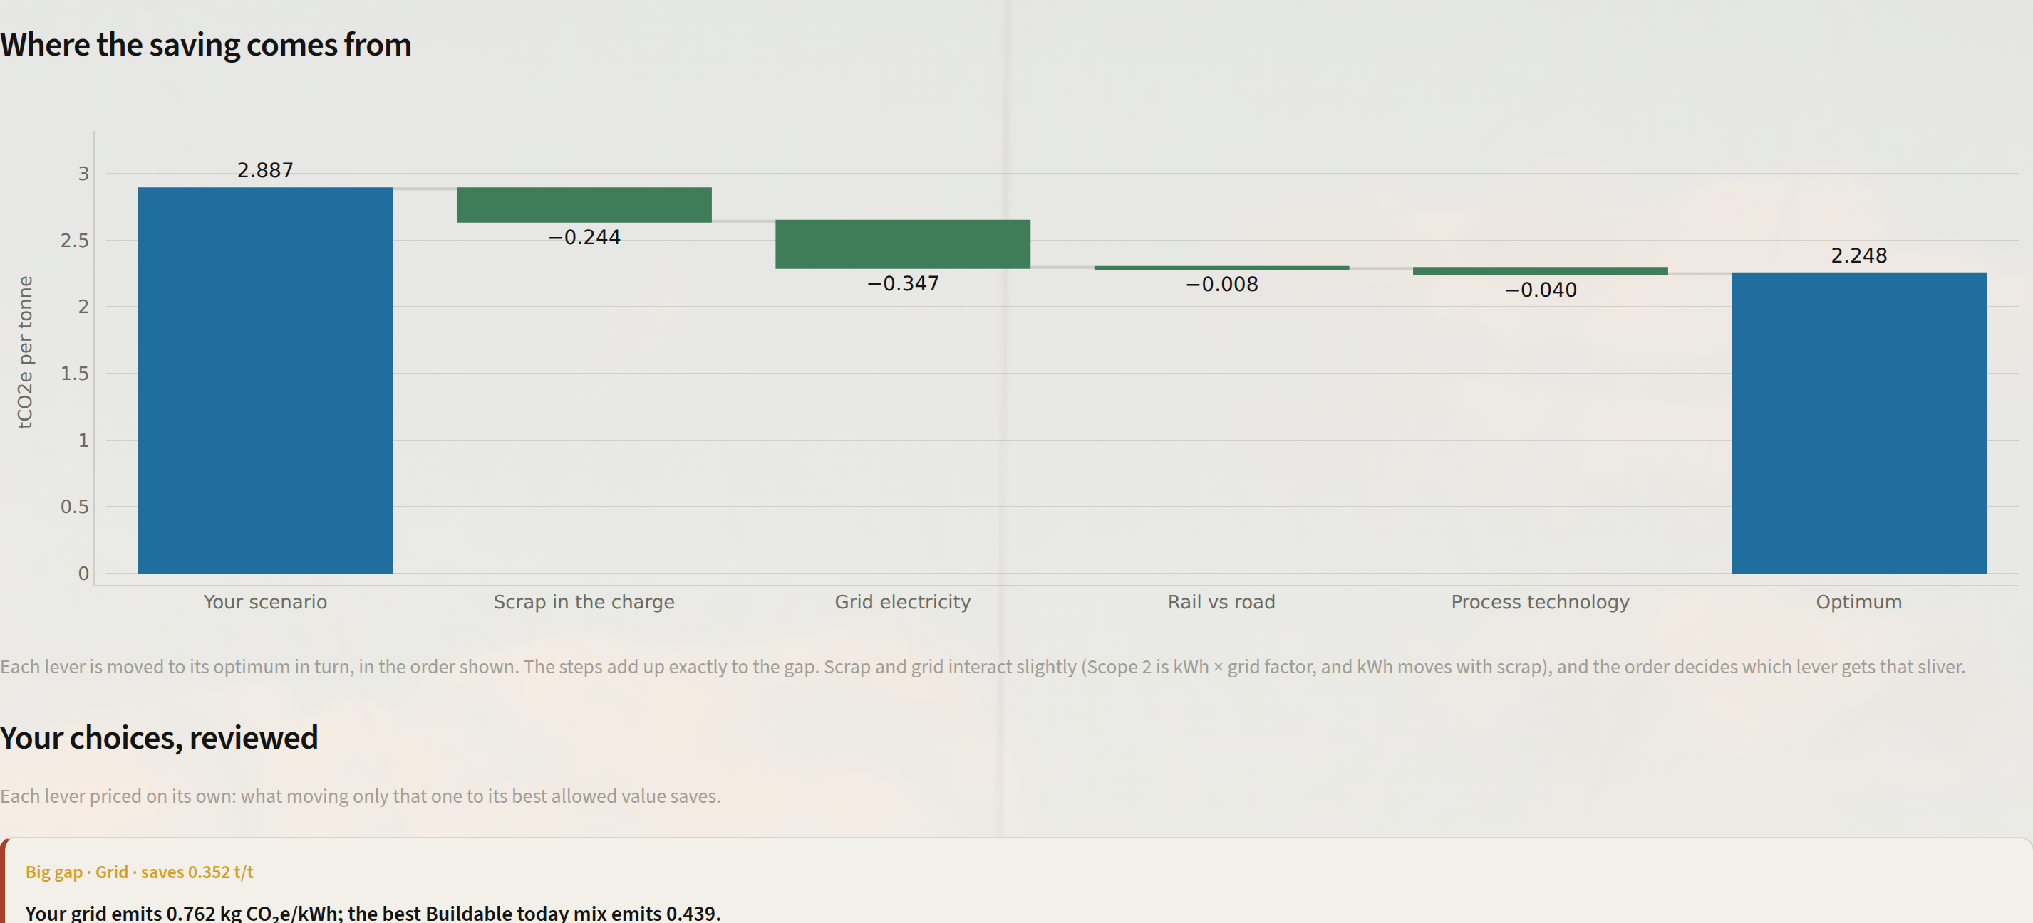
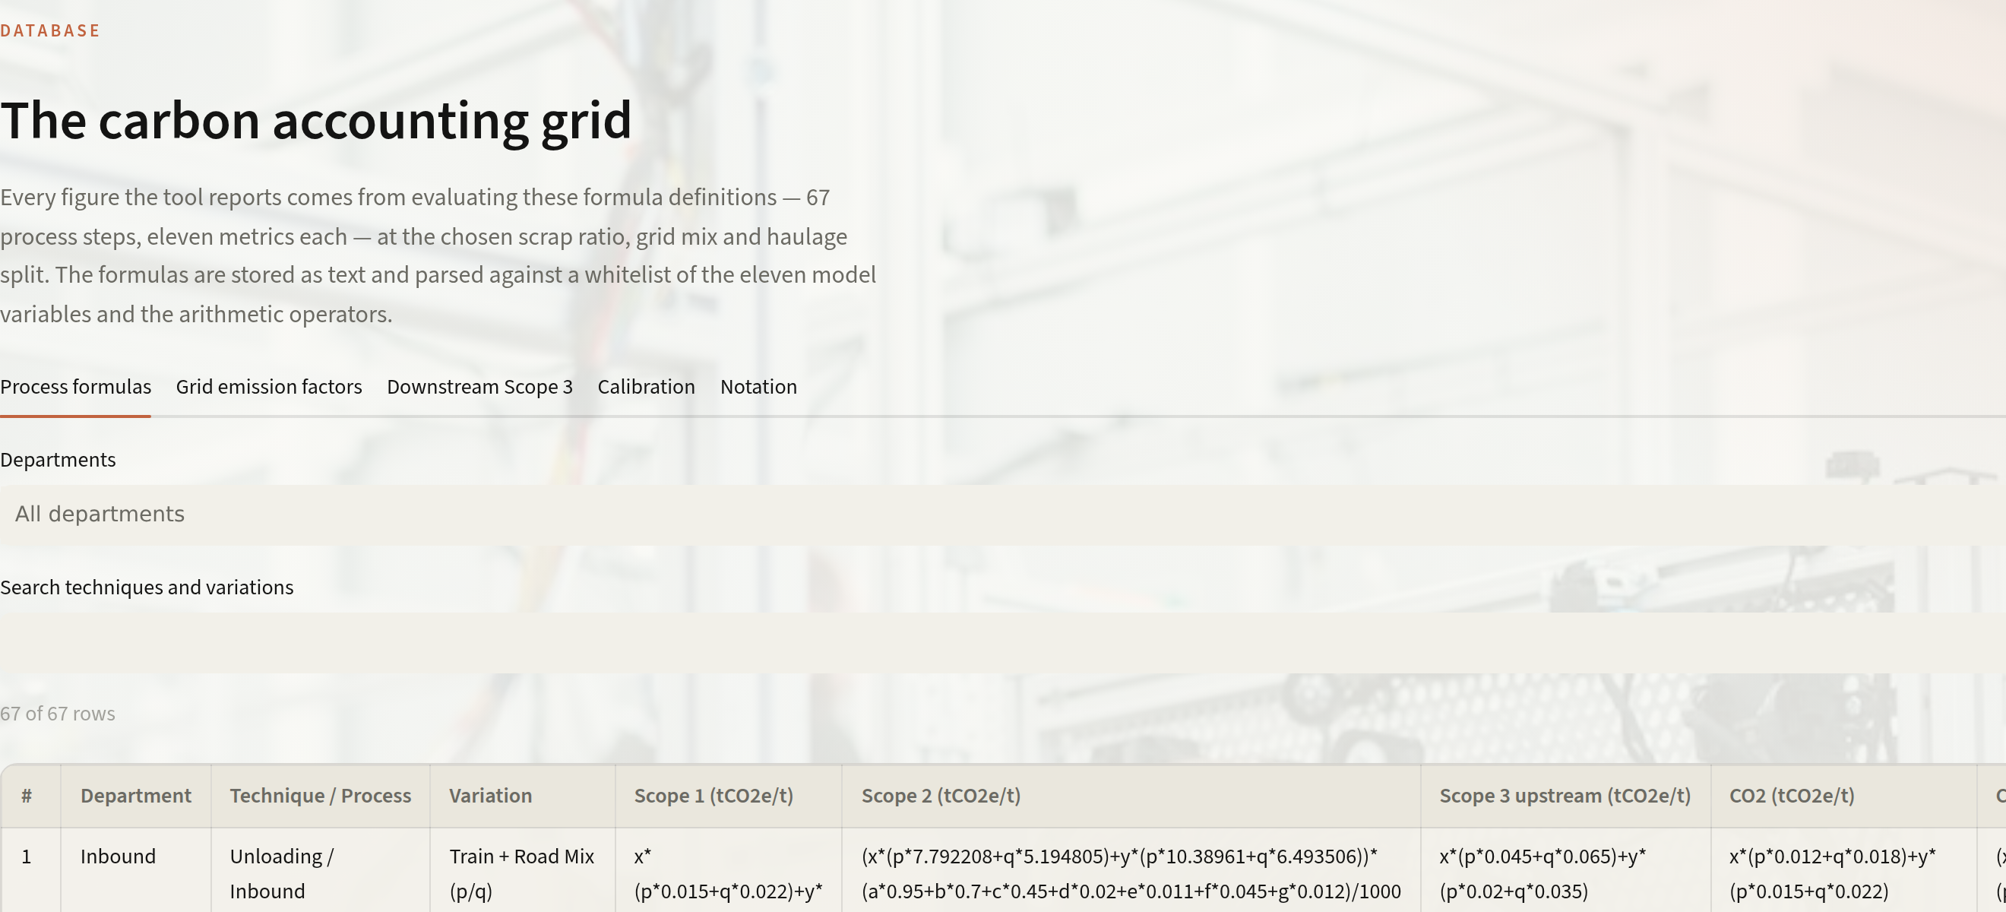




4
CARBONSPARK TOOLS
Four tools, one model
Input calculator
Compare
Optimiser
Open database
Scrap share, grid mix, rail vs road, and 67 process steps to switch on or off.
Two plans side by side, with the difference in every scope.
Lowest-carbon plan at three ambition levels, and a waterfall of where the saving comes from.
Every formula, factor and source, free for anyone to read and download.
One model underneath: a 67-step accounting grid, so every tool gives the same answer for the same plant.
Notes:
The four tools, all running on the same model. The input calculator covers the brief's two levers and goes further: haulage and every process step. Compare puts two plans side by side. The optimiser finds the lowest-carbon plan within an ambition level (buildable today, stretch, theoretical floor) and shows exactly where the saving comes from. The database is open: every formula, factor and source can be read and downloaded, so nothing is a black box.

Slide 6
5
ALWAYS CHANGING
A database that keeps up with the industry
1
New data
WE'VE ALREADY DONE IT ONCE
benchmarks, grid factors, plant meters
4.60 → 2.89
tCO₂e per tonne
2
Edit one row
in the workbook, with a note on why
3,283 → 1,091
kWh per tonne
3
Regenerate
one command rebuilds the database
67 rows
Re-test
re-checked, each with its reason
4
47 automated checks re-derive every total
WHAT WILL CHANGE NEXT
5
Live
Grid factors fall each year
New routes: H₂-DRI, green PPAs
in every tool at once
repeats whenever the data moves
Metered plant data
Carbon prices and CBAM rules
Notes:
The numbers behind steelmaking move: national grid emission factors fall every year, new routes such as hydrogen-based reduction and green power contracts arrive, and plants can supply metered data. CarbonSpark keeps up because the accounting workbook is the single source of truth. Change one row with a note on why, regenerate with one command, and 47 automated checks re-derive every total before it goes live in every tool at once. We've already done this once: our first release overstated the tonne because electricity per tonne was far above real furnaces. We re-checked all 67 rows against benchmarks and the reference plant went from 4.60 to 2.89 tCO2e per tonne and from 3,283 to 1,091 kWh.

Slide 7



6
IMPLEMENTATION
From pilot to every line
NOW
0–3 MONTHS
3–9 MONTHS
9–18 MONTHS
Live prototype
Plug in the plant
Decide with it
Scale it
Public data and reference plant profiles.
Metered power, contract emission factors, charge records.
Size renewable contracts and scrap sourcing.
Every site; per-grade footprints for customers.
What a plant provides
Who uses it
What it costs
Shop-level energy meters
Power contract factors
Charge-mix records
Procurement
Melt shop planning
Sustainability reporting
Open-source stack
One virtual machine
No licences
Notes:
Implementation. The prototype runs today on public data. Phase one connects a plant: metered electricity by shop, the actual emission factors in its power contracts, and the charge records the melt shop already keeps. Phase two puts it into decisions: sizing renewable contracts and scrap sourcing. Phase three scales to every site and produces per-grade footprints for customers. It needs no licences and no special hardware; the real requirement is access to plant data.

Slide 8



7
IMPACT
What CarbonSpark is worth
639 kt
CO₂e a year saved per million tonnes, with only buildable changes
−36%
Scope 2, from power procurement alone
Seconds
to price any plan, instead of a manual spreadsheet run
Transparency
Better decisions
Net Zero 2050
Carbon visible at the moment of choice
Scrap and power priced side by side
A stepwise path, not a single leap
−22% buildable today · −48% stretch · −69% theoretical floor
Notes:
Impact. The brief asks for a measurable reduction in estimated emissions. On the buildable path, only changes a plant could contract or commission within a year, the reference plant falls from 2.887 to 2.248 tCO2e per tonne: 22%, or 639 kt a year for every million tonnes. The stretch path cuts 48%, a concrete waypoint toward Net Zero 2050. Beyond the numbers, the brief's goal is transparency and informed decision-making: carbon becomes visible when a choice is made, scrap and power are priced side by side, and the path to Net Zero becomes a series of steps.

