Slide 1
Notes:
Title slide — left blank deliberately. Add team name, members, college and the problem statement title here.

Slide 2
1
PROBLEM UNDERSTANDING · OBJECTIVES
Emissions are decided long before anyone can see them
A stainless tonne's carbon is fixed by four choices — how much scrap is charged, which grid supplies the furnaces, how the material is hauled, and which technology each stage runs. Those choices are made by planners and buyers who have no number in front of them at the moment of deciding. The workbook that holds the coefficients is an audit artefact, not a decision tool.
THE TONNE TODAY
6.167
tCO₂e per tonne — workbook default route, 40% scrap, today's Indian grid
WHY IT MATTERS
Scope 2 — purchased electricity — is 56% of the baseline tonne. The single biggest lever is a procurement decision, not a metallurgical one.
Scrap displaces virgin chromium and nickel, but grade requirements cap how far it can go. The trade-off is real and currently unquantified at the plant.
Net Zero by 2050 needs the marginal question answered in seconds: what does this change do to the tonne?
56%
of that total is Scope 2 alone (3.451 tCO₂e/t)
47.4
OBJECTIVES — MEASURABLE
GJ/t specific energy at the same baseline
Price the brief's two levers: scrap versus virgin charge, and the energy mix behind every kWh.
Report Scope 1, 2 and 3 separately and reconcile to the accounting grid exactly.
Respond while the input is moving, not after it is released.
Return a lower-carbon combination that is actually procurable.
Beyond the brief: make the process route editable too, priced the same way.
67
process routes carrying their own Scope 1/2/3 coefficients
Notes:
Open on the decision gap, not on the technology. Keep the brief's own two levers front and centre — scrap versus virgin charge, and the energy mix — because those are what the problem statement asks for and what actually moves the tonne. The process-route work on the next slide is the cherry on top, not the headline; introduce it that way. Numbers are from our own model run on the supplied workbook: the default route (40% scrap, today's Indian grid, first-listed technology at every stage) gives 6.167 tCO2e/t and 47.4 GJ/t. Scope 2 at 3.451 t/t is 56% of the total — say this out loud, it is the reason the grid mix is the centrepiece of the tool. The objectives are deliberately measurable so the validation slide can be checked against them one by one.

Slide 3
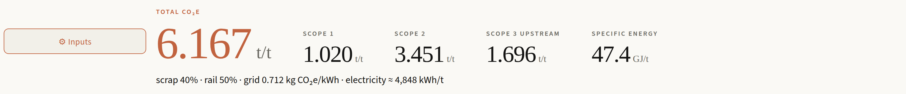
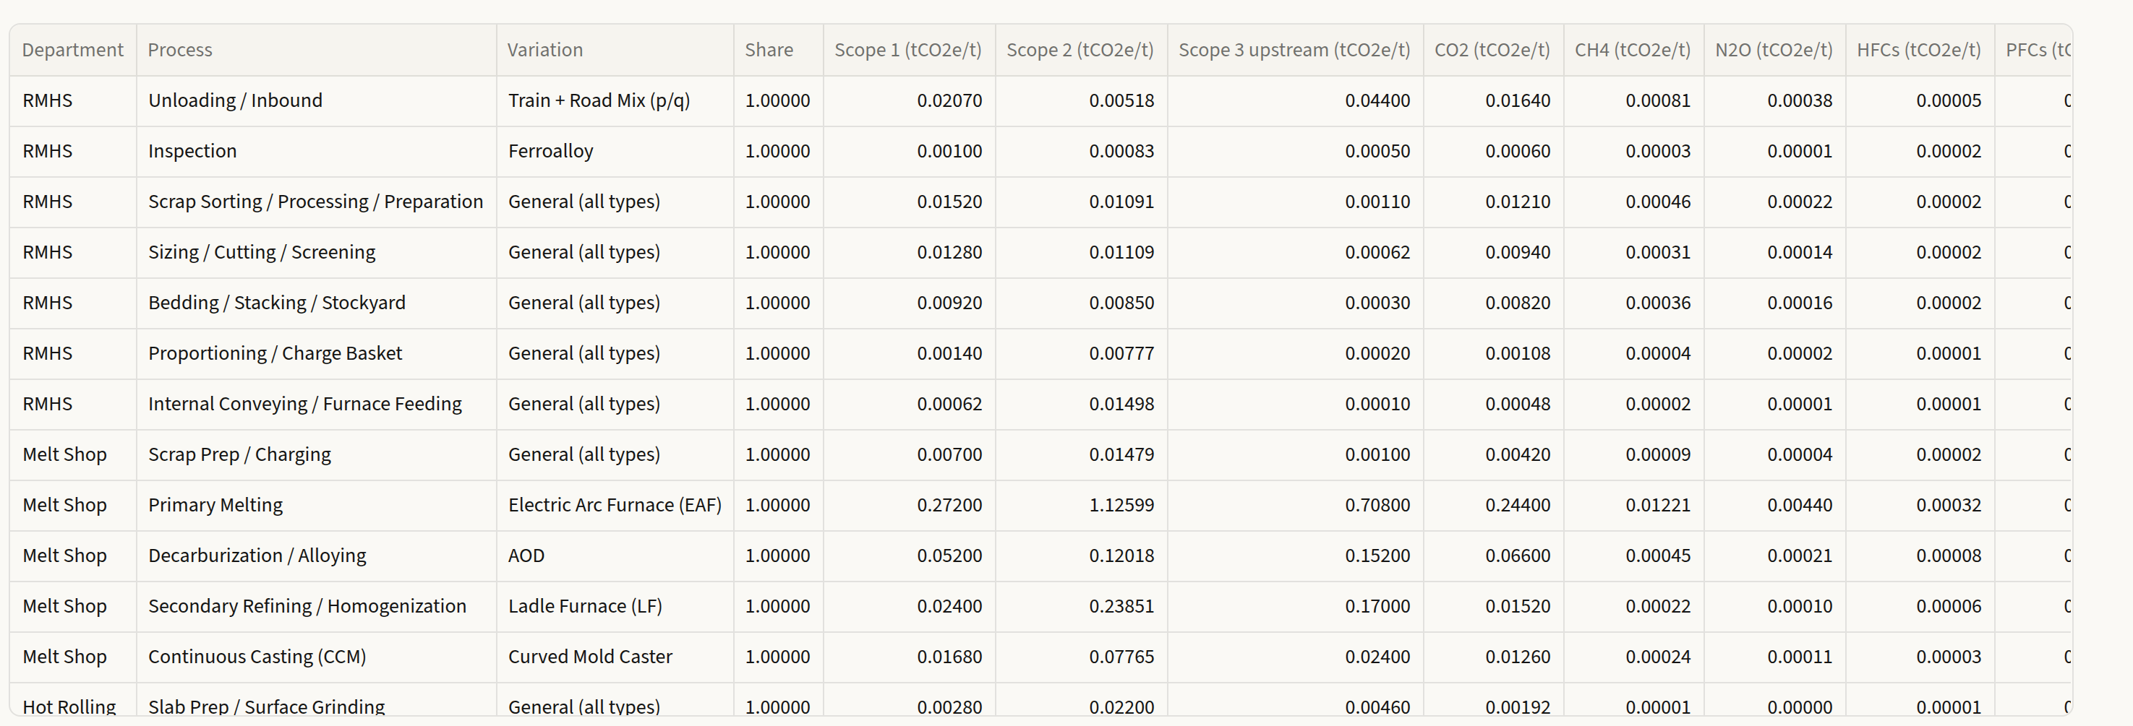
2
PROPOSED SOLUTION
CarbonSpark — every lever, live
A web application built directly on the accounting grid. Every coefficient is read from the workbook at load, so the tool cannot drift from its source.
WE WENT FURTHER THAN THE BRIEF
The brief asks for input mix and energy source. We modelled the process route as well — the technology a stage runs changes the tonne as much as the charge does, and nothing else lets a user see that.
1
48 stages, on or off
Any step can be taken out of the route; the tonne recomputes without it.
24 interchangeable technologies
Every row of the result carries its variation and its share of the stage.
2
Five stages carry real alternatives — 6 melting routes, 4 decarburisation, 4 refining, 8 casting, 2 inspection.
8
48
24
3
Split a stage between two
Pick more than one and the tonne divides between them, the way a plant running two casters actually does.
departments, raw material to despatch
process stages, each switchable
technologies across 5 decision points
4
Live, mid-drag
The route is re-arranged into coefficients and evaluated in the browser, so figures and charts move with the slider — exact to 1×10⁻⁹.
Notes:
This is the 'how', and the differentiation lives here — lead with it. The brief asks for two levers: input mix and energy source. We built those and then went further, modelling the process route itself, because the technology a stage runs moves the tonne as much as the charge does. Concretely: 48 stages that can each be switched out of the route, and 24 interchangeable technologies concentrated in five real decision points — six melting routes, four decarburisation, four refining, eight casting, two inspection. Pick two at one stage and the tonne splits between them, which is how a plant running two casters actually behaves. The second claim to land: all of it is live. Streamlit only commits a slider on release, so we re-arrange the route into a coefficient model and evaluate it in the page — figures and the charts move with your hand, and it still agrees with the server to 1e-9. The screenshot is the per-process table: every row carries its variation and its share, so nothing is hidden.

Slide 4
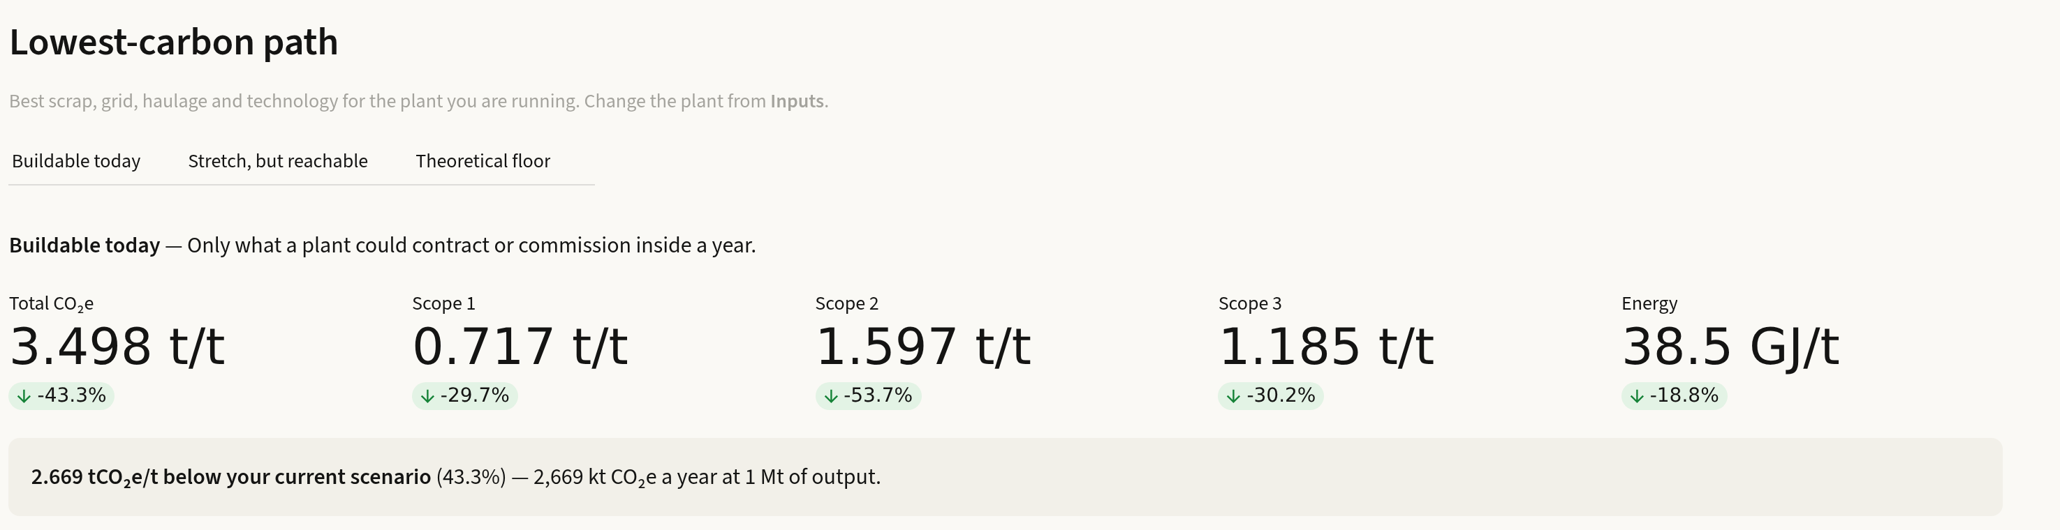
3
VALIDATION · FEASIBILITY · ASSUMPTIONS
What is buildable, not what is imaginable
SCENARIO | tCO₂e/t | vs DEFAULT | WHAT IT ASSUMES
Default route — reference | 6.167 | — | 40% scrap · grid 0.712 · first-listed technology
Scrap alone, to 76% | 4.912 | −20.4% | same grid, same route — the charge lever on its own
Buildable today | 3.498 | −43.3% | 60% scrap · grid 0.439 · coal held ≥45%
Stretch, but reachable | 2.057 | −66.7% | 80% scrap · grid 0.111 · firmed renewables
Theoretical floor | 1.498 | −75.7% | 100% scrap · non-fossil grid · any technology
WHY THREE LEVELS
An unbounded search lands on 100% scrap and a 100% wind grid and tells the plant nothing. Each level carries its own explicit limits — a coal floor because the grid a plant is connected to is coal-fired, a scrap cap because stainless needs virgin chromium and nickel, and no vacuum or remelting routes, which carry a negligible share of world tonnage. The tool states the reasoning for every limit on screen.
HOW WE KNOW IT IS RIGHT
ASSUMPTIONS & LIMITATIONS
37 automated tests, including a full re-derivation of the workbook totals.
The browser's live model matches the server to 1×10⁻⁹ across four scenarios and every department.
All 65 Scope-2 rows reconcile to their stated kWh and grid factor.
Global warming potentials are IPCC AR5; grid factors are AR5 lifecycle medians.
The workbook's gas columns carry Scope 1 only (~10% of the scope total) — we report them as such rather than as a full gas split.
Its electricity intensities are high against public figures (EAF 1,668 kWh/t vs a typical 450–700). Absolute values are therefore indicative; differences between scenarios are robust.
Site profiles in the tool are built from public disclosures, not equipment inventories, and their source-wise grid splits are estimates.
Notes:
This is the evidence slide — spend the most time here. Every row is quoted against the workbook's own default route, 6.167 tCO2e/t, which is the same reference the tool shows on screen. Row two is worth pausing on: moving scrap alone from 40% to 76%, with the grid and the route untouched, already takes 20.4% off the tonne — that is the brief's first lever doing its work on its own. Then the three optimiser levels, which move the charge and the grid together. The key defence: 'Buildable today' at 3.498 t/t (-43.3%) holds coal at 45% or more of supply and caps hydro and nuclear near their real grid share, because an industrial consumer cannot contract unlimited amounts of either. That is what makes it a feasible answer rather than a hypothetical one. On validation, the strongest single fact is the 1e-9 agreement between the browser model and the server — the live figures are the same arithmetic, not an approximation. Be upfront about the limitations; the electricity intensities in the supplied workbook are high against public benchmarks, which is exactly why we present deltas rather than certified absolutes.

Slide 5
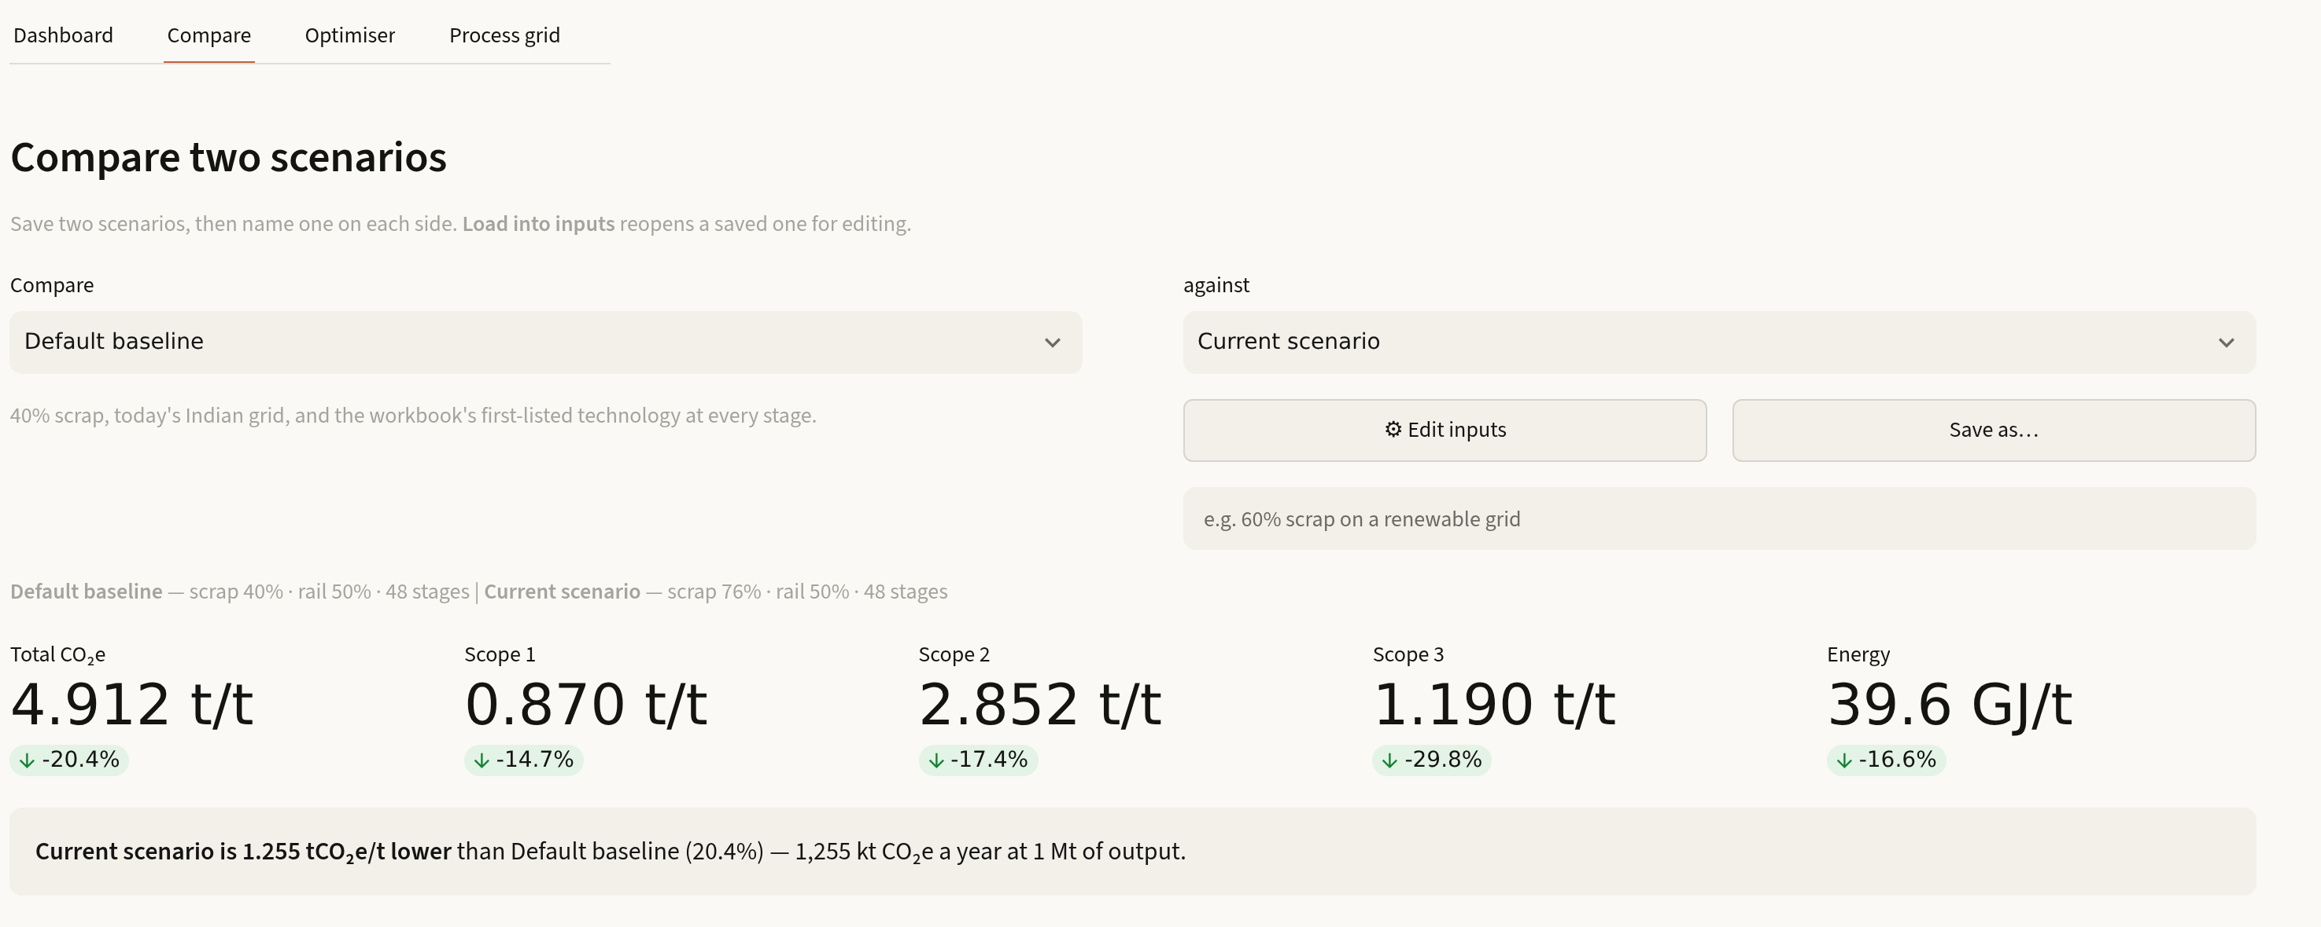
4
INNOVATION · DIFFERENTIATION · EXPECTED IMPACT
What this does that a spreadsheet cannot
Live, not lagged
The route is re-arranged into coefficients and evaluated in the browser, so figures and charts track the slider mid-drag — exact to 1×10⁻⁹, not an approximation.
Feasible, not fantastical
Three ambition levels with stated economic and grid limits, so the answer is something a plant can put in a procurement plan.
Scenario against scenario
Any two configurations compared side by side — baseline, the live plant, or two of the user's own — with per-scope deltas.
EXPECTED IMPACT — AT 1 Mt OF OUTPUT
2,669
−18.8%
−53.7%
Auditable to the row
Every headline opens into the per-process table and the workbook's own coefficient notes.
kt CO₂e avoided per year on the buildable path
specific energy, 47.4 → 38.5 GJ/t
Scope 2, the largest single component
Built on the supplied workbook · Streamlit · open to any plant configuration
Notes:
Close on differentiation and impact. The one thing to say if you only get one sentence: every other calculator recomputes on the server after you let go of the control — ours re-arranges the model into coefficients and evaluates it in the page, so the number moves with your hand and is still exact to 1e-9. Second differentiator is the feasibility framing, which answers the brief's word 'practical' directly. On impact, quote the annualised figure: at 1 Mt of output, the buildable path avoids 2,669 kt CO2e a year, cuts specific energy 18.8%, and takes 53.7% off Scope 2 — the component that was 56% of the tonne on slide 1. Invite them to open the tool and change any input; nothing in it is hard-coded.

