Slide 1
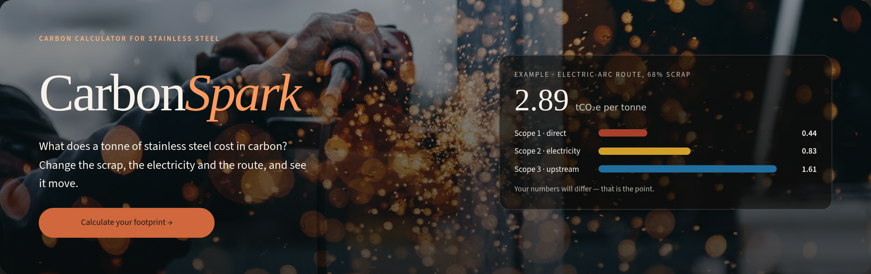
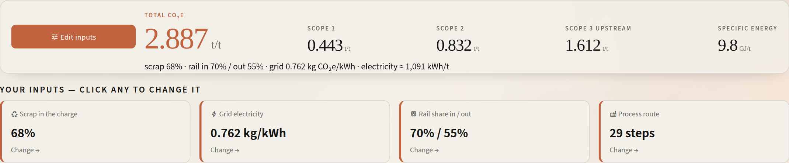
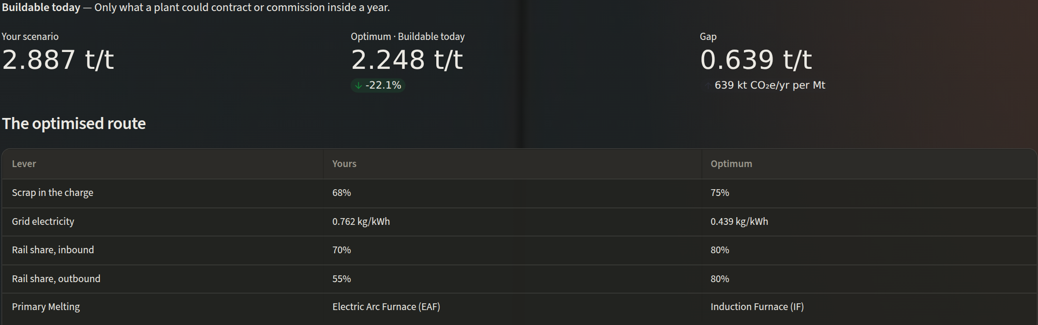
JINDAL STAINLESS · ENGINEERING CASE STUDY COMPETITION 2026 · ROUND 2
CarbonSpark
Carbon & Energy Calculator for Stainless Steelmaking
Problem Statement 3 — Round 1 built the calculator. Round 2 makes it accurate, and makes it decide: a recalibrated model, an exact optimiser, and a side-by-side comparison, all live.
2.887 → 2.248
−22%
~1.8 Mt
tCO₂e/t, JSL Jajpur today vs buildable today
carbon per tonne, no new plant
CO₂e a year avoidable across ~3 MTPA
The live site: landing page (dark mode) and the calculator's readout, JSL Jajpur profile.
Round 2 adds an exact optimiser: Jajpur 2.887 → 2.248 tCO₂e/t with only buildable changes.
TEAM
Team name · Members · Institute
Notes:
Title. Fill in the team name, members and institute in the TEAM line. One sentence to open with: in Round 1 we built a calculator; in Round 2 we made its numbers match what Jindal Stainless actually discloses, and we made it tell a plant what to do next. The three figures on this slide all come from the model running the JSL Jajpur and Hisar profiles.

Slide 2
1
PROBLEM · WHY IT MATTERS
A tonne's carbon is set by choices nobody can price
Stainless carbon per tonne is fixed by a few decisions: how much scrap goes in the charge, which electricity feeds the furnaces, how material is hauled, and which technology each stage runs. The people who make those decisions (procurement, melt shop, logistics) have no number in front of them when they make them.
THE TONNE TODAY — JSL JAJPUR, AS MODELLED
2.887
56%
tCO₂e per tonne of steel
is Scope 3: the upstream carbon of the charge
THE GAP
The coefficients sit in an accounting workbook: 67 process steps × 11 metrics. It's built for audit, not for deciding anything.
BRSR Core, EU CBAM and India's Carbon Credit Trading Scheme all ask for per-tonne intensity, and Net Zero 2050 needs every marginal choice priced.
Levers interact. A cleaner grid changes which furnace is best, so ranking them one at a time can give the wrong answer.
71%
1,091
sits in the melt shop (2.04 t/t)
kWh of electricity per tonne
WHAT ROUND 2 HAD TO FIX
Accuracy: Round 1 put Jajpur at 4.60 tCO₂e/t with Scope 1+2 at 3.19, against 1.76 that JSL discloses.
Decision: a number alone doesn't tell a plant what to change first, or by how much.
Notes:
Open on the decision gap. Four choices set the tonne's carbon, and the people who make them can't see the result. All figures are from our model running the JSL Jajpur profile on the recalibrated grid: 2.887 tCO2e/t, 56% of it Scope 3 (the upstream carbon of ferrochrome, nickel and iron units in the charge), 71% of it in the melt shop, about 1,091 kWh per tonne. Then be honest about Round 1: our numbers were too high, and the next two slides show how we found and fixed that.

Slide 3
2
INSIGHTS · WHAT THE MODEL TELLS US
Two levers carry the tonne, and order matters
1
Each point of scrap ≈ 35 kg CO₂e/t
Virgin ferrochrome, nickel and iron units bring their smelting emissions with them. Scrap is a carbon lever, not only a cost one.
2
Each 0.1 kg/kWh off the grid ≈ 0.11 t/t
At 1,091 kWh/t, a PPA decision is worth as much as a metallurgical one. It's the largest buildable gap.
3
The best furnace depends on the grid
An induction furnace beats the EAF only once the grid is clean. Fix the grid first, then revisit the technology.
Levers priced one at a time from Jajpur today. Scrap capped at 75%, coal held at 45% or more.
FRAMEWORK
GHG Protocol
Linear structure
Abatement order
4
Rail vs road is under 1%
Scope 1 · 2 · 3 (Cat. 1–8) kept separate; gases never double-counted
every metric is linear in scrap share, so the optimum is at a corner
price each lever alone, then walk the sequence so savings add exactly
Only 0.008 t/t is available. Put that capex into power and scrap instead.
Notes:
Insights come from sweeping the model, not from opinion. Left: holding Jajpur's grid and route fixed, scrap from 40% to 100% takes the tonne from 3.86 to 1.77, a straight line at about 35 kg per percentage point, because Scope 3 of the charge is linear in scrap. Middle: each lever moved on its own to its buildable limit. The grid is the biggest buildable gap (0.352 t/t), then scrap (0.244); technology and rail are small. Third insight is the subtle one: an induction furnace uses more electricity but burns less on site, so it only wins once the grid is clean. Pricing levers independently misses this, which is why the optimiser searches them jointly.

Slide 4
3
INSIGHTS · DEPTH OF ANALYSIS
Round 1 overstated the tonne, and we found out why
JAJPUR METRIC | ROUND 1 | ROUND 2 | PUBLIC BENCHMARK
Electricity, kWh/t | 3,283 | 1,091 | ~1,000–1,200 melt-to-coil
EAF electricity, kWh/t | 1,668 | 460–650 | 450–700 typical
Specific energy, GJ/t | 33.9 | 9.8 | ~10–15
Scope 1, t/t | 0.69 | 0.44 | ~0.4 worldstainless avg
Scope 1+2, t/t | 3.19 | 1.28 | 1.76 JSL FY26 (incl. captive FeCr, power)
Scrap in the charge | 35% | 68% | 70.12% JSL FY26 company-wide
WHAT WE CHANGED — ROW BY ROW, WITH REASONS
Electricity
Each of the 67 rows benchmarked stage by stage: EAF 460 on scrap, 650 on virgin; AOD 45–60; LF 35–55; caster ~30.
Scope 3 of the charge
Virgin charge raised 1.1 → 3.2 tCO₂e/t (ferrochrome, nickel, pig iron); scrap enters at 0.2. Over its full range, scrap is now the biggest lever.
4.60 → 2.89 t/t. Scope 2 fell 67% once electricity per tonne matched real furnaces.
Site profiles
Only publicly described equipment is ticked (Primetals, ANDRITZ, JSL). Scrap set so Jajpur + Hisar average back to JSL's 70%.
Notes:
This is the depth-of-analysis slide. In Round 1 we flagged that the workbook's electricity intensities were high; in Round 2 we fixed them. Every coefficient was checked against process literature and JSL's own disclosures, and every row's notes in the workbook record the Grid 4 to Grid 5 change and the reason. Result: Jajpur's electricity drops from 3,283 to 1,091 kWh/t, in line with real melt-to-coil routes, and Scope 1+2 lands at 1.28 against JSL's disclosed 1.76, which also covers captive ferrochrome and captive power that our route does not. Scope 3 went up, not down, because virgin ferroalloys carry more upstream carbon than the old workbook assumed. So scrap now matters more, not less.

Slide 5
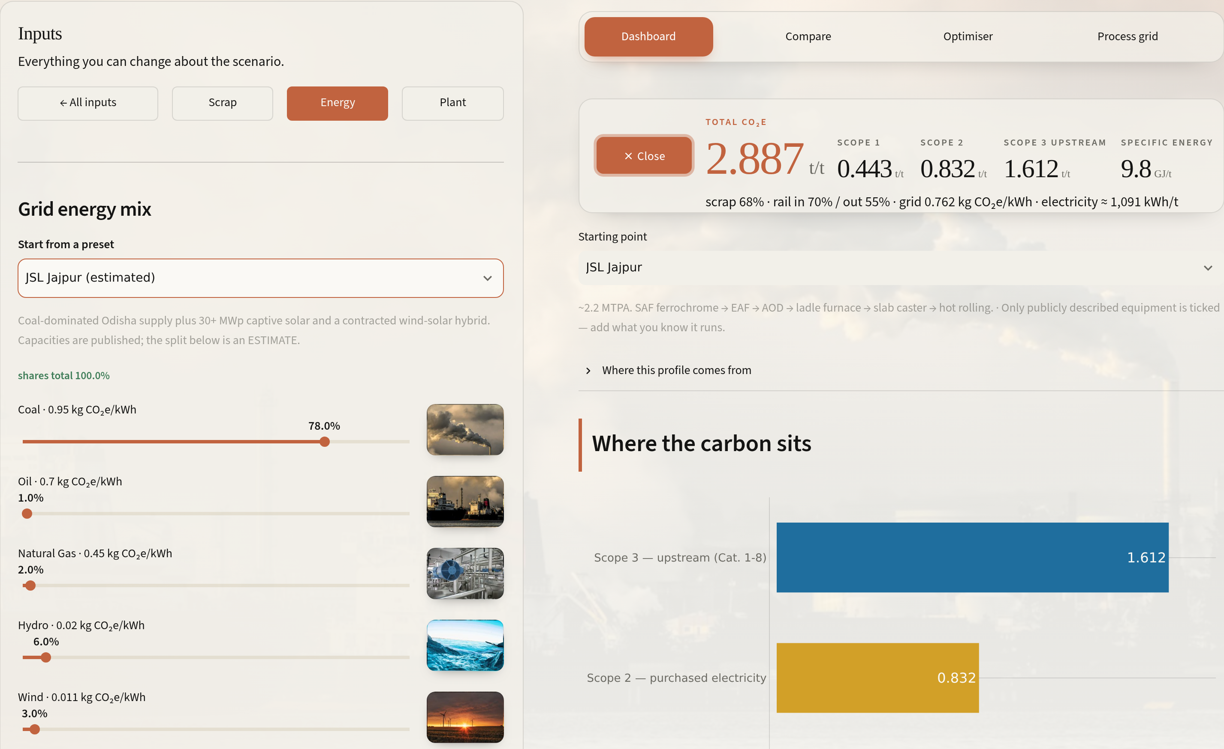





4
PROPOSED SOLUTION · THE PRODUCT
CarbonSpark: every lever on one screen, live
Dashboard
One headline tonne split into Scope 1 / 2 / 3, then by department and by gas.
Inputs drawer
Scrap share, 7-source grid mix, rail share per leg, and 67 process steps you can switch on or off.
Compare
Two plants or plans side by side, each with its own full route, per-scope deltas.
Optimiser
Lowest-carbon plan under three ambition levels, a savings waterfall, and a written review.
Database
Every formula, factor, source and calibration note, downloadable.
Inputs drawer, Energy panel: seven grid sources, each slider with its emission factor. The readout on the right updates as you drag.
New in Round 2: photo-led input panels, light/dark themes, JSL site profiles, Compare, exact optimiser, review.
Notes:
The product. Show the drawer: every input the brief asks for (scrap vs virgin, energy source) plus the ones it doesn't: the rail/road split per leg and the full process route. Round 2 changes for usability: inputs are grouped into three photo-led panels, grid mix and route edits are staged and applied in one step, there's a light and dark theme, and the app opens on a sourced JSL Jajpur profile instead of a blank form. Five views sit behind one navigation bar.

Slide 6
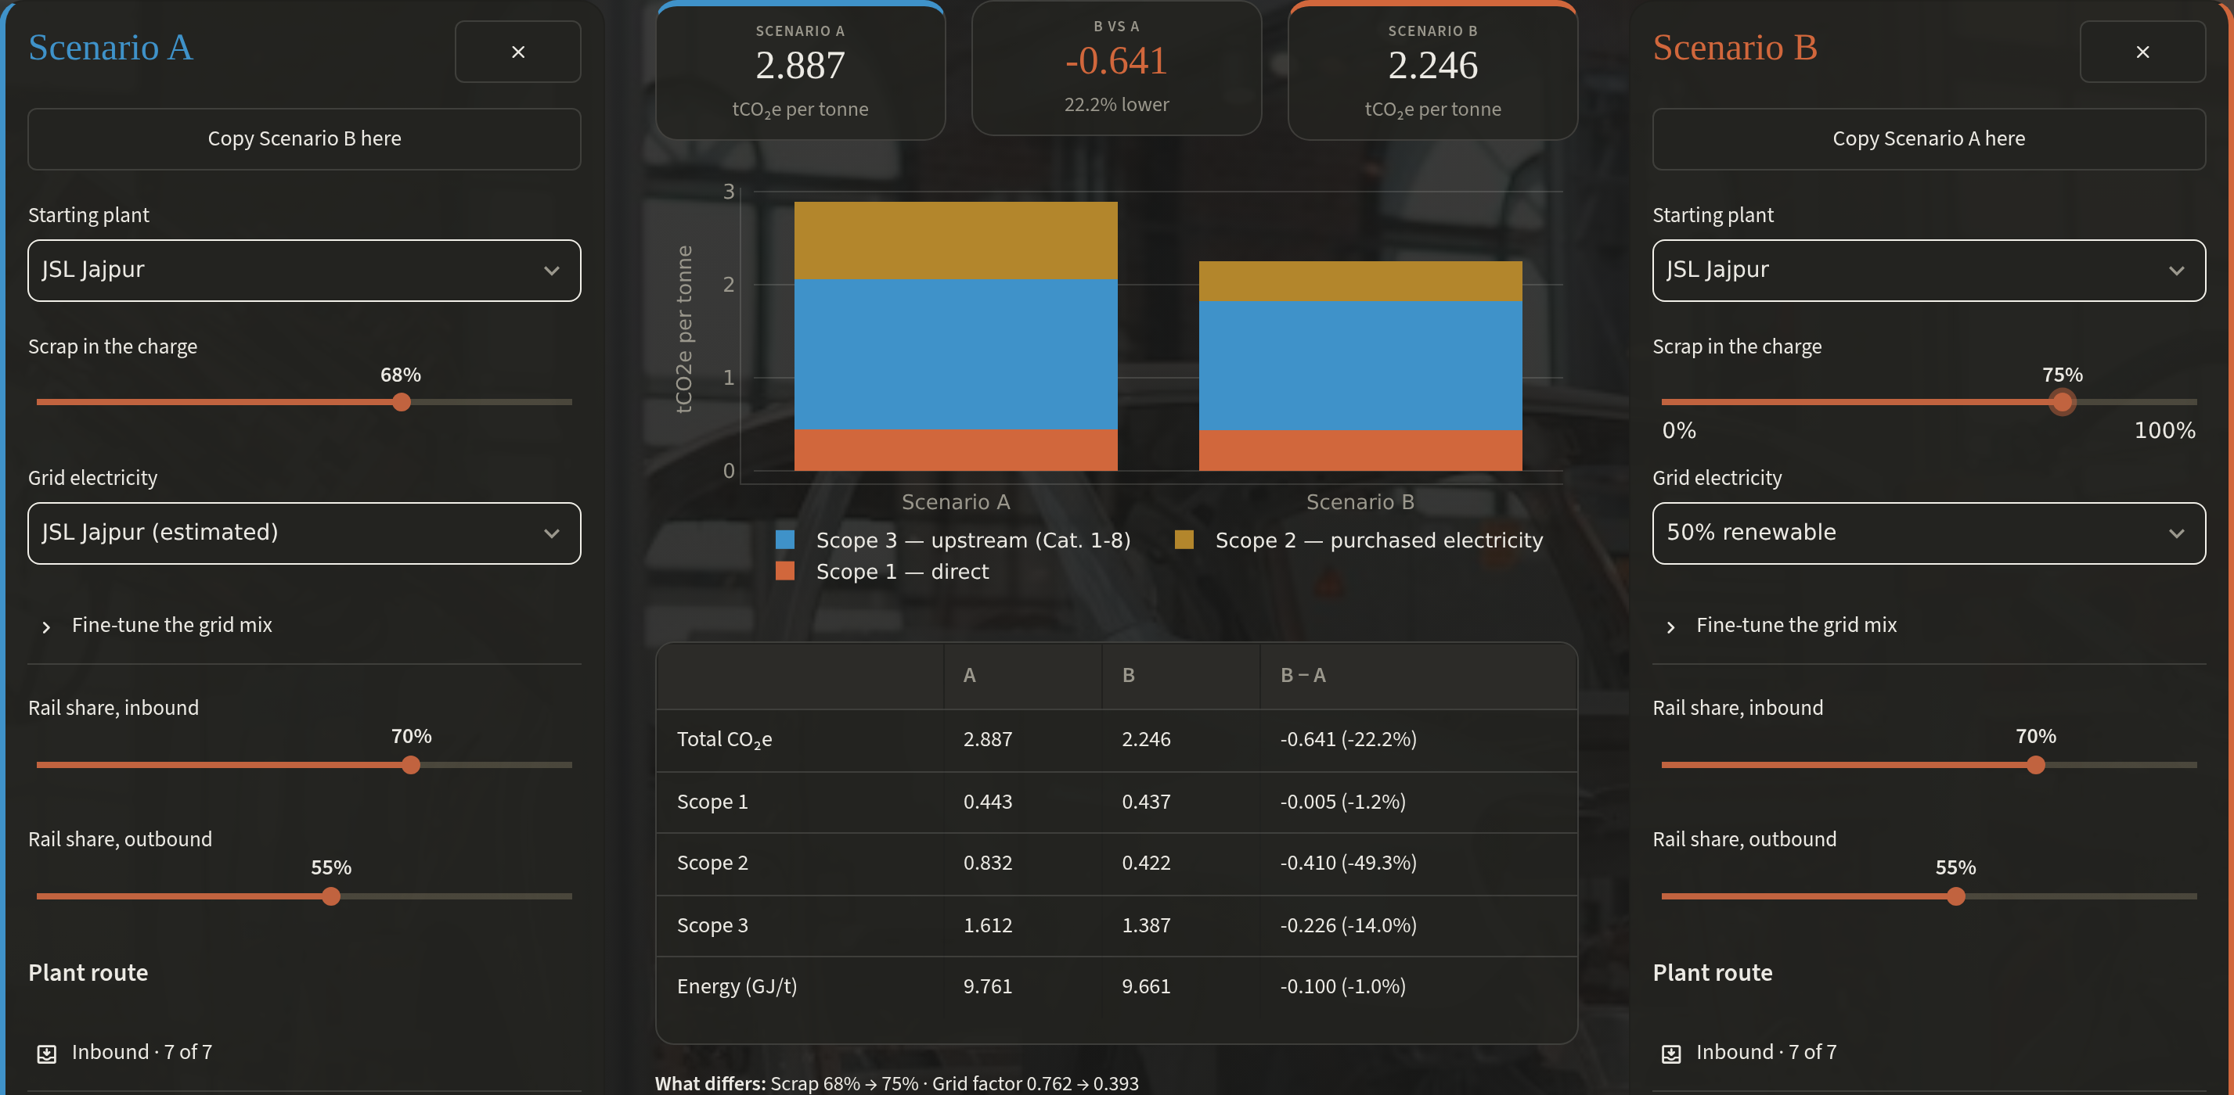
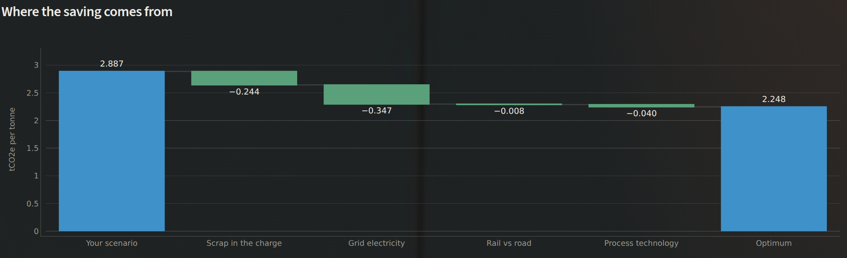
5
PROPOSED SOLUTION · FROM NUMBER TO DECISION
It doesn't just score a plan, it writes the next one
Compare: Jajpur today (A) vs 75% scrap + 50% renewable grid (B) = −0.641 t/t, −22.2%.
THREE AMBITION LEVELS — JAJPUR, tCO₂e/t
2.248
1.514
0.899
Optimiser, Buildable today: the plan, and a waterfall where each lever's saving adds up exactly to the gap.
Buildable today
Stretch
Theoretical floor
≤75% scrap · coal ≥45% · no new plant
≤85% scrap · firmed RE · coal 10–30%
100% scrap · non-fossil grid
WHY TRUST THE ANSWER
Exact, not heuristic. Grid mix is solved greedily to its proven minimum. Scrap and rail are linear, so all 8 corners are checked. Each stage's technology is minimised on its own. About 15 ms.
Notes:
This is where the tool becomes a decision aid. The optimiser finds the lowest-carbon plan for the plant on screen, within an ambition level that says what can actually be bought or built. Buildable today keeps coal at 45% or more because the connection is coal-fired, caps scrap at 75% because stainless still needs virgin chromium and nickel, and never proposes vacuum remelting or a blast furnace. The waterfall splits the 0.639 t/t gap into scrap, grid, rail and technology, and the parts add up exactly. Then a written review ranks the actions, names the limits that bind, and says what relaxing each limit is worth. Compare lets a planner test their own alternative against today. The search is exact, not sampled, which is why we can defend the number.

Slide 7





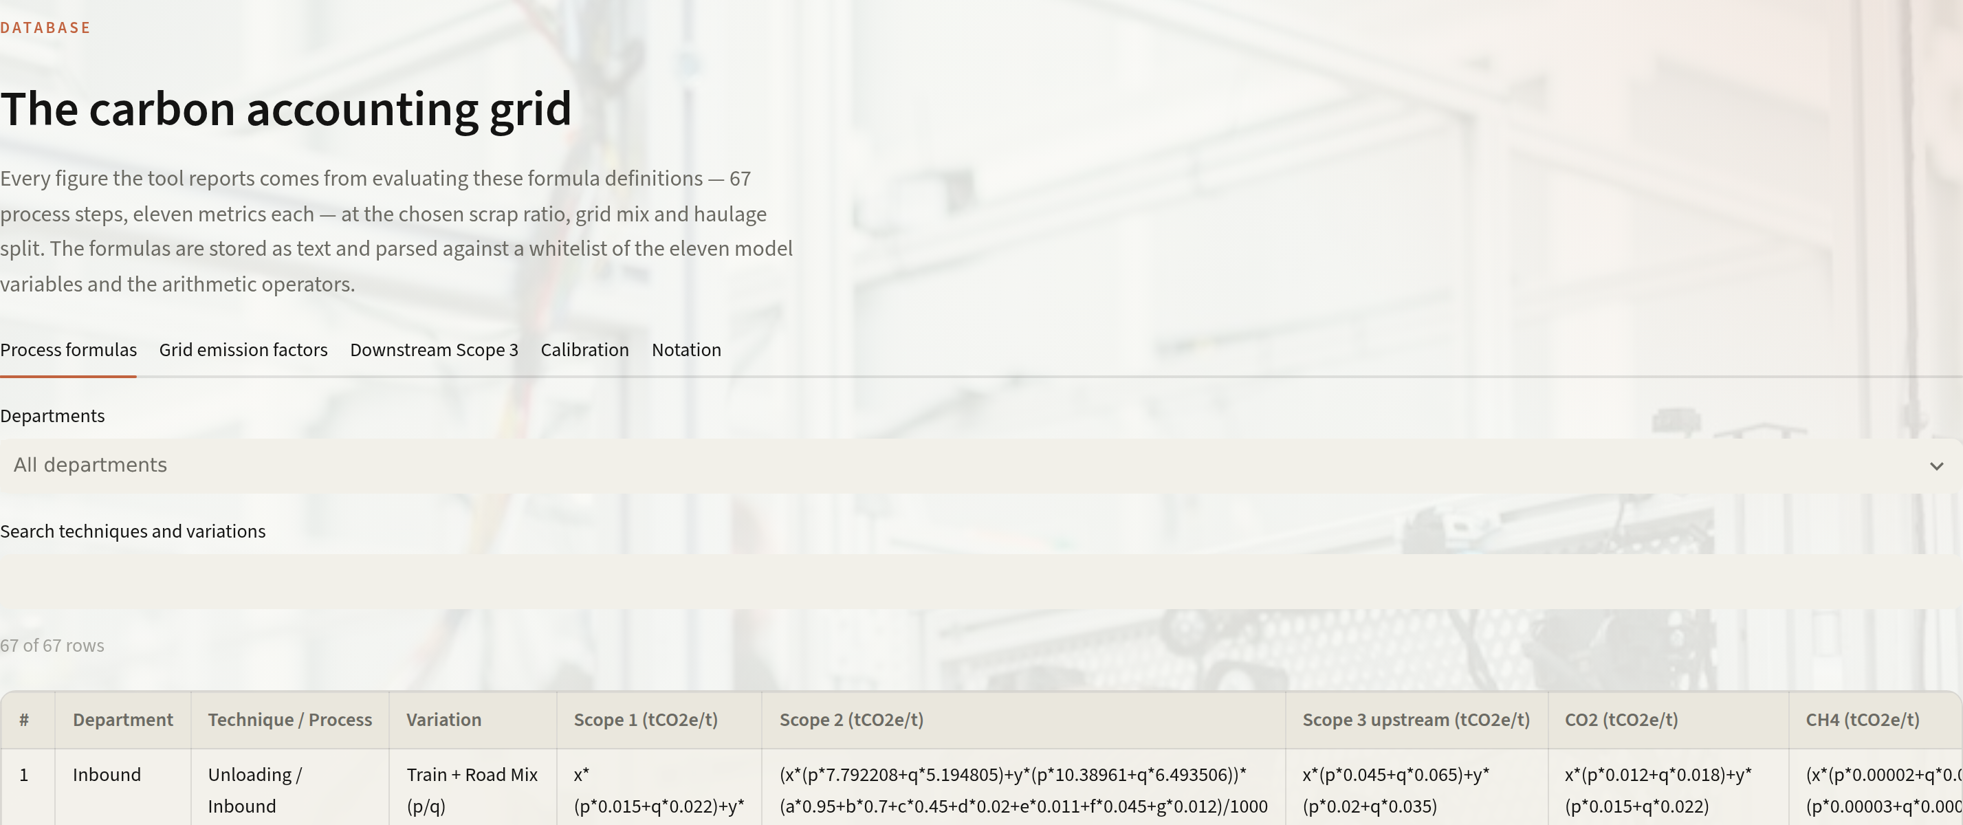
6
IMPLEMENTATION · ARCHITECTURE & ROLLOUT
Built, tested, and ready for plant data
Workbook
Extract
Safe evaluator
Model
Web app
Grid 5 .xlsx: 67 steps × 11 metrics, notes per row
→
Formulas kept as text in JSON; nothing re-typed
→
AST whitelist: 11 variables + arithmetic, no eval
→
Scope 2 = kWh × grid EF; exact corner search
→
Streamlit: 5 views, live readout, light/dark
ROLLOUT AT JINDAL STAINLESS
NOW
0–3 MONTHS
3–9 MONTHS
9–18 MONTHS
Prototype live
Plug in plant data
Decide with it
Scale it
Public data, JSL Jajpur & Hisar profiles, calibrated coefficients.
Shop-level kWh from energy meters, DISCOM/PPA emission factors, charge-mix records.
Size RE PPAs and scrap contracts in the optimiser. Feed BRSR Core and CBAM filings.
Per-grade and per-coil footprints for customers (EPD); every site on one grid.
47
automated tests pass, incl. full re-derivation of workbook totals
~15 ms
exact optimiser run per ambition level
Assumptions & limits. Coefficients are calibrated to published benchmarks, not metered. Site grid splits, scrap ratios and haulage are estimates, and the app labels them. That's why Phase 1 is metered data.
₹0
licences: Python, Streamlit, Plotly, one VM
Notes:
Feasibility. The pipeline is simple on purpose: the workbook is the single source of truth, formulas are kept as text and evaluated through a whitelisted parser, so a plant engineer can change a coefficient in Excel and the tool follows without a code change. 47 automated tests re-derive the workbook totals. Rollout needs no new hardware: Phase 1 swaps our estimates for metered shop-level electricity, the plant's actual PPA and DISCOM factors, and charge-mix records the melt shop already keeps. Phase 2 uses it to decide: size renewable contracts and scrap sourcing, and feed BRSR Core and CBAM reporting. Phase 3 produces per-grade footprints customers can use.

Slide 8
7
IMPACT · WHAT IT IS WORTH
~1.8 Mt CO₂e a year, using only what's buildable
1.8 Mt
CO₂e/yr avoided on the buildable path across ~3 MTPA (Jajpur 2.2 Mt × 0.639 + Hisar 0.8 Mt × 0.487)
−36%
Scope 2 at Jajpur (0.832 → 0.529 t/t) from power procurement alone
4.0 Mt
CO₂e/yr on the stretch path, nearly half the footprint: a concrete Net Zero 2050 waypoint
Operational
Commercial
Sustainability
Any plan priced in seconds, per scope and department
At an illustrative €80/tCO₂, each 0.1 t/t cut ≈ €8 per tonne of exposure
An auditable intensity trail for BRSR Core, CBAM and customer EPDs
Totals: 2.887 → 2.248 (−22%) → 1.514 (−48%) → 0.899 (−69%).
Built on the supplied workbook · open-source stack · every figure on this slide can be reproduced live in the tool
Notes:
Close on impact. On the buildable path, only contracts and settings a plant could change within a year, Jajpur falls from 2.887 to 2.248 tCO2e per tonne, 22%. Scaled by modelled capacity (Jajpur about 2.2 Mt, Hisar about 0.8 Mt, together matching JSL's 3 MTPA melt capacity) that's roughly 1.8 Mt CO2e a year. The stretch path, a decade of procurement and scrap-supply work, roughly halves the footprint and gives Net Zero 2050 a concrete intermediate target. The carbon price is illustrative only, to show how the tool turns carbon into money. Invite the judges to open the tool and change any input.

