Slide 1

JINDAL STAINLESS ENGINEERING CASE STUDY 2026 · PROBLEM STATEMENT 3 · ROUND 2
One tonne.
Three decisions.
Charge, power and route set the carbon of every tonne of stainless. CarbonSpark puts a live number on each one and finds the cheapest path down.
01
Charge
How much scrap vs virgin?
CarbonSpark
02
Power
Which grid feeds the furnaces?
Carbon & energy calculator for stainless steelmaking
03
Route
Team name · Members · Institute
Which technology, which haul?
Notes:
Alternate framing: instead of walking through features, this deck follows the three decisions that set a tonne's carbon. Fill in the team line. Open with the question: who at the plant actually decides the carbon of a tonne, and do they see the number when they decide?

Slide 2




01
PROBLEM
Carbon is decided every day, and reported once a year
Procurement
Melt shop
Logistics
Operations
Signs power contracts
Sets the charge mix
Books rail or road
Runs the process route
BLIND SPOT
BLIND SPOT
BLIND SPOT
BLIND SPOT
Can't see that 0.1 kg/kWh on the grid ≈ 0.11 t per tonne of steel
Can't see that each point of scrap ≈ 35 kg CO₂e per tonne
Can't see that it's worth under 1% of the tonne
Can't see which stage the carbon actually sits in
Decision
BRSR / annual report
2.887
tCO₂e per tonne at JSL Jajpur, as modelled. It arrives after the choices are made.
Day 1
up to 365 days
Carbon becomes visible
Notes:
The problem, framed as people. Four roles set the carbon of a tonne, and none of them sees the number when they decide. The sensitivities in the blind-spot lines are from our model on the Jajpur profile. The bottom bar is the core gap: carbon is decided daily but only becomes visible in the annual BRSR disclosure. The brief asks for a tool that makes the effect of each choice visible. That means closing this lag.

Slide 3

02
INSIGHT · THE TONNE
What actually moves it
2.887
Each lever swung across its practical range, the others held at Jajpur today (t/t vs 2.887)
tCO₂e per tonne · JSL Jajpur
Scope 3 · the charge
1.61
Scope 2 · electricity
0.83
Scope 1 · on site
0.44
96%
1.22 t/t
< 0.05
71% of it sits in the melt shop.
So the charge and the power behind the furnaces are where the carbon is, not the rolling mills or the trucks.
of the total swing comes from scrap and grid. They're the two levers the brief names, and the model confirms them.
separates a 50% and an 85% scrap charge: the single biggest range in the plant.
t/t from rail or from switching between realistic furnace and decarburiser routes. Don't chase them first.
Notes:
Anatomy of the tonne on the left: 56% of Jajpur's 2.887 is Scope 3, the upstream carbon of ferrochrome, nickel and pig iron in the charge. Scope 2 is electricity, and 71% of the total sits in the melt shop. On the right, a tornado chart: each lever swung across a practical range with everything else held at today's Jajpur settings. Scrap and grid make up 96% of the total swing. Rail and the choice among realistic technologies are each under 0.05 t/t. That tells a plant where to spend its attention.

Slide 4



03
INSIGHT · FRAMEWORK
The carbon map: trade scrap against power
Scrap ↓ Grid → | 0.80 | 0.76 | 0.60 | 0.44 | 0.30 | 0.11 | 0.02
60% | 3.21 | 3.16 | 2.98 | 2.81 | 2.65 | 2.44 | 2.34
68% | 2.93 | 2.88 TODAY | 2.71 | 2.53 | 2.38 | 2.17 | 2.08
75% | 2.68 | 2.64 | 2.47 | 2.30 BUILDABLE | 2.15 | 1.94 | 1.85
85% | 2.33 | 2.29 ≈ BUILDABLE | 2.12 | 1.96 | 1.81 | 1.61 STRETCH | 1.52
100% | 1.81 | 1.77 | 1.61 | 1.45 | 1.30 | 1.11 | 1.02
The exchange rate
10 points of scrap ≈ 0.32 kg/kWh off the grid. A planner who can't buy clean power can buy scrap instead, and the map prices the swap.
Two roads to the same tonne
85% scrap on today's grid (2.29) lands where 75% scrap on the buildable grid does (2.30). Which one is cheaper is a procurement question, not a metallurgical one.
The diagonal is the strategy
Moving both levers together, from TODAY to STRETCH, takes the tonne from 2.88 to 1.61. Within stretch limits, neither lever gets there alone.
tCO₂e per tonne, Jajpur route. Columns: grid emission factor in kg CO₂e/kWh (0.80 ≈ coal-heavy, 0.44 = buildable mix, 0.11 = firmed renewables).
Notes:
This is our framework: a carbon map for the two levers that matter. Rows are scrap share, columns are grid emission factor; each cell is the model's tonne on the Jajpur route. It turns the brief's two levers into a trade-off a planner can act on. The exchange rate is roughly 10 points of scrap for 0.32 kg/kWh of grid. Two very different strategies reach the same tonne, so the choice between them comes down to cost and availability, which is exactly what the optimiser's ambition levels encode.

Slide 5
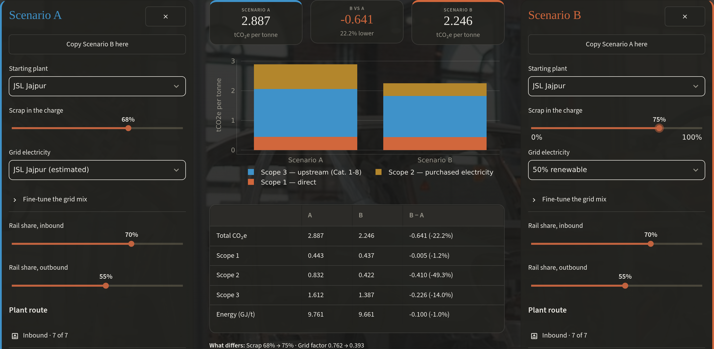

04
PROPOSED SOLUTION
CarbonSpark closes the loop from choice to carbon
Measure
Explore
Compare
Optimise
Act
Dashboard: tonne by scope, department, gas
Drag scrap, grid, rail, route. The readout follows
Two full plans side by side, per-scope deltas
Exact lowest-carbon plan at 3 ambition levels
A ranked, written action plan with the limits
WHAT'S NEW SINCE ROUND 1
Coefficients recalibrated. Jajpur Scope 1+2 now 1.28 vs JSL's disclosed 1.76, was 3.19
Sourced JSL Jajpur and Hisar site profiles
Exact optimiser: 8-corner search, ~15 ms
Savings waterfall that adds up exactly
Written review of the current choices
Compare view, photo-led inputs, light/dark
Compare, live: Jajpur today vs 75% scrap on a 50% renewable grid, −0.641 t/t (−22.2%)
Notes:
The solution as a loop rather than a list of screens. Measure, explore, compare, optimise, act. Each step is one view of the tool, and the output of the last feeds the next decision. The screenshot is Compare with a real what-if: Jajpur today against a plan with 75% scrap and a 50% renewable grid, which is 22% lower. Right column is what changed since Round 1. The most important change is accuracy: the model now reconciles with JSL's own disclosed intensity.

Slide 6
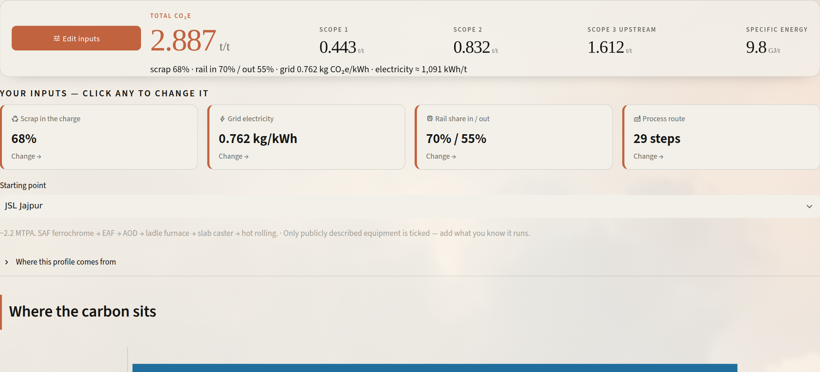
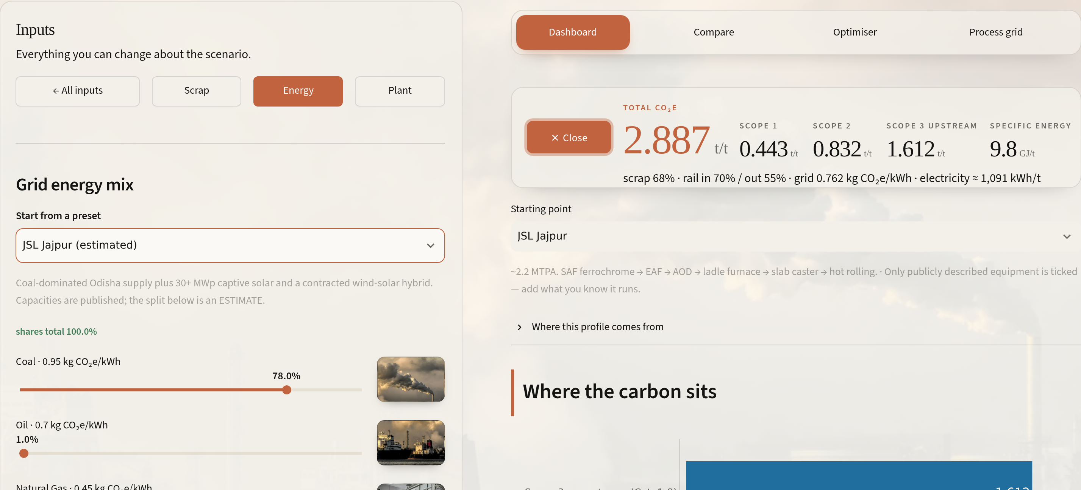
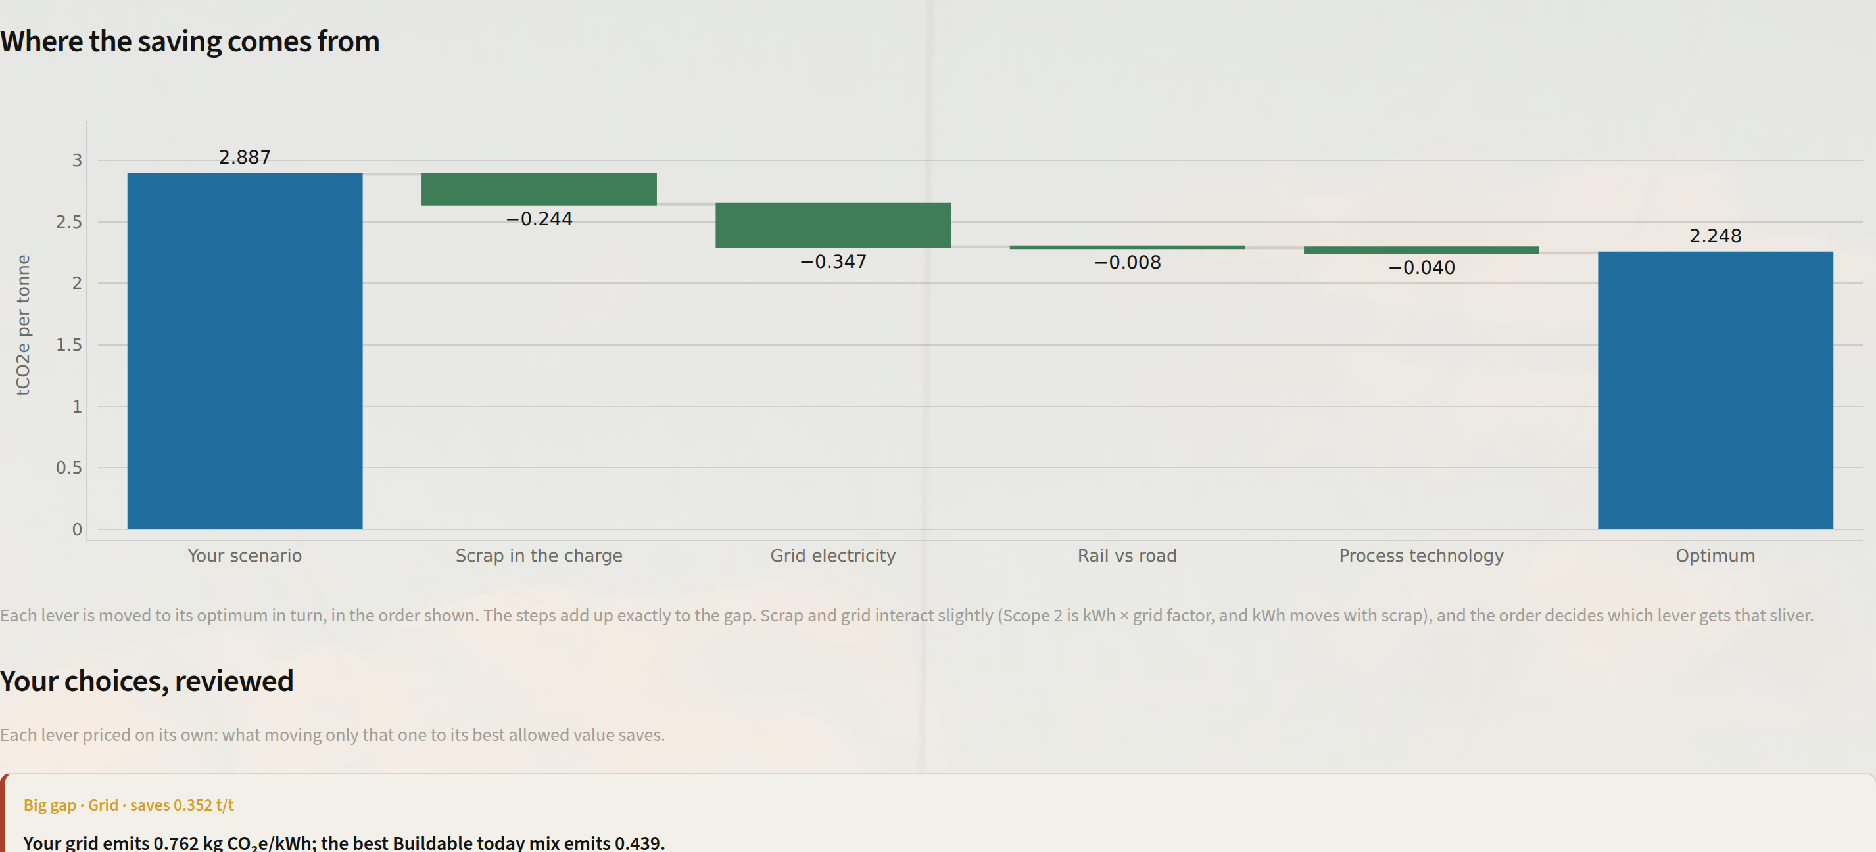
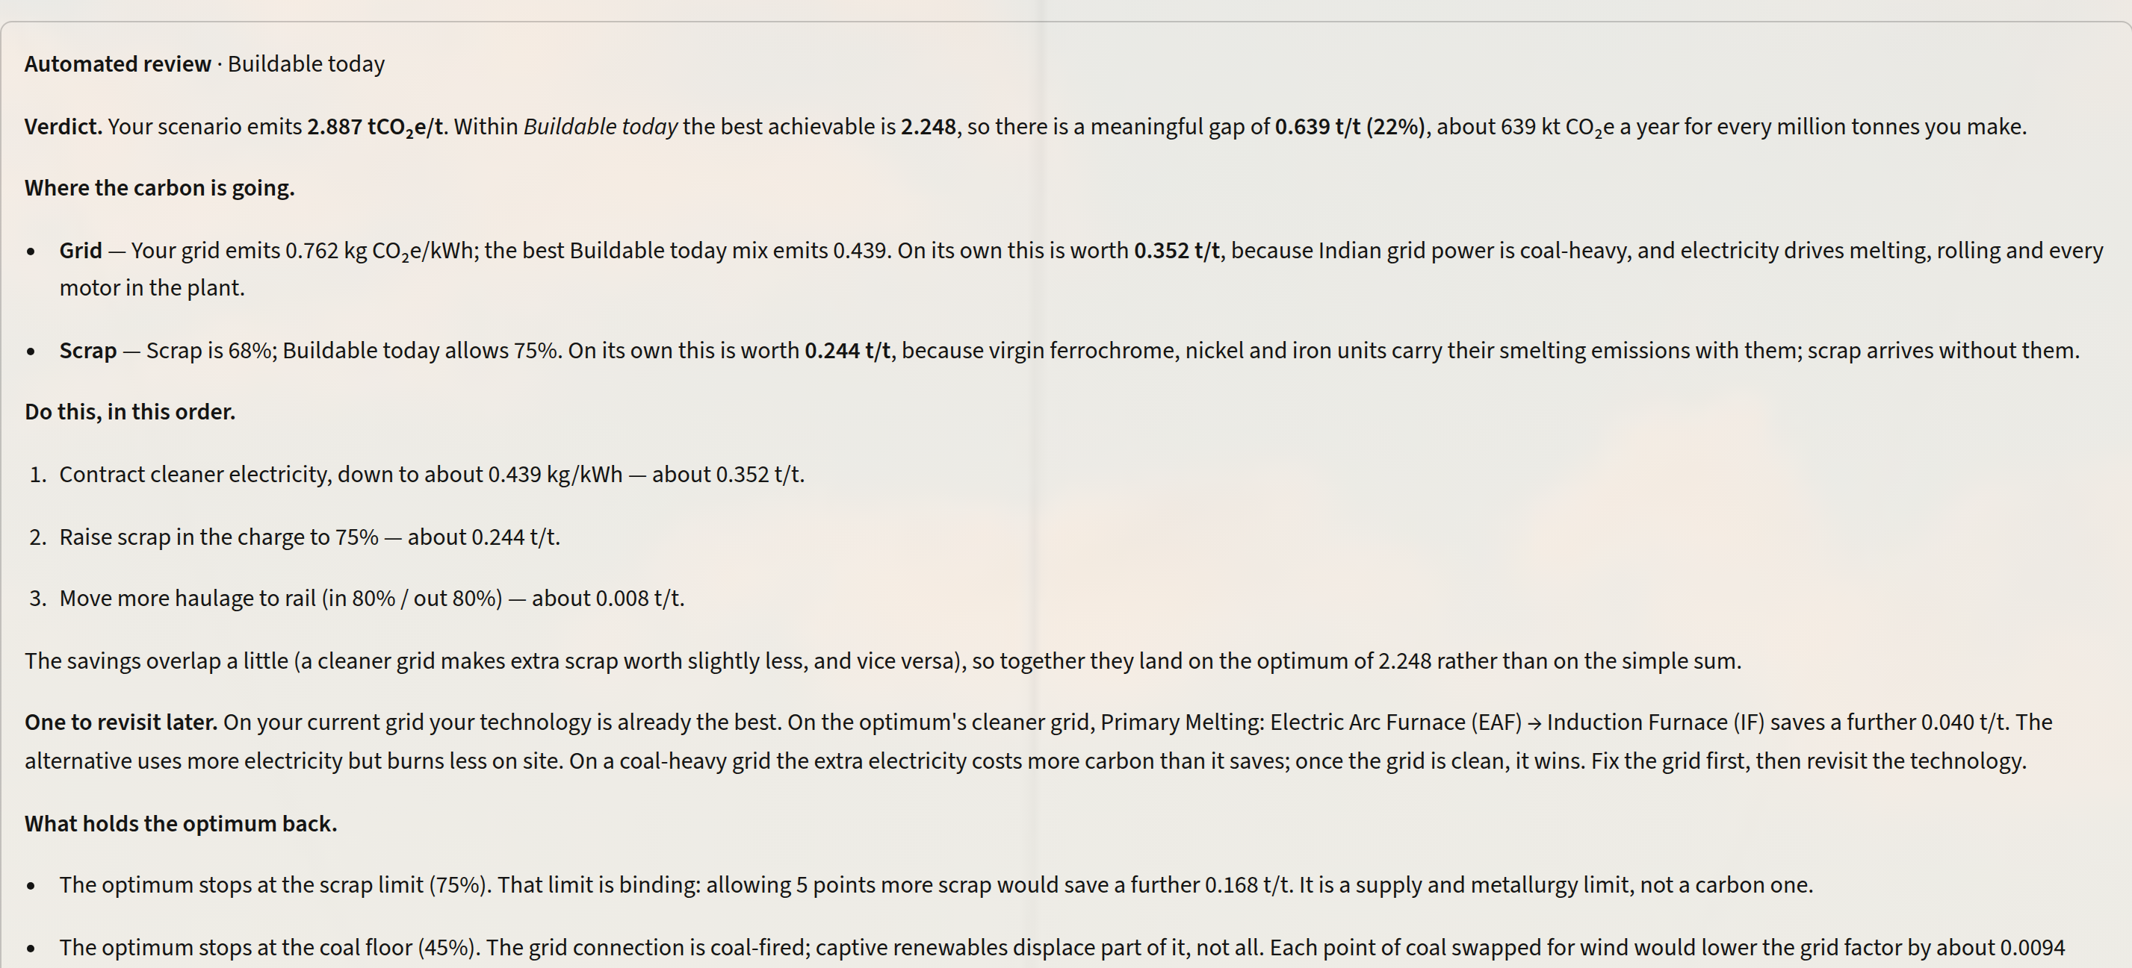
05
PROPOSED SOLUTION · WALKTHROUGH
A planner's five minutes with CarbonSpark
0:00
0:40
Open on the plant
Drag the grid
Jajpur profile loads: 2.887 t/t, split by scope, the four inputs ready to change.
Seven sources, each with its factor. Scope 2 moves as the slider moves.
2:00
3:30
Ask for the best buildable plan
Read the plan
Optimum 2.248 t/t. The waterfall shows grid −0.347 and scrap −0.244.
Do this, in this order, and which limit binds: scrap cap 75%, coal floor 45%.
Under 4 minutes from today's number to a ranked, buildable plan. Without it, the same question means a manual run through a 67-row workbook, one lever at a time.
Notes:
A user journey instead of a feature list. In under four minutes a planner goes from today's number to a ranked, buildable plan. Every screenshot is the live tool on the Jajpur profile. The point for judges: usability is measured in minutes to a decision, not in the number of charts.

Slide 7
06
IMPLEMENTATION
A 90-day pilot at Jajpur, then every site
WEEK
0
2
4
6
8
10
12
PILOT SUCCESS =
Connect data
±5%
model vs metered Scope 1+2
meters, PPA factors, charge records
Recalibrate
< 1 min
to price any scenario (today: days)
coefficients to metered values
Planners use it
weekly what-ifs, training
≥ 1
procurement decision a month made with it
Decide with it
PPA sizing, scrap contract
2 sites
on one grid by month 6
Go / no-go
roll out to Hisar
RISKS → MITIGATION
Estimated inputs
Model drift
Adoption
Grid splits and scrap ratios are labelled as estimates in the app; metered data replaces them in weeks 0–4.
The workbook stays the single source; 47 automated tests re-derive every total.
Opens on the plant's own profile; one screen, answers in minutes.
Notes:
Feasibility as a concrete pilot. Twelve weeks at Jajpur. Weeks 0 to 4 connect the data the plant already has: shop-level energy meters, the actual PPA and DISCOM emission factors, and the melt shop's charge records. Then recalibrate, put it in planners' hands, and use it on at least one real procurement decision before a go/no-go to roll to Hisar. Pilot success criteria are on the right. The stack is open-source Python and Streamlit on one VM, so cost is not the constraint. Data access is.

Slide 8
07
IMPACT
From 2.89 to under 1: a glide path, not a guess
SCORECARD VS THE BRIEF'S CONSIDERATIONS
Consideration | How CarbonSpark answers it
Reasonable model | 67-step grid recalibrated: Scope 1+2 at 1.28 vs JSL's disclosed 1.76; 47 tests
Clear input → result | Live readout, tornado and carbon map, a waterfall that adds up exactly
Interactive, easy UI | Opens on the plant; photo-led inputs; light/dark; 4 minutes to a plan
Useful optimisation | Exact search, 3 ambition levels, A/B compare, written review
Measurable reduction | 2.887 → 2.248 t/t buildable (−22%); 1.514 stretch (−48%)
Waypoints are the optimiser's own answers: Buildable today 2.248 (2027), Stretch 1.514 (2035), Theoretical floor 0.899 (2050). Years between are interpolated for illustration.
1.8 Mt
−22%
−48%
CO₂e/yr avoided, buildable path, ~3 MTPA
per tonne within a year
per tonne on the stretch path
Every figure here can be reproduced live in the tool.
Notes:
Close on impact as a trajectory. The grey line is doing nothing; the amber line uses the optimiser's own three answers as waypoints: buildable within a year, stretch within a decade, and the physical floor by 2050. The intermediate years are drawn for illustration only. Scaled to JSL's roughly 3 MTPA, the buildable path alone is about 1.8 Mt CO2e a year. On the right, we score ourselves against the five key considerations printed in the problem statement, so the judges can check each one.

