Slide 1
Notes:
Title slide — left blank deliberately. Add team name, members, college and the problem statement title here.

Slide 2
1
PROBLEM · WHY IT MATTERS
A tonne's carbon is set by choices nobody can price
Stainless carbon per tonne is fixed by a few decisions: how much scrap goes in the charge, which electricity feeds the furnaces, how material is hauled, and which technology each stage runs. The people who make those decisions (procurement, melt shop, logistics) have no number in front of them when they make them.
THE TONNE TODAY — REFERENCE PLANT
2.887
56%
tCO₂e per tonne: EAF → AOD → LF → caster → hot strip
is Scope 3: the upstream carbon of the charge
THE GAP
The coefficients sit in an accounting workbook: 67 process steps × 11 metrics. It's built for audit, not for deciding anything.
BRSR Core, EU CBAM and India's Carbon Credit Trading Scheme all ask for per-tonne intensity, and Net Zero 2050 needs every marginal choice priced.
Levers interact. Scope 2 is kWh × grid factor and kWh moves with scrap, so ranking them one at a time can mislead.
71%
1,091
sits in the melt shop (2.04 t/t)
kWh of electricity per tonne
WHAT THE TOOL MUST DO
Price: every lever (scrap, grid mix, haulage, route) per scope, live as it is dragged.
Recommend: the lowest-carbon plan that is actually buildable, what to change first, and by how much.
Notes:
Open on the decision gap. Four choices set a tonne's carbon, and the people who make them can't see the result when they choose. The figures are from our model on a reference EAF stainless plant (EAF, AOD, ladle furnace, slab caster, hot strip; about 68% scrap on a coal-heavy grid): 2.887 tCO2e/t, 56% of it Scope 3 (the upstream carbon of ferrochrome, nickel and iron units in the charge), 71% of it in the melt shop, about 1,091 kWh per tonne. The box at the bottom is what the tool therefore has to do.

Slide 3
2
INSIGHTS · WHAT THE MODEL TELLS US
Two levers carry the tonne, and order matters
1
Each point of scrap ≈ 35 kg CO₂e/t
Virgin ferrochrome, nickel and iron units bring their smelting emissions with them. Scrap is a carbon lever, not only a cost one.
2
Each 0.1 kg/kWh off the grid ≈ 0.11 t/t
At 1,091 kWh/t, a PPA decision is worth as much as a metallurgical one. It's the largest buildable gap.
3
Technology comes last
Switching furnace or decarburiser route is worth 0.04 t/t at most, and only once the grid is cleaner. Fix charge and power first.
Levers priced one at a time from the reference plant today. Scrap capped at 75%, coal held at 45% or more.
FRAMEWORK
GHG Protocol
Linear structure
Abatement order
4
Rail vs road is under 1%
Scope 1 · 2 · 3 (Cat. 1–8) kept separate; gases never double-counted
every metric is linear in scrap share, so the optimum is at a corner
price each lever alone, then walk the sequence so savings add exactly
Only 0.008 t/t is available. Put that capex into power and scrap instead.
Notes:
Insights come from sweeping the model, not from opinion. Left: holding the reference plant's grid and route fixed, scrap from 40% to 100% takes the tonne from 3.86 to 1.77. That's a straight line at about 35 kg per percentage point, because Scope 3 of the charge is linear in scrap. Middle: each lever moved on its own to its buildable limit. The grid is the biggest buildable gap (0.352 t/t), then scrap (0.244). Technology and rail are small. Levers also interact (Scope 2 is kWh times grid factor, and kWh moves with scrap), which is why the optimiser searches them jointly and the waterfall walks them in a fixed order.

Slide 4
3
INSIGHTS · VALIDATION
The model, checked against the real world
METRIC — REFERENCE PLANT | MODEL | PUBLIC BENCHMARK
Electricity, kWh/t | 1,091 | ~1,000–1,200 for melt-to-coil routes
EAF electricity, kWh/t | 460–650 | 450–700 typical (scrap → virgin charge)
Specific energy, GJ/t | 9.8 | ~10–15 GJ/t
Scope 1, t/t | 0.44 | ~0.4 worldstainless average
Virgin charge, tCO₂e/t | 3.2 | ferrochrome, nickel, pig iron upstream
Scrap charge, tCO₂e/t | 0.2 | Scope 3 linear in scrap share
HOW WE CHECKED IT
Stage by stage
All 67 rows benchmarked against process literature: EAF 460 kWh/t on scrap, 650 on virgin; AOD 45–60; LF 35–55; caster ~30.
Routes split
Two technologies at one stage share its tonne. Naively summing the whole grid gives an impossible 17.7 t/t.
2.89 · 2.93 · 4.04 t/t. Running every finishing line adds 1.1 t/t, so each of the 67 steps can be switched on or off.
Tested
47 automated tests re-derive every total. Formulas run through a whitelisted parser, never eval.
Notes:
Validation. A calculator is only useful if its numbers are believable, so every coefficient in the accounting grid was checked stage by stage against process literature and public benchmarks. For the reference plant (EAF, AOD, ladle furnace, slab caster, hot strip) the model gives about 1,091 kWh and 9.8 GJ per tonne, and 0.44 t/t of Scope 1, all inside published ranges. Scope 3 is driven by the charge: virgin ferrochrome, nickel and pig iron carry about 3.2 tCO2e per tonne upstream, scrap about 0.2. The chart shows why the route matters: the same model gives 2.89, 2.93 or 4.04 t/t depending on which lines run. That is why every step can be switched.

Slide 5
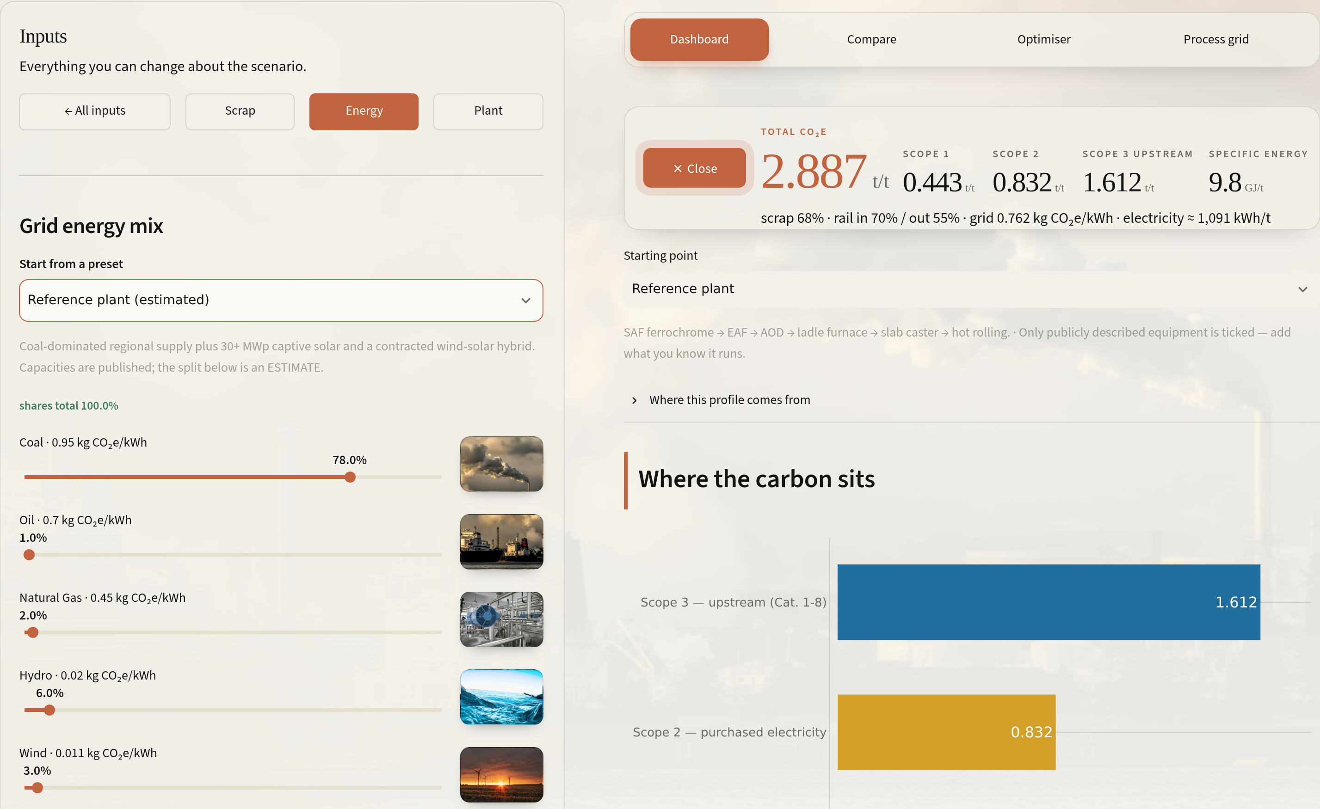





4
PROPOSED SOLUTION · THE PRODUCT
CarbonSpark: every lever on one screen, live
Dashboard
One headline tonne split into Scope 1 / 2 / 3, then by department and by gas.
Inputs drawer
Scrap share, 7-source grid mix, rail share per leg, and 67 process steps you can switch on or off.
Compare
Two plants or plans side by side, each with its own full route, per-scope deltas.
Optimiser
Lowest-carbon plan under three ambition levels, a savings waterfall, and a written review.
Database
Every formula, factor, source and calibration note, downloadable.
Inputs drawer, Energy panel: seven grid sources, each slider with its emission factor. The readout on the right updates as you drag.
Built for planners: photo-led input panels, light/dark themes, ready-made plant profiles, Compare, exact optimiser, review.
Notes:
The product. Show the drawer: every input the brief asks for (scrap vs virgin, energy source) plus the ones it doesn't: the rail/road split per leg and the full process route. Inputs are grouped into three photo-led panels. Grid mix and route edits are staged and applied in one step. There's a light and dark theme, and the tool opens on a ready-made plant profile instead of a blank form. Five views sit behind one navigation bar.

Slide 6
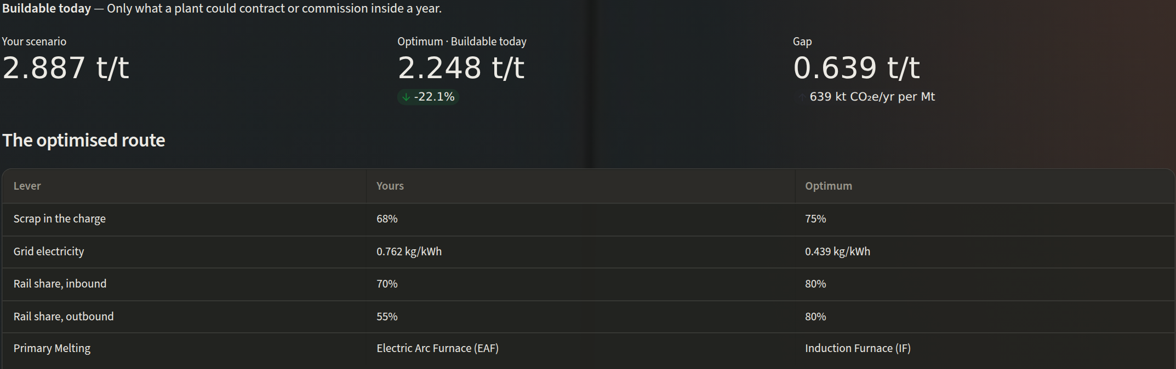
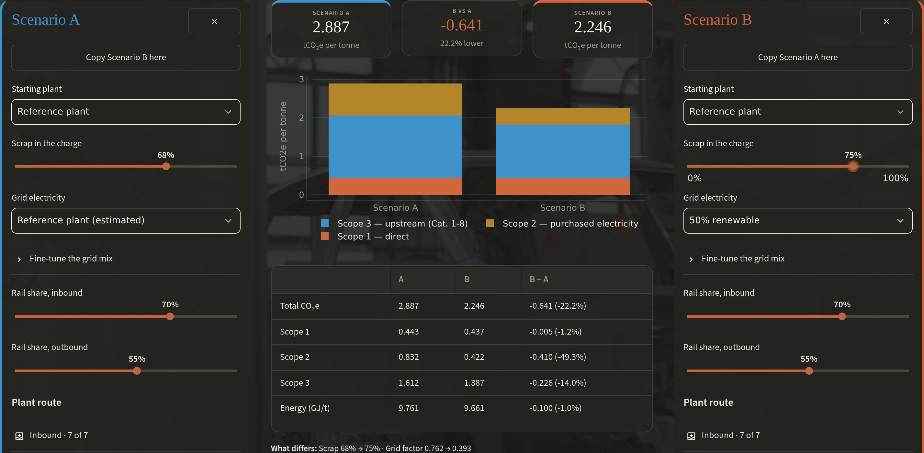
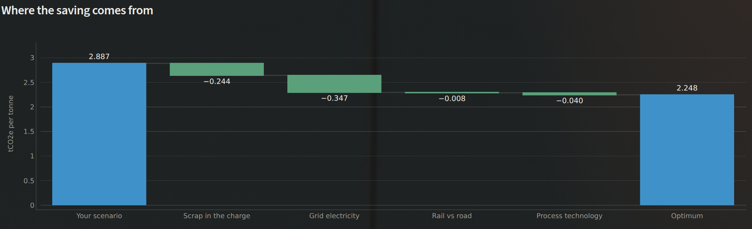
5
PROPOSED SOLUTION · FROM NUMBER TO DECISION
It doesn't just score a plan, it writes the next one
Compare: reference plant today (A) vs 75% scrap + 50% renewable grid (B) = −0.641 t/t, −22.2%.
THREE AMBITION LEVELS — REFERENCE PLANT, tCO₂e/t
2.248
1.514
0.899
Optimiser, Buildable today: the plan, and a waterfall where each lever's saving adds up exactly to the gap.
Buildable today
Stretch
Theoretical floor
≤75% scrap · coal ≥45% · no new plant
≤85% scrap · firmed RE · coal 10–30%
100% scrap · non-fossil grid
WHY TRUST THE ANSWER
Exact, not heuristic. Grid mix is solved greedily to its proven minimum. Scrap and rail are linear, so all 8 corners are checked. Each stage's technology is minimised on its own. About 15 ms.
Notes:
This is where the tool becomes a decision aid. The optimiser finds the lowest-carbon plan for the plant on screen, within an ambition level that says what can actually be bought or built. Buildable today keeps coal at 45% or more because a grid connection is coal-fired, caps scrap at 75% because stainless still needs virgin chromium and nickel, and never proposes vacuum remelting or a blast furnace. The waterfall splits the 0.639 t/t gap into scrap, grid, rail and technology, and the parts add up exactly. A written review ranks the actions and names the limits that bind. Compare lets a planner test their own alternative. The search is exact, not sampled.

Slide 7





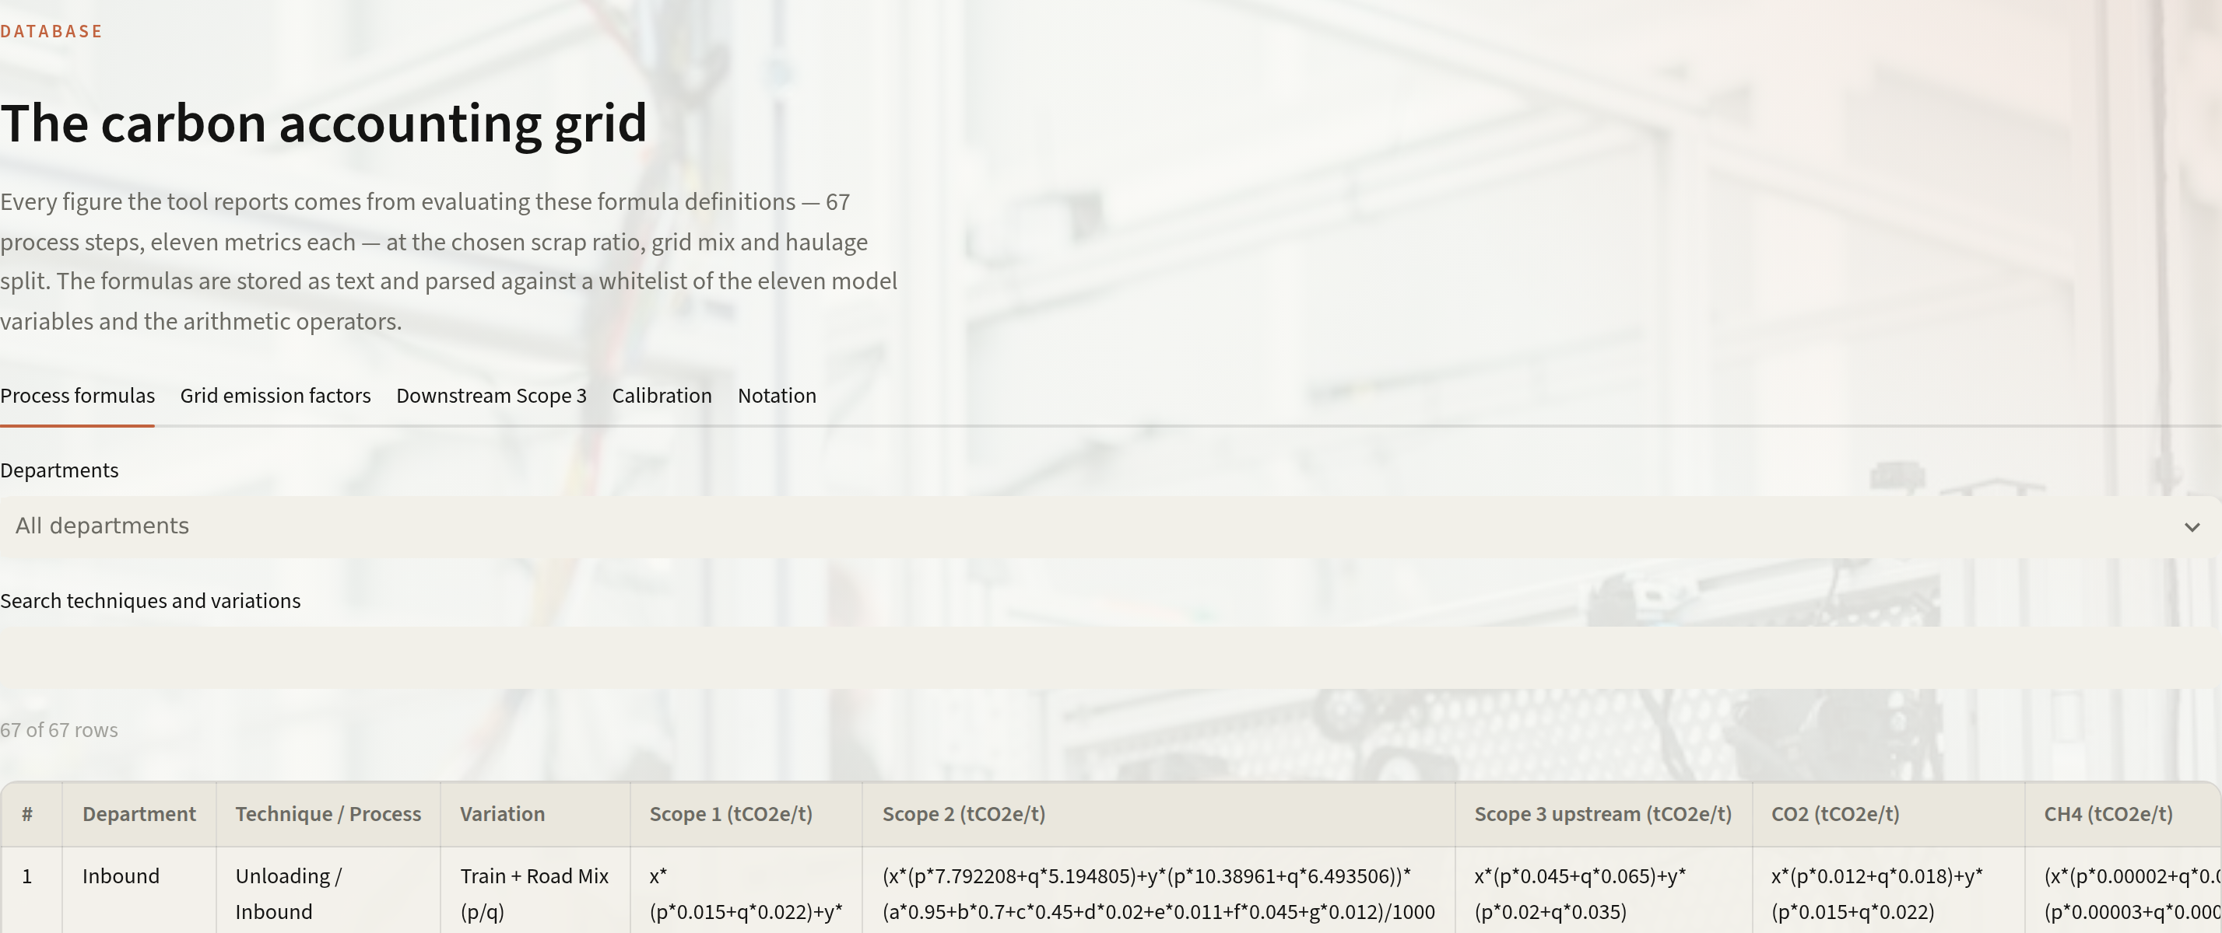
6
IMPLEMENTATION · ARCHITECTURE & ROLLOUT
Built, tested, and ready for plant data
Workbook
Extract
Safe evaluator
Model
Web app
Accounting grid .xlsx: 67 steps × 11 metrics, notes per row
→
Formulas kept as text in JSON; nothing re-typed
→
AST whitelist: 11 variables + arithmetic, no eval
→
Scope 2 = kWh × grid EF; exact corner search
→
Streamlit: 5 views, live readout, light/dark
ROLLOUT AT A PLANT
NOW
0–3 MONTHS
3–9 MONTHS
9–18 MONTHS
Prototype live
Plug in plant data
Decide with it
Scale it
Public data, two reference plant profiles, calibrated coefficients.
Shop-level kWh from energy meters, DISCOM/PPA emission factors, charge-mix records.
Size RE PPAs and scrap contracts in the optimiser. Feed BRSR Core and CBAM filings.
Per-grade and per-coil footprints for customers (EPD); every site on one grid.
47
automated tests pass, incl. full re-derivation of workbook totals
~15 ms
exact optimiser run per ambition level
Assumptions & limits. Coefficients are calibrated to published benchmarks, not metered. Site grid splits, scrap ratios and haulage are estimates, and the app labels them. That's why Phase 1 is metered data.
₹0
licences: Python, Streamlit, Plotly, one VM
Notes:
Feasibility. The workbook is the single source of truth. Formulas are kept as text and evaluated through a whitelisted parser, so an engineer can change a coefficient in Excel and the tool follows without a code change. 47 automated tests re-derive the totals. Rollout needs no new hardware: Phase 1 swaps estimates for metered shop-level electricity, the plant's actual power-contract emission factors, and charge-mix records the melt shop already keeps. Phase 2 uses it to size renewable contracts and scrap sourcing and to feed BRSR Core and CBAM reporting. Phase 3 produces per-grade footprints customers can use.

Slide 8
7
IMPACT · WHAT IT IS WORTH
639 kt CO₂e saved per Mt, using only what's buildable
639 kt
CO₂e/yr avoided per million tonnes of steel on the buildable path (0.639 t/t)
−36%
Scope 2 (0.832 → 0.529 t/t) from power procurement alone
1.37 Mt
CO₂e/yr per Mt on the stretch path, nearly half the footprint: a concrete Net Zero 2050 waypoint
Operational
Commercial
Sustainability
Any plan priced in seconds, per scope and department
At an illustrative €80/tCO₂, each 0.1 t/t cut ≈ €8 per tonne of exposure
An auditable intensity trail for BRSR Core, CBAM and customer EPDs
Totals: 2.887 → 2.248 (−22%) → 1.514 (−48%) → 0.899 (−69%).
Built on the supplied workbook · open-source stack · every figure on this slide can be reproduced live in the tool
Notes:
Close on impact. On the buildable path, only contracts and settings a plant could change within a year, the reference plant falls from 2.887 to 2.248 tCO2e per tonne, 22%. That's 639 kt CO2e a year for every million tonnes produced. The stretch path, a decade of procurement and scrap-supply work, cuts the tonne by 48% and gives Net Zero 2050 a concrete intermediate target. The carbon price is illustrative, to show how the tool turns carbon into money. Invite the judges to open the tool and change any input.

