Slide 1

AUGUSTINE
School of Humanities
ATENEO DE MANILA UNIVERSITY
(354-430 AD)

Slide 2
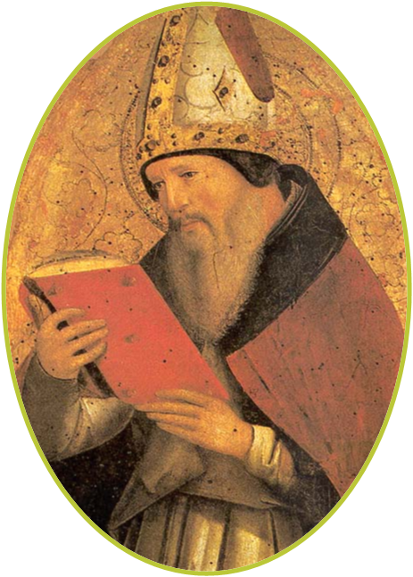
Doctor of the Church
‘a great sinner who became an even greater saint’
School of Humanities
ATENEO DE MANILA UNIVERSITY

Slide 3
CENTRALITY OF GOD IN AUGUSTINE’S PHILOSOPHY
True philosophy is a confluence of faith and reason. Authentic wisdom is Christian wisdom.
Reason needs revelation.
Man possesses a spiritual destiny so he must be
considered from the viewpoint of Christian faith.
School of Humanities
ATENEO DE MANILA UNIVERSITY

Slide 4
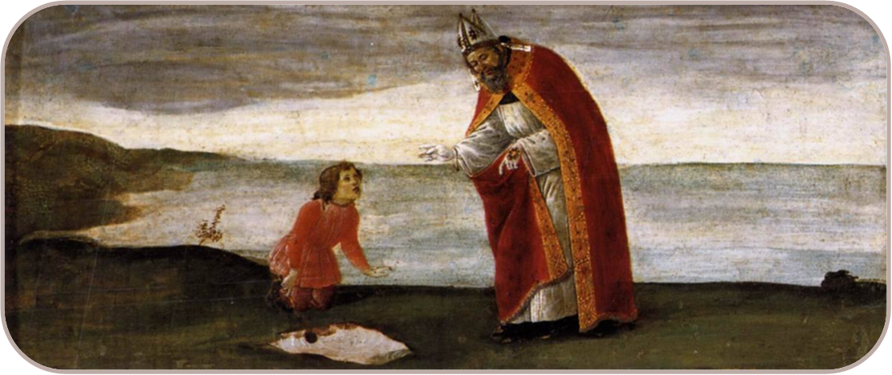
“Only when God by His grace illuminates the mind can it grasp the truth.”
Doctor of Grace
School of Humanities
ATENEO DE MANILA UNIVERSITY

Slide 5
Every philosophical notion culminates in morality or in clarifying for man the sure road to happiness which is
the goal of human behavior.
HUMAN KNOWLEDGE | NATURE OF GOD | DOCTRINE OF CREATION
School of Humanities
ATENEO DE MANILA UNIVERSITY

Slide 6
THE MORAL QUEST AND THE HUMAN CONDITION
The moral quest of man is the inevitable outcome of his specific and concrete condition. His condition is that he is made in such a way
that he seeks happiness.
a novel estimate of what constitutes happiness and just how it is to be achieved
School of Humanities
ATENEO DE MANILA UNIVERSITY

Slide 7
Augustine, The Love of God
“…Where there is no true religion there are no true virtues. For though the soul may seem to rule the body admirably, and the reason the vices, if the soul and reason do not themselves obey God, as God has commanded them to serve Him, they have no proper authority over
the body and the vices.”
School of Humanities
ATENEO DE MANILA UNIVERSITY

Slide 8
Happiness requires of man to go beyond the natural to the supernatural.
Augustine, Confessions
“Oh God Thou hast created us for Thyself so that our hearts are restless until they find their
rest in Thee.”
School of Humanities
ATENEO DE MANILA UNIVERSITY

Slide 9
Augustine, The Love of God
“The actual possession of the happiness of this life, without the hope of what is beyond, is but a false happiness and profound misery. For the true blessings of the soul are not now enjoyed; for that is no true wisdom which does not direct all its prudent observations, manly actions, virtuous self-restraint, and just arrangements, to that end in which God shall
be all and all in a secure eternity and perfect peace…”
School of Humanities
ATENEO DE MANILA UNIVERSITY

Slide 10
It is not by accident that man seeks happiness.
Man seeks happiness as a consequence of his
incompleteness or his finitude.
It is no accident that man can find happiness only in God since he was made by God to find
happiness only in God.
School of Humanities
ATENEO DE MANILA UNIVERSITY

Slide 11
THE ROLE OF LOVE
Man inevitably loves.
To love is to go beyond oneself and to fasten
affection upon an object of love.
What makes it inevitable that man will love is
his incompleteness.
School of Humanities
ATENEO DE MANILA UNIVERSITY

Slide 12
All things in the world are good because all
things come from God, who is goodness itself.
All things are legitimate objects of love.
School of Humanities
ATENEO DE MANILA UNIVERSITY

Slide 13
Everything that man loves will provide him with some measure of satisfaction and happiness.
Everyone expects to achieve happiness and fulfillment from love yet men are miserable,
unhappy, and restless.
School of Humanities
ATENEO DE MANILA UNIVERSITY

Slide 14
The moral problem of man consists not so much in loving or even in the objects he loves as in the manner in which he attaches himself to his objects of love and in his expectations regarding the
outcome of his love.
Each object of love is different and for this reason the consequences of loving them will be different.
School of Humanities
ATENEO DE MANILA UNIVERSITY

Slide 15
Augustine, The Love of God
“All things were made good, but not being made perfectly good, are liable to corruption: All things that exist, therefore, seeing that the Creator of them all is supremely good, are themselves good. But because they are not, like their Creator, supremely and unchangeably good, their good
may be diminished and increased.”
School of Humanities
ATENEO DE MANILA UNIVERSITY

Slide 16
Each object of love can give only so much satisfaction and no more.
Satisfaction requires that an object of love contain a sufficient amount of whatever it
takes to satisfy the particular need.
School of Humanities
ATENEO DE MANILA UNIVERSITY

Slide 17
Although each thing is a legitimate object of love, one must not expect more from it than its
unique nature can provide.
The basic need for human affection cannot be satisfied by things.
School of Humanities
ATENEO DE MANILA UNIVERSITY

Slide 18
“When the will which is the intermediate good, cleaves to the immutable good... man finds therein the blessed life, for to live well is nothing
else but to love God…”
To love God is, then, the indispensable requirement for happiness, because only God, who is infinite, can satisfy that peculiar need in
man that is precisely the need for the infinite.
School of Humanities
ATENEO DE MANILA UNIVERSITY

Slide 19
If things cannot substitute for a person, neither can
any finite thing or person substitute for God.
All men confidently expect that they can achieve true happiness by loving objects, other persons, and themselves.
DISORDERED LOVING
School of Humanities
ATENEO DE MANILA UNIVERSITY

Slide 20
Disordered love consists in expecting more from an object of love more than it is capable
of giving.
Disordered love produces all forms of pathology in human behavior.
School of Humanities
ATENEO DE MANILA UNIVERSITY

Slide 21
The rigorous and persistent fact is that personal reconstruction is possible only by reordering love
or by loving the proper things properly.
We can love a person properly only if we love God first for then we will not expect to derive from human love what can be derived only from our
love of God.
School of Humanities
ATENEO DE MANILA UNIVERSITY

Slide 22
FREE WILL AS THE CAUSE OF EVIL
The cause of moral evil is man himself by his choice of evil, for unless the will chooses evil it
cannot do evil.
Evil can be the result of an inordinate love of something that is good in itself. Attachment to a particular good leads man to disregard the greater
good.
School of Humanities
ATENEO DE MANILA UNIVERSITY

Slide 23
Evil, or sin, is a product of the will. It is neither ignorance nor the work of the principle of
darkness permeating the body.
Man needs divine grace in order to be good and to direct his love to its proper object.
School of Humanities
ATENEO DE MANILA UNIVERSITY

Slide 24
FREEDOM OF THE WILL
LIBERUM ARBITRIUM
LIBERTAS SPIRITUALIS
freedom of choice
spiritual liberty
Man does not will the good and when he does he cannot do the good that he wills.
School of Humanities
ATENEO DE MANILA UNIVERSITY

Slide 25
Man now uses his free will to choose wrongly.
Even when man chooses rightly he does not possess the spiritual power to do the good he
has chosen.
Man needs the grace of God to do good.
School of Humanities
ATENEO DE MANILA UNIVERSITY

Slide 26
Bonnie Kent, “Augustine’s Ethics”
As Augustine emphasizes what we are able to do with God’s grace, so he emphasizes what we are unable to do on our own, thanks to the nature we share with Adam. On the one hand, the nature created in Adam, endowed with the power of free choice, makes all human beings moral agents…. On the other hand, we all sinned ‘in Adam,’ so that we now suffer the consequences: the inability to be good without God’s
grace.
School of Humanities
ATENEO DE MANILA UNIVERSITY

Slide 27
Whereas evil is caused by an act of free will, virtue, on the other hand, is the product not of man's will but of
God's grace.
The moral law tells man what he must do but in the
end it really shows him what he cannot do.
“The law was given that grace might be sought; grace was given that the law might be fulfilled.”
School of Humanities
ATENEO DE MANILA UNIVERSITY

Slide 28
Bonnie Kent, “Augustine’s Ethics”
“Where ancient philosophers typically regard habit as the genus of virtue, Augustine tends to regard it as the enemy of virtue. .. Character depends on the will, by which one might break the bonds of habit and turn away from one’s own past. Hence the importance of conversion, the ‘turning around’ that marks the
decisive moment in a Christian’s life.”
School of Humanities
ATENEO DE MANILA UNIVERSITY

