Slide 1

IT DEPARTMENT
Arnel Endaya
IT Supervisor

Slide 2
Day 1
To understand the role of IT as part of the support group and how it affects the operation
To enable the trainees to learn the importance of Technology modernization for business continuity and flexibity
To Learn how to analyze IT requirements of each business unit or company

Slide 3
GOALS AND OBJECTIVES:
Provide reliable IT support and services through technology modernization, computerization and business process automation while reducing the operational cost of IT.

Slide 4
OUR ROLES AND FUNCTION:
Provide Technical Support
Maintain and Administer IT Services
Network & Security and administration
Technology Updates/Modernization

Slide 5
COMPONENTS OF IT:
Technical Support
Systems and Application Support
Network Support
Server Administration & Support

Slide 6
IT SUPPORT:
IT Support Process Flow
Start
Submits
requests
Submits
the request to
Requestor
Helpdesk
Department Admin
routes the
requests to
Ticket Handler
will process the ticket and complete the job
End
Update the requestor
Closing the ticket
Ticket Processing

Slide 7
IT SUPPORT:
PRF Process Flow
Requestor
IT
Purchasing
Start
Process PRF
Approval
Hardware Specifications
Quotation
Item Checking
Delivery
Purchase Order (PO)
Confirmation
Approval of Budget
Transfer to Dealership
Fixed Asset
End

Slide 8




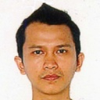



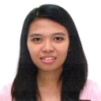
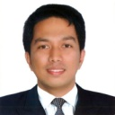
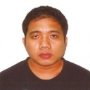
IT SUPPORT:
Christine P. Chua
VP - Administration
Gary F. Durias
IT - Head
4
Arnel Endaya
IT Supervisor
Germel Danganan
Network Admin
MGM
Regiemhel Ariston
Network Admin
BUA/HGC
Paul Dames
KLASSIK MOTORS
Harvey Charles Chua
GCASI
Kristine Montero
IT Assistant
Psalm Mazon
IT Assistant
Christian Cadag
Server Administrato
Alvin Lozano
IT Assistant
8
IT Policy Orientation
By: MIS™

Slide 9
TYPES OF IT SERVICES:
Domain Controller
File Server
Mail Server
Database Server
Application Server
Backup System
Telephone System / Call Accounting

Slide 10
Day 2
To gain knowledge on how Autohub Group work as one big network

Slide 11
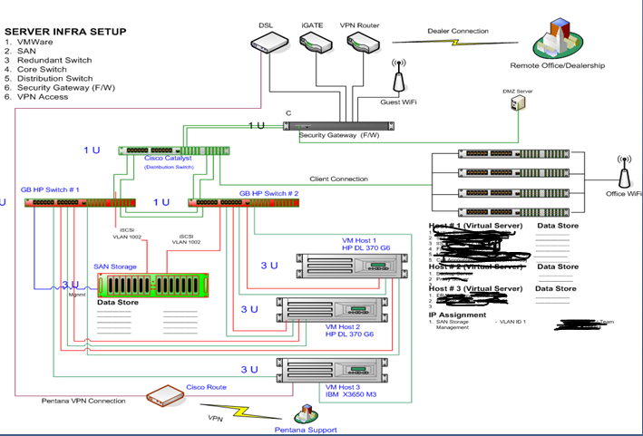
IT INFRA SERTUP:

Slide 12
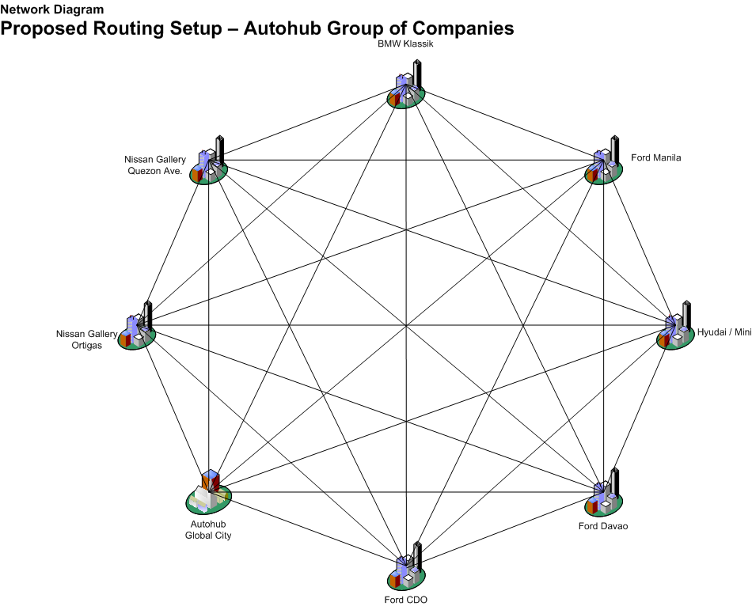
IT INFRA SERTUP:

Slide 13
NETWORK SERVICES:
ROUTERS
DSL CONNECTION (PLDT, Globe, BTel)
FIREWALL

Slide 14
Day 3
To enable the trainees to identify the key areas in setting up and in maintaining the IT infrastructure

Slide 15
Presentation of Business Plan

Slide 16
Day 4
To enable the trainees to understand the different types of support and techniques in handling customers concerns

Slide 17
Review of process in Customer
handling

Slide 18
Day 5
To enable the trainees to monitor and analyze current operation and utilization of IT services and the performance of IT equipment for business continuity

Slide 19
Actual Presentation of Services
And process in monitoring each
services

Slide 20
Day 6
To enable the trainees to discuss the overall picture of Autohub IT infra setup, it’s importance to business operation and the lacking in the existing setup of Autohub Group

Slide 21
Gap analysis, Feed backing
and open discussion
(question and answer portion)

Slide 22
Written Exam
Components of IT Support Group
Importance of System Monitoring
Roles or Function of IT as part of Support Group
Difference of each role or function
Significance of Technology Modernization in Autohub
How to improve the IT Department to help the company?
Objective of IT Support Group
Your Suggestion to improve the process in the IT department
Your observation based on the Setup, Process and Data Security
What is important in business continuity if all systems breaks down?
Types of IT Services maintained by Autohub

