Slide 1

THOMAS AQUINAS
School of Humanities
ATENEO DE MANILA UNIVERSITY
(1225-1274)

Slide 2
Prayer Before Study
Creator of all things, true Source of Light and Wisdom, lofty Origin of all Beings, graciously let a ray of Your brilliance penetrate into the darkness of our understanding and take us from the darkness in which we have been born. Grant us the talent of being precise in our explanations and the ability to express ourselves with caution and charm. Point out the beginning, direct the progress, and help in the completion of our study through Christ our Lord. Amen.
Saint Thomas Aquinas
School of Humanities
ATENEO DE MANILA UNIVERSITY

Slide 3
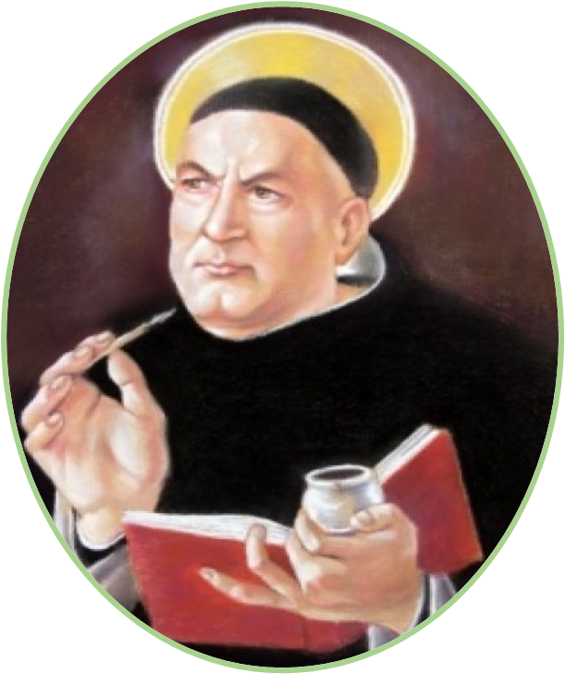
Doctor Angelicus
Philosopher and Theologian, Doctor of the Church
Patron of Catholic Schools
School of Humanities
ATENEO DE MANILA UNIVERSITY

Slide 4
“He will enter the Order of Friars Preachers, and so great will be his learning and sanctity that in his day no one will be found to equal him.”
LANDULPH | THEODORA
Count of Aquino | Countess of Teano
His family was related to the Emperors Henry VI and Frederick II, and to the Kings of Aragon, Castile, and France.
School of Humanities
ATENEO DE MANILA UNIVERSITY

Slide 5
“When his brothers wanted to prevent him from becoming a Dominican… they captured him as he was on his way to Paris and shut him up in the family castle; then, to get the crazy notions out of his head and turn him into a respectable abbé, they sent a naked girl, ready and willing, into his room. And Thomas grabbed a firebrand and started running after her, clearly
meaning to burn her buttocks…
Umberto Eco, “In Praise of Thomas Aquinas”
School of Humanities
ATENEO DE MANILA UNIVERSITY

Slide 6
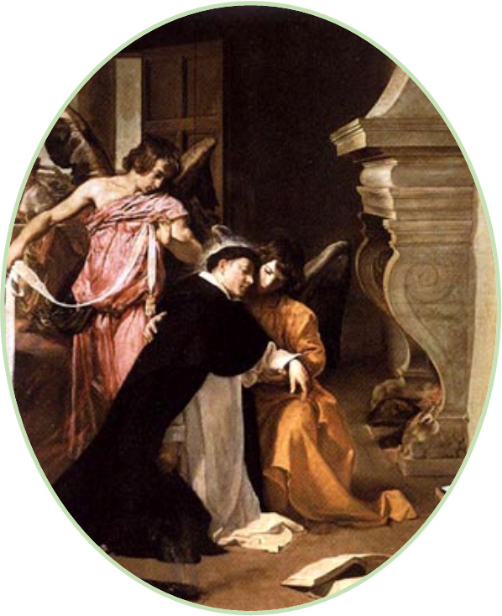
“We gird thee with the girdle of perpetual virginity.”
School of Humanities
ATENEO DE MANILA UNIVERSITY

Slide 7
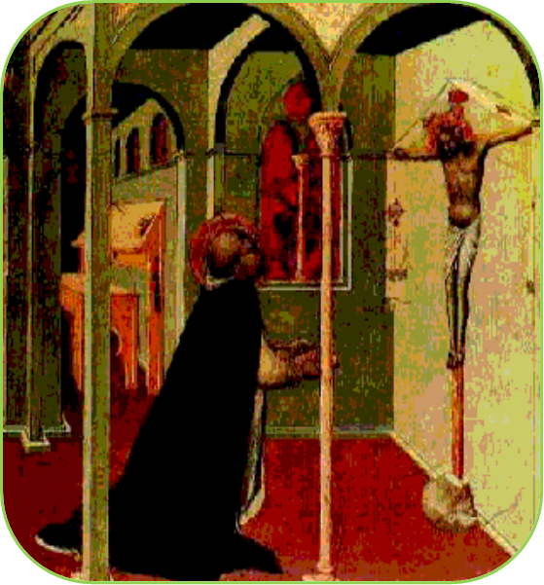
“I can do no more. Such secrets have been revealed to me that all I have written now appears to be of little value.”
“Thou hast written well of me, Thomas; what reward wilt thou have?” Thomas replied, “None other
than Thyself, Lord.”
School of Humanities
ATENEO DE MANILA UNIVERSITY

Slide 8
Morality is the quest for happiness.
Happiness is closely associated with the end or purpose of man.
To achieve happiness man must fulfill his purpose.
School of Humanities
ATENEO DE MANILA UNIVERSITY

Slide 9
ARISTOTLE
envisioned a naturalistic morality through which men could achieve virtue and happiness by fulfilling their
natural end
THOMAS AQUINAS
added the doctrine of the supernatural end of man and proposed a double level of morality corresponding to the dual ends of man
School of Humanities
ATENEO DE MANILA UNIVERSITY

Slide 10
Human nature has its source and ultimate end in God.
Human nature does not contain its own standard of fulfillment.
It is not enough for man to be simply a man and to exercise his natural functions and abilities in
order to achieve perfect happiness.
School of Humanities
ATENEO DE MANILA UNIVERSITY

Slide 11
“Due to its potentiality and openness, the human soul is oriented to become actualized and fulfilled by something else. This ‘something else’ cannot consist in something limited and particular because of the universality of human striving… [N]ot one created good is in a position to fulfill wholly the infinite striving of the human being…. Due to its infinity, human striving cannot come to rest in creation, therefore, ‘Human
happiness consists in God alone.’”
Georg Wieland, “Happiness,” The Ethics of Aquinas
School of Humanities
ATENEO DE MANILA UNIVERSITY

Slide 12
THE ROLE OF THE WILL
“At the heart of [his] ethics lies the will. Moral acts are willed acts. Where the will does not operate, action has no moral quality whatsoever and falls back into the category of mere natural activity. And even in moral actions, external acts have a moral quality only because they have been commanded by the will. Thus moral goodness is
located first and foremost in the will.”
David M. Gallagher, “The Will and Its Acts”
School of Humanities
ATENEO DE MANILA UNIVERSITY

Slide 13
A person is said to be good or bad simply or morally, on the basis of his will, for it is through the will that everything else in the person is
used well or badly.
Moral action is willed action and morally good action arises from a good will.
School of Humanities
ATENEO DE MANILA UNIVERSITY

Slide 14
THE NATURE OF THE WILL
the power or faculty of the soul by which a human agent is in control of his actions
“To have control means that when the person acts, it is possible to act otherwise or not to act at all. This mode of acting is contrasted to the mode of nature in which an agent is determined to act in only one way and cannot do otherwise than it
does…”
David M. Gallagher, “The Will and Its Acts”
School of Humanities
ATENEO DE MANILA UNIVERSITY

Slide 15
The will is the power of choice.
The full range of appetites seeks to be satisfied and in man the process of satisfaction requires that choices be made between alternatives. The choice must be made by the will under the
direction of reason.
If the right choices are made, a person achieves happiness.
School of Humanities
ATENEO DE MANILA UNIVERSITY

Slide 16
FREEDOM OF THE WILL
“If there is nothing free in us but we are moved necessarily to will, then we destroy deliberation, exhortation, precepts and punish-ments, and praise and blame, the very things with which moral
philosophy deals.”
David M. Gallagher, “The Will and Its Acts”
School of Humanities
ATENEO DE MANILA UNIVERSITY

Slide 17
FREEDOM OF THE WILL
The will is the power that inclines man toward the achievement of the good. The good is the will’s natural inclination.
The will, while naturally determined to the good in general, is not determined by nature to any of the particular goods.
With respect to them it remains free.
School of Humanities
ATENEO DE MANILA UNIVERSITY

Slide 18
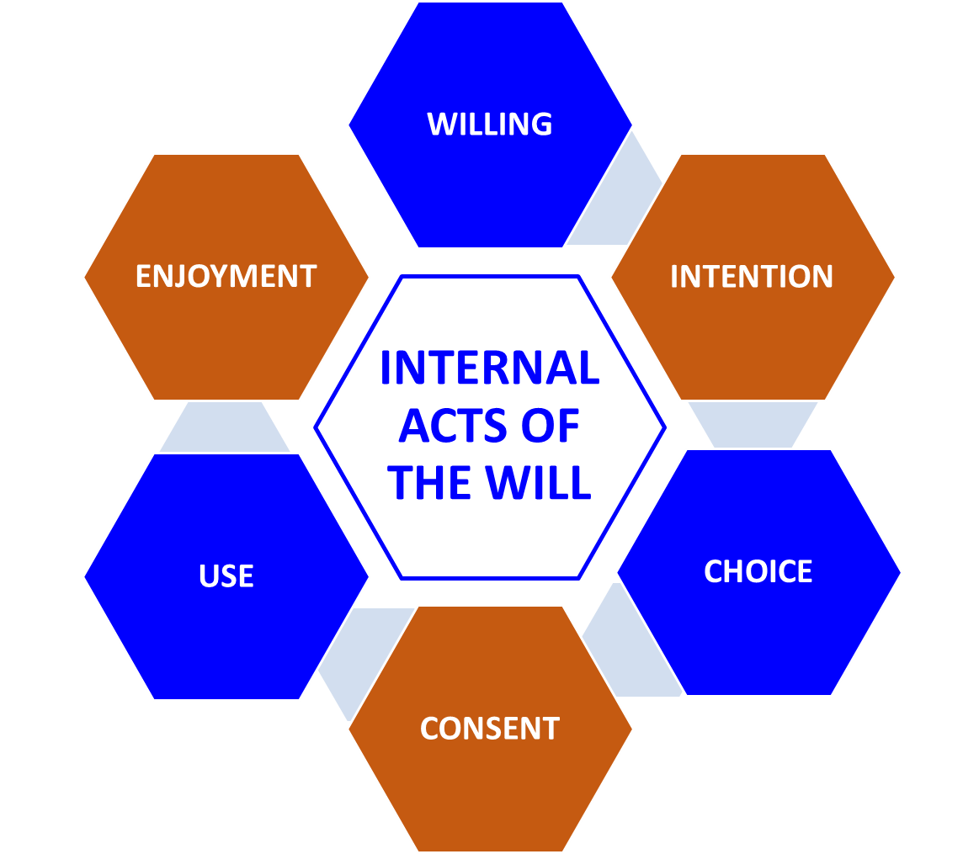
School of Humanities
ATENEO DE MANILA UNIVERSITY

Slide 19
IMPERFECT ENJOYMENT
when the good is not possessed in reality but only in intention or as desired
when the good possessed is not the final end but only some means
School of Humanities
ATENEO DE MANILA UNIVERSITY

Slide 20
PERFECT ENJOYMENT
Perfect enjoyment occurs when
the final end is really possessed.
Enjoyment in the fullest sense will occur only with the possession of
the last end, God, in the next life.
School of Humanities
ATENEO DE MANILA UNIVERSITY

Slide 21
THE MORAL CONSTITUTION OF MAN
The moral constitution of man consists of sensuality, appetites,
the will, and reason.
What confers upon man the attributes of morality is that these elements are the ingredients of
free acts.
School of Humanities
ATENEO DE MANILA UNIVERSITY

Slide 22
If a man were moved to act by his appetites in a mechanical or rigorously determined way, his acts would not be free and could not be considered from a
moral point of view.
School of Humanities
ATENEO DE MANILA UNIVERSITY

Slide 23
Not only is freedom a prerequisite for an act to be considered moral. An
act is human only if it is free.
Freedom is possible where there is knowledge of alternatives and the
power of the will to make choices.
School of Humanities
ATENEO DE MANILA UNIVERSITY

Slide 24
Not every choice is correct. The will by itself cannot always make the right move. Reason or the intellect
must serve as its guide.
When the intellect directs the will, it
helps the will to choose the good.
School of Humanities
ATENEO DE MANILA UNIVERSITY

Slide 25
THE MORAL LAW
⇒
INTELLECT
⇒
WILL
⇒
ACTION
School of Humanities
ATENEO DE MANILA UNIVERSITY

Slide 26
The virtues of the natural man are achieved when the appetites are duly controlled by the will and
reason.
The natural end of man is further realized through his knowledge of
the natural or the moral law.
School of Humanities
ATENEO DE MANILA UNIVERSITY

Slide 27
Law is a dictate of practical reason for the common good promulgated by one who has care of the community. A supposed law that lacks any of these four criteria
is not a genuine law.
Coercion is not of the essence of law but coercion by threat of sanction is necessary because not all subjects will readily listen
to the law.
Clifford G. Kossel, “Natural Law and Human Law”
School of Humanities
ATENEO DE MANILA UNIVERSITY

Slide 28
ETERNAL |  |  |  |  | NATURAL
 |  |  | KINDS OF LAW
HUMAN |  |  |  |  | DIVINE
School of Humanities
ATENEO DE MANILA UNIVERSITY

Slide 29
The ETERNAL Law
“There are things which can be known about God and creatures by… an examination of the world of experience… that God exists and is intelligent and loving… that He cares for, plans (providentia), and governs (gubernatio) the being and activity of the universe and
of every creature…”
Clifford G. Kossel, “Natural Law and Human Law”
School of Humanities
ATENEO DE MANILA UNIVERSITY

Slide 30
The ETERNAL Law
the ruling idea which exists in the eternal mind the design or plan viewed as the ruling principle of all the activities of creation
DIVINE PROVIDENCE
LAW OF NATURE
School of Humanities
ATENEO DE MANILA UNIVERSITY

Slide 31
The very idea of the governance of things existing in the Divine mind has the nature of law, and since divine reason transcends time, this conception must be eternal. And this plan looks principally to the order of the whole to its common good. Eternal law is comprehensive; it applies to the move-ment of all creatures, rational or irrational,
but in different ways.
Clifford G. Kossel, “Natural Law and Human Law”
School of Humanities
ATENEO DE MANILA UNIVERSITY

Slide 32
The NATURAL Law
the portion of the eternal law that pertains particularly to man and consists of broad general principles that reflect the divine intentions for man
the participation in the eternal law by the rational creatures
School of Humanities
ATENEO DE MANILA UNIVERSITY

Slide 33
[Man] is under divine providence in a more excellent way… as it shares in divine providence by exercising providence for itself and others… participates actively in the eternal reason from which it receives its natural inclination to its own appropriate acts and end. This participation in the eternal law is called natural law…. This does not exclude free choice, but it does insist that underlying free acts there is some natural
determination and necessity.
Clifford G. Kossel, “Natural Law and Human Law”
School of Humanities
ATENEO DE MANILA UNIVERSITY

Slide 34
PRECEPTS OF THE NATURAL LAW
“Good is to be pursued and evil avoided.”
as a being | as an animal | as rational
preservation of life | propagation of species | propensity for truth
School of Humanities
ATENEO DE MANILA UNIVERSITY

Slide 35
preservation of life | propagation of species | propensity for truth
“The particular goods come under deliberation and choice. They oblige only when reason sees them as necessary or appropriate to the ultimate end. The negative imperative (avoid the contrary evils) obliges in every action. One is not required to pursue these goods in every action but only at the right time, place, and so on, according to a reasonable order determined by the judgment of prudence. They constitute the horizon of reasonable goals for practical reason in ordering
human living.”
Clifford G. Kossel, “Natural Law and Human Law”
School of Humanities
ATENEO DE MANILA UNIVERSITY

Slide 36
Morality is not an arbitrary set of rules for behavior.
The basis of moral obligation is found in the very nature of man.
School of Humanities
ATENEO DE MANILA UNIVERSITY

Slide 37
Although the ‘common’ principles of natural law cannot be abolished from the mind as universals, they may be eliminated in a particular action because reason may be impeded from applying the universal principle to the particular action by
some passion.
BAD BELIEFS malae persuasiones | EVIL CUSTOMS parvas consuetudines | CORRUPT HABITS habitus corruptos

Slide 38
The HUMAN Law
specific statutes of government derived from the general precept of the natural law
“From the precepts of the natural law, the human reason needs to proceed to the more particular determination of
certain matters.”
School of Humanities
ATENEO DE MANILA UNIVERSITY

Slide 39
What gives a rule the character of law is its moral dimension, its conformity with the precepts of natural law, its agreement with the
moral law.
“Every human law has just so much of the nature of law, as it is derived from the law of nature.”
School of Humanities
ATENEO DE MANILA UNIVERSITY

Slide 40
If in any point it deflects from the law of nature, it is no longer a law but a perversion of law. Such a law no longer binds in conscience but is sometimes obeyed in order to prevent an even greater evil. Such command should otherwise not be
obeyed.
School of Humanities
ATENEO DE MANILA UNIVERSITY

Slide 41
There are two ways in which human law is derived from natural law; for instance, that one must not kill is easily derived from the primary principle that people are social animals and should not injure their neighbors. The second is by way of giving determination to matters left indeterminate by natural law; for instance, by natural law a criminal ought to be punished, but what punishment is appropriate natural law does not say; rather, this is the determination of the
human lawgiver.
Clifford G. Kossel, “Natural Law and Human Law”
School of Humanities
ATENEO DE MANILA UNIVERSITY

Slide 42
LIMITS OF HUMAN LAW
1. Human law can be contrary to divine law.
2. Human law is affected by the uncertainty of human judgment, especially in particular and contingent matters with which morality and law deal.
3. Human law is only about matters that humans can judge, and these are exterior acts of virtue.
4. Human law cannot prohibit or punish all evils.
School of Humanities
ATENEO DE MANILA UNIVERSITY

Slide 43
JUST LAWS
Laws are just by reason of their end, serving the common good and not private gain; by reason of their authority and not exceeding his or her range of authority; and by reason of their form, when they distribute the burdens of society on the subjects with proportional equality in relation to the common good.
School of Humanities
ATENEO DE MANILA UNIVERSITY

Slide 44
UNJUST HUMAN LAWS
Law can be unjust in two ways: first, if it is contrary to the human good by violating any of the requirements of law; second, when it violates the divine good or divine law, such
as laws requiring idolatry.
Laws contrary to the divine law should never be obeyed. Laws against the human good may be obeyed, not by reason of the law, but from charity to avoid scandal or from the obligation of general justice to the com-
munity to avoid turmoil.
School of Humanities
ATENEO DE MANILA UNIVERSITY

Slide 45
The DIVINE Law
the law meant to direct man to his supernatural end available to man through revelation and is found in the scriptures
“It was necessary that besides the natural and the human law, man should be directed to his end by law given by
God.”
THOMAS AQUINAS
School of Humanities
ATENEO DE MANILA UNIVERSITY

Slide 46
Divine law is law divinely revealed; this refers to the biblical revelation of God’s directives for human beings. In fact, there are two divine laws, related not as two species, but as the imperfect to the perfect. It was part of the divine pedagogy to prepare His people through fear of punishment for the new covenant of love poured into our hearts by the Holy Spirit. This law is necessary especially because humans are called to a destiny which transcends the natural order and the human power of achievement; so special directives were needed for the
achievement of this end.
Clifford G. Kossel, “Natural Law and Human Law”
School of Humanities
ATENEO DE MANILA UNIVERSITY

Slide 47
KINDS OF ACTS
HUMAN ACT
ACT OF MAN
Actus Humanus
Actio
Hominis
School of Humanities
ATENEO DE MANILA UNIVERSITY

Slide 48
THE HUMAN ACT
actions over which man is the master
They are properly called human because they are rationally con-
trolled and are voluntary.
School of Humanities
ATENEO DE MANILA UNIVERSITY

Slide 49
THE ACT OF MAN
actions not regulated and directed by reason
They characterize and manifest the generic nature of man or his
participation in animal life.
School of Humanities
ATENEO DE MANILA UNIVERSITY

Slide 50
Human acts and moral acts are synonymous. Anything done with deliberation, consciously, voluntarily, counts as a human action. Not every event or activity that can truly be ascribed to a human person counts as a human act. Digesting, ageing, falling when dropped, are called ‘acts of man’ but not human acts. Thinking and all other activities that come under the sway of thought are moral acts, human acts. It is one thing for Socrates’ beard to be growing, it is another for
Socrates to grow a beard.
Ralph McInerny, “Aquinas’s Moral Theory”
School of Humanities
ATENEO DE MANILA UNIVERSITY

Slide 51
Only those actions which proceed from deliberate will are called properly human.
ACTS OF THE WILL
INTERNAL
the proper acts of the will itself
EXTERNAL
acts done as commanded by the will
School of Humanities
ATENEO DE MANILA UNIVERSITY

Slide 52
THE EXTERIOR AND THE INTERIOR ACTS
The interior act of the will and the exterior deed compose a single act. There are times when an act that takes place exhibits a double good or evil and sometimes only one. So the moral goodness or evil of an act is sometimes identical from the interior and exterior points of view and sometimes it is
different.
School of Humanities
ATENEO DE MANILA UNIVERSITY

Slide 53
THE EXTERIOR AND THE INTERIOR ACTS
For the act to be good, willing a good end is not enough. The object must also be good. Sometimes the exterior act is
good because of the good end.
Does an exterior act increase the goodness or badness of an interior
act?
School of Humanities
ATENEO DE MANILA UNIVERSITY

Slide 54
REPETITION
Doing an action repeatedly can increase the quality of the will’s intention.
EXTENT
The tenacity in pursuing the goal to conclusion may serve either the goodness or the badness of the act.
School of Humanities
ATENEO DE MANILA UNIVERSITY

Slide 55
INTENSITY
Certain actions, as instances of pleasure and pain, make the will more intense or more remiss.
In cases where the will is not deficient but circumstances totally prevent the execution of the act, there is no diminishment of the goodness of the
will.
School of Humanities
ATENEO DE MANILA UNIVERSITY

Slide 56
THE CONSEQUENCE OF AN ACT
The consequence does not make an action that was evil to be good, nor one
that was good to be evil.
If a person gives alms to a beggar man who then misuses the gift of money to buy an illegal drug, the generosity of
the giver is not diminished.
School of Humanities
ATENEO DE MANILA UNIVERSITY

Slide 57
If after undergoing torture a prisoner develops the virtue of forbearance, the torturer is not excused just because his
action turned into something good.
FORESEEN CONSEQUENCES
form part of the goodness or badness of an act
School of Humanities
ATENEO DE MANILA UNIVERSITY

Slide 58
When the consequences are naturally connected to the action itself, a reasonable person would normally expect such results, the agent should be anticipating them, and these increase the goodness or malice of the action – the consequences determine
the object of the action.
School of Humanities
ATENEO DE MANILA UNIVERSITY

Slide 59
UNFORSEEN CONSEQUENCES
When the consequences are rarer or more incidental, and one would not normally anticipate them, then they do not increase the goodness or
badness of the act.
School of Humanities
ATENEO DE MANILA UNIVERSITY

Slide 60
MODIFIERS OF VOLUNTARINESS factors that undermine mastery of the human acts
VIOLENCE | FEAR | CONCUPISCENCE
coercion or imposition by an external principle | caused by threat of evil which can be avoided by adopting certain measures | passion caused by a perceived pleasure
School of Humanities
ATENEO DE MANILA UNIVERSITY

Slide 61
VIOLENCE
“When external acts are done through force or violence they are involuntary since they are contrary to the will of the person coerced.”
School of Humanities
ATENEO DE MANILA UNIVERSITY

Slide 62
FEAR
An act done out of fear is voluntary because despite the fear, the act can be considered to emanate from the will and presupposes an interior act of willing.
School of Humanities
ATENEO DE MANILA UNIVERSITY

Slide 63
CONCUPISCENCE
There are instances, though rare, when concupiscence or the lust for a delightful object or a pleasurable activity is so intense that it overpowers reason and the sub-sequent act is appropriately considered as an animal act since it does not originate from
reason and will but entirely from passion.
Since there is no internal act of the will, either of consent or of resistance, then the
act is neither voluntary nor involuntary.
School of Humanities
ATENEO DE MANILA UNIVERSITY

Slide 64
IGNORANCE privation of the requisite ignorance
CONCOMITANT
accompanies the doing of an act which would still be done even if there were knowledge prior to the execution of the act
Concomitant ignorance does not cause an act to be involuntary because it does not result to something that is
contrary to the will.
School of Humanities
ATENEO DE MANILA UNIVERSITY

Slide 65
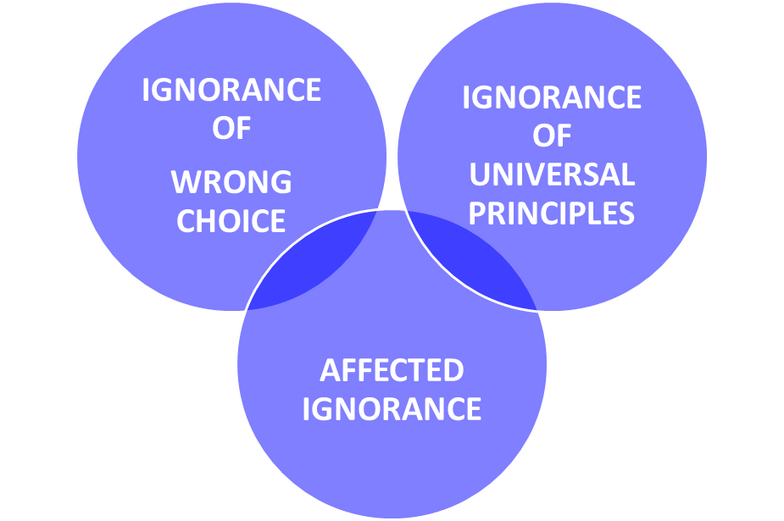
CONSEQUENT IGNORANCE a consequence of the will because the person deliberately avoids to have knowledge of what he can and should know
School of Humanities
ATENEO DE MANILA UNIVERSITY

Slide 66
All acts that follow from consequent ignorance are voluntary.
ANTECEDENT IGNORANCE
precedes the act of willing and causes the moral agent to will and then do that which he would not have willed and done
Antecedent ignorance causes an act to be involuntary.

Slide 67
THE MORALITY OF HUMAN ACTS
There are three factors that determine the morality of an act:
OBJECTUM the objective of the act itself |  | FINIS from the intention of the moral agent
 | CIRCUMSTANTIA the circumstances affecting the act
School of Humanities
ATENEO DE MANILA UNIVERSITY

Slide 68
 | THE OBJECTIVE OF THE ACT ITSELF
THE INTENTION OF THE MORAL AGENT |  | CIRCUMSTANCES AFFECTING THE ACT
The objective of the human act inherently constitutes the reality of the human act while the end of the moral agent and the circumstances of the act enter into or are
integral to the full reality of the human act.
School of Humanities
ATENEO DE MANILA UNIVERSITY

Slide 69
OBJECTUM specific objective of the act
The objective can cause a human act to be morally good or evil even without considering either the end of the moral
agent or the circumstances.
bonum in genere | malum in genere
School of Humanities
ATENEO DE MANILA UNIVERSITY

Slide 70
“The central defining feature of an action – which establishes its species, i.e., what kind of action it is – is the objectum. The object or objective is what the person or agent is planning to achieve in the immediate sense. This must be differen-tiated from the larger purpose or end, which is also relevant to the moral assessment of an act, but does not give
the action its specific nature.”
Daniel Westberg, “Good and Evil in Human Acts”
School of Humanities
ATENEO DE MANILA UNIVERSITY

Slide 71
MORALLY NEUTRAL ACTIONS
There are certain acts that we do consciously and willingly which cannot be easily classified as good or evil if we judge them only on the
basis of their respective objectives.
School of Humanities
ATENEO DE MANILA UNIVERSITY

Slide 72
They can become good or evil, however, if we consider the circumstances and the end or motive of the moral agent. In a concrete case, a particular human act is done for a specific purpose and in a designed manner, at a preferred time and place, and the like. The intention and circumstances of the objectively neutral act are either in conformity or against the norm of reasonable behavior, and so, it is either morally good or morally evil.
School of Humanities
ATENEO DE MANILA UNIVERSITY

Slide 73
FINIS OPERANTIS
The end of the moral agent can provide moral species to the human act, or it can cause a morally good act to differ in kind
from a morally evil act.
An act that is objectively good can become evil due to the evil intention of the moral agent. The intention or end of the moral agent can cause a human act to be morally good or morally evil of its
kind.
School of Humanities
ATENEO DE MANILA UNIVERSITY

Slide 74
FINIS OPERIS
end of the act
exterior purpose of the act
FINIS OPERANTIS
end of the agent
interior purpose of the agent

Slide 75
CIRCUMSTANTIA contributes to the moral goodness or badness of an act
QUIS Who |  | QUID What
CUR Why | QUIBUS AUXILIIS By what means | UBI Where
QUANDO When |  | QUOMODO How
School of Humanities
ATENEO DE MANILA UNIVERSITY

Slide 76
The circumstances are accidents of the human act since they are outside the essence or specific nature of the
human act.
A human act is not fully good, though it is good in its kind and its intended end, unless it is done in a proper way, at the right place and time, and
even for the right beneficiary.
School of Humanities
ATENEO DE MANILA UNIVERSITY

Slide 77
Prayer for Peace
Dear Lord, make us instruments of Your peace: to bring love where there is hatred, pardon where there is injury, faith where there is doubt; to bring hope where there is despair, light where there is darkness, and joy where there is sadness. Almighty Father, grant that we may never seek: so much to be consoled as to console; to be understood as to understand; to be loved as to love with all our soul. For it is in pardoning that we are pardoned; in giving to all men that we receive; and in dying that we are born to eternal life. Amen.
Saint Francis of Assisi

Slide 78
Opening Prayer
Grant us, O Lord, an ever watchful heart that no alien thought can lure away from You; a noble heart that no sordid love can defile; an upright heart that no perverse intention can lead astray; an invincible heart that no distress can over-come; an unfettered heart that no impulsive desire can enchain. O Lord, our God, also bestow upon us: understanding to know You, zeal to seek You, wisdom to find You, a life that is pleasing to You, unshakeable perseverance, and a hope that we will one day take hold of You.
Saint Thomas Aquinas
School of Humanities
ATENEO DE MANILA UNIVERSITY

