Slide 1

PLATO
School of Humanities
ATENEO DE MANILA UNIVERSITY
(c. 428-348 BC)

Slide 2
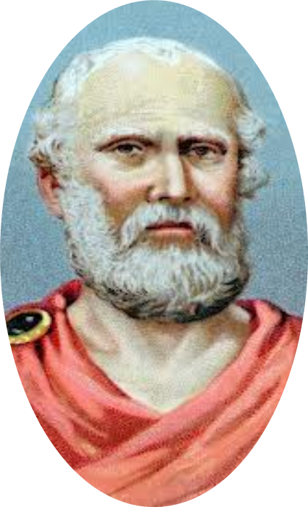
“By his mode of life and by his method of philosophizing, he set before mankind the clear conclusion that the quest for happiness is the same as the
quest for excellence.”
ARISTOTLE
School of Humanities
ATENEO DE MANILA UNIVERSITY

Slide 3
Through his father Plato traced his descent to Cadmus, the last king of Athens, and the kings before him, even to the god Poseidon. His mother, Perictione, was the sister of Charmides and the cousin of Critias, both of whom were leading statesmen in the oligarchy that followed the fall of Athens after the Peloponessian War. When his father died, early in his childhood, his mother married PyriIampes, who had been a close
friend of Pericles.
School of Humanities
ATENEO DE MANILA UNIVERSITY

Slide 4
PLATONIC DIALOGUES
Protagoras | Ion | Apology | Crito | Euthrypho
Charmides | Laches | Lysis | Republic | Hippias
Gorgias | Meno | Menexenus | Euthydemus | Phaedo
Symposium | Phaedrus | Cratylus | Theaetetus | Parmenides
Sophistes | Politicus | Timaeus | Critias | Laws
School of Humanities
ATENEO DE MANILA UNIVERSITY

Slide 5
Ethics is the quest for the good life.
not to pursue excellence or the good life but to ‘take care’ or ‘be careful’ in this pursuit
EPIMELEISTHAI
School of Humanities
ATENEO DE MANILA UNIVERSITY

Slide 6
Susan S. Meyer, “Plato and the Pursuit of Excellence”
“Socrates thinks his ambitious contemporaries are not being properly careful or discriminating about what they seek to acquire under the name of excellence. They are obsessed with the question – how to acquire excellence – to the neglect of the prior questions insisted upon by Socrates: what
excellence really is.”
School of Humanities
ATENEO DE MANILA UNIVERSITY

Slide 7
Plato, Apology
“Are you not ashamed of your eagerness to possess as much wealth, reputation and honours as possible, while you do not care for nor give thought to wisdom and truth, or the
best possible state of your soul?”
School of Humanities
ATENEO DE MANILA UNIVERSITY

Slide 8
The care of one’s soul is more important than the accumulation of such external objects of ambition
as wealth, political power, and reputation.
One cares for one’s soul by seeking ‘wisdom and truth’ or by engaging in philosophy – the practice of examining the ethical beliefs of oneself and
others.
School of Humanities
ATENEO DE MANILA UNIVERSITY

Slide 9
Knowledge provides everything needed for living well.
Wisdom is responsible for good fortune. Those with the relevant knowledge have ‘better luck’ than those
without it.
None of the ‘goods’ is in fact good for anyone unless he possesses wisdom, and that wisdom is what makes
them good.
School of Humanities
ATENEO DE MANILA UNIVERSITY

Slide 10
The proper use of external goods and not their
mere possession is what benefits a person.
The knowledge of how to use properly the conventionally recognized ‘goods’ is what one
needs in order to be happy.
School of Humanities
ATENEO DE MANILA UNIVERSITY

Slide 11
Susan S. Meyer, “Plato and the Pursuit of Excellence”
The conclusion... amounts to the thesis that wisdom is necessary for living well... that wisdom is sufficient for happiness... ‘is the only thing that makes a man happy and fortunate’... that a person who wants to live well must strive to become as wise as possible. To pursue
such wisdom is to ‘engage in philosophy’.
School of Humanities
ATENEO DE MANILA UNIVERSITY

Slide 12
The life of reason is the happiest and best.
When reason governs the desires and passions
an orderly and well balanced life is attained.
Knowledge produces a harmonious person.
School of Humanities
ATENEO DE MANILA UNIVERSITY

Slide 13
PLATONIC MORAL PHILOSOPHY
DOCTRINE OF TELEOLOGY
THEORY OF IDEAS
Everything in the universe has a purpose or proper function within a harmonious hierarchy of purposes.
There exists the World of Ideas where the unchanging models of things in the world are patterned after.
School of Humanities
ATENEO DE MANILA UNIVERSITY

Slide 14
PRE-EXISTENCE OF THE SOUL
The soul enjoyed a basic harmony between its rational and irrational parts, a harmony wherein reason controlled the spirit and
appetites through its knowledge of the truth.
School of Humanities
ATENEO DE MANILA UNIVERSITY

Slide 15
The cause of evil is discovered in the very nature of the soul and in the relation of the soul to the body.
The two main parts of the soul originate from different sources:
RATIONAL | IRRATIONAL
created by the Demiurge | created by the celestial gods
School of Humanities
ATENEO DE MANILA UNIVERSITY

Slide 16
The soul has the inherent possibility of disorder, so that when in fact disorder does occur in the soul, the cause of evil is to be located within the soul
itself.
The entrance into the body is a further cause of disorder or the breakdown of the harmony
between the various parts of the soul.
School of Humanities
ATENEO DE MANILA UNIVERSITY

Slide 17
TRIPARTITE NATURE OF THE SOUL
ACTIVITY
POWER
Awareness of a goal
Drive toward action
Desire for bodily things
Reason
Spirit
Appetites
School of Humanities
ATENEO DE MANILA UNIVERSITY

Slide 18
TRIPARTITE NATURE OF THE SOUL
ACTIVITY | POWER
Awareness of a goal or a value | Reason
Drive toward action | Spirit
Desire for things of the body | Appetites
School of Humanities
ATENEO DE MANILA UNIVERSITY

Slide 19
The reason could suggest a goal for behavior only to be overcome by sensual appetite, and the power of the spirit could be pulled in either
direction by these sensual desires.
ANALOGY OF THE CHARIOTEER
School of Humanities
ATENEO DE MANILA UNIVERSITY

Slide 20
Plato, Phaedrus
The condition of man may be likened to the charioteer driving two horses. One horse is good, “needs no touch of the whip, but is guided by word and admonition only.” The other is bad, “the mate of insolence and pride… hardly yielding to whip and spur.” Though the charioteer has a clear vision of where to go and the good horse is on course, the bad horse “plunges and runs away, giving all manner of
trouble to his companion and the charioteer…”
School of Humanities
ATENEO DE MANILA UNIVERSITY

Slide 21
Plato, “Knowledge and Virtue”
Each of the three elements of the soul is involved in moral behaviour, and each, when it carries out its proper function, is characterized by an appropriate virtue: Governing the soul by reason constitutes wisdom; rational regulation of desire constitutes temperance; the support of reason by the spirit constitutes courage; the harmony of the three faculties constitutes justice, which is the overarching
virtue.
School of Humanities
ATENEO DE MANILA UNIVERSITY

Slide 22
The peculiar function of the rational part of the soul is to seek the true goal of human life, to penetrate the world of fantasy, to discover the true world and thereby direct the passions to objects of love that are capable of producing
true pleasure and true happiness.
School of Humanities
ATENEO DE MANILA UNIVERSITY

Slide 23
Just as there can be order between the charioteer and the horses only if the charioteer is in control, so also with the human soul – it can achieve order and peace only if the rational
part is in control of the spirit and appetite.
School of Humanities
ATENEO DE MANILA UNIVERSITY

Slide 24
MORAL EVIL
Evil or vice is caused by ignorance or false knowledge which occurs when the passions influence reason to think what appears to bring happiness will do so
although it reality it cannot.
When the appetites overcome reason the unity of the soul is adversely affected; reason is subordinated to
the appetites and thereby loses its rightful place.
School of Humanities
ATENEO DE MANILA UNIVERSITY

Slide 25
MORALITY AS RECOVERY OF LOST HARMONY
Morality consists in reversing the process by which the reason has been overcome by the appetites and the stimuli of the body. The reason must regain its
control over the irrational part of the soul.
Only knowledge can produce virtue because it is
ignorance or false knowledge that has produced evil.
School of Humanities
ATENEO DE MANILA UNIVERSITY

Slide 26
When people are ignorant their personalities are disorganized for the unruly desires and passions then
control them.
When people truly know what is good, that is, when they know what promotes harmony, they will do what
is good.
The virtuous person or the rational individual is the
truly happy person.
School of Humanities
ATENEO DE MANILA UNIVERSITY

Slide 27
False knowledge must be replaced with an accurate appraisal of things or acts and their values.
“The recognition of ignorance is the beginning of knowledge.”
AWAKENING
something within |  | something without
 | someone
School of Humanities
ATENEO DE MANILA UNIVERSITY

Slide 28
RECOLLECTION or REMINISCENCE
ALLEGORY OF THE CAVE
The release of the prisoners from the chains and the healing of their unwisdom, is brought about by their being forced suddenly to stand
up, turn and walk with eyes lifted to the light.
School of Humanities
ATENEO DE MANILA UNIVERSITY

Slide 29
MEANING OF VIRTUE
Virtue means knowledge.
Virtue is the fulfilment of a unique function.
Virtue is grounded in the nature of the soul.
School of Humanities
ATENEO DE MANILA UNIVERSITY

Slide 30
When a musician tunes his instrument, he knows that each string should be tightened just so much, no more and no less, for each string has its specific pitch. The musician's art consists, therefore, in acknowledging the limit beyond which a string should not be tightened and, in playing the instrument, observing
the measure between intervals.
The art of living requires knowledge of limits and of measure.
School of Humanities
ATENEO DE MANILA UNIVERSITY

Slide 31
When the appetites are kept within limits and in their measure, avoiding excesses, this moderation in pleasures and desires leads to the virtue of
temperance.
When the energy of will, which issues from the spirit, is kept within limits avoiding rash or headlong action and becomes a trustworthy power in aggressive and
defensive behavior the virtue of courage is achieved.
School of Humanities
ATENEO DE MANILA UNIVERSITY

Slide 32
When reason remains undisturbed by the onrush of appetites and continues to see the true ideals in spite of the constant changes experienced in daily life it achieves the virtue
of wisdom.
School of Humanities
ATENEO DE MANILA UNIVERSITY

Slide 33
REASON | SPIRIT | APPETITE
undisturbed by the onrush of appetites | kept within limits avoiding rash action | kept within limits avoiding excesses
WISDOM | COURAGE | TEMPERANCE
School of Humanities
ATENEO DE MANILA UNIVERSITY

Slide 34
Virtue is attained only when each part of the soul is fulfilling its own function. The appetites and the spirit must be subject to the sovereignty of the rational element, which directs one's dynamic capacities and orders the desires and affections according to
intelligence.
When each of the parts of the soul fulfils its special function, a fourth virtue, justice, is attained, for justice
means giving to each its own due.
School of Humanities
ATENEO DE MANILA UNIVERSITY

Slide 35
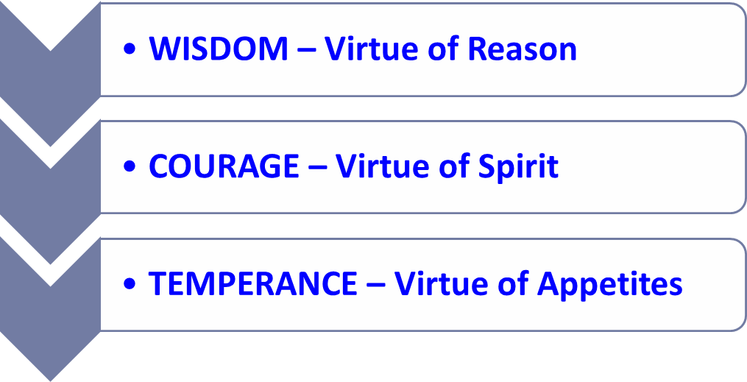
JUSTICE
School of Humanities
ATENEO DE MANILA UNIVERSITY

Slide 36
Plato, Knowledge and Virtue
“Among all the virtues that a person may have, justice is the most important, especially because it brings about happiness in the just person, who is far happier than an unjust one. Justice in anything is a special sort of balance, order, or harmony among its components. In an individual person this harmony is established
and governed by reason… “
School of Humanities
ATENEO DE MANILA UNIVERSITY

Slide 37
THE RING OF GYGES
If there were two such magic rings and the just put on one of them and the unjust the other,
both will behave in the same unjust way.
“No man can be imagined to be of such an iron nature that he would stand fast in justice.”
School of Humanities
ATENEO DE MANILA UNIVERSITY

Slide 38
No man would keep his hands off what was not his own when he could safely take what he liked out of the market, or go into houses and lie with any one at his pleasure, or kill or release from prison whom he
would, and in all respects be like a god among men.
A man is just, not willingly or because he thinks that justice is any good to him individually, but of necessity, for wherever anyone thinks that he can
safely be unjust, there he is unjust.
School of Humanities
ATENEO DE MANILA UNIVERSITY

Slide 39
True justice pertains more to the true self “being concerned not with the outward man, but with the inward... for the just man... sets in order his own inner life... is his own master and his own law, and at peace
with himself.
Justice in the end is far nobler than injustice for it serves the telos of man. The end of man is attained
when his higher powers are perfected.
School of Humanities
ATENEO DE MANILA UNIVERSITY

Slide 40
Plato, Knowledge and Virtue
“What will he profit, if his injustice be undetected and unpunished? He who is undetected only gets worse, whereas he who is detected and punished has the brutal part of his nature silenced and humanized; the gentler element in him is liberated, and his whole soul is perfected and ennobled by the acquirement of justice and temperance and wisdom, more than the body ever is by receiving gifts of beauty, strength, and health, in
proportion as the soul is more honourable than the body.”
School of Humanities
ATENEO DE MANILA UNIVERSITY

Slide 41
Plato, Knowledge and Virtue
“To this nobler purpose the man of understanding will devote the energies of his life, and in the first place, he will honor studies which impress these qualities on his soul, and will disregard others... In the next place, he will regulate his bodily habit and training, and so far will he be from yielding to brutal and irrational pleasures... as to preserve the
harmony of the soul...”
School of Humanities
ATENEO DE MANILA UNIVERSITY

