Slide 1

REFLECTION PROCESS
School of Humanities
ATENEO DE MANILA UNIVERSITY
Framework and Format

Slide 2
Dear Lord, let us do our work each day, and if the darkened hours of despair overtake us, may we not forget the strength that comforted us in the desolation of other times. Spare us from bitterness and from the sharp passions of unguarded moments. Lift our eyes from the earth and let us not forget the uses of the stars. Let us not follow the clamor of the world, but walk calmly in our path. Teach us always to be thankful for life, and for time’s olden memories that are good and sweet. And may the evening
twilight find us gentle still. Amen.

Slide 3
Pierre Hadot, Philosophy as a Way of Life: Spiritual Exercises from Socrates to Foucault
“Philosophy was a mode of existing-in-the-world, which had to be practiced at each instant, and the goal… was to transform the whole of the individual’s life…. Thus, philosophy was a way of life, both in its exercise and effort to achieve wisdom... for real wisdom does not merely cause
us to know: it makes us be in a different way.”
School of Humanities
ATENEO DE MANILA UNIVERSITY

Slide 4
REFLECTION ON ARISTOTLE
“The most important insight I gained is that knowledge imposes a responsibility. The reason why some people run away from knowledge is because they are afraid of the enormous gravity of their own freedom. They see freedom as making us liable to failure rather than enabling us to effect renewal. And so they forfeit their freedom. They choose to be determined rather than to determine. They prefer to be slaves to circumstances rather than masters of their actions. Such is not the human thing to do however. What is human is to face reality, to constantly and actively seek the truth, because the
demand of our humanity is that we be responsible.”
School of Humanities
ATENEO DE MANILA UNIVERSITY

Slide 5
 | 2 SIGNIFICANCE | 
1 EXPERIENCE | MOMENTS OF THE REFLECTION PROCESS | 3 INSIGHT
 | 4 RESPONSE | 
School of Humanities
ATENEO DE MANILA UNIVERSITY

Slide 6
The study of the good must empower and transform towards the living of the good.
If the experience has no significance,
the encounter is not real.
If the insight does not lead to a response,
the learning is a pretense.
School of Humanities
ATENEO DE MANILA UNIVERSITY

Slide 7
THE ASCENT OF BUDDHA TO NIRVANA AS A
JOURNEY OF REFLECTION
EXPERIENCE
Siddharta encounters four people while on a stroll at Lumbini park: an old man, a sick man, a corpse, and a monk.
School of Humanities
ATENEO DE MANILA UNIVERSITY

Slide 8
SIGNIFICANCE
He is shocked by this confrontation with the evils of life which he did not know before in the comforts of his palace.
School of Humanities
ATENEO DE MANILA UNIVERSITY

Slide 9
INSIGHT
He concludes that all life is pain and suffering.
RESPONSE
He sought release from pain and suffering.
School of Humanities
ATENEO DE MANILA UNIVERSITY

Slide 10
Crystallize the experience: Identify a particular idea or teaching in the theory that appeals to you.
Plato advocates that the virtuous man is the rational individual who is truly happy. He explains the human condition using the charioteer analogy. Reason, like the charioteer, must be given the right to govern the irrational components of spirit (good horse) and appetite (bad horse), because passion cannot distinguish between what gives higher or longer-lasting happiness and what only seems to provide this… And reason must possess true knowledge. One cannot be a moral man if he bears this form of
ignorance.
School of Humanities
ATENEO DE MANILA UNIVERSITY

Slide 11
Highlight its significance: Recall a personal incident which the idea or theory brings up.
In a few months I shall graduate and I have already submitted my resumes to prospective companies. I asked my mom once, “Mama, saang companies gusto n’yo mag apply ako?” Without missing a heartbeat, she replied, “Kahit saan, basta malapit sa bahay, at may pinakamataas na sweldo.” I was expecting a different answer so I asked her, “Hindi ba dapat sa kung saan ako masaya?” And she explained, “Eh, kung gusto mo nga pero wala ka namang pera, hindi ka rin naman sasaya doon. Pag may pera ka,
sasaya ka rin naman doon.”
School of Humanities
ATENEO DE MANILA UNIVERSITY

Slide 12
Draw an insight: Learn a lesson that will apply to your personal incident and which you can universalize.
There is nothing wrong with wanting the good life per se… However, is this what it means to live?… Are we humans made to work for money, the eventual key to a good life?… While there is nothing wrong about wanting to be rich, we fail to be virtuous when we blindly pursue to be rich, making everything else secondary… We all aspire for a life of money thinking that this is the key to a good life, but there is more… There is the happiness that springs from a satisfaction of greater human needs like peace,
communion, and love that are priceless and irreplaceable.
School of Humanities
ATENEO DE MANILA UNIVERSITY

Slide 13
Make a response: Allow the insight to make a difference in your life by resolving to do something good.
I can’t blame my mom for wishing me the best in my career. But I have to disagree with her on what considerations I prioritize in my choice of companies to apply for. My reflection has certainly made me think twice about what direction I am going to take in the next months. I have to love what I do, and what I do must help me unleash my potential and propel me to become the best person I can be. There is more to
life than money.
School of Humanities
ATENEO DE MANILA UNIVERSITY

Slide 14
“To think philosophically is to reflect on my lived experience and to come up with answers
which I can address to all humanity.”
“Reflection has a recuperative element by means of which we learn not only how to interpret our experience but as a matter of fact
how to experience.”
School of Humanities
ATENEO DE MANILA UNIVERSITY

Slide 15

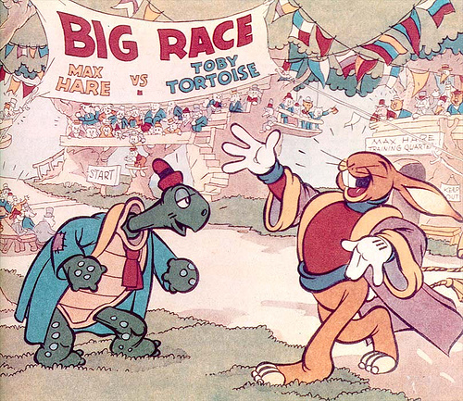

School of Humanities
ATENEO DE MANILA UNIVERSITY

Slide 16
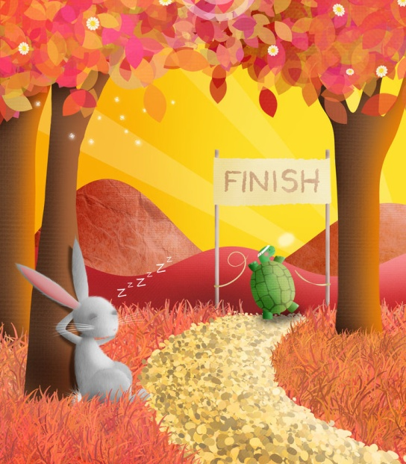
MORAL OF THE STORY
Slow and steady wins the race.
School of Humanities
ATENEO DE MANILA UNIVERSITY

Slide 17
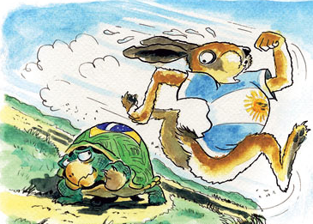
MORAL OF THE STORY
Fast and consistent will always beat the slow and steady. It is good to be slow and steady; but it is better to be fast and reliable.
School of Humanities
ATENEO DE MANILA UNIVERSITY

Slide 18
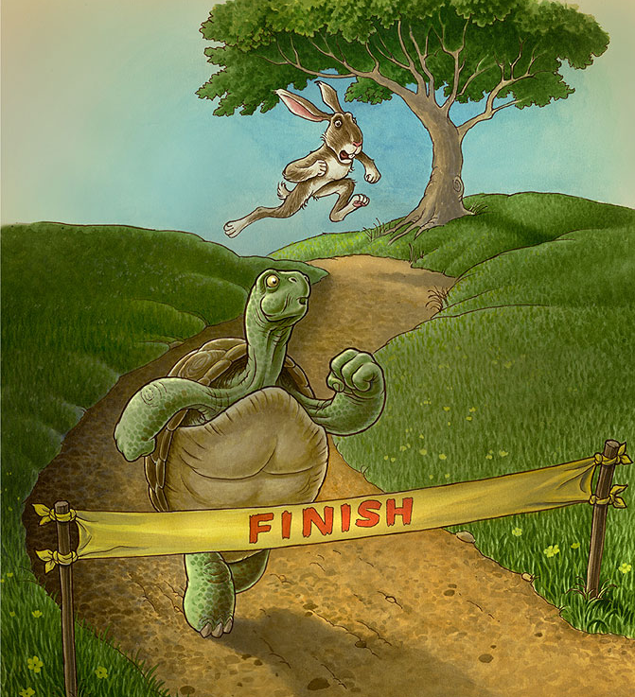
MORAL OF THE STORY
Identify your core competency and then change the playing field to suit your core competency. Working to your strength will not only get you noticed, but will also create opportunities
for growth and advancement.
School of Humanities
ATENEO DE MANILA UNIVERSITY

Slide 19
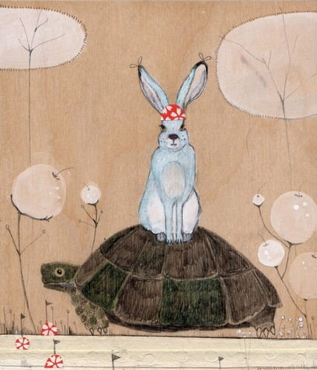
MORAL OF THE STORY
It is good to be individually brilliant and to have strong core competencies; but unless you are able to work in a team and harness each other’s core competencies, you will always perform below par because there will always be situations at which you will do poorly and someone else does well.
School of Humanities
ATENEO DE MANILA UNIVERSITY

Slide 20
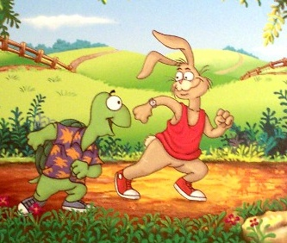
MORAL OF THE STORY
In life, when faced with failure, sometimes it is appropriate to work harder and put in more effort. Sometimes it is appropriate to change strategy and try something different. Sometimes it is appropriate to
do both.
[ A. Harrison Barnes, “The Story Doesn’t End There” ]
School of Humanities
ATENEO DE MANILA UNIVERSITY

Slide 21
REFLECTION ON ARISTOTLE
In his theory, Aristotle defined the moral man as one whose actions are guided by reason; in so doing, he fulfills “the good of man” or the proper function of man as a rational being. Aristotle added that moral conduct involves knowledge of what we ought to do and the deliberate choice to do it. In our world, it is our capacity for deliberate, rational choices that sets us apart from all
other living organisms.
School of Humanities
ATENEO DE MANILA UNIVERSITY

Slide 22
REFLECTION ON ARISTOTLE
Likewise, among us human beings, it is the choices that we make that set us apart from one another. We may share certain qualities with other people (physical attributes, mental capacity or emotional state), but our particular choices for certain things, people, activities, etc. give us our own identity as individuals. The same holds true for the moral man according to Aristotle: it is his desire for the good and his constant choice to do it that distinguish him as
virtuous.
School of Humanities
ATENEO DE MANILA UNIVERSITY

Slide 23
REFLECTION ON ARISTOTLE
I remember Harry Potter confiding to his teacher, Professor Dumbledore, a concern that has been nagging him. After meeting Tom Riddle who later became Lord Voldemort, the most evil of all wizards, Harry realized that he and Tom had a strange likeness: both of them possessed the wit, talent, resourcefulness, and the determination of a great wizard in-the-making and they shared the
rare ability to talk to snakes.
School of Humanities
ATENEO DE MANILA UNIVERSITY

Slide 24
REFLECTION ON ARISTOTLE
So Harry thought that maybe he is no better than Tom, fearing that he might end up to be as bad as he did. What Harry did not realize is the fact that he is very different from Tom because of how he chose to use his abilities. This was also what Professor Dumbledore pointed out: he is different because of his choice to use his abilities to do good
rather than to take advantage of other people.
School of Humanities
ATENEO DE MANILA UNIVERSITY

Slide 25
REFLECTION ON ARISTOTLE
I think this is why Aristotle emphasized the importance of deliberate choice in moral conduct. It is our choices that show who we truly are, far more than our looks or our abilities can, especially when faced with moral dilemmas. This is because we are in constant struggle against a world that continually presents us with tricky situations that
make it hard to choose to do the good.
School of Humanities
ATENEO DE MANILA UNIVERSITY

Slide 26
REFLECTION ON ARISTOTLE
What make it harder are the many tempting and attractive possibilities that doing otherwise offers. Particularly for people endowed with intellect, talents and skills, the opportunities for wealth, power, and prestige is so great nowadays that many become so caught up in their ambitions and turn into new age Voldemorts, acting out of greed and excessive concern for financial success, access to power and influence and personal satisfaction, all at the expense of other
people.
School of Humanities
ATENEO DE MANILA UNIVERSITY

Slide 27
REFLECTION ON ARISTOTLE
Given the prevalence of materialist and consumerist attitudes in our society today, it is easy to be lured into thinking that happiness comes in having, that to have is what is good because then we feel secure and can luxuriate in comfort. Aristotle begs to disagree and insists that happiness means more than just having; rather, it is a state of being attained by living a life of virtue through the constant exercise of
deliberately choosing what is good.
School of Humanities
ATENEO DE MANILA UNIVERSITY

Slide 28
REFLECTION ON ARISTOTLE
And I can say that Aristotle is right in pointing out that while it is one thing to know what is right from wrong, it is another to have the strength to always choose to do what is right, especially when under pressure from the things and the people around us. Goodness is not just a matter of personal conviction but more importantly it is a matter of action based on a deep personal awareness of what is good and of developing
the habit of doing it.
School of Humanities
ATENEO DE MANILA UNIVERSITY

Slide 29
REFLECTION ON ARISTOTLE
I must admit the countless times that I also lost my head in tricky situations. I also fell victim to the many appealing “traps” which often appear in the guise of good things. I will see to it that from now on I am more discerning, more patient, and extra careful in making my choices and decisions so as not to be easily overcome by temptations, fear or confusion. But more importantly, I will work harder towards building a commitment to a constant “yes” to the good, at all
times and at all costs.
School of Humanities
ATENEO DE MANILA UNIVERSITY

Slide 30
FORM and STYLE
Paper Size: Short Bond, 8.5” x 11”
Font: Arial 12
Spacing: Double
Margin: 1” All Sides, Justified
Due Date: 09 Jan., Thu, Class Time
Word Count: 1,000-1,500
Pages: 4-5
School of Humanities
ATENEO DE MANILA UNIVERSITY

Slide 31
FIRST PAGE
Reflection on Aristotle Ranilo B. Hermida
“Knowledge as Responsibility”
In his theory, Aristotle defined the moral man as one whose actions are guided by reason; in so doing, he fulfills “the good of man” or the proper function of man as a rational being. Aristotle added that moral conduct involves knowledge of what we ought to do and the deliberate choice to do it. In our world, it is our capacity for deliberate, rational choices that sets us apart from all other living organisms. Likewise, among us human beings, it is the choices that we make that set us apart from one another.
School of Humanities
ATENEO DE MANILA UNIVERSITY

Slide 32
TURNITIN SUBMISSION
1. You need to upload your Reflection Paper in turnitin.com.
2. Your paper will not be marked if it is not uploaded. You will then get a failing mark for the first essay.
3. There is a cut-off time for uploading after which the class site will automatically close. Please upload papers between Jan. 09, 8:00 am and Jan. 11, 11:00 pm.
School of Humanities
ATENEO DE MANILA UNIVERSITY

Slide 33
4. You should get an acknowledgment receipt that you have successfully uploaded your paper. If you did not get a receipt, please repeat the procedure of uploading your paper.
5. If you are unable to upload your paper, refer your problem at once to the librarian at the Reference section of the Rizal Library. It is best then to upload your paper while in campus and during library time.
School of Humanities
ATENEO DE MANILA UNIVERSITY

Slide 34
6. Create you own Turnitin account. Go to the website turnitin.com and follow instructions.
7. Please take note of the following data needed for uploading your paper:
Class Name: Ph 104 Rh
Enrolment Password: Etika
Class ID: 7388722
Assignment Title: Reflection
School of Humanities
ATENEO DE MANILA UNIVERSITY

Slide 35
SAMPLE REFLECTIONS
Reflection on Augustine
Augustine described man as incomplete for being a creature. He is incomplete in so many ways and thus in need of a lot of things: physical objects, other persons, himself, and most of all, God. As an outcome of this finitude, man seeks happiness by loving things and people, which would satisfy his needs. Unfortunately, each object of love can give him only some measure of satisfaction and no more. Man is in danger of seeking happiness and satisfaction of each of his needs by loving the wrong things.
Augustine warned against disordered love. All things are legitimate objects of love for God created them all. The problem may lie, however, in man’s manner of loving and in his expectations from the outcome of his love. A man’s love is disordered if he expects more from his object of love than what it can provide naturally. Loving things will not satisfy the need of man for human affection. In the same way, expecting that the person he loves will give him ultimate satisfaction and happiness is disordered, and would only cause him to be miserable, unhappy, and restless.
Only God can give man this ultimate happiness, for he is created to love Him. Only God can satisfy man’s need for the infinite; finite objects like material things and other people cannot be substitutes for Him. By establishing an eternal union with Him, man finds rest for his restless heart.
School of Humanities
ATENEO DE MANILA UNIVERSITY

Slide 36
I witnessed this satisfaction of a spiritual need in my mother just a few weeks ago. For years, I had seen her survive a lot of battles in her life beginning with the diagnosis of my dad of cerebellar degeneration – a condition in which a part of his brain undergoes rapid deterioration – until the day when my dad accidentally killed an old woman while driving to work. Through all of these experiences, she was challenged physically, emotionally, financially, and even spiritually; but she always overcame. Last October, however, I was afraid that she would finally give up when we were forced to send my father to a private institution. His brain disease eventually affected not only his muscle coordination and balance but also his cognitive activities. He started to act weirdly and talk about spirits, snakes, and magical powers. He believed he has a different identity and became paranoid.
This incident took a great toll on my mom psychologically. She started to have sleepless nights and depressing thoughts. She would only sleep in my bedroom; she was afraid to be alone, for she already felt alone. She also started to demand that we should always be at home. She would frantically confess to us that she would not know what she could do to herself if something happened to us, for we were her only source of happiness and inspiration. She became clingy and dependent. Instead of going out or watching television, she would just sit on my bed or on my brother’s while she watched us work. As much as we wanted to be there for her, we couldn’t. This pattern of helplessness went on until she decided to go to Church more often. After weeks, she showed signs of recovery as she renewed her love of God. She started to sleep properly at night, and was not afraid to be physically alone anymore. According to her, she now fears nothing, whether it is her death or ours for she knows that God will always be there. She started to have a positive outlook in life again, and to live as if she has finally found what she was looking for in the past years.
School of Humanities
ATENEO DE MANILA UNIVERSITY

Slide 37
Nowadays, the society pushes us to disordered forms of love by pushing us to search for the completion of our being in the wrong places and manner. As we live in a globalized, developed economy where consumerism and capitalism are the dominant ideas, we are made to believe that certain things can give us the satisfaction we are looking for, and that the more we have, the happier we will be. Materialism transforms us into being slaves for our love of material things. We begin to divert our energies and live by amassing more material richness. But up to what level of richness will we stop because we are already fulfilled? The answer is none, for no matter how much we have, we will still feel fear losing what we have and remain unfulfilled as if we have nothing. In the same way, as our society develops, it forces us to become more individualistic and to pursue self-development. In the process of developing ourselves, we feel the need to experience more things, see more things, and travel to many places. We live juggling the many responsibilities that the world and ourselves have thrust upon our shoulders: as a young professional, as the breadwinner of the family, as a responsible citizen, as a volunteer, etc. Compared to our forefathers, we live a busier life. We work, exercise, attend meetings, answer calls in between, and run family errands. But the ironic thing is no matter how busy we are with our obligations we do not really feel that we have fulfilled them. As said by Catholic priest and author Ronald Rolheiser, “The great paradox of our time is that many of us are busy and bored at the same time.” We spend our time fulfilling these responsibilities, but in the end, we are restless. As the society gives more importance to the individual himself our relationship with other people also transforms. Nowadays, privacy is given more importance by our laws, enforcing rules respecting the private space and property of each individual.
School of Humanities
ATENEO DE MANILA UNIVERSITY

Slide 38
Another paradox of our current situation is that the more we are connected to people through technology, the more we feel isolated for we expect these impersonal technologies to maintain our relationships. Our world also becomes the world of functions, and people are distinguished by the functions that they fulfill in society. These circumstances make it harder for us to see the people for who they really are, pushing us to value ourselves more than others. We fail to see the reality of other people, and we create our own world with just our own reality. And again, this leaves us incomplete, for our need for human affection is not satisfied.
The same disorder also happens when we love other people. The media promote the idea that we are living a romantic journey to find that someone who will complete our incompleteness. This makes us set unnecessary expectations. The married life is also given more importance than the life of singlehood. The latter evokes pity from people. This pressures the people to find someone who will save them from this doomed fate. But after the honeymoon stage of the relationship, people start to realize that there is no happily-ever-after, that they will always be alone and incomplete just like when they were single.
We fail to realize that whatever we do, we will always be alone and unsatisfied for we will always have that greatest need: the need for the Infinite. In Karl Rahner’s words, “All symphonies remain unfinished.” But for Augustine, the symphony of our life can be finished but by only one note: God. Having been created by Him, we are incomplete and imperfect. The feeling of dissatisfaction that we often have is due to our efforts of filling up the infiniteness of our finitude with finite objects of love. We must realize, however, that only someone as infinite as God can complete us. Only in loving Him can we finally find rest and peace in our hearts.
School of Humanities
ATENEO DE MANILA UNIVERSITY

Slide 39
I admit that it may be difficult for me to do what my mother has already done: to let God satisfy and complete all the desires of her heart. Having been raised by a father who emotionally distanced himself from us since we were children and having a brother who hated me for years – I fear that I am in the danger of seeking from someone those kinds of love that I never experienced. I admit that I am in danger of committing a disordered love. However, this process of reflection has let me know myself better by making me realize the destruction that I may incur upon others and myself if I try to substitute someone for the love of my father and brother. Knowledge is the first step towards repositioning my life towards the right direction. Nevertheless, it may be harder for me to commit to this right path with this longing that I have inside. No matter how hard it will be though, my mother will always serve as my inspiration to veer away from the path of destruction. It is through reflection and spiritual solitude that my mother finally realizes that her love of God is superior to any other kind of love. And this is what I shall pursue.
School of Humanities
ATENEO DE MANILA UNIVERSITY

Slide 40
Reflection on Confucius
Confucius believes that it is every person’s goal to become a moral man, a chün-tzu. Before becoming so however, one of the virtues he must possess is ren, defined to be that of having connaturality and harmonious relations with other men. Furthermore, Confucius finds the concept of filial piety and brotherly love as aspects that contribute to the realization of ren. Filial piety simply defined is that of having great love and respect for one’s parents. These would encompass all actions that a good child does such as honoring one’s parents, taking care of them, being obedient, and those of the like. It is through these affections of love and respect that one acknowledges a parent’s authority and a parent’s hierarchical relationship with the children. From this foundation, a person then extends this understanding of filial piety and sees its extension towards hierarchical relationships in society that in effect contribute to the peaceful relationship between humans. It is in this sense that filial piety and brotherly love are considered crucial elements of ren that consequently enable one to achieve the status of becoming a chün-tzu.
School of Humanities
ATENEO DE MANILA UNIVERSITY

Slide 41
Coming from a pure Chinese family, the teachings of Confucius are very much influential to me as to how traditional family values are formed. Without a doubt, filial piety is one of the most evident and well-upheld values in our family. In light of this, the elderly’s pieces of advice are highly regarded – celebrations are regularly held to honor the family’s ancestors and following the parent’s wishes is deemed to be of grave importance. Presently however, we can observe how filial piety is misinterpreted to mean that the judgments that parents make along with their authority are unquestionable simply by virtue of their seniority. Furthermore, a difference in opinion that the children have with their parents is often understood to be a form of disrespect and is thus considered by many as violation of the well-valued virtue of filial piety.
A concrete instance I personally experienced in my life is that of the disagreement I had with my parents regarding their insistence on only getting into romantic relationships with people who have Chinese ancestries. This is not a dilemma that I face alone as I noticed that it is the same problem that many of my pure-Chinese friends face today. Despite being respectful while trying to present my disagreement on the subject, my parents have reprimanded me numerous times for doing so. Consequently, they dismissed my argument based on the grounds that respecting them would entail following their beliefs and accepting their stand as true and irrevocable. Doing otherwise, they say, would mean questioning their authority.
School of Humanities
ATENEO DE MANILA UNIVERSITY

Slide 42
There is no doubt that filial piety must be observed in every family, regardless of one’s culture. Parents have sacrificed a great deal for the sole purpose of keeping their children safe and healthy while all the decisions they make are what they deem to be the best for their children. The basic things such as respect and love are simply due to them. However while acknowledging that there is a hierarchy to be respected, this does not always mean that those who at the higher levels are always on the right simply because they are above. Each judgment they make should be based on a rational explanation rather than simply using their position as a reason for inerrancy. Although it may be true that their perspectives and judgments are most likely to be correct as a result of exposure to much experience, there is still the possibility of being mistaken.
Disagreements inevitably arise between people: between friends, colleagues, and even between the parents and their children. Each parent and child goes through this stage in their relationship most especially as the child reaches adolescence. It is for the reason that as a person grows older and realizes his own personality and values he would want to manifest his maturity through making his own decisions. And although parents do play a critical role on what kind of a person a child grows up to be, it is still very possible that both may reach different understandings on a certain subject. The problem now arises as these differences in opinion tend to be seen as a threat to filial piety to the eyes of the parent. As they fear that their child is slowly breaking away from their grip, the result is that some parents, such as mine, tend to go back to the defense of violating filial piety to resolve these disagreements between them.
School of Humanities
ATENEO DE MANILA UNIVERSITY

Slide 43
What can now be observed is that many relationships between parents and children (most especially for pure Chinese families) are broken because of the wrong interpretation of filial piety. With this, the original purpose of filial piety is no longer met as it now gives the opposite effect. Instead of being a base for harmony, it brings about disorders. As a strong emphasis is given to a wrong perspective on filial piety, we see how some children grow to become rebellious, not wishing to listen to their parents and at certain times deliberately defying them. Instead of developing a stronger relationship with their parents, they end up seeing them as antagonists from whom they wish to stay away. I have had Chinese friends who end up lying to their parents and keeping their relationships with their significant others a secret from their family. Some have been developing resentments towards their parents, further worsening their relationships with them.
The same arguments go for the hierarchical relationships in society which stem from filial piety in the family. Leaders are elected by the people as they are believed to be the most capable and competent men who best represent them. Although elected leaders are now placed in a higher level in the hierarchy, they are still capable of misrepresenting and making decisions that do not appear to be addressing the people’s needs despite their intelligence and seniority. When this happens, disagreements emerge between the two parties. Some leaders insist with their authority that their decision was right while the people end up enraged and grow more distant and hateful towards their leaders.
School of Humanities
ATENEO DE MANILA UNIVERSITY

Slide 44
Confucius intended to show how filial piety is an instrument that would bring harmony to people but as what can be observed nowadays, through misconception and misinterpretation it is now a tool that leads to divergence. There is a need to revisit the original intention of filial piety, that is, to bring about good human relations. Having said this, mutual respect must be present in parent-child relationships, and to extension, leader-subject relationships. While the children must appreciate and understand the concerns of their parents, the parents, by the same token, must also be open to new perspectives and insights from children. As for the leaders, even with their qualifications, they should express humility and hear out the concerns of the people should there be disagreements between them. Citizens on the other hand must bear in mind that the leaders, regardless of their competence, are still capable of faults. Notwithstanding the mistakes that the leaders make, the citizens must give them due respect and instead of blindly name calling them, communicate to them to let the leaders understand their perspective.
As portrayed in a conversation in the 2012 movie Skyfall, the new young quartermaster challenges the elder James Bond by saying “age is no guarantee of efficiency” to which Bond responds by saying in reply “youth is no guarantee of innovation.” Both parties must approach disagreements with respect and must be open to discussion. In order to have a good and healthy relationship, cooperation must come from both ends of the spectrum rather than from one or none at all.
School of Humanities
ATENEO DE MANILA UNIVERSITY

Slide 45
Following this reflection, I believe that I am now in a better position to understand how parent-child relationships should be. I now know that whenever I find myself in a position that is not compatible with that of my parents, I should never forget to still uphold the respect I have for them. Rather than simply dismiss them, I will politely ask them to explain why they believe their judgment is right and try to grasp their stand. Should I still find myself in disagreement with them after careful deliberation and understanding, I shall respectfully present my side to them to allow them to understand where I am coming from. Now, I know better than to see disagreements and conflicts in opinions as inevitable things that disturb and break a once good relationship. I will approach these disagreements with humility and must keep in mind that these should not pose a threat to my relationship with my parents. Rather than allowing it to makes us drift apart, I will see it as an opportunity and a learning experience that will bring us closer together and will allow us to build a stronger bond than what we already have.
School of Humanities
ATENEO DE MANILA UNIVERSITY

