Slide 1
Logistic Regression

Slide 2
Binary Target

Slide 3
Binary Target
Assume a data set has a BINARY Target Variable: 0 or 1
Linear (OLS) Regression cannot be used to predict this target because:
Errors won’t be normally distributed
Probability value from OLS regression can take on values > 100% or < 0%
Even if the Predicted value is truncated, the predictions are usually not good

Slide 4
Binary Target
Logistic Regression
Uses Maximum Likelihood algorithm
Predicts LOG-ODDS (“LOGIT”) of target (value can range from +/- Infinity)
Logit can be converted to a Probability Score ranging from 0% to 100%
Most common method of dealing with Binary Targets
Easy to write scoring code
Easy to interpret coefficients

Slide 5
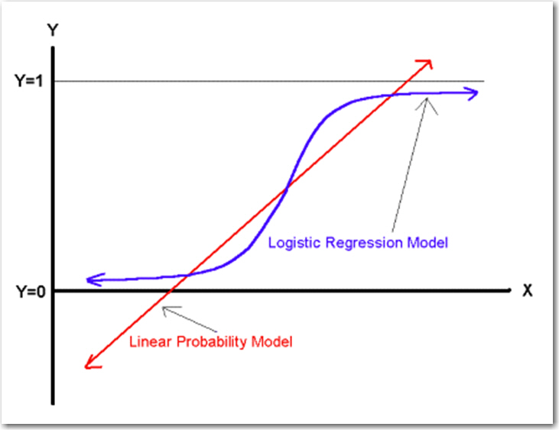
Binary Target

Slide 6
Logistic Regression
Overview

Slide 7
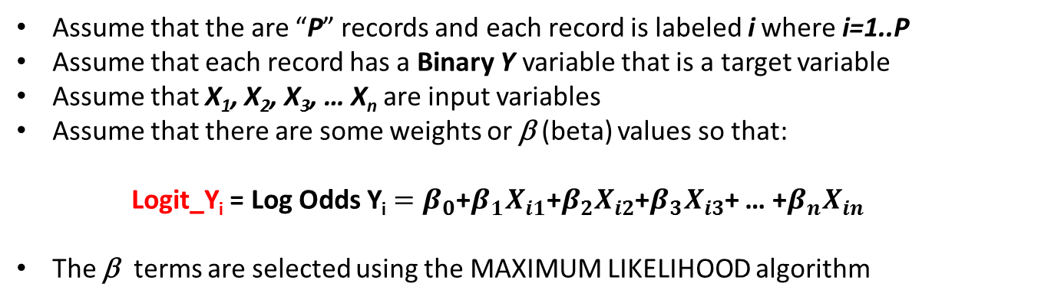
Logistic Regression Review
Assume that the are “P” records and each record is labeled i where i=1..P
Assume that each record has a Binary Y variable that is a target variable
Assume that X₁, X₂, X₃, … X_{n} are input variables
Assume that there are some weights or β (beta) values so that:
Logit_Y_{i} = Log Odds Y_{i} $=β_{0}$+$β_{1}X_{i1}\text{+}β_{2}X_{i2}$+$β_{3}X_{i3}$+ … +$β_{n}X_{in}$
The β terms are selected using the MAXIMUM LIKELIHOOD algorithm

Slide 8
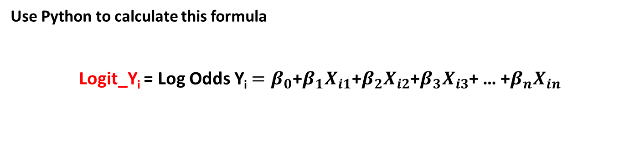
Logistic Regression Review
Use Python to calculate this formula
Logit_Y_{i} = Log Odds Y_{i} $=β_{0}$+$β_{1}X_{i1}\text{+}β_{2}X_{i2}$+$β_{3}X_{i3}$+ … +$β_{n}X_{in}$

Slide 9
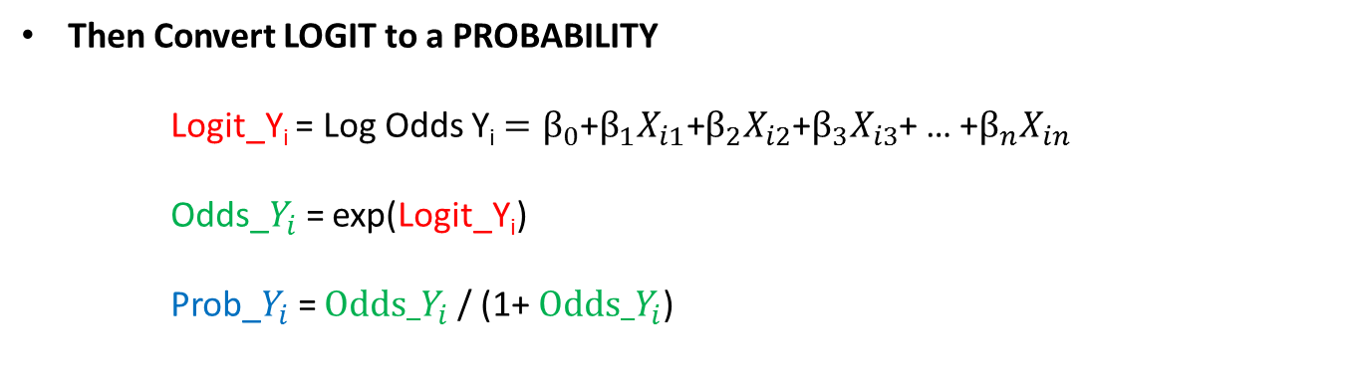
Logistic Regression Review
Then Convert LOGIT to a PROBABILITY
Logit_Y_{i} = Log Odds Y_{i} $=β_{0}$+$β_{1}X_{i1}\text{+}β_{2}X_{i2}$+$β_{3}X_{i3}$+ … +$β_{n}X_{in}$
Odds_$Y_{i}$= exp(Logit_Y_{i})
Prob_$Y_{i}$= $Odds_Y_{i}$ / (1+ $Odds_Y_{i}$)

Slide 10
Logistic Regression
Example

Slide 11
Logistic Regression: Example
This example is taken from the previously mentioned Draper and Smith reference.
The data describes monthly steam usage in a manufacturing plant
Y_Temp Monthly use of steam
Y 1: Y_Temp > 10
0: Y_Temp <= 10
X6 Operating days per month
X8 Average temperature in degrees Fahrenheit
NOTE: Draper and Smith named their variables X6 and X8, don’t worry about that. The names of the variables are not important and don’t affect the formula.
Raw Data is given on the following slide.
SAS Code is provided to read data into SAS

Slide 12
Logistic Regression: Example
Raw Steam Usage Data
 | X6 | X8 | Y
1 | 20 | 35.3 | 10.98
2 | 20 | 29.7 | 11.13
3 | 23 | 30.8 | 12.51
4 | 20 | 58.8 | 8.4
5 | 21 | 61.4 | 9.27
6 | 22 | 71.3 | 8.73
7 | 11 | 74.4 | 6.36
8 | 23 | 76.7 | 8.5
9 | 21 | 70.7 | 7.82
10 | 20 | 57.5 | 9.14
11 | 20 | 46.4 | 8.24
12 | 21 | 28.9 | 12.19
13 | 21 | 28.1 | 11.88
14 | 19 | 39.1 | 9.57
15 | 23 | 46.8 | 10.94
16 | 20 | 48.5 | 9.58
17 | 22 | 59.3 | 10.09
18 | 22 | 70 | 8.11
19 | 11 | 70 | 6.83
20 | 23 | 74.5 | 8.88
21 | 20 | 72.1 | 7.68
22 | 21 | 58.1 | 8.47
23 | 20 | 44.6 | 8.86
24 | 20 | 33.4 | 10.36
25 | 22 | 28.6 | 11.08

Slide 13
Logistic Regression: Example
import numpy as np
import pandas as pd
from sklearn.linear_model import LogisticRegression
import warnings
warnings.filterwarnings("ignore")
FILE = "Steam_Logit_Data.csv"
df = pd.read_csv( FILE )
X = df.copy()
X = X.drop( "Y", axis=1 )
Y = df["Y"]
varNames = list( X.columns.values )
m = LogisticRegression()
m.fit(X,Y)
coef_dict = {}
coef_dict["INTERCEPT"] = m.intercept_[0]
for coef, feat in zip(m.coef_[0],varNames):
coef_dict[feat] = coef
for i in coef_dict :
print( i, " = ", coef_dict[i] )

Slide 14
Logistic Regression: Example
After the data has been read in and transformed, the data set looks like this:
INTERCEPT = -0.15080520918667048
X6 = 0.4454426549695621
X8 = -0.20260649804962044

Slide 15

Logistic Regression Review
EXAMPLE:
Assume:
X6 = 20
X8 = 35.3
Logit_Y_{i} = $\text{−}\text{0.15}\text{ + }\text{0.45}\text{∗}\text{X}\text{6 − }\text{0.20}\text{∗}\text{X}\text{8}$
Odds_$Y_{i}$= exp(Logit_Y_{i})
Prob_$Y_{i}$= $Odds_Y_{i}$ / (1+ $Odds_Y_{i}$)

Slide 16

Logistic Regression Review
EXAMPLE:
Assume:
X6 = 20
X8 = 35.3
Logit_Y_{i} = $\text{−}\text{0.15}\text{ + }\text{0.45}\text{∗}\text{20} \text{− 0.20∗}\text{35.3}$
Odds_$Y_{i}$= exp(Logit_Y_{i})
Prob_$Y_{i}$= $Odds_Y_{i}$ / (1+ $Odds_Y_{i}$)

Slide 17

Logistic Regression Review
EXAMPLE:
Assume:
X6 = 20
X8 = 35.3
1.61 = $\text{−0.15 + 0.45∗}\text{20} \text{− 0.20∗}\text{35.3}$
Odds_$Y_{i}$= exp(Logit_Y_{i})
Prob_$Y_{i}$= $Odds_Y_{i}$ / (1+ $Odds_Y_{i}$)

Slide 18

Logistic Regression Review
EXAMPLE:
Assume:
X6 = 20
X8 = 35.3
1.61 = $\text{−0.15 + 0.45∗}\text{20 }\text{− 0.20∗}\text{35.3}$
Odds_$Y_{i}$= exp(1.61)
Prob_$Y_{i}$= $Odds_Y_{i}$ / (1+ $Odds_Y_{i}$)

Slide 19

Logistic Regression Review
EXAMPLE:
Assume:
X6 = 20
X8 = 35.3
1.61 = $\text{−0.15 + 0.45∗}\text{20 }\text{− 0.20∗}\text{35.3}$
4.98 = exp(1.61)
Prob_$Y_{i}$= $Odds_Y_{i}$ / (1+ $Odds_Y_{i}$)

Slide 20

Logistic Regression Review
EXAMPLE:
Assume:
X6 = 20
X8 = 35.3
1.61 = $\text{−0.15 + 0.45∗}\text{20 }\text{− 0.20∗}\text{35.3}$
4.98 = exp(1.61)
Prob_$Y_{i}$= 4.98/ (1+4.98)

Slide 21

Logistic Regression Review
EXAMPLE:
Assume:
X6 = 20
X8 = 35.3
1.61 = $\text{−0.15 + 0.45∗}\text{20 }\text{− 0.20∗}\text{35.3}$
4.98 = exp(1.61)
0.83 = 4.98/ (1+4.98)

Slide 22

Logistic Regression Review
EXAMPLE:
Assume:
X6 = 20
X8 = 35.3
1.61 = $\text{−0.15 + 0.45∗}\text{20 }\text{− 0.20∗}\text{35.3}$
4.98 = exp(1.61)
0.83 = 4.98/ (1+4.98)
PROB that Y=1 is 83%

