Slide 1
SOFTWARE DEVELOPMENT WITH JAVA (SESSIONAL) — CSE-202
Project Lighthouse
Wellbeing and Self-Reflection Web Platform
Course: Software Development with JAVA (Sessional) (CSE-202)
Department: Department of Computer Science & Engineering, CUET
Development Team: Muhammad Zarif Rahman (2304039) | Md. Al-Saiban (2304041) | Md. Irfan (2304066)

Slide 2
THE PROBLEM
Why Does Mental Wellbeing Go Untracked?
No Structured Habit
People want to reflect daily but have no guided framework to do it consistently.
Fear of Privacy Invasion
Most organizational wellness tools are rejected out of fear reflections are read by managers.
No Longitudinal Insight
Standalone mood apps capture a single moment but never correlate sleep, stress, and activity over time.
No Gentle Intervention
Admins or counsellors have no visibility into who may need a gentle check-in until it's too late.

Slide 3
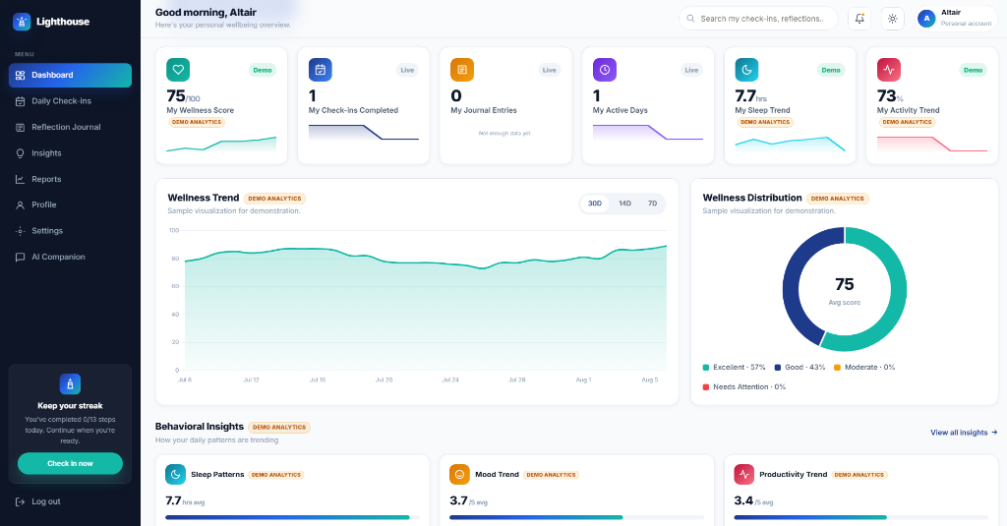
INTRODUCTION
What is Lighthouse?
● Core Mission: A guided daily wellbeing platform pairing a 13-step reflection journey with strict user privacy.
● Privacy Moat: Built on Supabase Row Level Security (RLS). Journal entries are cryptographically scoped to the user.
● Longitudinal Analytics: Interactive Chart.js visualisations reveal hidden sleep-mood-energy correlations over time.
● Proactive Admin Care: Heuristic flagging + soft nudges allow admins to reach out compassionately without invading privacy.
Lighthouse Wellbeing Platform Overview

Slide 4
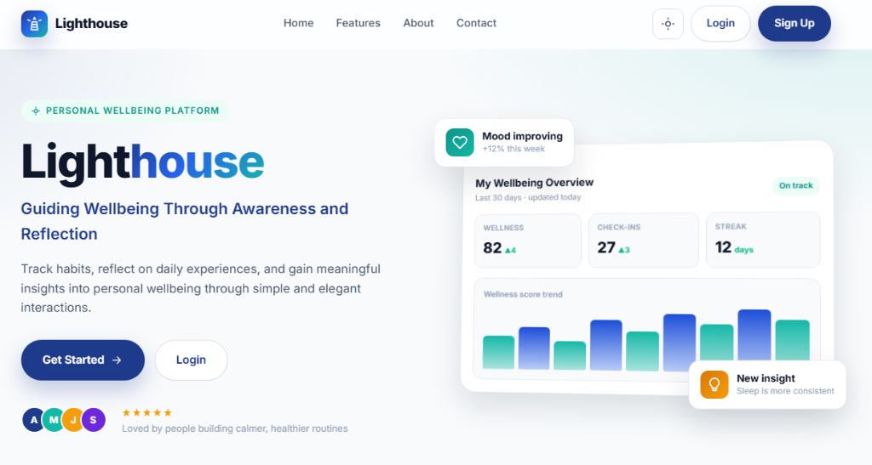
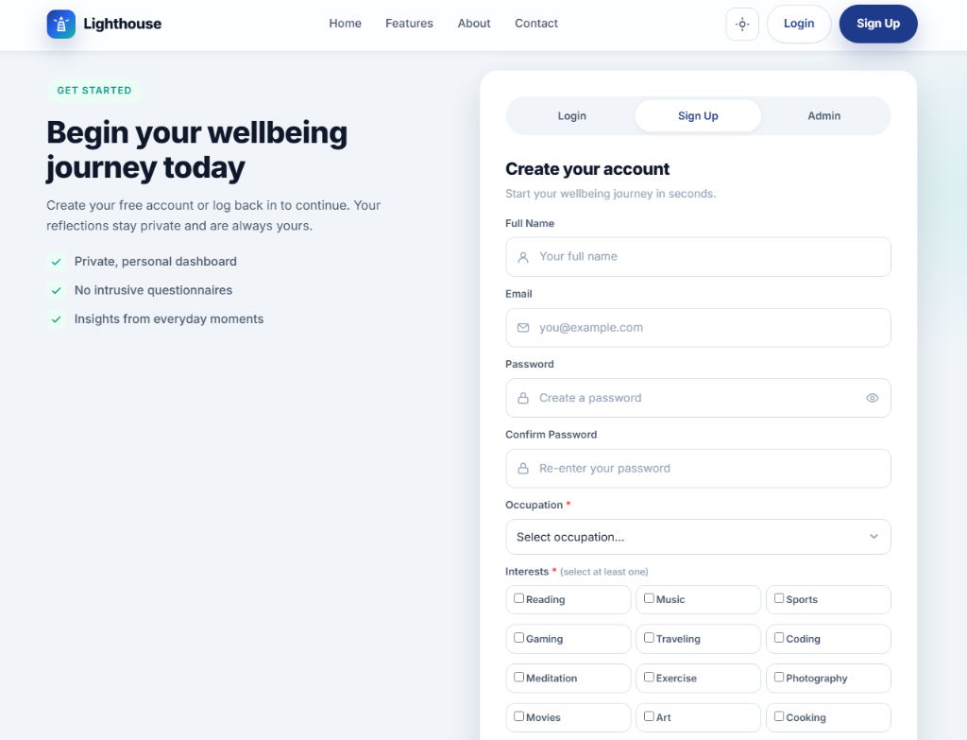
AUTHENTICATION
Landing Page & User Sign-Up
Marketing + Auth Page
Single page hosting Login, Sign Up, and Admin tabs. New visitors see product pitch; returning users access auth.
Extended Sign-Up Profile
Collects extended profile fields - display name, avatar, occupation, interests, DOB - powering personalized AI context.

Slide 5
CORE LOOP
The Daily Journey — 13 Steps
● Sequential Flow: Users progress through a 13-step structured sequence each day.
● Varied Micro-Activities: Check-ins, coping scenario assessments, cognitive visual challenges, and freeform journal writing.
● Progress Tracking: Clear step indicator ('Step X of 13') keeps daily reflection lightweight and engaging.
Daily Journey & Progress Tracker

Slide 6
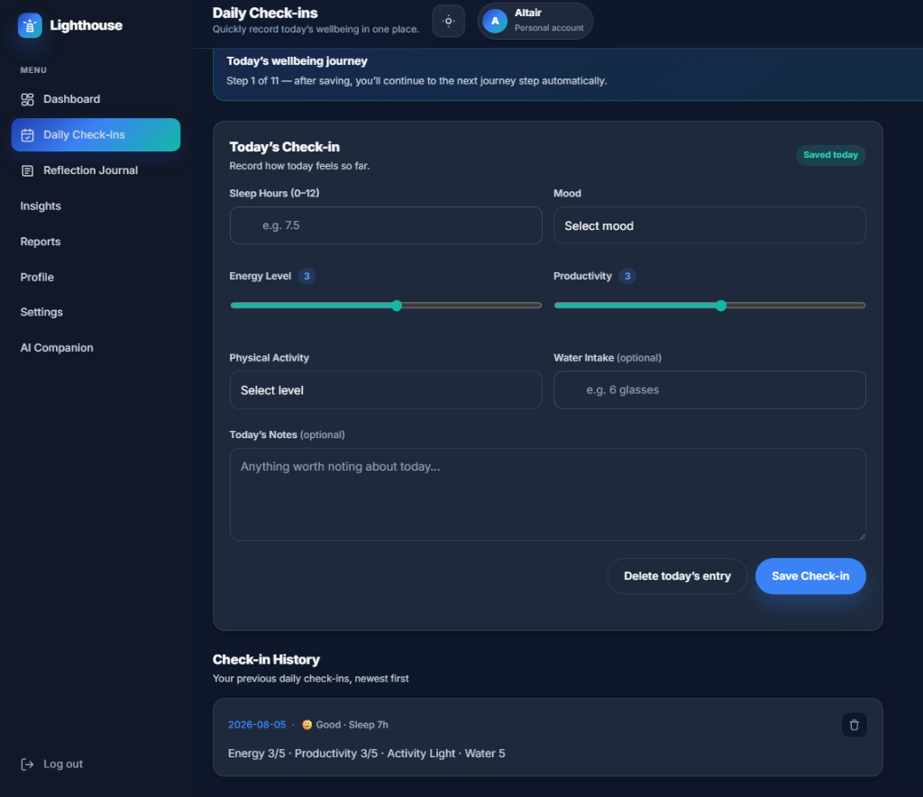
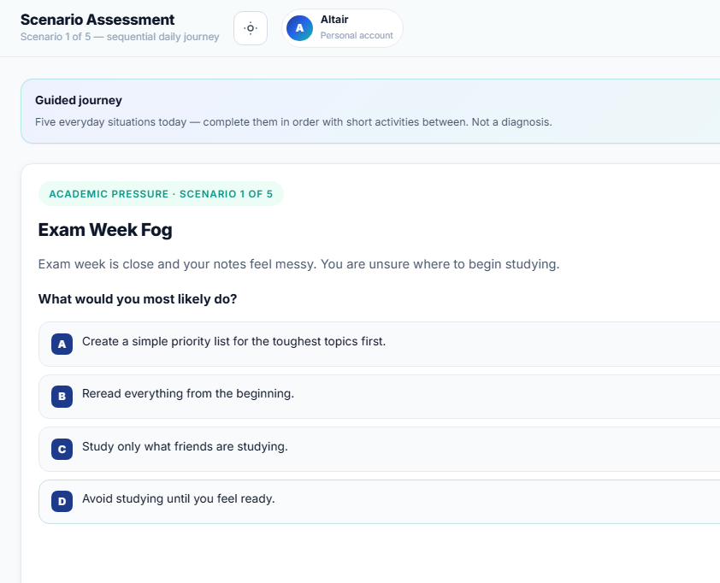
GUIDED JOURNEY — STEPS 1 & 3, 5, 7, 9, 11
Daily Check-in & Scenario Assessment
Step 1 — Daily Check-in
Users log sleep hours, mood (1-5), energy, productivity, and physical activity via smooth sliders in under 60 seconds.
Steps 3, 5, 7, 9, 11 — Scenario Assessment (x5)
Five scenario rounds present situational stories from an 80+ item bank to probe coping patterns without clinical labels.

Slide 7
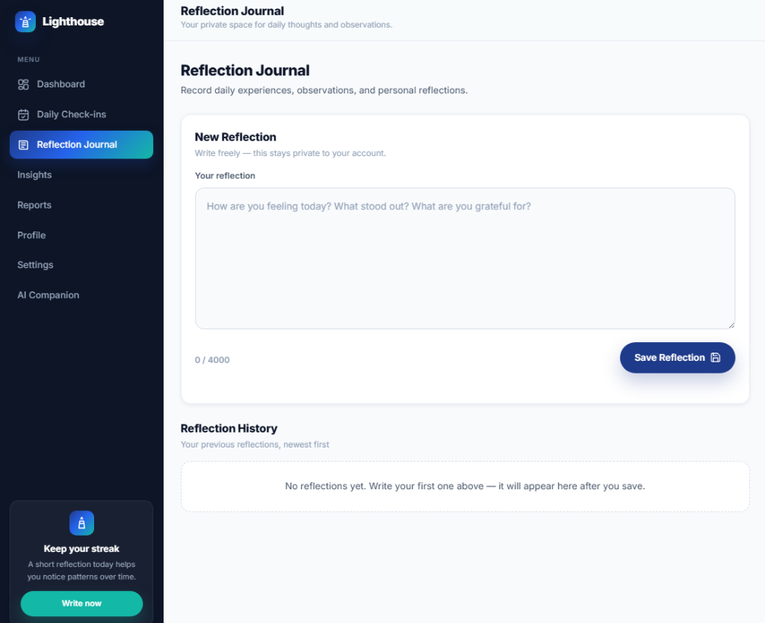
GUIDED JOURNEY — STEPS 6 & 13
Visual Reflection & Private Journal
● Step 6 — Visual Reflection: Interactive color/shape choices capturing non-verbal emotional state.
● Step 13 — Reflection Journal: Distraction-free writing canvas with guided prompt cards ('What made you smile today?').
● RLS Protection: Journal entries are encrypted in Postgres and unreadable by platform administrators.
Reflection Journal — serene, prompt-guided writing canvas

Slide 8
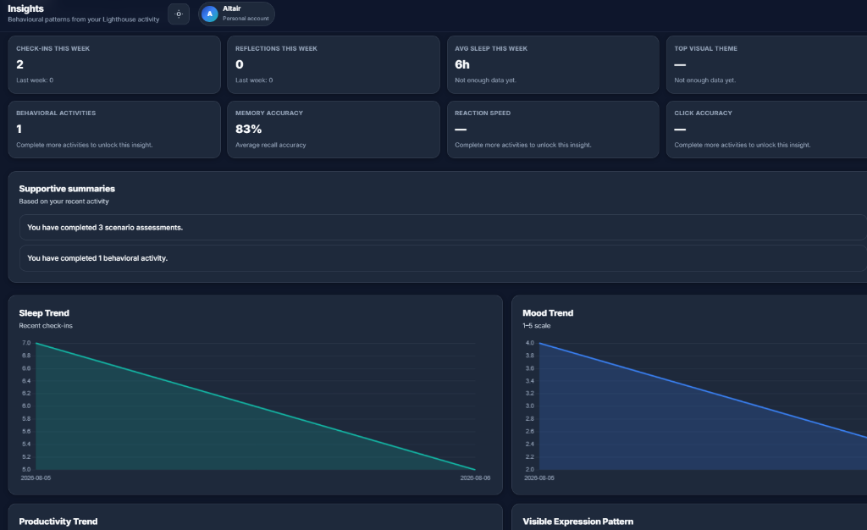
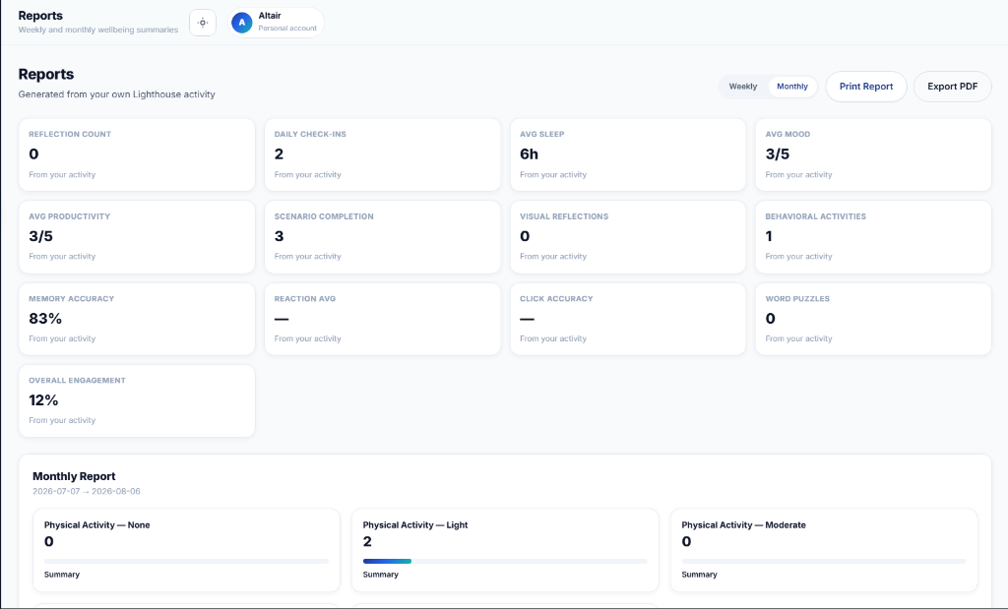
PERSONAL ANALYTICS
Insights & PDF Reports
Insights Page
Behavioural pattern dashboard powered by Chart.js. Correlates sleep, mood, energy, and productivity across weeks.
Weekly / Monthly Reports + PDF Export
Summarises journey activity into weekly/monthly snapshots. One-click jsPDF export compiles charts for personal records or therapy.

Slide 9
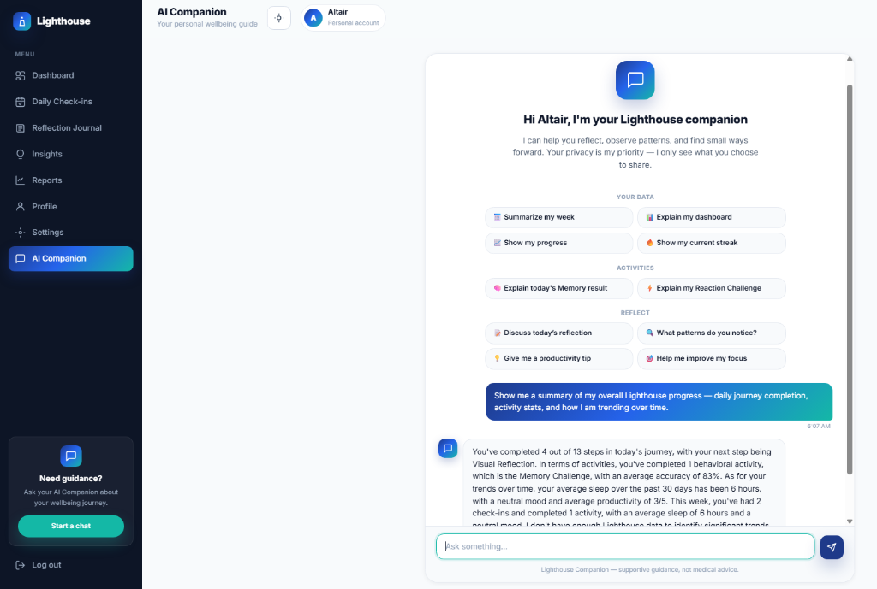
AI FEATURE
AI Companion — Lighthouse Chat
● Context-Aware AI: Powered by Groq (Llama-3.3-70B) via an Express.js backend proxy.
● Personal Data Grounding: Reads the user's real check-in averages and mood trends to give grounded, empathetic guidance.
● Privacy Guardrails: Never receives raw journal text; receives only aggregated numerical metrics.
Lighthouse AI Companion — empathetic, grounded wellness guidance

Slide 10
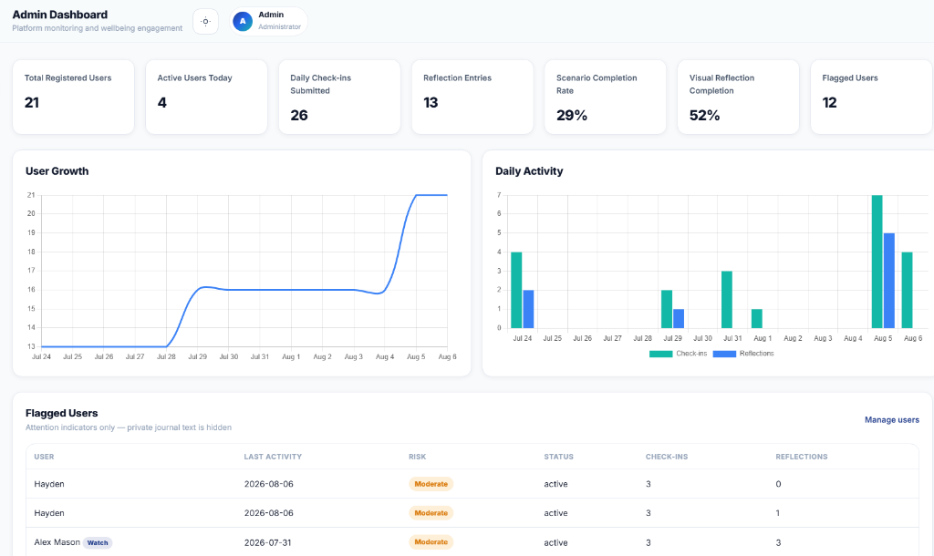
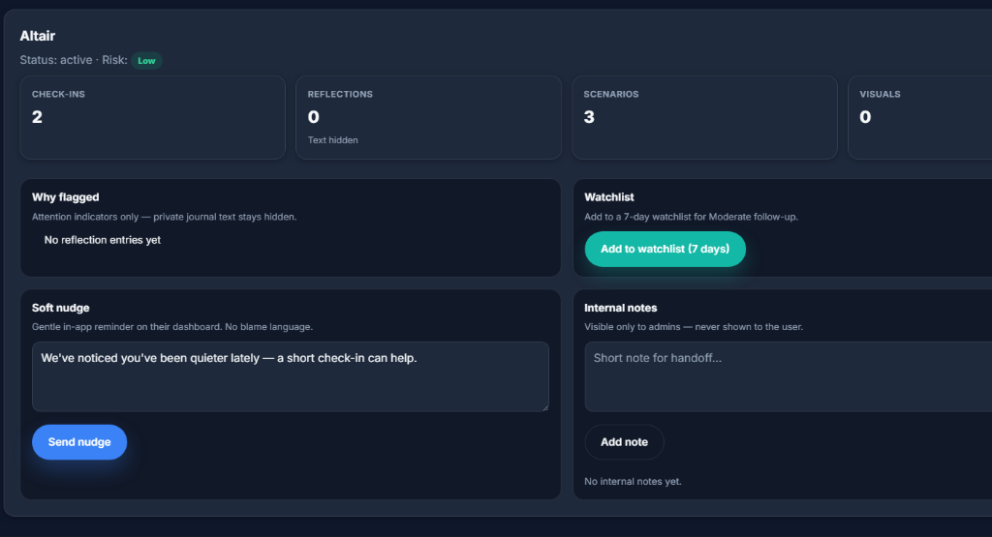
ADMIN PORTAL
Platform Monitoring & Care Panel
Admin Dashboard & Analytics
Bird's-eye view of platform health: total users, daily activity, growth charts, flagged counts, and PDF report packs.
Care Panel — Watchlist & Nudges
Flagged users appear here via heuristics (low mood streaks, inactivity). Admins review signals, add notes, or send soft nudges.

Slide 11
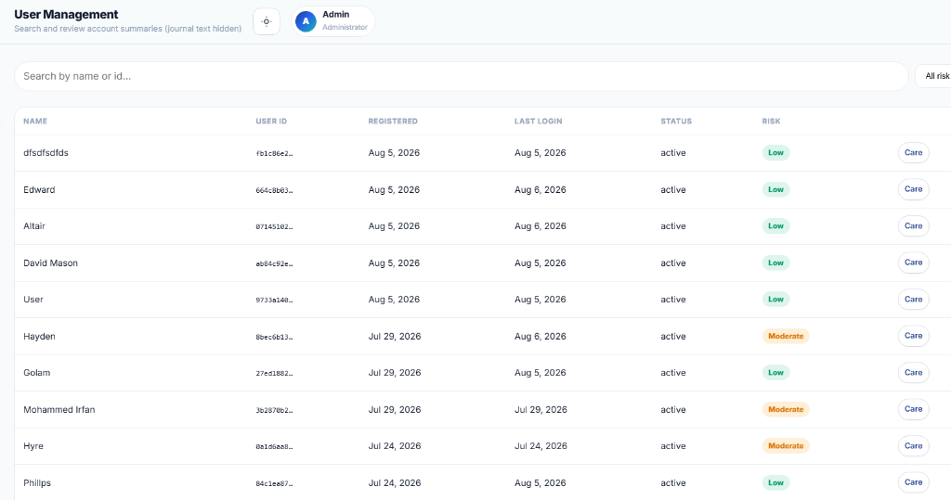
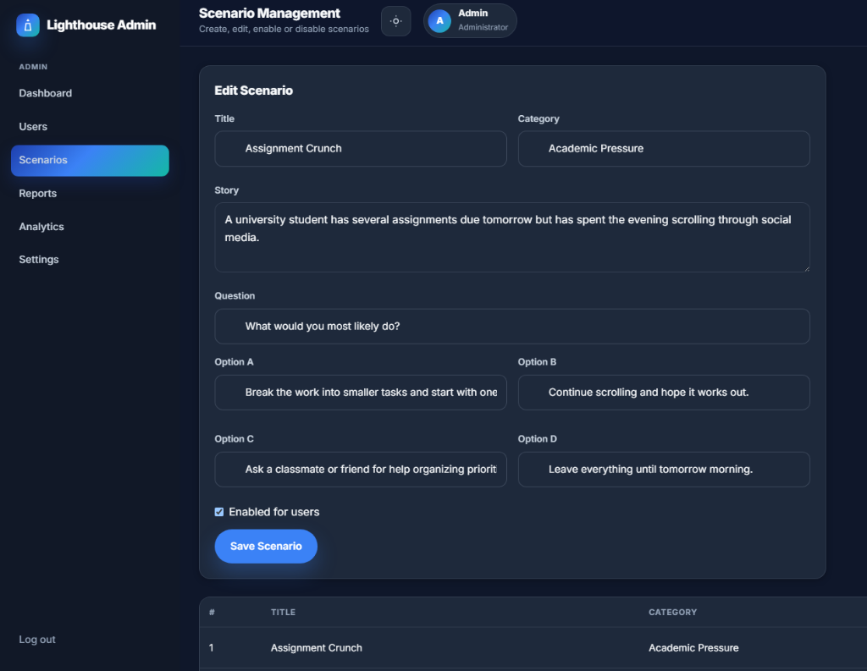
ADMIN PORTAL
User Directory & Scenario Management
User Directory
Admins browse all registered users, view engagement status, and surface accounts needing care with zero journal access.
Scenario Bank Management
Admins create, edit, enable, or disable scenario items. Ships with 80+ seed scenarios customizable to institutional context.

Slide 12
ARCHITECTURE
Technology Stack
FRONTEND
Vanilla HTML / CSS / JS
Static multi-page app — intentionally no framework. Fast, zero-build, deployable anywhere.
DATABASE & AUTH
Supabase (Postgres + RLS)
Row Level Security enforces privacy boundaries at the DB layer — users only see their own rows.
AI BACKEND
Groq · Llama-3.3-70B
Express.js proxy server holds the Groq API key server-side, feeding live data snapshots per request.
DATA VISUALISATION
Chart.js
Renders all mood, sleep, energy, productivity, and behavioural trend charts on dashboard & insights.
PDF EXPORT
jsPDF (client-side)
Generates personal wellness reports and admin PDF packs entirely in the browser.
HOSTING
Vercel (Static Deploy)
Deployed via vercel.json. Zero-build static deployment with environment configuration via config.js.

Slide 13
CONCLUSION
What Lighthouse Delivers
Guided Daily Habit
A 13-step journey building consistent self-reflection — check-ins, scenarios, activities, visual, journal.
Compassionate Admin Care
Heuristic flagging + soft nudges let admins reach out proactively — as a care tool, not surveillance.
AI Companion
Context-aware Groq-powered assistant grounded in real user data — no hallucinated scores or generic advice.
Bulletproof Privacy
Supabase RLS means journal entries are cryptographically scoped to the user. Admins see signals, never diaries.
Personal Insights
Longitudinal charts surface mood-sleep-energy correlations that single-point wellness checks miss.
Future Roadmap
Component framework migration, mobile app, and predictive anomaly detection for admin care signals.

Slide 14
Thank You
Questions & Discussion
PROJECT LIGHTHOUSE
Muhammad Zarif Rahman · Md. Al-Saiban · Md. Irfan
Software Development with JAVA (Sessional) (CSE-202) · CUET

