Slide 1
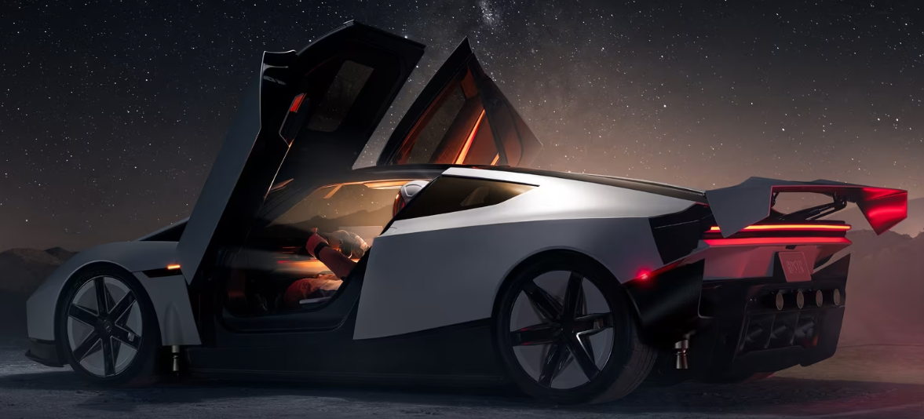
Roadster Lab
ROBOTICS CLUB · 19 OCTOBER 2026
We rebuilt Tesla's 15 October stunt in a physics engine to find out how much thrust, air and suction it really takes.
Zarif
Notes:
Four days ago Tesla showed a Roadster that hangs upside down and flips in the air. I wanted to know if the numbers add up, so I built a simulator that runs the real physics. This talk shows what I built, what it found, and what our club could build next with the same ideas.

Slide 2
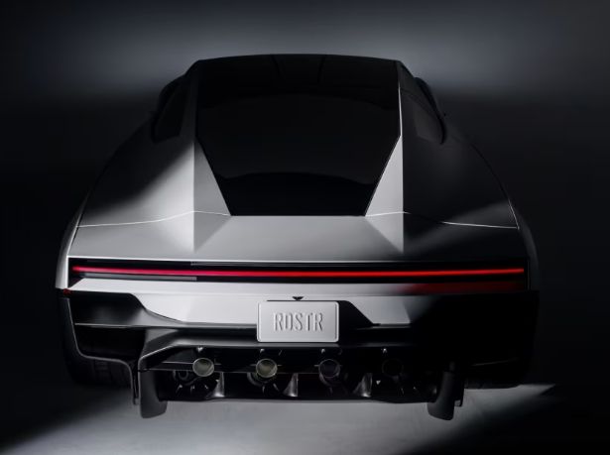
On 15 October a Roadster hung upside down from a ramp
It drove up a curved ramp and stopped underneath it. Fans under the car held it there. Then it dropped, flipped onto its wheels with cold-gas thrusters, and later jumped a row of five parked Teslas while spinning.
0.81 s
10
600 L
2 g
0 to 60 mph at the event
cold-gas thrusters
compressed-air tank
fan suction, "up to"
REPORTED
REPORTED
REPORTED
REPORTED
Sources: TechCrunch, Teslarati, CBS News coverage of the 15 Oct 2026 reveal. Tesla published no thrust, pressure or ramp dimensions.
Notes:
These four numbers are what Tesla or the press reported. Everything else, like how hard each thruster pushes, was never published. That gap is why a simulator is useful: we can test which numbers make the stunt possible.

Slide 3
Nobody published the numbers that make it work
How hard must the thrusters push?
How long does the air last?
Is 2 g of suction enough?
To flip a 2.3-tonne car in under a second and float it over a 3.8 m truck.
600 L sounds like a lot. Thrusters burn it in kilograms per second.
Upside down, the fans have to beat gravity and still press the tyres on.
44 kN
~9 s
1 g
from both rear boost nozzles in our model
of hover on a full tank
left over to press the tyres into the ceiling
Notes:
These are the three questions the simulator answers. The blue numbers are our model's answers, and I will show where each one comes from.

Slide 4
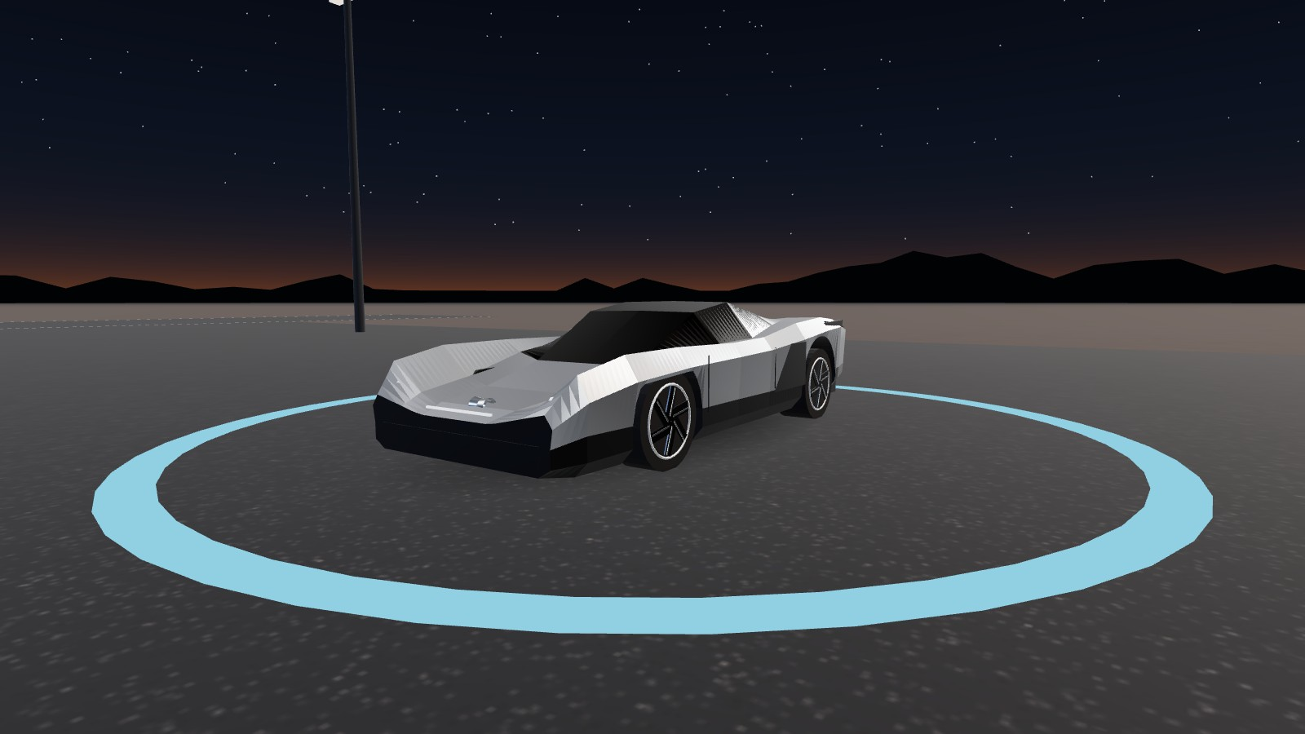
Roadster Lab runs the stunt in real physics
Drive
Keyboard driving, suspension, tyre grip, drag. Hover with H.
Stunts
Autopilot replays the ramp, the kickflip, a hover and a 0 to 60 run. Press any key to take over.
How it works
The body turns see-through. Power, air and fan flows move only when that system is working.
Data
Live readings, graphs, recorded runs, CSV export with every parameter and its source.
One file, RoadsterLab.html. Double-click it on any laptop. No install, no internet.
Notes:
The car model was built by hand from the three reveal photos, because no 3D model of the 2026 car exists yet. The physics engine is Rapier, the same kind of engine games use, and on top of it I wrote every force on the car myself.

Slide 5
Every number carries a tag
A guess must never look like a spec. The simulator and every exported file label each value one of three ways.
REPORTED
ESTIMATE
HYPOTHETICAL
4
13
13
Reported in public
Our estimates
Our design
Wheel torque 10,000 N·m, tank 600 L, fan suction 2 g, gravity.
Mass 2,000 kg, tyre grip 1.2, drag 0.30, 300 kg of air at 690 bar, exhaust speed 700 m/s.
Where all 10 thrusters sit and how hard each pushes, the pressure regulator, the controller gains.
Notes:
Only four inputs are actually reported. Thirteen are estimates I worked out, like how much air fits in a 600 litre tank at 690 bar. The thruster layout is my own design. If a value is a guess, the simulator says so.

Slide 6
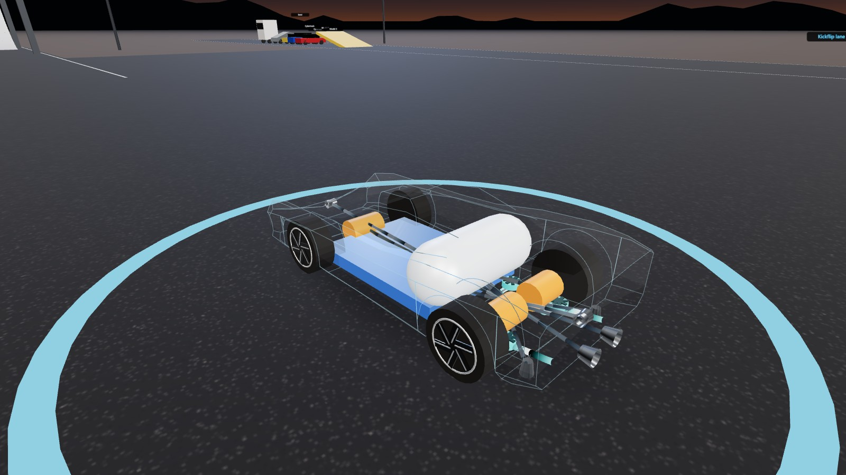
120 times a second, every force is computed and applied
1
Measure
Four rays find where each tyre touches the ground, or a ramp, or a ceiling.
2
Compute
Spring, tyre grip, drag, fan suction and thrust, each in newtons.
3
Apply at the real point
A force off the centre of mass also spins the car. Torque = r × F, nothing faked.
The arrows in the simulator are these same forces, drawn where they act.
4
Step
The Rapier engine moves the car 1/120 s. Same result at 30 or 144 fps.
Notes:
This is the core loop. The engine only knows the car as one solid body. I calculate every push and pull on it, apply each one at the exact point where it acts, and the engine works out how the car moves and turns. Because the step is fixed at 1/120 of a second, a slow laptop gives the same answer as a fast one.

Slide 7
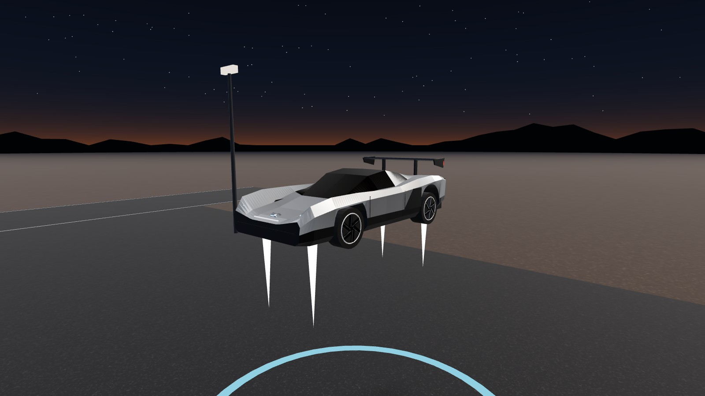
A thruster turns kilograms of air into push
F = ṁ × vₑ
Push equals air flow (kg/s) times exhaust speed (about 700 m/s). So 1 kg of air per second gives 0.7 kN.
300 kg
32 kg/s
of air in the 600 L tank
to hold the car up in a hover
ESTIMATE
ESTIMATE
Full boost empties the tank in under 5 s. A hover lasts about 9 s, so the hover mode lands itself when 30 % of the air is left. Flying around all day is not possible with this tank.
Notes:
This is the most important equation in the project. A cold-gas thruster has no fire. It just throws air out fast. To hold a 2.3 tonne car up you need about 23 kilonewtons, which means throwing out 32 kilograms of air every second. Three hundred kilograms of air lasts about nine seconds. That is why the reveal showed hops, not long flights.

Slide 8
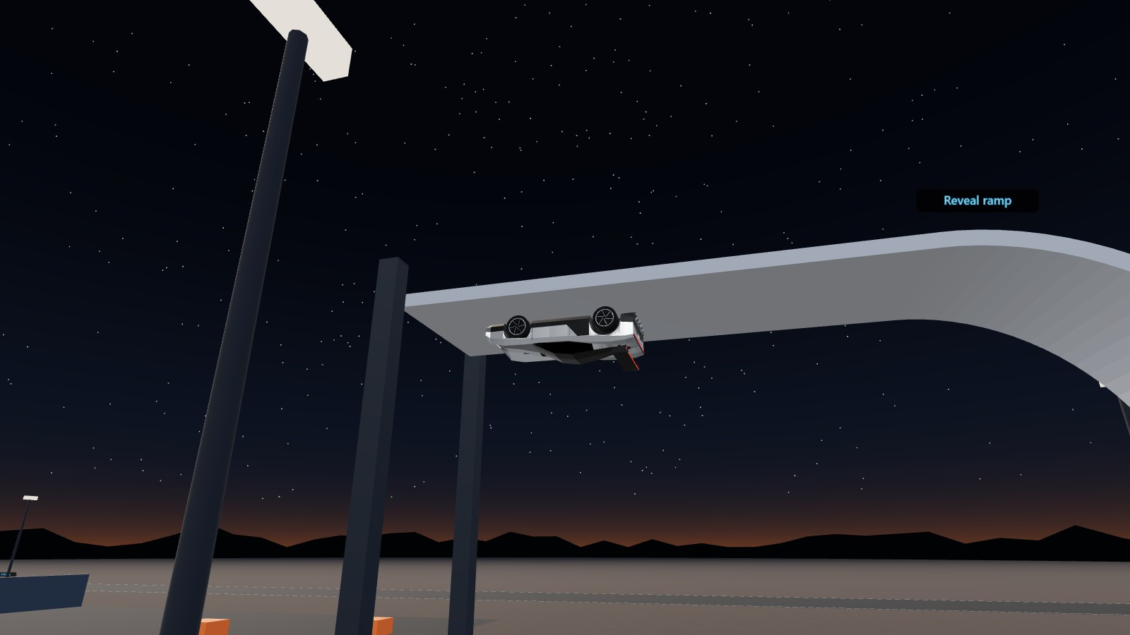
Suction is what holds it upside down
Fans pull the car toward the surface
2 g
Gravity pulls it away from the ceiling
−1 g
Left over to press the tyres on
1 g
It only works while the underbody seals against the surface. In the model suction fades to zero once the gap passes about 0.3 m. Turn the fans off and the car falls, which is exactly how the stunt ends.
Notes:
Upside down, the fans pull the car up with twice its weight. Gravity takes one weight away, so the tyres are still pressed into the ceiling with one full weight, the same as driving on a road. That is enough grip to drive on the ceiling. Lose the seal and it falls.

Slide 9
The hover controller is quadcopter maths
4 lift nozzles
Point down, push up. 10 kN each.
2 boost nozzles
Point back, push forward. 22 kN each.
4 side nozzles
Push the nose or tail sideways to spin the car.
Each step the controller measures tilt and height, decides the push it wants, and splits it across the four lift nozzles, like a drone splits power across four motors. When it asks for more than the nozzles can give, the screen says AT THRUST LIMIT instead of hiding it.
Top view, nose up
Notes:
Ten thrusters were reported. Where they sit is my design, chosen so the car can lift, push forward and spin. The controller is the same idea as a drone flight controller, and that is the first thing our club could build for real.

Slide 10
0 to 60 mph: the model lands near both claims
Tesla 2017 claim: 1.9 s
Our wheels + fans run: 1.88 s
REPORTED
Reveal run, Oct 2026: 0.81 s
Our run with thrusters: 0.85 s
REPORTED
Tyres alone stop at about 1.2 g, so 2.31 s. Fan suction adds grip without adding mass. Thrusters push without needing grip at all.
Notes:
I did not tune the model to hit these numbers. With only the reported torque and normal tyre grip, the car does 2.3 seconds. Turn the fans on and it lands on 1.88, almost exactly the 2017 claim. Add thrusters and it lands on 0.85, close to the 0.81 shown at the reveal. That tells me the estimates are in the right range.

Slide 11
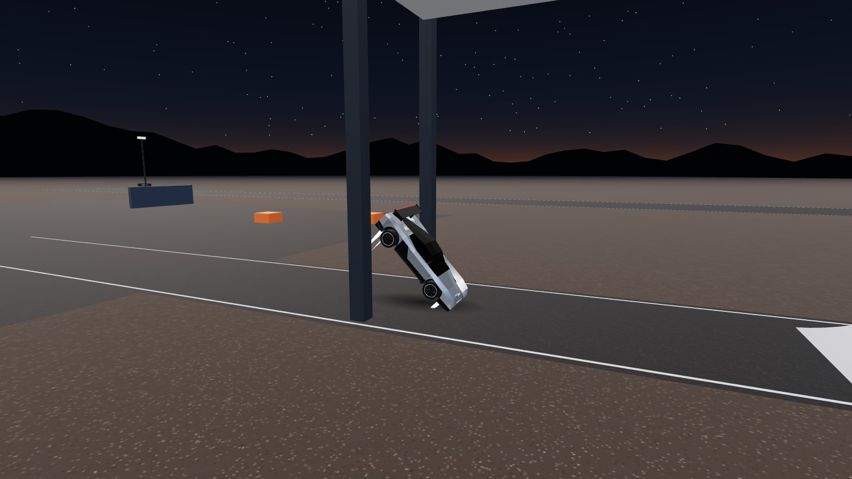
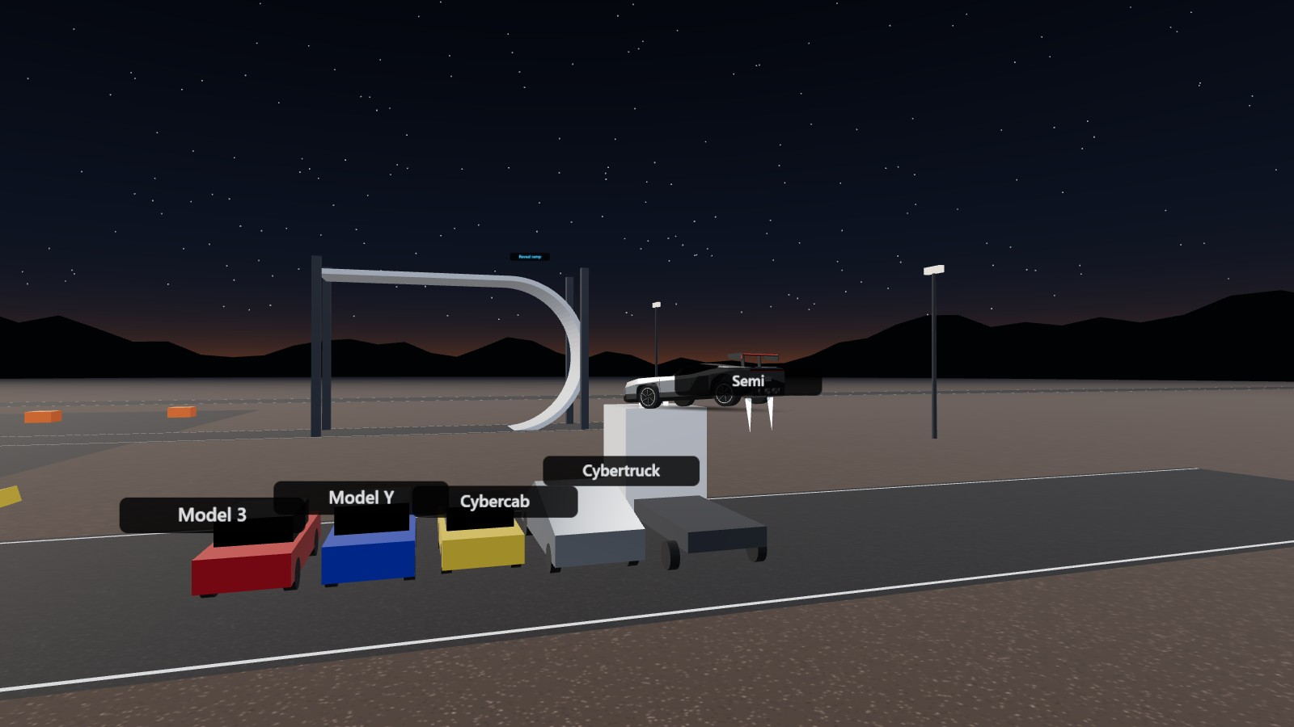
The three stunts, recreated
Reveal ramp
Kickflip
Hover
Climbs a 6 m radius curve, hangs 11 m up on suction for 3 s, drops, rolls upright with the lift nozzles, lands.
Jumps at 68 km/h, lift nozzles carry half its weight so it clears the 3.8 m Semi, spins 368° and lands.
Holds 3 m, climbs to 5 m, turns, and lands itself when the air drops to 30 %.
Each one is the autopilot pressing the same controls you would. Nothing is animated by hand.
Notes:
These are not videos. The autopilot gives throttle, steering and thruster commands and the physics decides what happens. If I change the gravity or the air supply, the stunts can fail, and that is the point.

Slide 12
We check the model before we trust it
Check | Expected | Simulated | Result
Free fall for 1 s | 4.905 m | 4.914 m | PASS, 0.2 % off
Car settles on 4 wheels | at rest | 0.03 m/s, 4 contacts | PASS
Side nozzle T9 spin (r × F) | −0.0241 rad/s | −0.0241 rad/s | PASS, exact
Air used, 1 s full boost | 62.86 kg | 62.86 kg | PASS, exact
All 4 stunts finish upright | complete | ramp, kickflip, hover, 0-60 | PASS
Run it yourself: node test/sim-check.mjs. It replays every check without a browser.
Notes:
A simulator is only useful if it is right about the things we can check. Free fall should match the school physics formula, and it does to 0.2 percent. The spin from one side nozzle matches r cross F exactly. These are consistency checks, not proof about the real car.

Slide 13
What this cannot tell us
Model ≠ car
Nothing was measured on a real Roadster. Tesla's engineering data is not public.
Tyres use a simplified grip curve, not a full tyre model.
Air flow ignores temperature drop as the tank empties.
The thruster layout is ours. The real car may place them differently.
A model is only as good as its inputs, and most of ours are estimates.
Notes:
I want to be clear about what this is. It is a careful model that passes its own checks and lands close to Tesla's published times. It is not proof the real car works this way.

Slide 14
Same physics, smaller hardware
Wall-climbing robot
Thruster pointing rig
from the suction fans
from the cold-gas thrusters
One ducted fan, a foam skirt and a pressure sensor. Suction must beat weight divided by grip.
Low-pressure air, solenoid valves and an IMU on a single bearing. Torque = r × F, live.
Self-levelling drone
Traction-control RC car
from the hover controller
from the tyre model
Our own controller and thrust mixer on a quadcopter frame, the code from this project.
1:10 car with wheel encoders. Firmware keeps each tyre under its grip limit.
Club builds stay at a few bar of air pressure, never near 690 bar, and run under supervision.
Notes:
Every system in the car scales down. My first pick is the wall-climbing robot: it uses the same suction maths, it is cheap, and we can test it in the simulator first by changing the mass and fan force.

Slide 15
What we are asking for
1
Parts for the wall-climbing robot
Live demo
Fan, battery, sensors and a small chassis. We size each part in the simulator before we buy it.
Open RoadsterLab.html
Stunts, then Reveal ramp
How it works, then hold Shift
Data, then Export CSV
2
Lab time and a supervisor
For building and for any work with compressed air.
3
A review in six weeks
We bring the robot, the simulator prediction, and the measured result side by side.
github.com/Zarif0101/Roadster-Sim
Notes:
Here is the ask. Then I will switch to the simulator and show the ramp stunt live, open the see-through view while the thrusters fire, and export the data the run produced.

