Slide 1
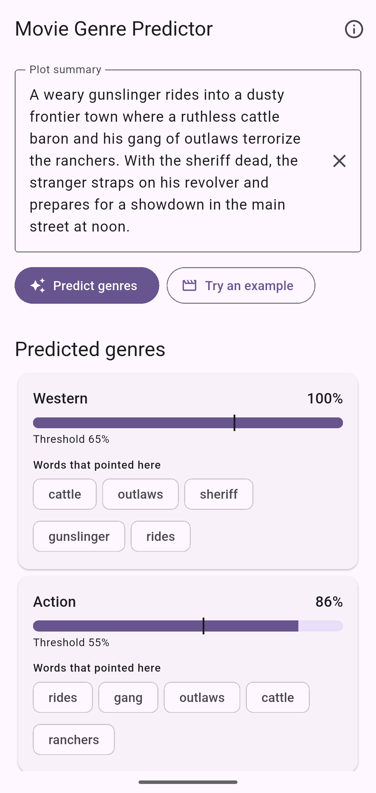
What genre is
this movie?
Capstone project
Predicting genres from a plot summary, offline, on a phone
Zariff · October 2026
Notes:
Hi, I'm Zariff. For my capstone I built a genre predictor: you give it a movie's plot, and it tells you which genres the movie belongs to. It runs completely on the phone. There's no server behind it, and it works in airplane mode. I'll go through the data, the model and the results, including a few things it learned that I didn't expect, and then the part that took the most work, which was getting the phone to give exactly the same answers as the Python model.

Slide 2
One plot, several genres
An example plot from the app
What the model says
“A weary gunslinger rides into a dusty frontier town where a ruthless cattle baron and his gang of outlaws terrorize the ranchers. With the sheriff dead, the stranger straps on his revolver and prepares for a showdown in the main street at noon.”
Western 100%
Action 86%
Adventure 82%
15 genres, any combination
Each genre is its own yes/no question.
2.2 genres per film
That’s the average across all 38,397 films.
Notes:
Here's one of the example plots from the app. It's obviously a western, but you could call it an action film too, and the model also says adventure. Lots of films are like that. In this dataset the average film has 2.2 genres. So I treat it as fifteen separate yes-or-no questions, one per genre, and any combination is allowed. Something like this could suggest genres for a film or a story idea that has a synopsis but no tags yet.

Slide 3
Why run it on the phone?
Works offline
The catch
No connection needed. It runs in airplane mode.
Whatever I train in Python, I have to rebuild by hand in Dart, the language Flutter apps are written in. That rules out big models. I needed one where a prediction is mostly multiplying and adding.
Private
Whatever you type stays on your phone.
Free to run
No server to host or pay for.
Notes:
I wanted it on the phone for practical reasons. It works anywhere, even with no signal. Nothing you type leaves your phone. And I don't have a server to keep running or pay for. The catch is that whatever I train in Python, I have to rewrite myself in Dart, which is the language Flutter apps are written in. That pushed me toward a simple model, where a prediction is mostly multiplying and adding numbers.

Slide 4
The data
42,306
Share of films tagged with each genre
plot summaries from Wikipedia (2012), the CMU Movie Summary Corpus
363 → 15
Freebase genre labels, mapped onto 15 story genres
38,397
films kept after mapping and removing duplicates
Notes:
The data is the CMU Movie Summary Corpus: about 42,000 Wikipedia plot summaries, with genre labels from Freebase. Freebase has 363 different genre labels, and a lot of them aren't really about the story, things like black-and-white or Bollywood, which say how or where a film was made rather than what happens in it. So I mapped the labels onto 15 story genres and dropped the films that didn't fit any of them. That left about 38,000 films. And as you can see it's very unbalanced. Half the films are dramas, and fewer than 3% are westerns. That imbalance comes back later.

Slide 5
How it fits together
Train in Python
model.json
Predict in Dart
scikit-learn
TF-IDF + 15 logistic regressions
3.5 MB
vocabulary, IDF values, weights, thresholds
Flutter app, no server
about 1 ms per plot on a laptop
How the 38,397 films were split
Training 26,877
Validation 5,760
Test 5,760
Training: fit the model. Validation: every setting I tuned. Test: used once, at the very end.
Notes:
This is the whole system. I train in Python with scikit-learn. The vocabulary, the IDF values, the weights and the thresholds all go into one JSON file, about three and a half megabytes. The Flutter app bundles that file and does the prediction in plain Dart. The films are split 70/15/15. Training data fits the model, validation data is for every setting I tuned, and the test set was only used once, at the very end, so the score I report wasn't tuned on it.

Slide 6
The model
TF-IDF over 20,000 words
Choosing C (regularisation) on validation data
Common words count for less, rare words for more.
15 logistic regressions
One per genre, with balanced class weights.
A threshold per genre
From 0.39 (Drama) to 0.72 (War), set on validation data.
Best at C = 1 (0.615). All six values are within 0.014.
Notes:
The model is simple on purpose. Each plot becomes a TF-IDF vector over 20,000 words, so rare, specific words like saloon count for more than common ones. Then there are fifteen logistic regressions, one per genre. I used balanced class weights, because otherwise the model mostly says no to rare genres like westerns. With tuned thresholds the unweighted model catches up, and both get about 0.615 on validation, but balanced weights mean it doesn't depend so much on getting the thresholds right. I picked the regularisation strength on the validation set too. It's best at C equals one, but all six values are within about 0.014, and 0.5 and 2 are only about 0.002 behind it, so anything from 0.5 to 2 would have been fine.

Slide 7
Results on 5,760 films it never saw
0.643
0.598
micro-F1 (all genre decisions pooled)
macro-F1 (every genre counts equally)
95% interval: 0.636 to 0.649
Tagging every film with every genre gets 0.257.
95% interval: 0.588 to 0.608
Tagging every film with every genre gets 0.239.
F1 runs from 0 (useless) to 1 (perfect). F1 per film: 0.631 Exact genre set right: 17% of films
Notes:
These are the test results, on films the model never saw while I was training or tuning it. F1 balances two things: when the model tags a genre, how often is it right, and of the films that really have that genre, how many does it find. Zero is useless and one is perfect. Micro-F1 pools all the yes/no decisions, so the common genres count most, and it's 0.64. Macro-F1 gives the fifteen genres equal weight, and it's 0.60. If you just tag every film with every genre you get about 0.26 and 0.24. Only 17% of films get exactly the right set of genres, which sounds bad, but all fifteen yes/no answers have to be right for that, and some labels are missing in the first place.

Slide 8
Easy genres and hard genres
F1 per genre on the 5,760 test films
Western F1 0.75 vs 0.05
Cowboys are easy to spot:
ranch, outlaw, cattle, saloon.
Drama 0.78, but 0.69 for free
Half the films are dramas, so the baseline is already high.
Musical F1 0.38
69% of Bollywood films are tagged Musical, but only 7% of other Indian films. Indian names push the model to Musical for both.
Notes:
Per genre, the grey bars are the F1 you'd get by tagging everything, and purple is the model. Drama has the highest score, but most of it comes for free, because half of all films are dramas. Western is the real success, 0.75 against a baseline of 0.05, because westerns have such a distinctive vocabulary. The hardest are Musical, Mystery and Fantasy. Musical is partly a labelling problem. Freebase tags 69% of Bollywood films as musicals, but only 7% of other Indian films, so the tag isn't used consistently. The model picked up Indian names and places, so almost half of its Musical false positives are Indian films that aren't labelled Bollywood. On the Bollywood films themselves it gets 0.59, about its average across all genres. But even on films that aren't listed as made in India it only gets 0.36, so musicals are hard to spot from a plot anyway.

Slide 9
Per-genre thresholds helped a little
Test F1 with the tuned threshold, minus test F1 at 0.5
9 genres better
Western +0.064 and Family +0.047 gained most.
1 unchanged
Thriller’s tuned threshold is exactly 0.50.
5 genres worse
Fantasy lost 0.026.
The other four lost 0.006 or less.
Macro-F1 0.588 → 0.598
Small, but above zero in all 1,000 bootstrap resamples of the test films.
Notes:
I expected per-genre thresholds to help a lot. They helped a bit: macro-F1 went from 0.588 to 0.598, and Western and Family gained the most. For five genres the tuned threshold did slightly worse on the test set than plain 0.5. Fantasy lost 0.026. I think a threshold picked on a few thousand validation films is just a noisy estimate, especially for a small genre. To check the overall gain wasn't luck, I bootstrapped the difference on the same test films. In 95% of the resamples the gain was between 0.005 and 0.016, and it stayed above zero in all 1,000. Next time I'd tune the thresholds with cross-validation, so each one is based on more data.

Slide 10
What it actually learned
Makes sense
Shortcuts from the data
Western
ranch
outlaw
cattle
saloon
daffy
→ Family
85% of plots that mention Daffy are tagged Family
War
war
soldiers
army
nazi
stooges
→ Comedy
199 of the 202 plots that mention the Stooges are comedies
Horror
vampire
zombie
werewolf
mumbai
→ Musical
31% are tagged Musical, against 6% of all films
Sci-Fi
alien
planet
robot
she
→ Romance
the #3 strongest Romance word
Notes:
Because the model is linear, you can read off which words push each genre up. Most of it makes sense: ranch and saloon for westerns, soldiers for war, vampire for horror. But some of it is just quirks of this dataset. Woody and bugs are two of the top three Family words, and daffy is in the top ten. That's Woody Woodpecker, Bugs Bunny and Daffy Duck. The corpus has a lot of cartoon shorts, and they're tagged Family. The Stooges do the same for comedy, and Mumbai pushes toward Musical because of Bollywood. 'She' is the third strongest Romance word, probably because romance plots on Wikipedia are more often written around a woman. So a love story between two men gets less of that push. Those cartoon and Stooges plots are in both the training and the test set, which I'll come back to at the end.

Slide 11
Splitting text into words
Python and Dart don’t agree about text
So the rule is blunt
A word is a run of 2 or more plain ASCII letters, lowercased. Everything else splits words.
K
Kelvin sign (U+212A)
Python lowercases it to a plain “k”
“Spider-Man’s 2nd fight!”
İ
Turkish capital I
Python turns it into two characters
spider
man
nd
fight
\w
“word character”
means different things in each language
Notes:
Now the part that took the most work. This slide is about splitting text into words. If Python and Dart do that even slightly differently, the phone looks up different words from the ones the model learned. Nothing crashes and there's no error, the scores are just wrong. Most of the trouble is Unicode. Python, for example, turns the Kelvin sign into a normal k when it lowercases it. So I made the rule really simple: a word is two or more letters from a to z in a row. Accented words get split up, which mostly affects names, so it shouldn't matter much.

Slide 12
Making Python and Dart agree
Tokenizer
Exported file
Dart app
19 awkward inputs (accents, emoji, the Kelvin sign) give identical tokens in Python and Dart.
All 86,400 test decisions are rechecked from the file against scikit-learn. Largest gap: 0.00000004. Decisions changed: 0.
48 texts go through the real Dart code. Every probability matches Python within 0.000001.
I broke it on purpose to check. Replacing 1 + ln(count) with the raw count made the Dart test fail (0.928 instead of 0.959).
Notes:
I check that Python and Dart agree in three places. First, both tokenizers have to split 19 awkward inputs the same way. Every time I train, the script reads the exported file back, runs all 5,760 test plots through it and compares the probabilities with scikit-learn's. It's only comparing the two copies of the model, it never looks at the labels. The biggest gap is in the eighth decimal place, and no yes/no decision changes. If it were ever bigger than a millionth, the new file wouldn't replace the one in the app. Then a Dart test runs 48 texts through the real app code and checks every probability against Python. To make sure that test could fail, I broke the Dart code on purpose, and it failed straight away.

Slide 13
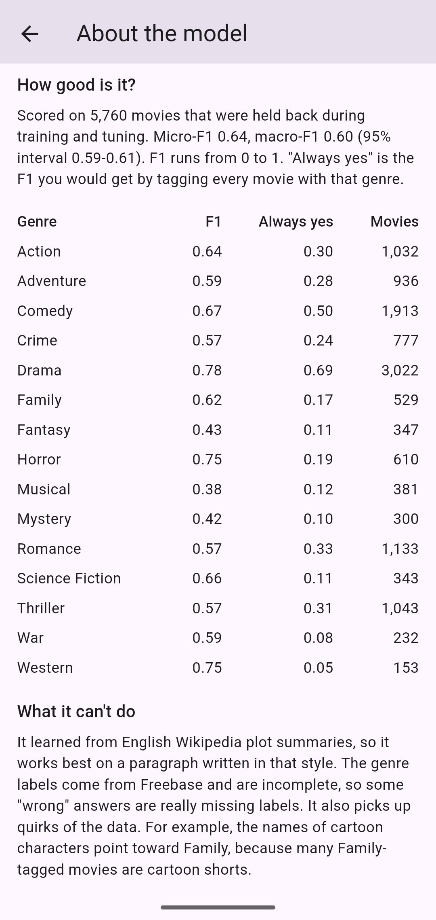
The app
Runs in airplane mode
Tested on an Android emulator with the network off.
No internet permission
The Android release build doesn’t ask for it.
About 1 ms per prediction
Measured on a laptop. The model is a dot product.
Shows its reasons
The words that pushed each genre up, plus the test scores.
Notes:
Here's the app. I tested the release build on an Android emulator in airplane mode, and it doesn't ask for internet permission at all. If there's time, I'll show it live. [If the phone won't cooperate, talk through the two screenshots instead.] First, one of the built-in examples: I tap “Try an example”, which fills in a plot and predicts straight away. Each genre that passes its threshold gets a card with the probability, the threshold marked on the bar, and the words that pushed it up. Then the About screen. These are the test scores, read straight from the model file, so they always match the model that's installed. Then I type a one-line plot, “A cowboy rides into town.” It still says Western, but it warns that it only knows four of the words, so the result is shaky. Last, I press predict on an empty box, which brings me to the next slide.

Slide 14
Bugs caught along the way
Bug | Why it happened | Fix
An empty box said “Drama” | With no known words, each genre falls back to its intercept. For Drama that gives 0.391, just over its 0.39 threshold. | The app asks for a plot, and shows no genres when it knows none of the words.
An accessibility error | The probability bar gave screen readers text where Flutter expects a number. A widget test caught it. | The bar is hidden from screen readers. The card already says both numbers.
Rounding twice | Scores were rounded to 4 decimals, then printed to 3, so micro-F1 showed 0.642 instead of 0.643. | Everything is rounded once, when the results are written.
Notes:
Three bugs I want to mention. The best one came from a code review: if you pressed predict on an empty box, the app said Drama. With no words, each genre falls back to its intercept, and for Drama that works out at 0.391, just over its 0.39 threshold. I fixed it in the app, not the model, so Python and Dart still match. The second was an accessibility error that one of the widget tests caught. And rounding numbers twice had shifted a reported score by 0.001, so now everything is rounded once, at the end.

Slide 15
What’s still wrong, and what’s next
Limitations
Next
Series sit in both train and test. Stooges plots: 135 in training, 39 in test.
Labels are incomplete. The Double, a CIA thriller, isn’t tagged Thriller.
It reads words, not order: “the police chase the gang” looks the same as “the gang chase the police”.
It only really works on Wikipedia-style English.
Split by film series, not by film
Check whether the probabilities are calibrated
Classifier chains, so genres can inform each other
A smaller model file (16-bit weights)
Notes:
These are the problems I know about. The biggest is that I split the data randomly by film, so cartoon series and Stooges shorts end up in both training and test, and the model gets credit for recognising character names. That makes Family and Comedy look a bit better than they really are. The labels are also incomplete: The Double is a CIA thriller that isn't tagged Thriller, so when the model says Thriller it counts as a mistake. And it reads words, not their order, so “the police chase the gang” and “the gang chase the police” look exactly the same to it. If I had another week, the first thing I'd do is split by series, so the test score tells you how it does on series it's never seen. The other ideas are on the slide.

Slide 16
Thanks
Questions? Or give me a plot and I’ll run it.
Data: CMU Movie Summary Corpus (Bamman, O’Connor and Smith, 2013), CC BY-SA 3.0 US
Notes:
So, to sum up. It reaches a macro-F1 of 0.60 on films it never saw, against 0.24 for tagging everything. It runs entirely on the phone, and the app matches the Python model to within a millionth. And the explanations showed me what it really learned, cartoon names included. Thanks for listening. I'm happy to take questions, or to try the app on any plot you want to give it.

