Slide 1
Reinforcement Learning to Trade the Stock Market
Zarin Subah Shamma
A02368194

Slide 2
Reinforcement Learning to Trade the Stock Market
Why so hard to trade????
The goal of this project is to train an agent successfully using Reinforcement Learning
so that ​we can make great profit in stock market.​
Non-linear, arbitrary, uncontrollable fluctuations
Highly volatile
Position sizing (striking a balance between return and risk)
Information asymmetry
Difficult to identify factors affecting stock prices
Hard to control the price direction of a company

Slide 3
Reinforcement Learning to Trade the Stock Market
Neural Network
Q-Learning Agent
Input
Layer
Hidden
Layer
probability(hold)​ | probability(sell)​ | probability(buy)​
Output
Layer
1
1
2
1
2
3
2
States
Hold, Buy, Sell
3
10
256

Slide 4
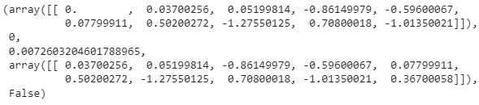
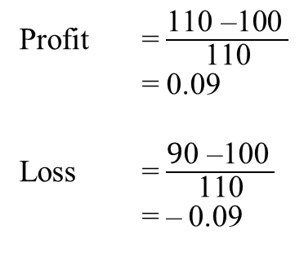
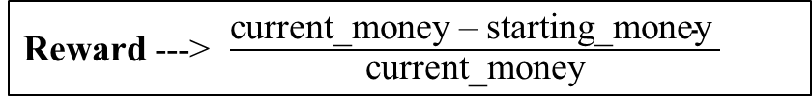
Memory
Action
State
Reward
Next State
Done
State --->
Difference between previous day & present-day close price
Reward ---> $\frac{\text{current}\text{_}\text{money} \text{–} \text{starting}\text{_}\text{money} }{\text{current}\text{_}\text{money}}$
Action: Random / Greedy
0: Hold: No change
1: Buy: if (current_money >= close_price):
inventory will record the bought price
current_money = current_money – close_price
2: Sell: if (we have a stock to sell):
bought_price will be taken from inventory
profit = profit + (close_price – bought_price)
current_money = current_money + close_price
Profit = $\frac{\text{110 }\text{–}\text{100} }{\text{110}}$
= 0.09
Loss = $\frac{\text{9}\text{0 }\text{–}\text{100} }{\text{110}}$
= $\text{–}$0.09

Slide 5
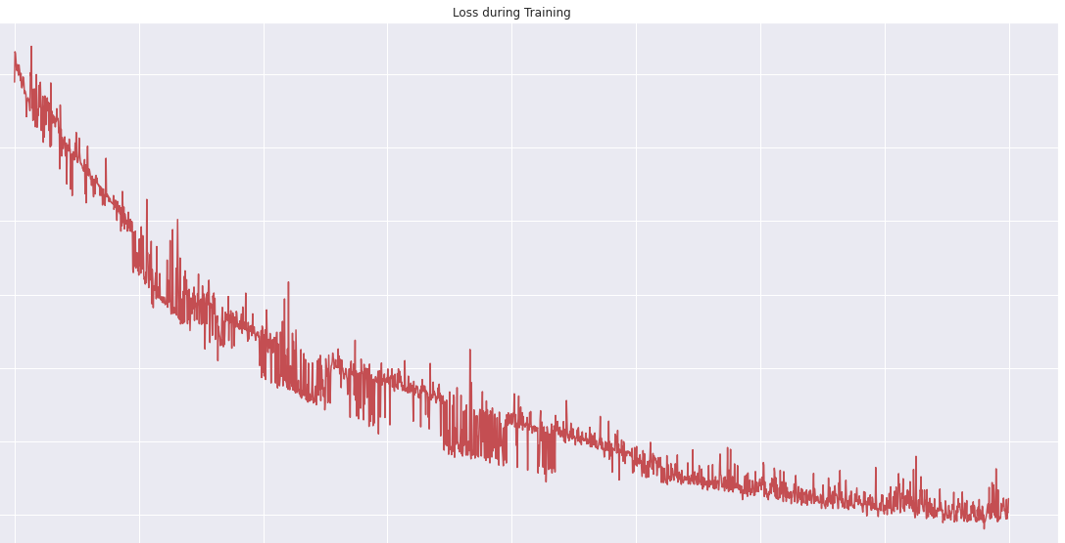
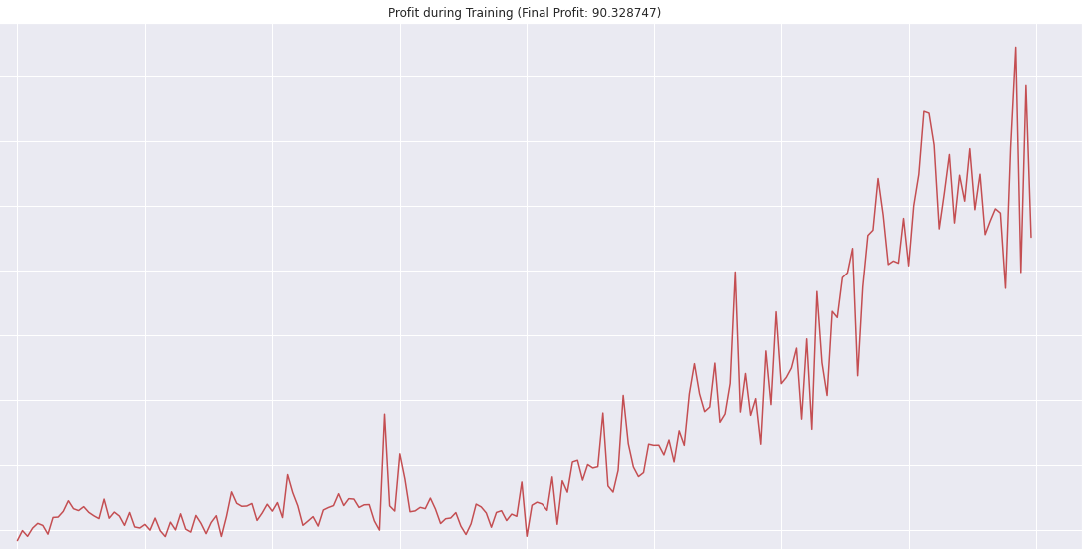
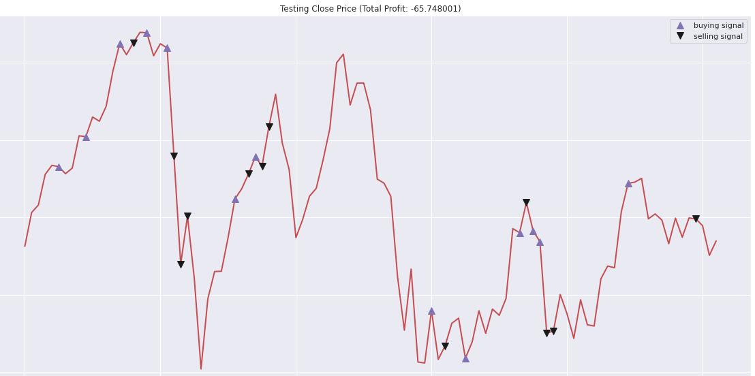
0.00200
Loss during Training
140
Profit during Training
0.00175
Q-Learning Agent
120
0.00150
100
80
0.00125
Profit
Loss
60
0.00100
40
0.00075
20
0.00050
0
0
250
500
750
1000
1250
1500
1750
2000
0
25
50
75
100
125
150
175
200
Iteration
Iteration
Training Data: 2016 – 2017
Window = 5 days
Iterations = 2000
Starting money = 10,000
58
Profit: -65.75
Buying Signal
56
Selling Signal
54
Close price
Testing Data: 2018(Jan – May)
Starting money = 10,000
52
Testing
50
0
20
40
60
80
100
Iteration

Slide 6
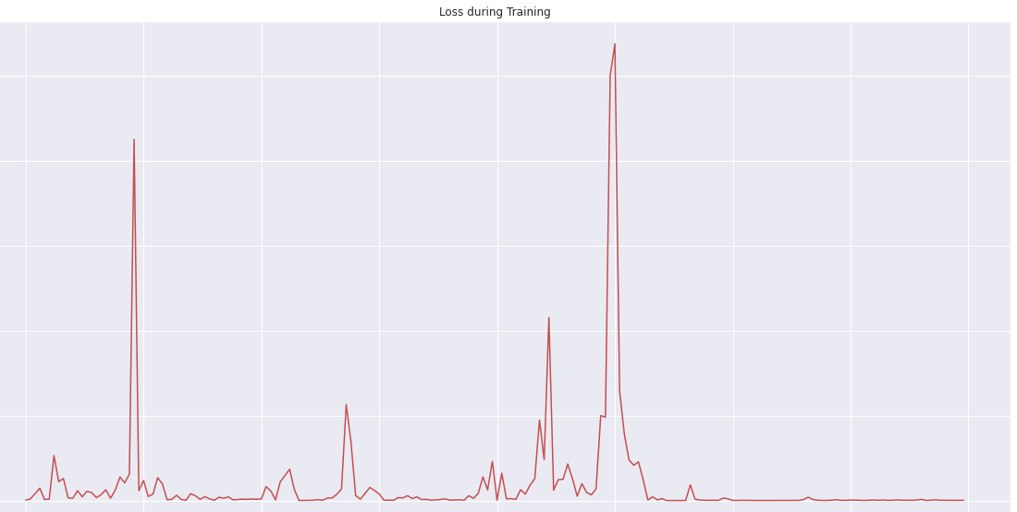
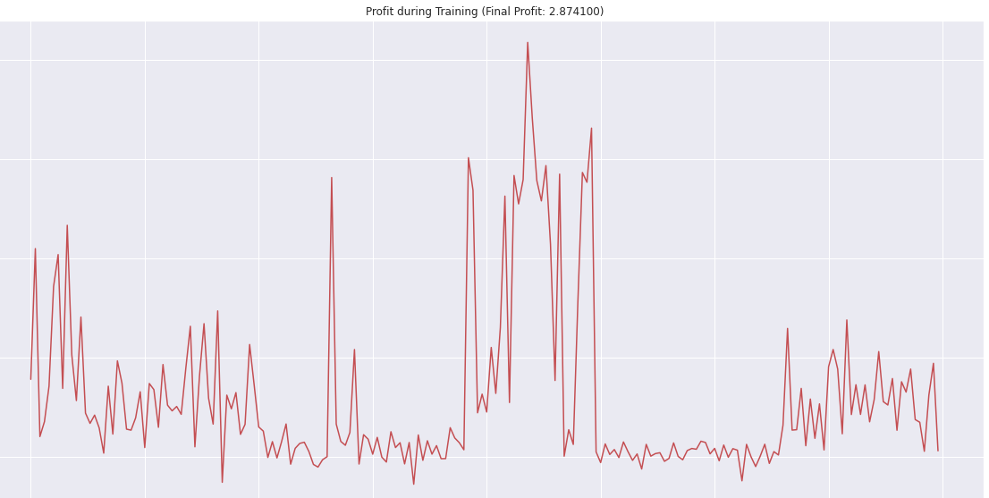
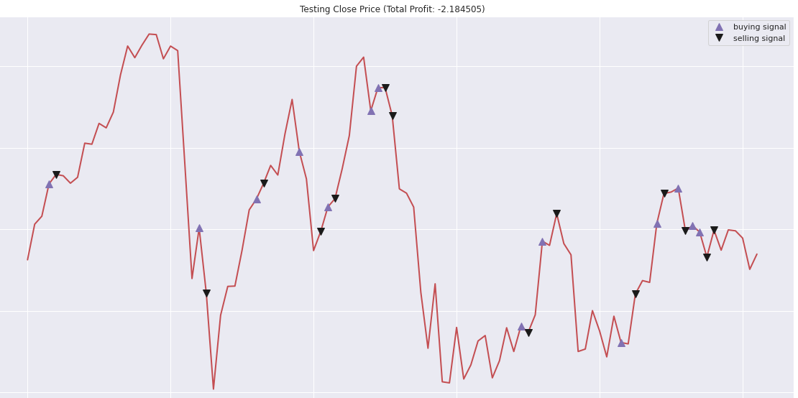
0.5
200
Loss during Training
Profit during Training
Actor-Critic Agent
0.4
150
Profit
0.3
100
Loss
0.2
50
0.1
0
0.0
0
250
500
750
1000
1250
1500
1750
2000
0
25
50
75
100
125
150
175
200
Iteration
Iteration
Training Data: 2016 – 2017
Window = 5 days
Iterations = 200
Starting money = 10,000
58
Profit: -2.19
Buying Signal
56
Selling Signal
54
Close price
Testing Data: 2018(Jan – May)
Starting money = 10,000
52
Testing
50
0
20
40
60
80
100
Iteration

Slide 7
Reinforcement Learning to Trade the Stock Market
Discussion and Future Works
Define size of trading
2-years of training data
Actor-Critic agent → more training data hungry
Good agent → Q-learning agent

Slide 8
Thank You
Any Question ?????

