Slide 1


Securing a networked system with Public Key Infrastructure

Slide 2
MEMBERS
Tanjilul Haq
2020-1-60-214
Zarin Tasnim Hassan
2020-1-60-169
Fariha Mosharof
2020-1-60-171
Zarin Tasnim Nuzhat
2020-1-60-211

Slide 3
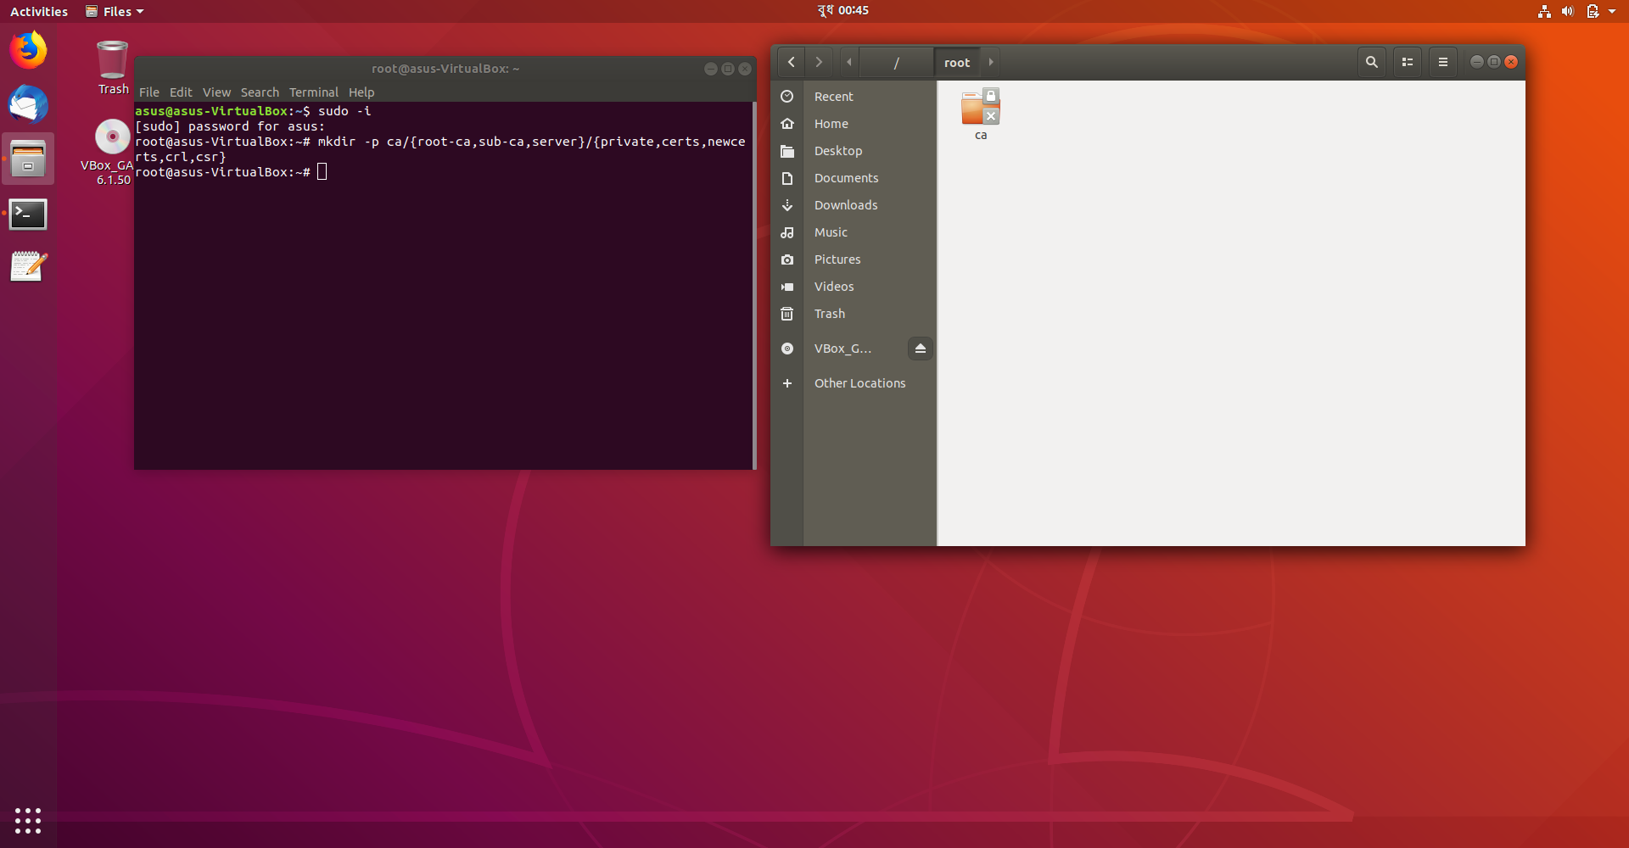
Configuring CA
Preparing the environment Moving to the root using : sudo –i
Creating directory: mkdir -p ca/{root-ca,sub ca,server}/{private,certs,newcerts,crl,csr}

Slide 4

Configuring CA
Changing the root of ca and sub ca private folder: chmod -v 700 ca/{root-ca,sub-ca,server}/private

Slide 5

Configuring CA
Creating file index in both root ca and
sub ca: touch ca/{root-ca,sub-ca}/index

Slide 6

Configuring CA
writing serial number of root ca: openssl rand -hex 16 > ca/root-ca/serial
writing serial number of sub ca: openssl rand -hex 16 > ca/sub-ca/serial

Slide 7
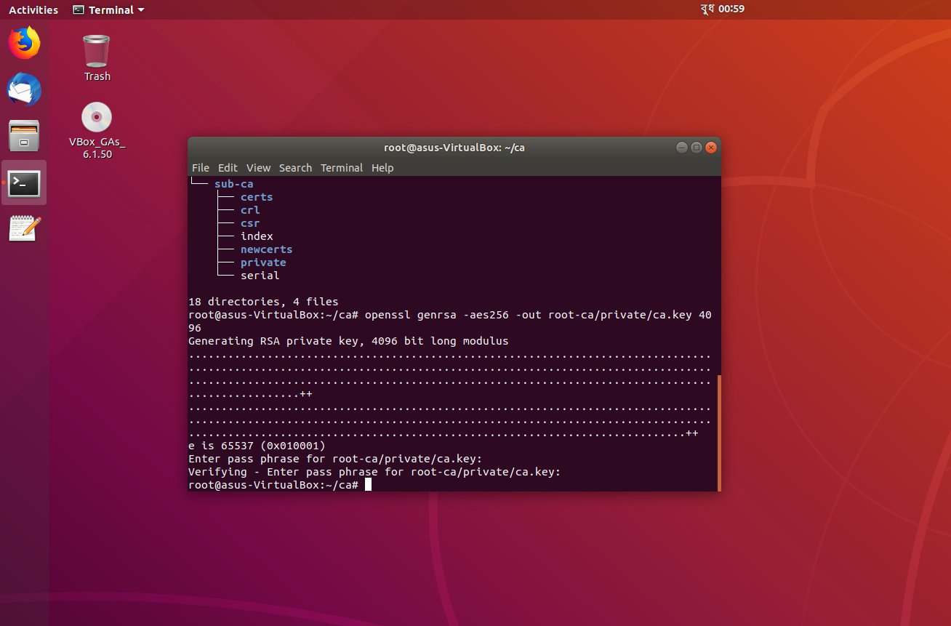
Generating private keys
Public key for rootCA: openssl genrsa -aes256 -out root-ca/private/ca.key 4096

Slide 8
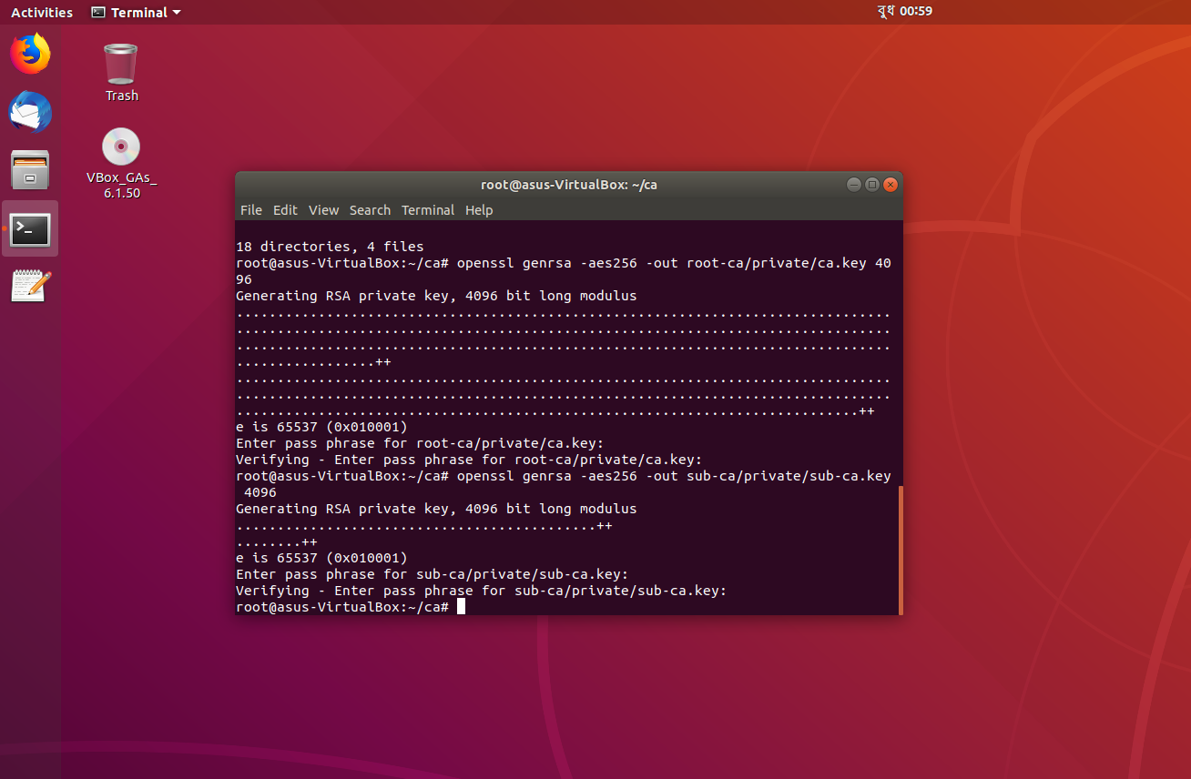
Generating private keys
Public key for subCA: openssl genrsa -aes256 -out sub-ca/private/sub-ca.key 4096

Slide 9
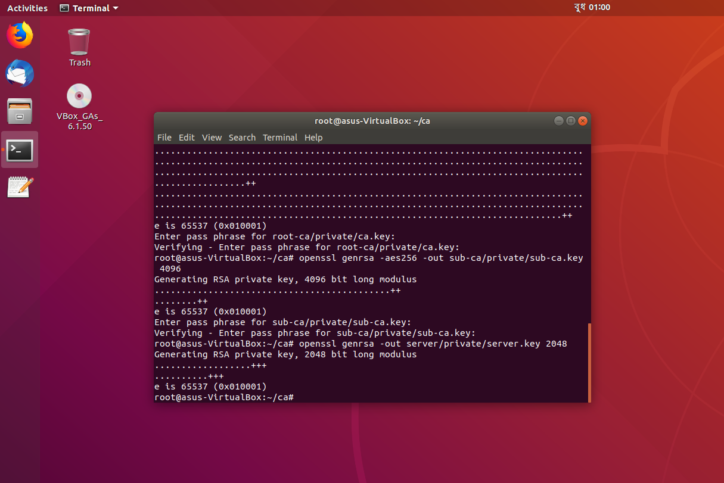
Generating private keys
Public key for server: openssl genrsa -out server/private/server.key 2048

Slide 10
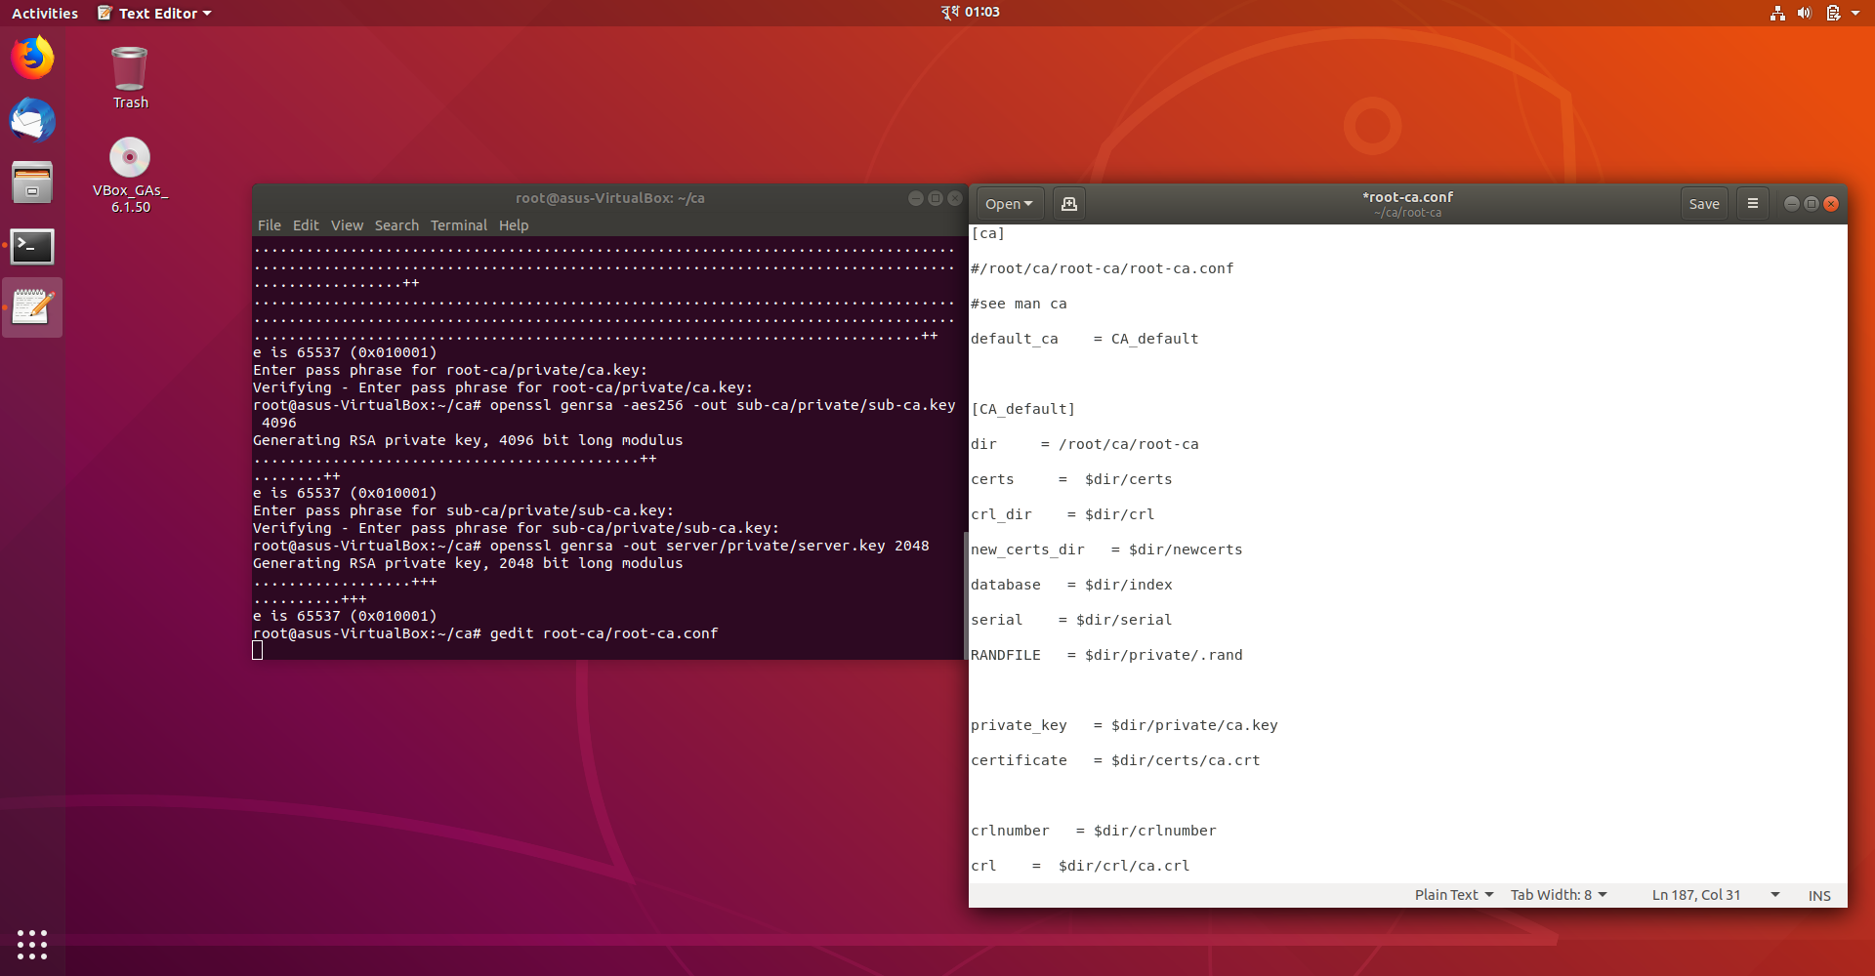
Generating private keys
Creating root ca.config: gedit root-ca/root-ca.conf

Slide 11
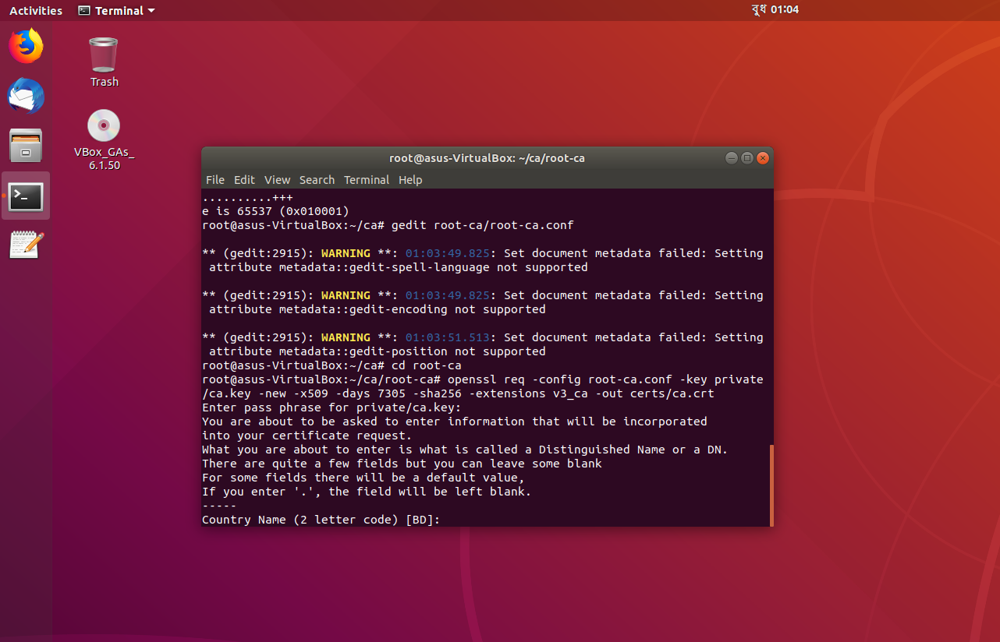
Generating certificates
Generating root ca certificate: openssl req -config root-ca.conf -key private/ca.key -new -x509 -days 7305 -sha256 -extensions v3_ca -out certs/ca.crt

Slide 12
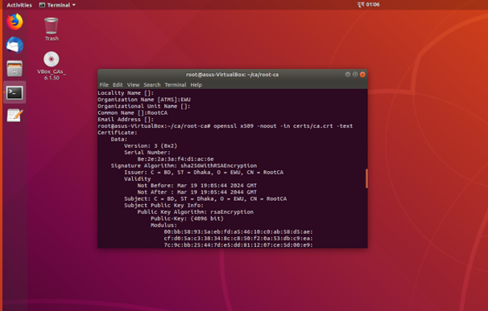
Generating certificates
Ensuring that the certificate has been created properly: openssl x509 -noout -in certs/ca.crt -text

Slide 13
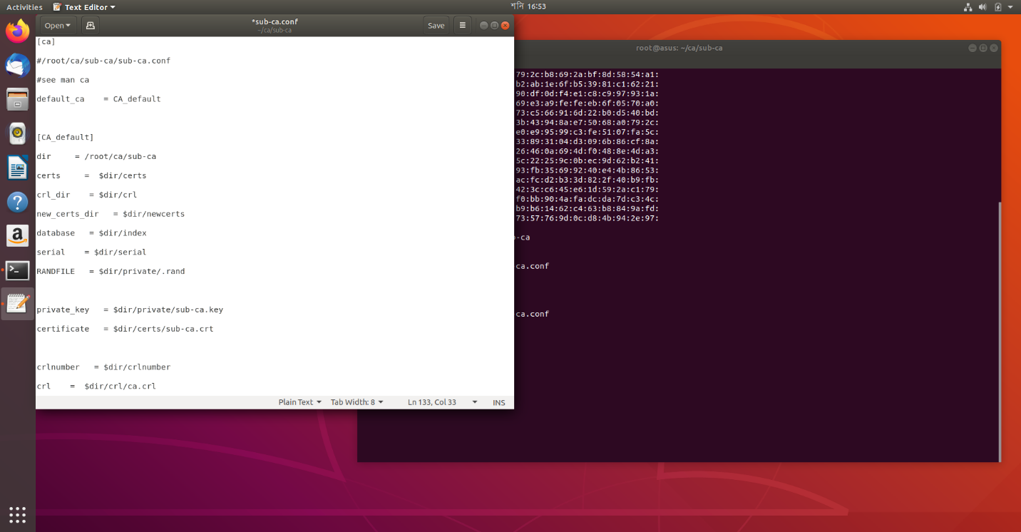
Generating certificates
Creating sub-ca.config: gedit sub-ca.conf

Slide 14

Generating certificates
Requesting for sub ca certificate signing request :openssl req -config sub-ca.conf -new -key private/sub-ca.key -sha256 -out csr/sub-ca.csr

Slide 15
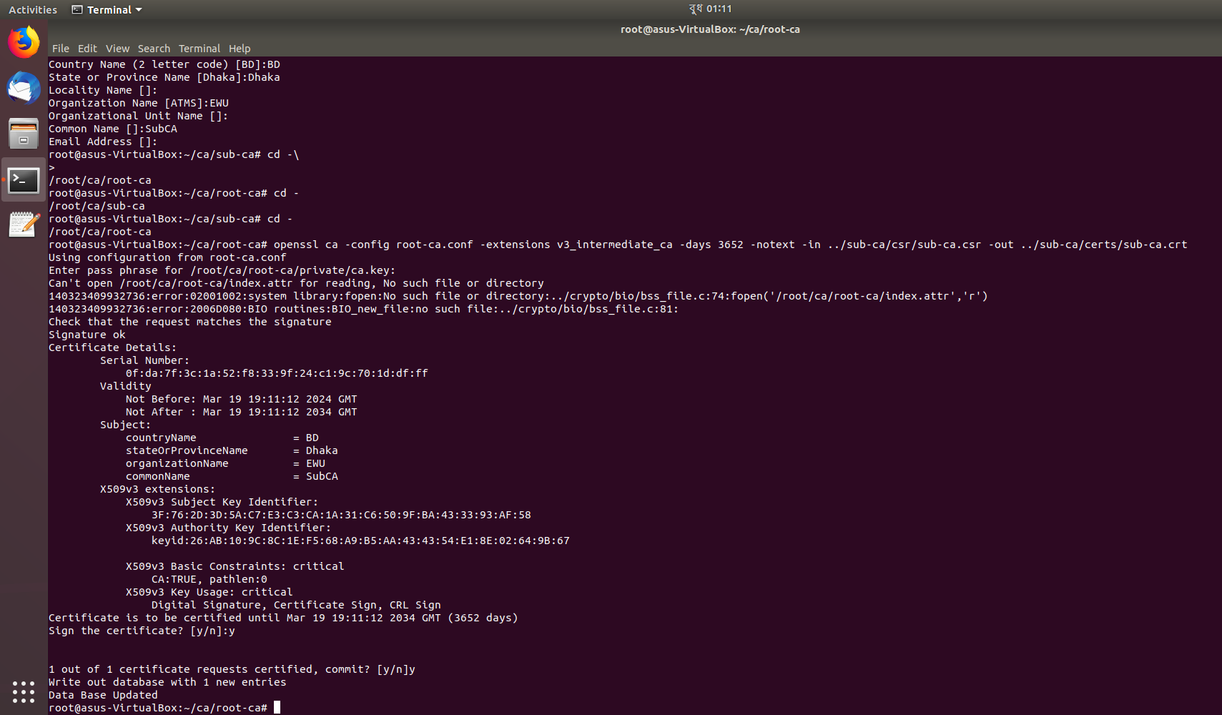
Generating certificates
Signing the request of sub ca by root ca: openssl ca -config root-ca.conf -extensions v3_intermediate_ca -days 3652 -notext -in ../sub-ca/csr/sub-ca.csr -out ../sub-ca/certs/sub-ca.crt

Slide 16
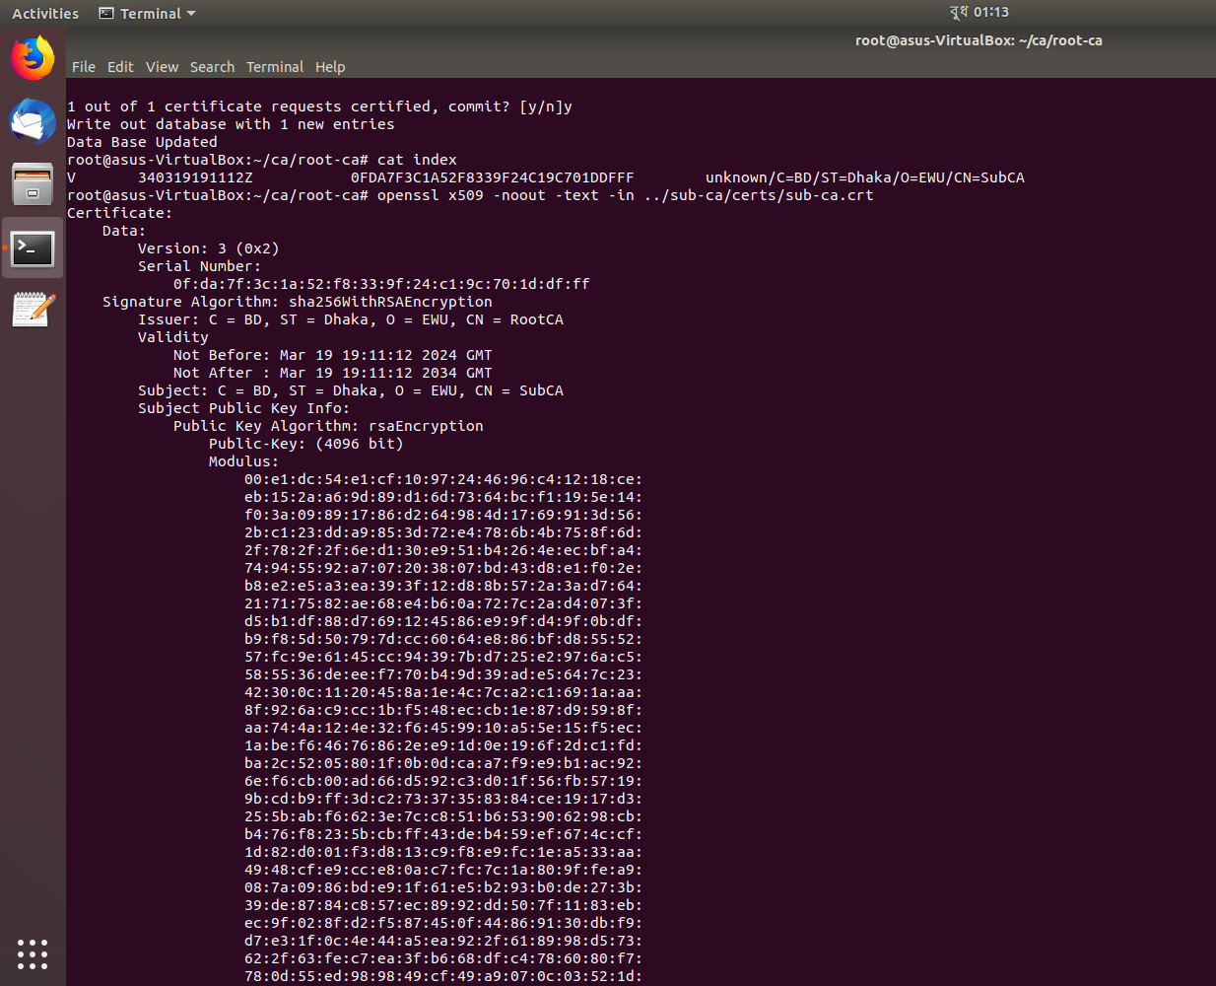
Generating certificates
See the signing: cat index
Root ca signed sub ca Seeing detail: openssl x509 -noout -text -in ../sub-ca/certs/sub-ca.crt

Slide 17
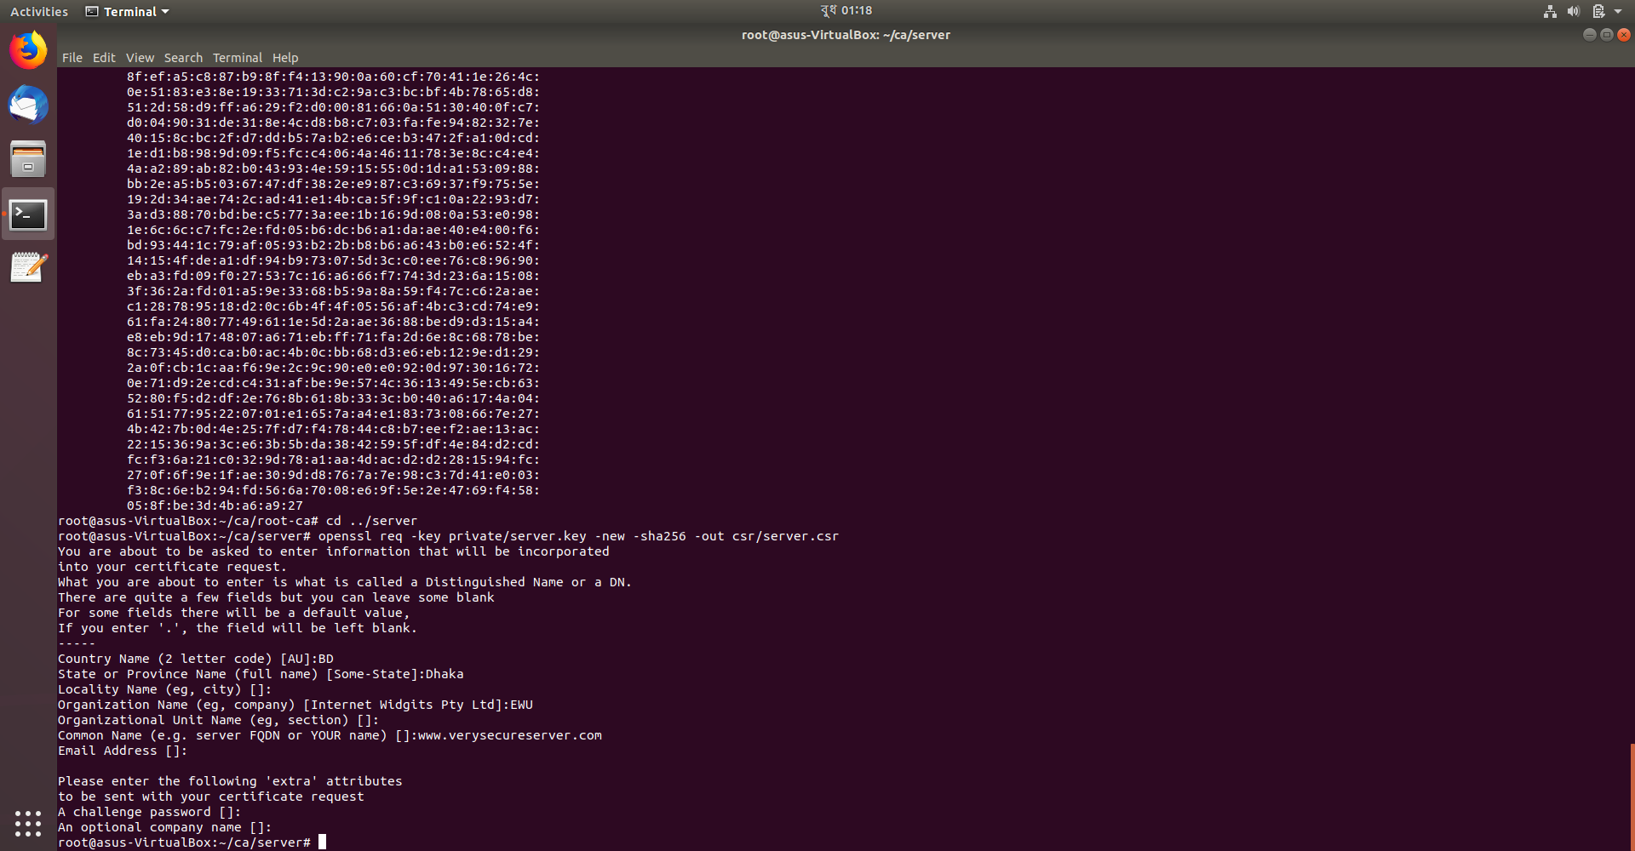
Configuring server
Moving to server: cd ../server
Generating certificate signing request from server :openssl req -key private/server.key -new -sha256 -out csr/server.csr

Slide 18
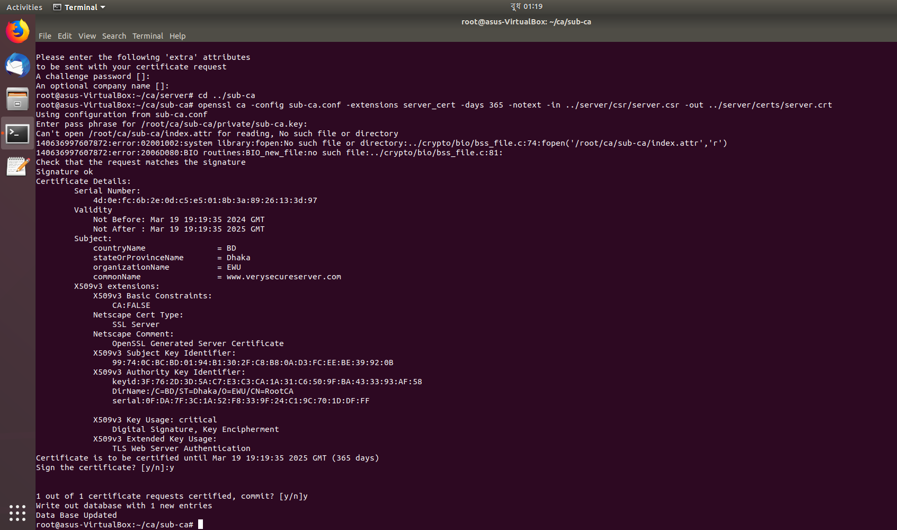
Configuring server
Moving to sub ca to sign the server’s certificate: cd ../sub-ca
Sub ca signing certificate request of server: openssl ca -config sub-ca.conf -extensions server_cert -days 365 -notext -in ../server/csr/server.csr -out ../server/certs/server.crt

Slide 19
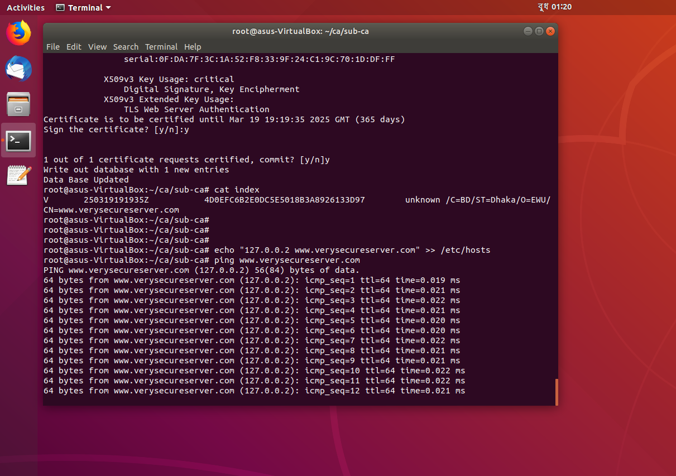
Configuring server
Seeing detail:cat index
Ping: echo "127.0.0.2 www.verysecureserver.com" >> /etc/hosts
ping www.verysecureserver.com

Slide 20
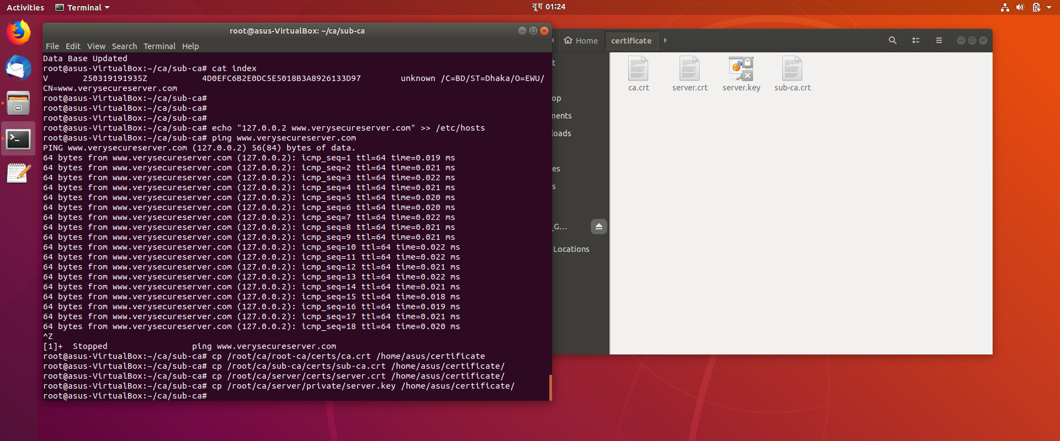
Configuring server
Copy to newcerts directory:
cp /root/ca/root-ca/certs/ca.crt /home/asus/certificate
cp /root/ca/sub-ca/certs/sub-ca.crt /home/asus/certificate/
cp /root/ca/server/certs/server.crt /home/asus/certificate/
cp /root/ca/server/private/server.key /home/asus/certificate/

Slide 21
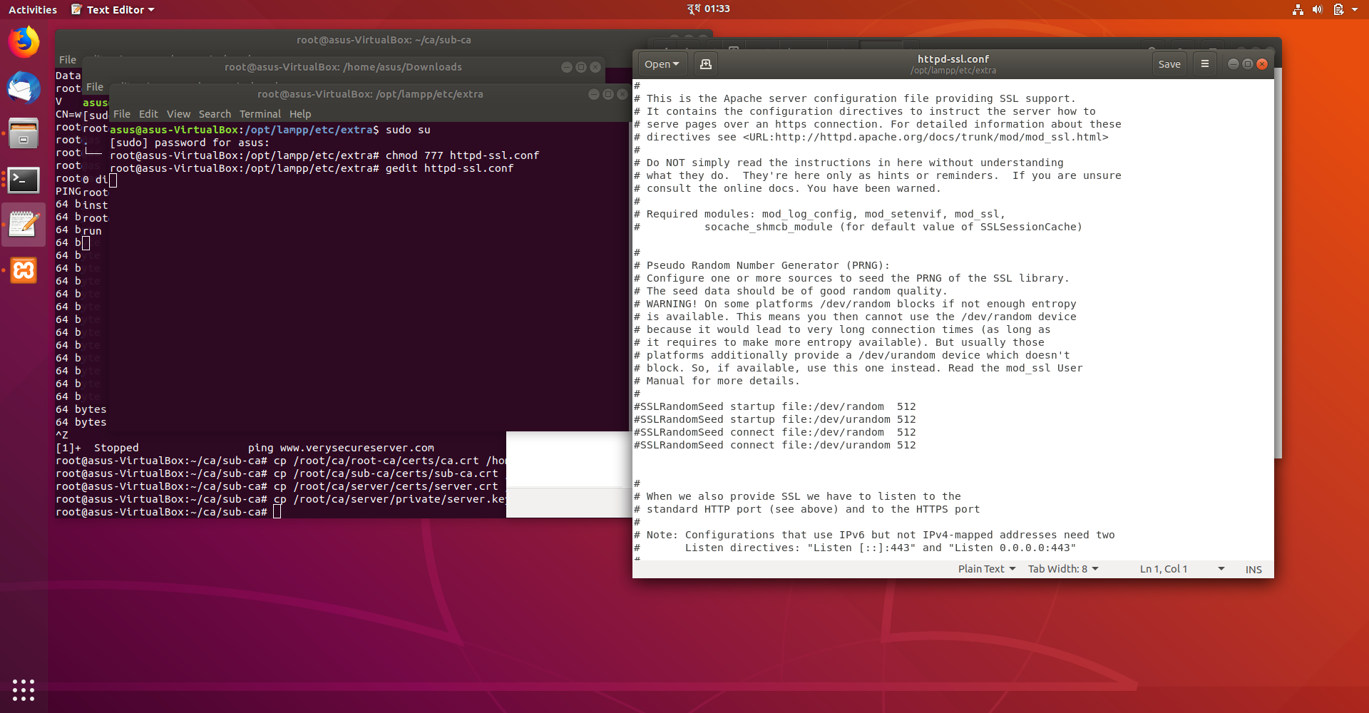
Configuring server
Opening root shell: sudo -i
Moving ssl config: cd /opt/lampp/etc/extra
Changing permission: chmod 777 httpd-ssl.conf
Opening in editor: gedit httpd-ssl.conf

Slide 22
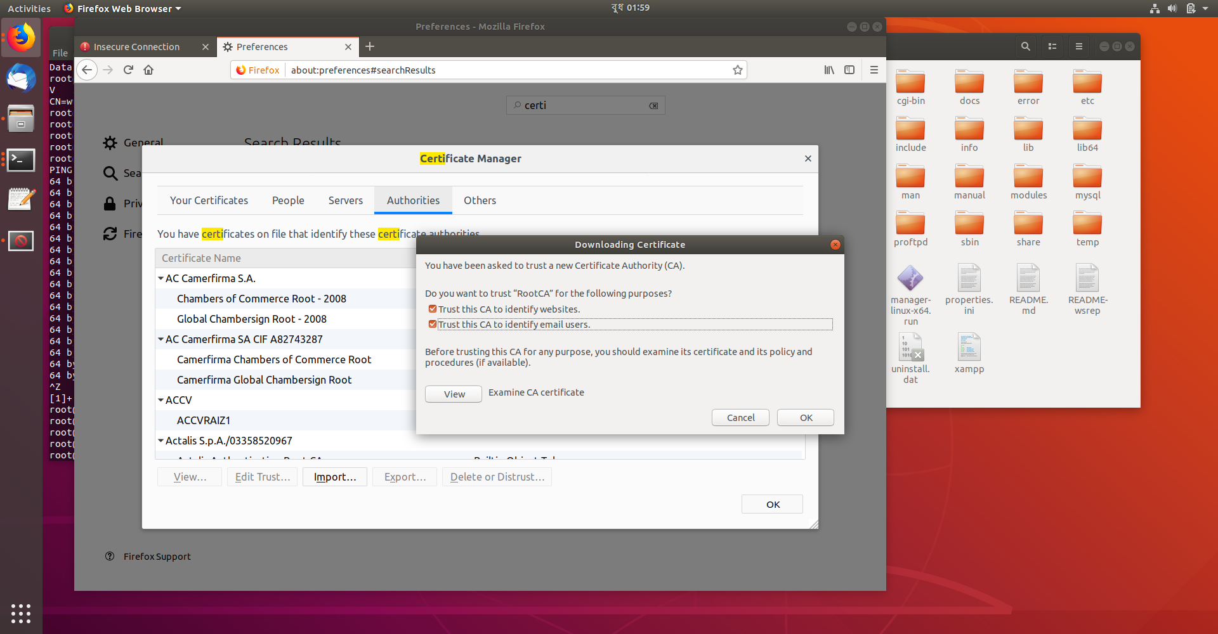

Configuring server
Uploading certificate in website

Slide 23
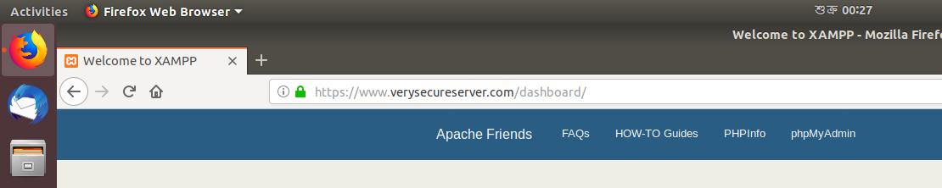
Configuring server
Web server secured

Slide 24
Thank You

