Slide 1

COM
7003
Predicting CO₂ Emissions
from Commercial Aviation
Artificial
Intelligence
A Machine Learning Regression Approach
Student
Zarin Tasnim Nuzhat
Student No.
2510148
Module Leader
Dr Xin Lu
Assessment 2 - Presentation
“Can a machine learning model estimate flight CO₂ from pre-flight data alone?”
1

Slide 2
OVERVIEW
What This Presentation Covers
01
Problem & Business Case
02
Dataset & Exploration
Why aviation emissions matter, who benefits
AeroSCOPE: 293,838 routes, EDA findings
03
Data Preprocessing
04
Model Selection
Six-stage pipeline: cleaning, encoding, scaling
Five-model comparison with academic justification
05
Optimisation
06
Results & Data Leakage
RandomizedSearchCV — 614 seconds, CV-R² = 0.9998
Why R² = 1.00 is a warning, not a win
07
Code Walkthrough
08
Deployment & Business Value
Live demonstration of the Jupyter Notebook
API integration, monitoring, stakeholder impact
09
Ethics & Challenges
10
Conclusions & References
Bias, fairness, GDPR, challenges resolved
Limitations, future work, all citations
2

Slide 3
PROBLEM DEFINITION
Why Does Aviation CO₂ Prediction Matter?
Regulatory pressure meets data-driven opportunity
The Core Challenge
2.5%
Traditional physics-based models require in-flight data — fuel load, passenger weights, weather deviations — that simply does not exist at the route-planning stage.
of global CO₂ emissions from aviation — rising post-pandemic
ICAO (2021). Carbon Emissions Calculator Methodology.
Research Question
IEA (2023). Aviation. International Energy Agency.
“Can ML accurately estimate CO₂ from route-level and aircraft data available before a flight operates?”
Airlines — route planning & CORSIA
Regulators — verify emissions data
Passengers — carbon-aware booking
IEA (2023). Aviation — iea.org | ICAO (2021). Carbon Emissions Calculator — icao.int
3

Slide 4
WHY MACHINE LEARNING
ML vs Traditional Methods
What data-driven modelling brings to the table
Physics-Based Modelling
Machine Learning Approach
✕ Requires real-time in-flight fuel data
✓ Uses only pre-flight: distance, aircraft, seats
✕ Cannot generalise across aircraft types
✓ Learns patterns directly from historical data
VS
✕ Needs specialist domain expertise
✓ Automated — no domain physics equations
✕ Unavailable at planning stage
✓ Works at scheduling time, before flights
✕ Cannot scale to 244,000+ routes
✓ Batch predictions across all routes in seconds
Breiman (2001). Random Forests. Machine Learning, 45(1), 5–32. | Hastie et al. (2009). Elements of Statistical Learning, 2nd ed. Springer.
4

Slide 5
DATASET SELECTION
AeroSCOPE: An Open-Source Global Flight Database
293,838
26
244,478
Zenodo
flight route records
variables per record
clean records (post-processing)
peer-reviewed open source
What Each Record Contains
Route Geography:
Departure & arrival IATA codes, lat/lon, distance (km), domestic flag
Aircraft:
ICAO type code, aircraft class (WB, NB, TP etc.), number of seats
Operations:
Annual flight frequency, Available Seat-Km (ASK), Revenue Passenger-Km (RPK)
Emissions (Target):
CO₂ in tonnes per route per year — target variable for regression
Fuel Estimates ⚠:
fuel_burn, fuel_burn_seymour — derived from CO₂; source of leakage identified in Slide 12
Salgas et al. (2023). AeroSCOPE — compilation of open-source traffic & CO₂ data for commercial aviation. J. Open Aviation Science, 1(2). doi:10.59490/joas.2023.7201
5

Slide 6
End-to-End ML Pipeline
Raw Data
Cleaning
EDA
Feature Engineering
Model Training
Evaluation
Deployment

Slide 7
EXPLORATORY DATA ANALYSIS
Four Findings That Shaped Design Decisions
Figure 1
Figure 2
CO₂ distribution was severely right-skewed — a handful of long-haul, high-frequency routes dominated the scale.
Wide-body (WB) and narrow-body (NB) aircraft showed distinctly higher emissions than turboprops (TP).
Decision: Applied log₁ₚ transformation to normalise distribution before modelling.
Decision: Confirmed aircraft class as a strong, informative predictor — kept throughout all experiments.
Box & Cox (1964). J. Royal Statistical Society B, 26(2), 211–252.
Salgas et al. (2023). AeroSCOPE dataset.
Figure 3
Figure 5
fuel_burn, ask, and rpk had near-perfect correlations (r > 0.99) with CO₂ — the first warning of leakage.
Route distance showed a strong positive relationship with emissions, consistent with fuel consumption physics.
Decision: Flagged for critical investigation (Slide 12). These features are direct mathematical derivatives of CO₂.
Decision: Validated distance_km as a legitimate, non-leaked pre-flight feature for the production model.
Kaufman et al. (2012). ACM TKDD, 6(4).
ICAO (2021). Carbon Emissions Calculator.
6

Slide 8
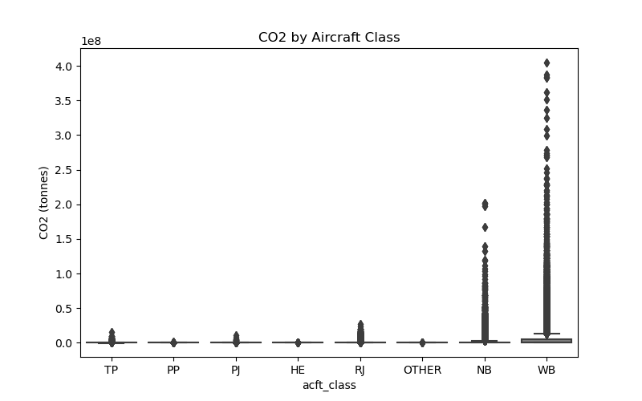
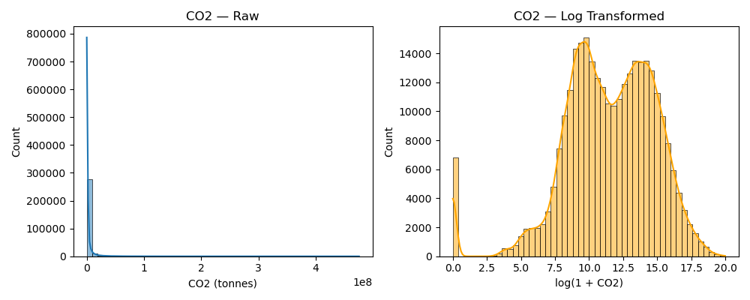
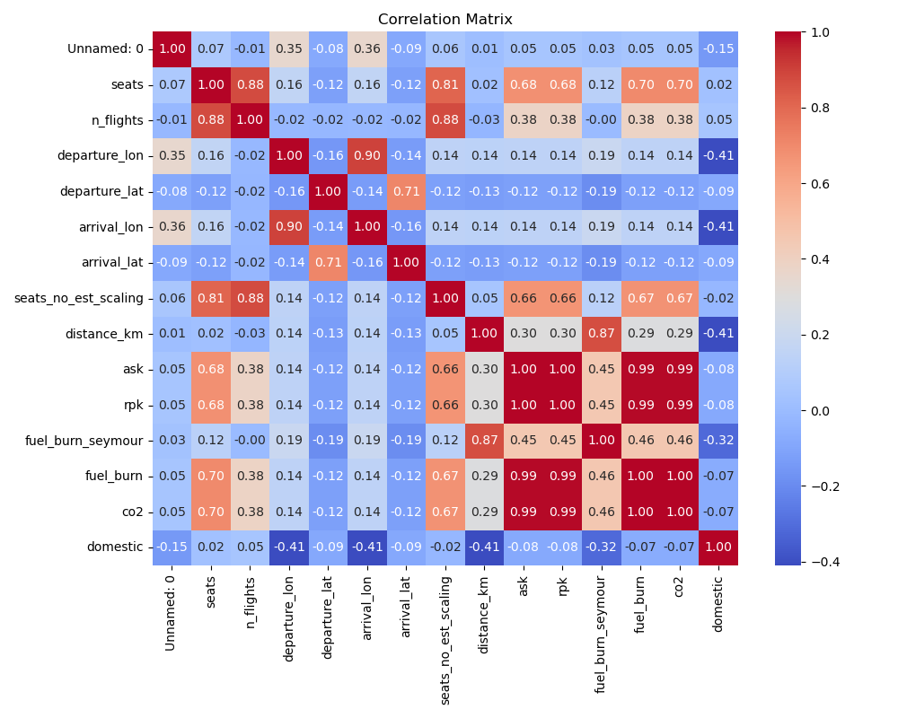
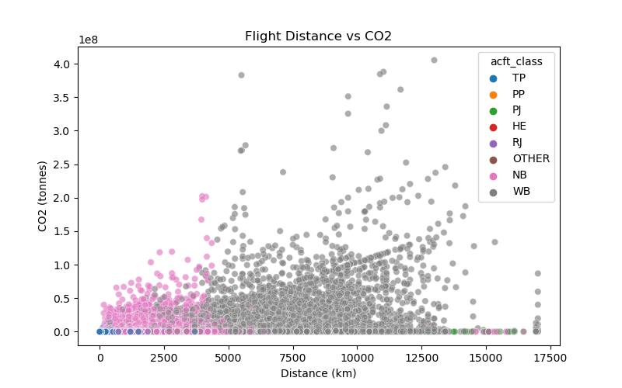
Figure 1
Figure 2
Figure 3
Figure 5

Slide 9
DATA PREPROCESSING
Six-Stage Preprocessing Pipeline
1
Drop high-NA columns
2
Remove invalid records
departure_continent & arrival_continent: 43.5% missing. Dropped entirely — imputing >40% adds more noise than signal.
6,830 records with CO₂ ≤ 0 removed (min value: −5,317). Physically impossible — a flight cannot emit zero or negative CO₂.
Kuhn & Johnson (2013). Applied Predictive Modelling. Springer.
3
log₁ₚ transform target
4
IQR outlier removal
Applied to CO₂ to address severe right skew. Converts multiplicative relationships to additive, improving both linear and tree model performance.
1.5 × IQR method reduced data from 287,008 → 244,478 records. Removes non-representative extremes that distort model learning.
Box & Cox (1964). J. Royal Statistical Society B, 26(2), 211–252.
Tukey (1977). Exploratory Data Analysis. Addison-Wesley.
5
Label encode categoricals
6
Scale + train/test split
IATA codes, aircraft type label-encoded. Chosen over target encoding to prevent secondary leakage from target statistics.
StandardScaler (zero mean, unit variance). 80/20 stratified split → 195,582 train / 48,896 test (random_state=42).
Micci-Barreca (2001). ACM SIGKDD Explorations, 3(1), 27–32.
Hastie et al. (2009). Elements of Statistical Learning, 2nd ed. Springer.
7

Slide 10
MODEL SELECTION
Five Models — A Progression from Simple to Complex
Each must justify its added complexity over simpler alternatives
Linear Regression
Interpretable floor — any complex model must beat this to earn its keep. Assumes linear log-CO₂ relationship.
Baseline
Hastie et al. (2009)
Ridge Regression
L2 regularisation (α=1.0) addresses the strong multicollinearity visible in the correlation heatmap.
Regularised
Hoerl & Kennard (1970). Technometrics, 12(1), 55–67.
Decision Tree
Handles interactions linear models miss. Interpretable tree structure — relevant for regulatory transparency.
Non-linear
Breiman et al. (1984). Classification & Regression Trees.
Random Forest
Bootstrap-averaged trees: low variance, captures non-linear interactions. Strong tabular performance. Selected for optimisation.
Primary Model
Breiman (2001). Machine Learning, 45(1), 5–32.
Gradient Boosting
Sequential residual correction — high accuracy when signal-to-noise is high; more sensitive to hyperparameters.
Secondary
Friedman (2001). Annals of Statistics, 29(5), 1189–1232.
Fernandez-Delgado et al. (2014). Do we need hundreds of classifiers? JMLR, 15(1), 3133–3181. — justification for multi-model comparison strategy.
8

Slide 11
MODEL OPTIMISATION
Hyperparameter Search with RandomizedSearchCV
Why not GridSearchCV?
Parameter Space Searched
With 244,478 rows, exhaustive grid search was computationally impractical. RandomizedSearchCV samples n_iter random combinations with equivalent statistical efficiency at a fraction of the cost.
n_estimators
50, 100
max_depth
5, 10, 15
Bergstra & Bengio (2012). JMLR, 13, 281–305.
min_samples_split
2, 5, 10
10 combinations × 3-fold CV = 30 fits | Total: 614 seconds
min_samples_leaf
1, 2, 4
max_features
'sqrt', 'log2'
Best Configuration Found
n_estimators=100 max_depth=15 min_samples_split=10 min_samples_leaf=1 max_features='sqrt'
Cross-validated R² = 0.9998 — hyperparameter tuning preserved generalisation across folds
Top 3 features: fuel_burn (25.3%), ask (20.3%), rpk (20.0%) = 63.6% combined — indicates data leakage (see Slide 12).
Guyon & Elisseeff (2003). Introduction to variable & feature selection. JMLR, 3, 1157–1182.
9

Slide 12
EVALUATION
How Performance Was Measured
Three complementary metrics on log₁ₚ CO₂ scale
R²
Coefficient of Determination
Proportion of variance in CO₂ explained by the model. R² = 1.0 = perfect prediction. Used as primary comparison metric across all five models. Identical test and CV-R² confirms no overfitting.
MAE
Mean Absolute Error
Average absolute deviation on the log-scale target — interpretable in the same units as transformed CO₂. Robust to occasional large errors; appropriate for this heavy-tailed emission distribution.
RMSE
Root Mean Squared Error
Penalises large errors disproportionately. Especially relevant here — a large CO₂ prediction error in a regulatory context could result in incorrect carbon offset obligations for airlines.
Chai & Draxler (2014). RMSE or MAE? Geoscientific Model Development, 7(3), 1247–1250. doi:10.5194/gmd-7-1247-2014
10

Slide 13
RESULTS
Model Comparison — Test Set Performance
Model
MAE
RMSE
R² (Test)
CV-R²
Note
Linear Regression
1.0329
1.2960
0.7214
0.7167
← Honest baseline
Ridge Regression
1.0329
1.2960
0.7214
0.7166
Marginal improvement
Decision Tree
0.0397
0.0489
0.9996
0.9996
Leakage signal
Random Forest
0.0005
0.0008
1.0000
1.0000
⚠ Leakage — see Slide 12
Gradient Boosting
0.0076
0.0104
1.0000
0.9999
⚠ Leakage — see Slide 12
RF Optimised (Top 10 F.)
0.0069
0.0155
1.0000
0.9998
★ Final model selected
R² = 1.00 for tree models is not excellence — it is a red flag. Honest performance ceiling with pre-flight features only: R² = 0.72.
11

Slide 14
CRITICAL INTERPRETATION
The near-perfect R² is a warning, not a win.
Data Leakage: What Happened, Why It Matters, and How to Fix It
The Mechanism
The Production-Ready Fix
CO₂ = fuel_burn × 3.16 kg/litre × conversion factor
Remove (leaked):
fuel_burn, ask, rpk, fuel_burn_seymour, seats_no_est_scaling
fuel_burn is a direct mathematical transformation of CO₂. Including it means the model simply reverses the formula — no learning involved. ASK and RPK incorporate distance and seats, then feed into fuel_burn.
Keep (pre-flight only):
distance_km, aircraft class/type, IATA codes, seats, domestic flag
Kaufman et al. (2012). Leakage in data mining. ACM TKDD, 6(4).
Honest R² = 0.72 (leakage-free linear baseline)
Reflection: Identifying this leakage and reporting it honestly — rather than celebrating a perfect score — is the mark of rigorous, responsible AI practice. A retrained model at R² = 0.72 with transparent uncertainty disclosure is far more valuable to deployers than a hollow R² = 1.00.
Kaufman et al. (2012). ACM TKDD, 6(4). | Breiman (2001). Machine Learning, 45(1). | Hastie et al. (2009). Elements of Statistical Learning.
12

Slide 15
DEPLOYMENT CONSIDERATIONS
From Notebook to Production System
Proposed Architecture
Airline
Scheduling System
REST API
(FastAPI / Flask)
Model Registry
(joblib)
CO₂ Output
→
→
→
Route + aircraft input
JSON payload
RF + Scaler + Encoder
Tonnes per route
Pre-Deployment Fix Required
Dataset Shift Monitoring
Retrain on pre-flight features only. Disclose R² = 0.72 honestly — users must understand prediction uncertainty.
As airlines modernise fleets, input distributions change over time — accuracy degrades without retraining.
Regulatory Compliance
Data Privacy
Cannot replace CORSIA/ICAO-mandated methods without formal approval. Near-term: planning tool only.
No personal data in AeroSCOPE. Passenger booking integration requires a DPIA under UK GDPR.
Quionero-Candela et al. (2009). Dataset Shift in Machine Learning. MIT Press. | ICAO (2021). Carbon Emissions Calculator Methodology.
15

Slide 16
BUSINESS IMPACT
How This Model Enhances Decision-Making
Even at the honest R² = 0.72, this model enables data-driven carbon planning not previously achievable at route-level scale.
Airlines
Regulators & Auditors
Passengers & Platforms
Embed carbon cost in scheduling dashboards
Cross-check self-reported airline emissions at scale
Display CO₂ per flight at booking — informed choice
Compare WB vs NB emissions per route for fleet decisions
Flag routes where reported vs predicted CO₂ diverges
Transparent carbon offset calculation
Pre-calculate CORSIA offset obligations before operations
Evidence-based enforcement prioritisation
Compare direct vs connecting route impact
Identify highest-emission routes for priority action
Track sector-wide emission trends over time
Support consumer sustainability certifications
16

Slide 17
ETHICAL CONSIDERATIONS
Responsible AI: Bias, Fairness & Legal Context
Geographic Data Bias
Environmental Justice
Issue:
AeroSCOPE over-represents EU and North American routes — better-developed open data infrastructure.
Issue:
If less accurate predictions lead to incorrect carbon offset requirements, airlines in data-sparse regions bear unfair burden.
Impact:
Predictions for sub-Saharan Africa, South Asia, and Latin America will be systematically less accurate.
Impact:
Direct environmental justice implications — penalising carriers least responsible for data gaps.
Mitigation:
Do not use for enforcement in under-represented regions without supplementary local data.
Mitigation:
Restrict enforcement to high-coverage regions. Advocate for global open aviation data standards.
Barocas et al. (2019). Fairness & Machine Learning — fairmlbook.org
Barocas et al. (2019).
Legal & Regulatory Compliance
Data Privacy (GDPR)
Issue:
CORSIA mandates ICAO-approved fuel monitoring methodologies. ML model not currently on approved list.
Issue:
AeroSCOPE is route-level aggregate data — no individual personal data.
Impact:
Cannot legally replace compliance methods without formal ICAO accreditation.
Impact:
No GDPR obligations for the core model itself.
Mitigation:
Deploy as planning tool only. Engage ICAO working groups for future certification pathway.
Mitigation:
Passenger booking integration requires a DPIA under UK GDPR Article 35.
ICAO (2021). CORSIA — icao.int
UK GDPR Article 35. ICO guidance.
17

Slide 18
CHALLENGES & REFLECTION
Four Key Challenges and How They Were Addressed
Data Quality
Challenge: 43.5% missing in continent columns; 6,830 records with CO₂ ≤ 0 (min: −5,317).
Preprocessing
Resolution: Dropped high-NA columns. Removed physically impossible records. Median imputation for remaining nulls.
Kuhn & Johnson (2013). Applied Predictive Modelling.
Data Leakage
Challenge: fuel_burn, ASK, RPK are mathematical derivatives of CO₂ — giving tree models hollow perfect scores.
Critical
Resolution: Identified via heatmap and feature importance. Reported transparently. Proposed leakage-free pipeline.
Kaufman et al. (2012). ACM TKDD, 6(4).
Computational Scale
Challenge: GridSearchCV on 244,478 rows was computationally impractical — thousands of hours estimated.
Scalability
Resolution: RandomizedSearchCV: n_iter=10, 3-fold CV = 30 fits, 614 seconds. Statistically efficient.
Bergstra & Bengio (2012). JMLR, 13, 281–305.
Interpretability vs Performance
Challenge: Random Forest (best performing) is a black-box — problematic in a regulatory compliance context.
Trade-Off
Resolution: Decision Tree included as interpretable alternative. SHAP values recommended for production.
Breiman (2001). Machine Learning, 45(1).
18

Slide 19
CONCLUSIONS & LIMITATIONS
What Was Learned — and What Comes Next
Key Achievements
Limitations & Future Work
End-to-end ML pipeline on 293,838 global flight routes
Leakage not resolved in current pipeline
→ Retrain on pre-flight features only
Five models systematically compared using R², MAE, RMSE
Geographic bias toward EU/NA routes
RandomizedSearchCV optimisation — CV-R² = 0.9998
→ Supplement with ICAO non-Annex 1 data
Honest linear baseline: R² = 0.72 (no leakage)
Black-box RF limits regulatory use
→ Add SHAP explainability layer
Data leakage identified, explained, and proposed fix developed
Dataset shift as fleets modernise
Deployment architecture with monitoring strategy designed
→ Scheduled retraining + drift monitoring
Only CO₂ — ignores NOx, H₂O
Ethical analysis: geographic bias and environmental justice addressed
→ Extend to multi-output climate model
19

Slide 20
References
1. Barocas, S., Hardt, M., & Moritz, H. (2019). Fairness and machine learning. fairmlbook.org https://fairmlbook.org/
11. Hoerl, A. E., & Kennard, R. W. (1970). Ridge regression. Technometrics, 12(1), 55–67. https://doi.org/10.1080/00401706.1970.10488634
2. Bergstra, J., & Bengio, Y. (2012). Random search for hyper-parameter optimisation. JMLR, 13, 281–305.
12. ICAO. (2021). Carbon emissions calculator methodology. International Civil Aviation Organization. https://www.icao.int/environmental-protection/CarbonOffset/Pages/default.aspx
Thank you
3. Box, G. E. P., & Cox, D. R. (1964). An analysis of transformations. JRSS-B, 26(2), 211–252. https://doi.org/10.1111/j.2517-6161.1964.tb00553.x
13. IEA. (2023). Aviation. International Energy Agency. iea.org/energy-system/transport/aviation https://www.iea.org/energy-system/transport/aviation
for your time.
4. Breiman, L. (2001). Random forests. Machine Learning, 45(1), 5–32. https://doi.org/10.1023/A:1010933404324
14. Kaufman, S., Rosset, S., Perlich, C., & Stitelman, O. (2012). Leakage in data mining. ACM TKDD, 6(4). https://doi.org/10.1145/2382577.2382579
5. Breiman, L., Friedman, J., Olshen, R., & Stone, C. (1984). Classification and regression trees. Wadsworth. https://doi.org/10.1201/9781315139470
15. Kuhn, M., & Johnson, K. (2013). Applied predictive modeling. Springer. https://doi.org/10.1007/978-1-4614-6849-3
AI Disclosure
This assignment used generative AI for: brainstorming, research, planning, and editing.
6. Chai, T., & Draxler, R. R. (2014). RMSE or MAE? Geoscientific Model Development, 7(3), 1247–1250. https://doi.org/10.5194/gmd-7-1247-2014
16. Micci-Barreca, D. (2001). Preprocessing for high-cardinality categoricals. ACM SIGKDD, 3(1), 27–32. https://doi.org/10.1145/507533.507538
7. Fernandez-Delgado et al. (2014). Do we need hundreds of classifiers? JMLR, 15(1), 3133–3181.
17. Quionero-Candela et al. (2009). Dataset shift in machine learning. MIT Press.
8. Friedman, J. H. (2001). Gradient boosting machine. Annals of Statistics, 29(5), 1189–1232. https://doi.org/10.1214/aos/1013203451
18. Salgas et al. (2023). AeroSCOPE: Open-source aviation dataset. J. Open Aviation Science, 1(2). https://doi.org/10.59490/joas.2023.7201
9. Guyon, I., & Elisseeff, A. (2003). Introduction to variable & feature selection. JMLR, 3, 1157–1182.
19. Tukey, J. W. (1977). Exploratory data analysis. Addison-Wesley.
10. Hastie, T., Tibshirani, R., & Friedman, J. (2009). Elements of statistical learning (2nd ed.). Springer. https://doi.org/10.1007/978-0-387-84858-7

