Slide 1

“Disability Awareness”
Presented By: Zarin Tasnim Roichi
Student ID: 20210104111
SECTION: C
GROUP: CSE(C1)
COURSE: HUM 1108
Supervised by:Mohammad Rukanuddin
Department of Arts and Sciences, Ahsanullah University of Science And Technology

Slide 2

What is disability?
Disability is any condition of the body or mind that makes it more difficult for the person with the condition to do certain activities and interact with the world around them.
“Person with disability” means a person with long term physical, mental, intellectual or sensory impairment which, in interaction with barriers, hinders his full and effective participation in society equally with others.
Some types of disabilities:
Attention Deficit Hyperactivity Disorder (ADHD)
Learning Disabilities.
Mobility Disabilities.
Medical Disabilities.
Psychiatric Disabilities.
Traumatic Brain Injury (TBI) and Post-Traumatic Stress Disorder (PTSD)
Visual Impairments.
Deaf and Hard of Hearing.
Spine Bifida (SB)

Slide 3

“Disability is neither a blessing , nor a curse”
In ritual ridden Indian society, disability is attached with so many notions. One section of Indian society believes that disability is the punishment of sins committed by the person during his previous birth and every disabled has to go through this punishment.
Another section believes that these crippled persons are the examples set by Almighty so that able persons should thanks to God for their healthy and complete body and who so ever help the handicap will get reward from God in the form of heaven in next world.
Third section of society believes that disability is a curse so it should be checked in the womb of a mother and there after every disabled fetus should be aborted and should not be allowed to see this beautiful world of God
Fourth section of society believes that every disabled has all rights to live and enjoy this beautiful world of God and it would be every one’s prime duty to help them to live their life comfortably.

Slide 4
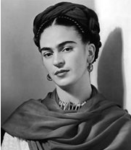
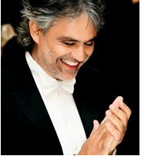
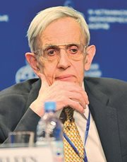
Andrea Boccelli
Tenor, musician, writer and musical producer of Italian origin, Andrea Boccelli has sold more than 75 million records.
He was born with congenital glaucoma that left him partially blind, something that did not prevent him from taking piano lessons until the age of six.
However, at age 12 he suffered a blow during a football game that left him completely blind. Endowed with a spirit of innate improvement, he decided to focus entirely on music, specifically on singing. He also studied Law.
Boccelli has received numerous awards of international prestige and even has a beach named after him on the Adriatic.
Frida Kahlo
Frida suffered polio during her childhood and, according to some sources, also had spina bifida, which caused dysmetria in her right leg. In addition, her spinal problems were aggravated by an accident suffered in her adolescence, which left her with physical issues for her entire life.
Frida spent much of her life in bed suffering from severe pain. Even so, she became one of the most famous artists of all time and an icon of the twentieth century.
John Nash
Another example of a celebrity with a disability who broke the mould is John Nash, an American mathematician whose life, marked by acute paranoid schizophrenia, is known to us thanks to the film "A Beautiful Mind" Aware of his illness, Nash fought against it and developed a successful academic career that earned him the Nobel Prize in Economics in 1994.

Slide 5
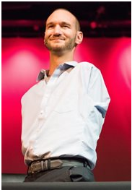
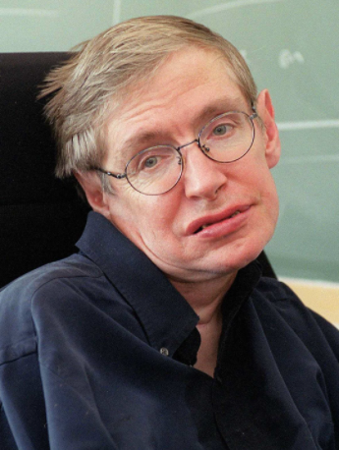
Stephen Hawking
A theoretical physicist, astrophysicist, cosmologist, and eminent scientist, Stephen Hawking was diagnosed with ALS at age 21: he was given 2 more years to live. He lived until he was 76-years-old.
He had been paralysed from head to toe for over thirty years and used a voice synthesiser to be able to communicate, and a wheelchair that he operated through slight movements of the head and eyes.
None of this prevented him from developing his activity as an exemplary researcher and professor, and intense personal life that allowed him to make his illness known to the world.
Becoming one of the most recognisable celebrities of our time, his story was taken to the cinema in the film "The Theory of Everything".
Nick Vujicic
Nick Vujicic is another world-famous celebrity with a disability, and founder of Life Without Limbs - an organisation for people with physical disabilities.
Vujicic was born in 1982 with no limbs. He claims that as a child he suffered ridicule and discrimination, and tried to commit suicide but, with time, he learned to see his own potential.
He is currently giving motivational talks around the world, has written several books and is a regular on talk shows and TV programs. He became very famous when starring in the touching short film "The Butterfly Circus".

Slide 6

“Disability does not mean inability”
THANK YOU

