Slide 1

Scanner Sweep

Slide 2

Problem Statement
Design a tool for women that use to feel safer at night. The tool should be able to use AI to detect threats, and avoid hindering daily life, easy to use, and portable.

Slide 3
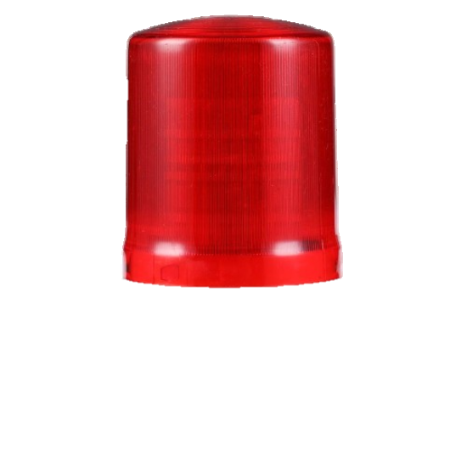
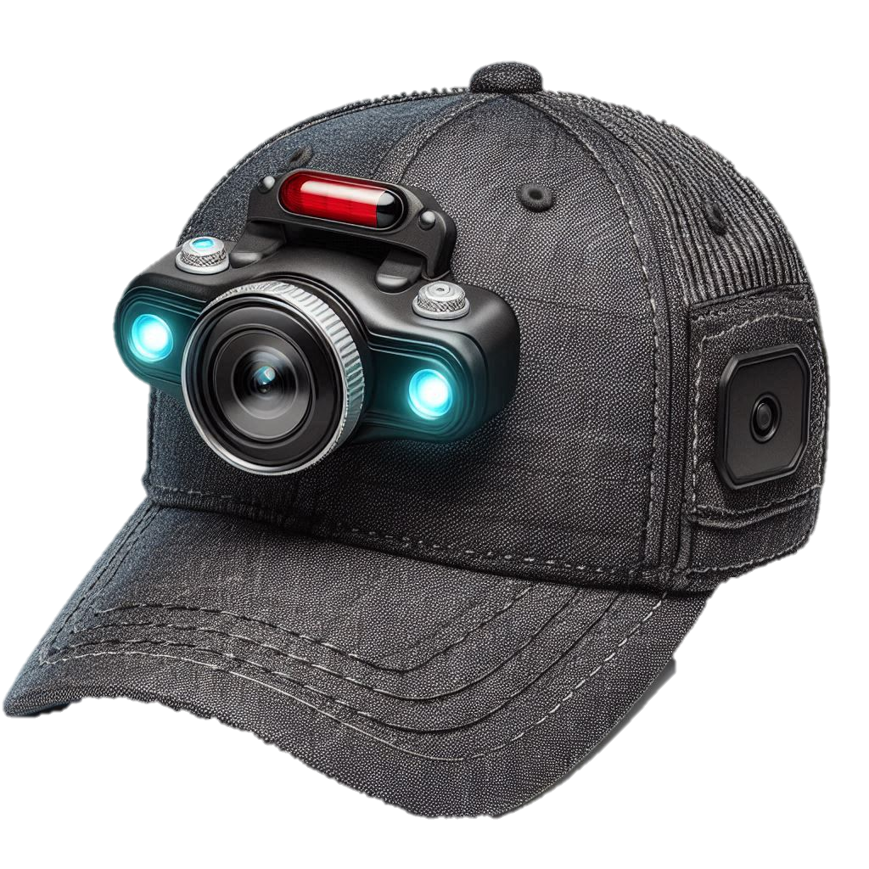
Cameras
Alarm
Hat

Slide 4
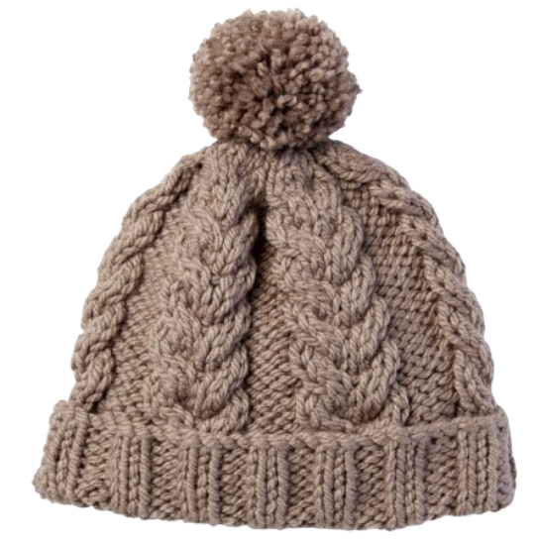

What Next?
App to connect to the Hat
Hat Ergonomics
Battery
App

Slide 5
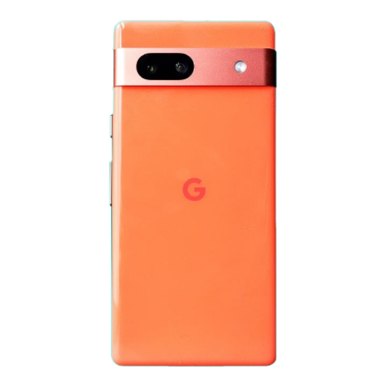
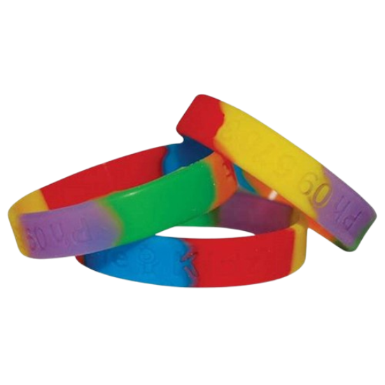
Issues/Conflicts
Recording Device

Slide 6
THANK YOU

Slide 7
Appendix
Perceptions of personal safety and experiences of harassment, Great Britain - Office for National Statistics

