Slide 1

Cryptocurrencies Analysis and price prediction with LSTM
Zarmina Ursino
zarmina.ursino@studio.unibo.it

Slide 2
Summary
Data exploration over Ethereum, Ripple, IOTA, Dogecoin, Litecoin Cryptocurrencies datasets
Analysis of the trends
Total Traded
Candlestick plots
Simple Returns
Cumulative Returns
LSTM
livelossplot API

Slide 3





09 November 2017 - 26 August 2021

Slide 4
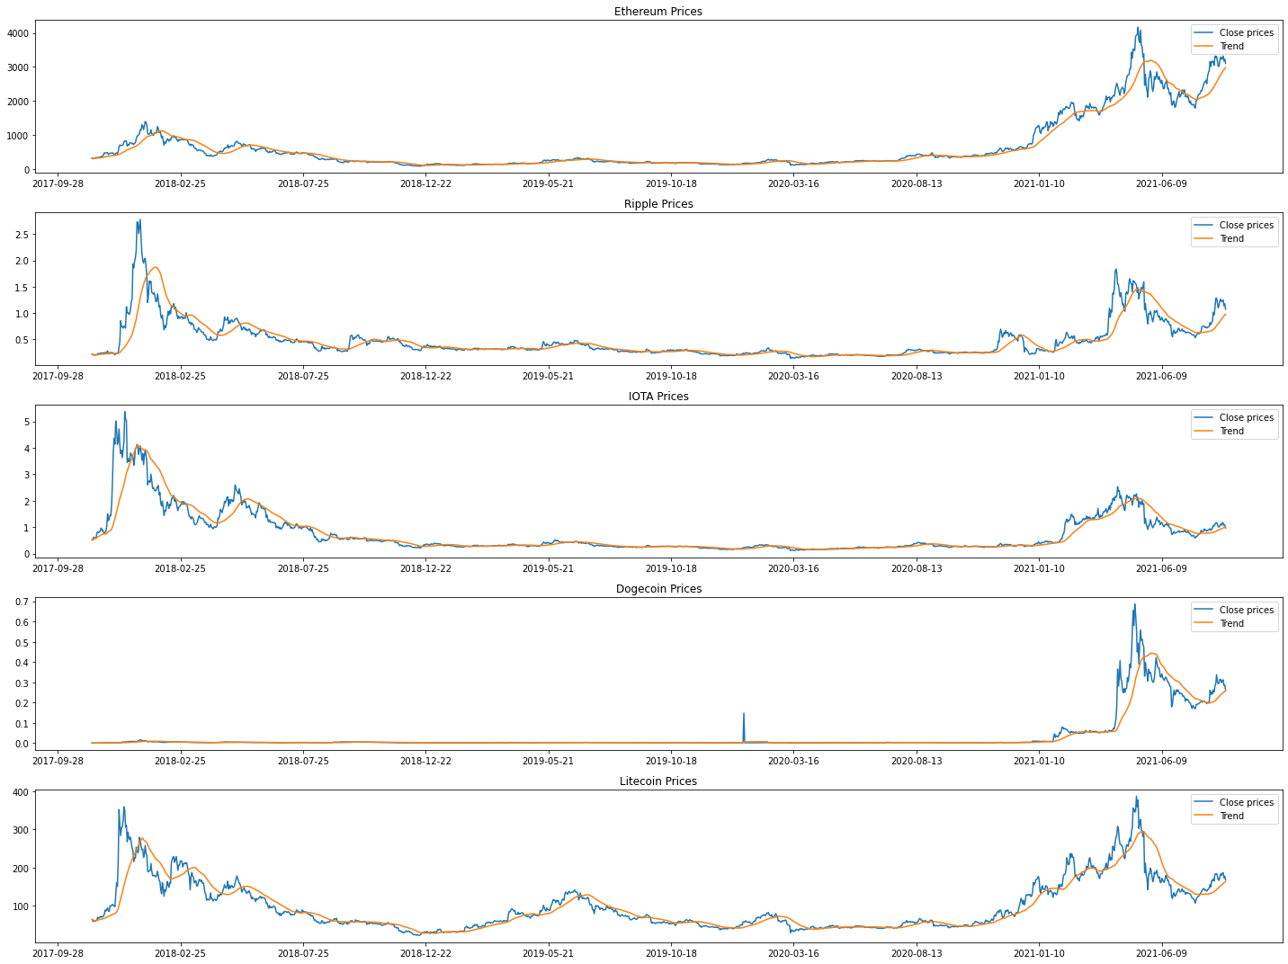
Cryptocurrecies trends

Slide 5
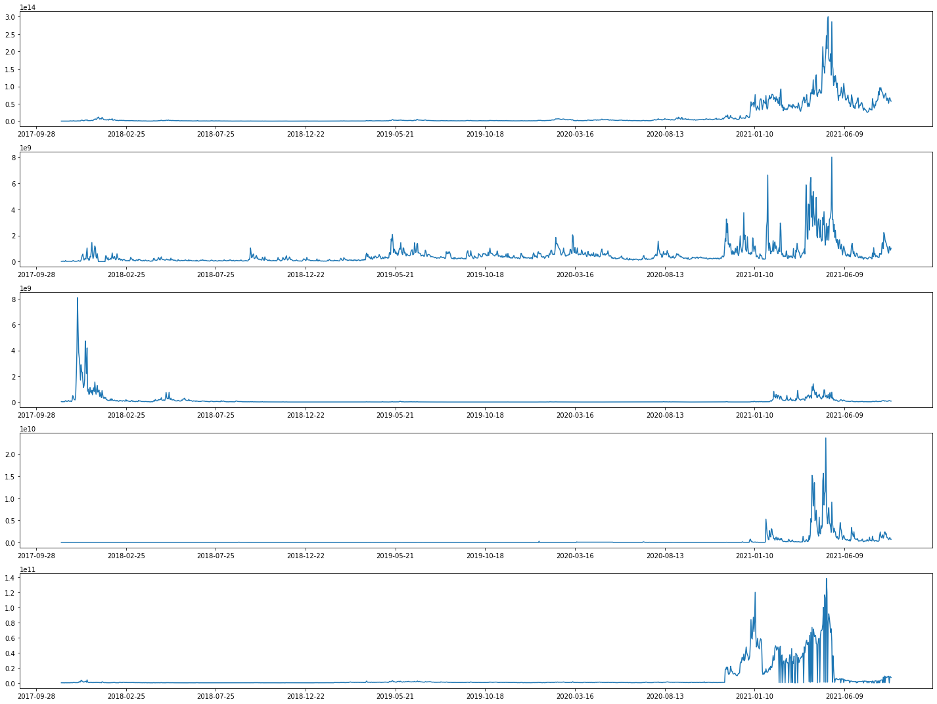
Capital market
Ethereum
We note that the highest peaks relate to the year 2021. Infact I found out in a article that around 13th Ethereum spiked (https://www.livemint.com/market/cryptocurrency/bitcoin-logs-over-800-jump-for-fy21-ethereum-zooms-1300-11617209720781.html)
"Since October 2019, ethereum has been slowly but gradually stealing the market share from bitcoin. In a little more than 1.5 years, ethereum's dominance has gone from roughly 8% to 11.25%. The bulk of this market share can perhaps be attributed to the growth of various decentralized apps and crypto innovations on the ethereum blockchain, such as DeFi and NFTs“

Slide 6
Capital market
Ripple

Slide 7
Capital market
IOTA
"The reason is the collaboration with Microsoft! In fact, the first public marketplace for IoT was launched last week, based in Berlin. IOTA has partnered with Microsoft, Fujitsu and twenty other companies (including Bosch and Accenture) to develop a solution for monetising data from Internet-connected devices. This marketplace will allow people to sell their data while remaining anonymous. The idea behind IOTA is to allow any Internet-connected device to sell its data on an open marketplace that allows micro-payments. There are no specific applications yet, but according to the IOTA team this will be a new marketplace based on an innovative business model." (https://www.ilbitcoin.news/boom-iota-372-10-giorni/)

Slide 8
Capital market
Dogecoin
"Yesterday, 9 May 2021, Geometric Energy Corporation (GEC) announced the first space mission fully funded by Dogecoin in partnership with SpaceX."
"In addition to the transition, the two companies agreed that Dogecoin will be the official currency for all future GEC space missions. Dogecoin will therefore become the first official cryptocurrency for interplanetary trade. Samuel Reid, CEO of Geometric Energy Corporation commented: "After officially negotiating an agreement of this magnitude with DOGE, Geometric Energy Corporation and SpaceX have consolidated DOGE as the unit of account for lunar business in the space sector."
(https://www.astrospace.it/2021/05/10/spacex-e-geometric-energy-finanziano-una-missione-verso-la-luna-con-i-dogecoin/)

Slide 9
Capital market
Litecoin

Slide 10
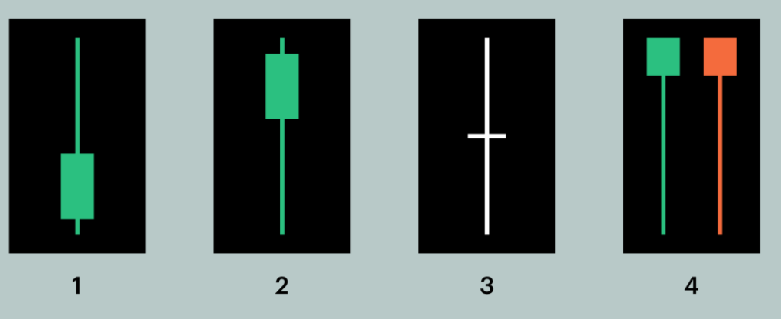
Candlesticks

Slide 11

Simple Return, Cumulative Return
Percentage change is a way to calculate the degree of change in a stock over a specific period of time using simple arithmetic. This metric is useful to investors, who use it to compare stocks with different price movements.
$$r_{t}=\frac{p_{t}}{p_{t−1}}−1$$
In the formula, pt denotes the price of an asset time t . Thus, rt is the profit rate of holding the asset from time t−1 to t . From here we can define rt+1 as the one period gross return, which is the ratio of the new market value at the end of the holding period over the initial market value.
The cumulative return is the total change in the investment price over a set time—an aggregate return, not an annualized one. (https://www.investopedia.com/terms/c/cumulativereturn.asp#:~:text=The%20cumulative%20return%20is%20the,investment%20impacts%20its%20cumulative%20return).
$$c_{t}=\left(1+r_{t}\right)c_{t−1}$$

Slide 12
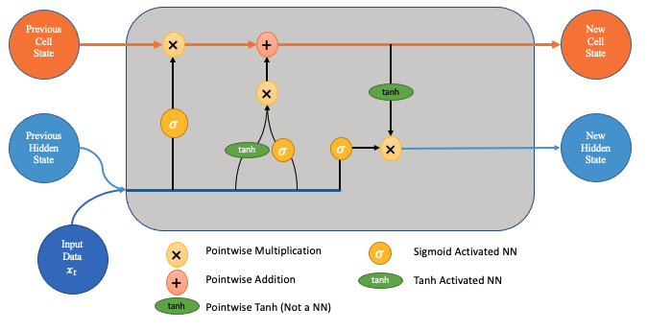
LSTM to predict the CUMULATIVE RETURNS
Time-series forecasting models are the models that are capable to predict future values based on previously observed values. Long short-term memory (LSTM) is an artificial recurrent neural network (RNN) architecture used in the field of deep learning. Unlike standard feedforward neural networks, LSTM has feedback connections. It can not only process single data points (e.g. images), but also entire sequences of data (such as speech or video inputs).

Slide 13
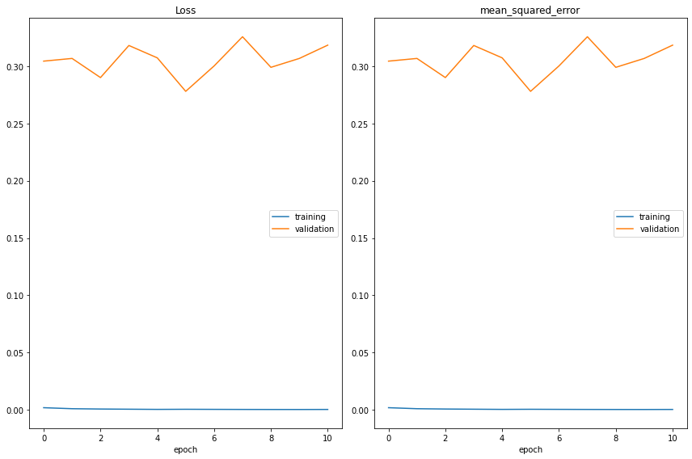
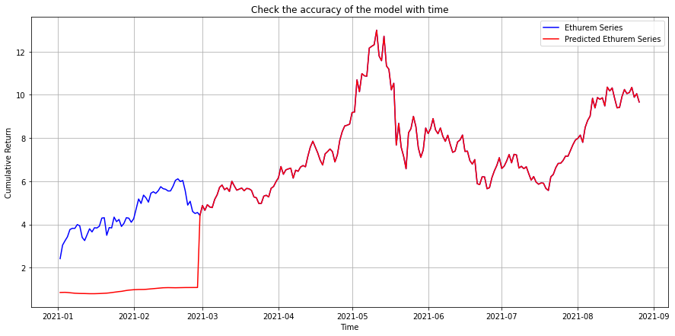
Epochs=20 and batch_size=16 Ethereum
Epoch 00011: val_loss did not improve from 0.27811
61/61 [==============================] - 68s 1s/step - loss: 2.6506e-04 - mean_squared_error: 2.6506e-04 - val_loss: 0.3185 - val_mean_squared_error: 0.3185 Epoch 00011: early stopping 3
1/31 [==============================] - 12s 393ms/step - loss: 1.4726e-04 - mean_squared_error: 1.4726e-04
Train score: 0.00015 MSE(0.01 RMSE)
2/2 [==============================] - 1s 311ms/step - loss: 0.3185 - mean_squared_error: 0.3185 Test Score: 0.31846 MSE (0.56 RMSE)

Slide 14
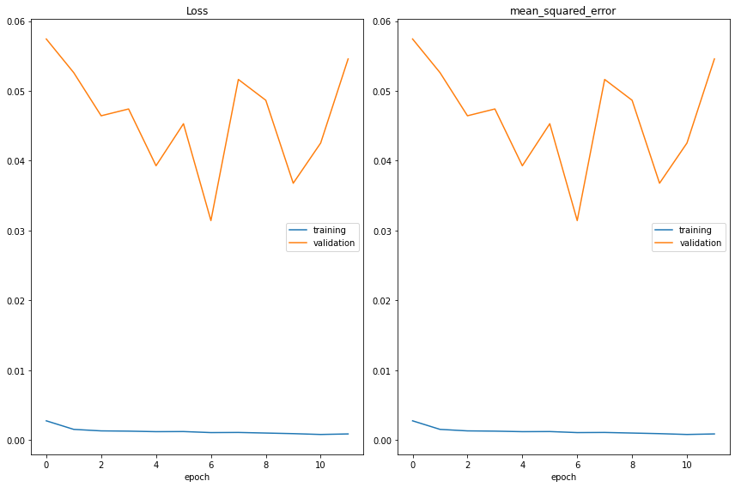
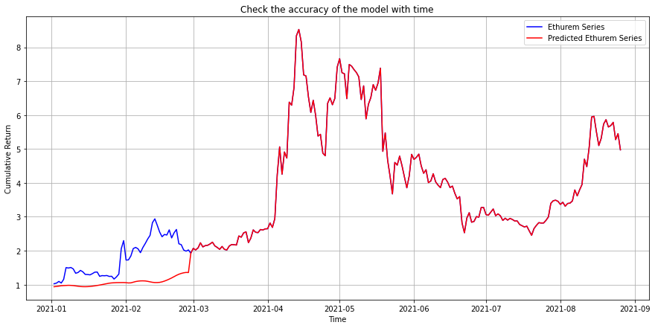
Epochs=20 and batch_size=16 Ripple
Epoch 00012: val_loss did not improve from 0.03142 61/61 [==============================] - 76s 1s/step - loss: 8.6573e-04 - mean_squared_error: 8.6573e-04 - val_loss: 0.0546 - val_mean_squared_error: 0.0546 Epoch 00012: early stopping
31/31 [==============================] - 13s 405ms/step - loss: 9.8039e-04 - mean_squared_error: 9.8039e-04
Train score: 0.00098 MSE(0.03 RMSE)
2/2 [==============================] - 1s 312ms/step - loss: 0.0546 - mean_squared_error: 0.0546
Test Score: 0.05458 MSE (0.23 RMSE)

Slide 16
Thank you for your attention!

Slide 17
References
How to read candlesticks, link

