Slide 1

Cryptocurrencies Analysis and Price Volatility prediction with hybrid LSTM-GARCH model
Zarmina Ursino
zarmina.ursino@studio.unibo.it

Slide 2
Summary
Data exploration over Ethereum, Ripple, IOTA, Dogecoin, Litecoin Cryptocurrencies datasets
Analysis of the trends
Total Traded
Candlestick plots (mlp_finance library)
Simple Returns
Cumulative Returns
LSTM
Mechanism of LSTM
livelossplot API

Slide 3
Introduction
If markets had a predictive model that could predict the price tomorrow with 100% certainty, all investors would act on it today and the prediction would turn out to be wrong. Hence, one might say that predicting the predictable causes the predictable to become unpredictable. A model that can predict the future with 100% certainty is of course not possible, but the dynamics of the thought experiment stands. Moving on, a danger with similar algorithms doing most trades is that they are likely to perform the same trades at the same time. This will in turn lead to reduced liquidity if every market participant wants to perform the same trade (e.g. buy), and no market participant want to be on the opposing side of the trade (e.g. sell).

Slide 4
Question and Objectives
Research Question
Can a hybrid of ANN-GARCH model provide a significant improvement in predicting the price volatility of the Ethereum? (We choose as ANN, LSTM Model)
Objectives
Observe if Ethereum and Bitcoin time series are satisfiable for the use of a hybrid model
Implementing a rolling window approach to predict volatility by using the 3 models
Comparing the results of the 3 models and highlighting their significances

Slide 5

09 November 2017 - 26 August 2021

Slide 6

Methodology
Business Understanding
Data Understanding
Deployment
Data
Data Cleaning
Modeling
Evaluation

Slide 7
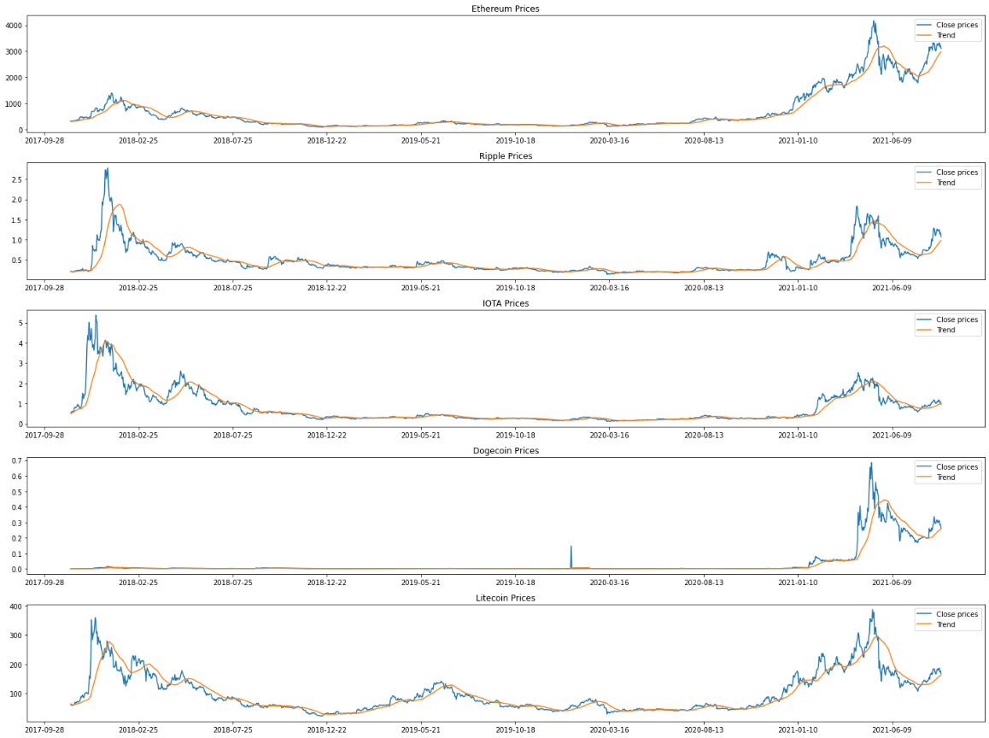
Cryptocurrecies trends
df_eth['100ma'] = df_eth['Close'].rolling(window = 30, min_periods = 0).mean()
df_xrp['100ma'] = df_xrp['Close'].rolling(window = 30, min_periods = 0).mean()
df_iota['100ma'] = df_iota['Close'].rolling(window = 30, min_periods = 0).mean()
df_doge['100ma'] = df_doge['Close'].rolling(window = 30, min_periods = 0).mean()
df_lite['100ma'] = df_lite['Close'].rolling(window = 30, min_periods = 0).mean()

Slide 8
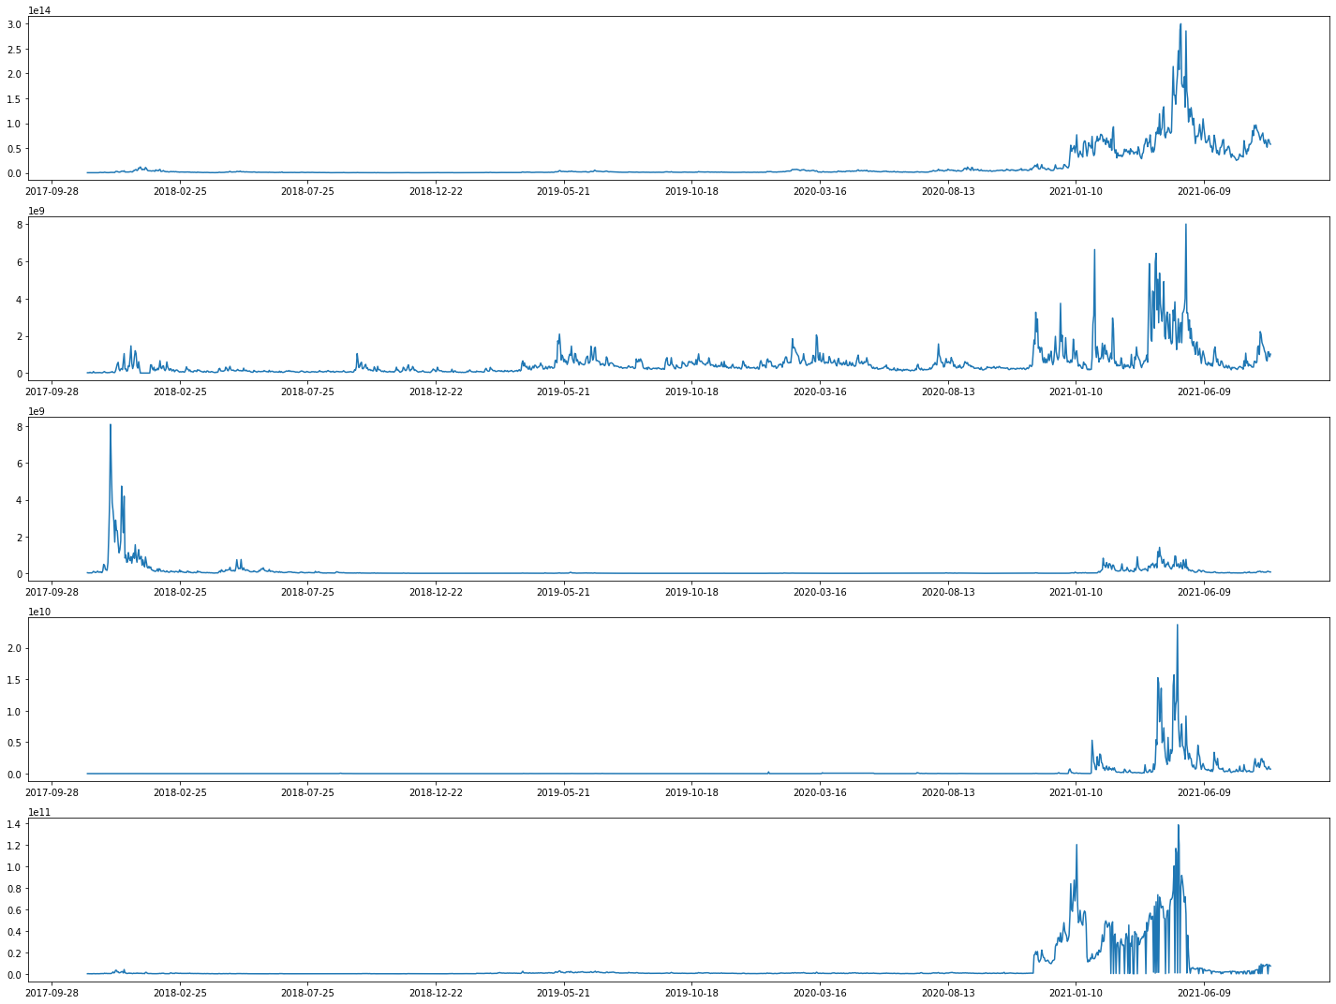
Capital market matplotlib interactive?
Ethereum
We note that the highest peaks relate to the year 2021. Infact I found out in a article that around 13th May Ethereum spiked (https://www.livemint.com/market/cryptocurrency/bitcoin-logs-over-800-jump-for-fy21-ethereum-zooms-1300-11617209720781.html)
"Since October 2019, ethereum has been slowly but gradually stealing the market share from bitcoin. In a little more than 1.5 years, ethereum's dominance has gone from roughly 8% to 11.25%. The bulk of this market share can perhaps be attributed to the growth of various decentralized apps and crypto innovations on the ethereum blockchain, such as DeFi and NFTs“

Slide 9
Capital market
Ripple

Slide 10
Capital market
IOTA
"The reason is the collaboration with Microsoft! In fact, the first public marketplace for IoT was launched last week, based in Berlin. IOTA has partnered with Microsoft, Fujitsu and twenty other companies (including Bosch and Accenture) to develop a solution for monetising data from Internet-connected devices. This marketplace will allow people to sell their data while remaining anonymous. The idea behind IOTA is to allow any Internet-connected device to sell its data on an open marketplace that allows micro-payments. There are no specific applications yet, but according to the IOTA team this will be a new marketplace based on an innovative business model." (https://www.ilbitcoin.news/boom-iota-372-10-giorni/)

Slide 11
Capital market
Dogecoin
"Yesterday, 9 May 2021, Geometric Energy Corporation (GEC) announced the first space mission fully funded by Dogecoin in partnership with SpaceX."
"In addition to the transition, the two companies agreed that Dogecoin will be the official currency for all future GEC space missions. Dogecoin will therefore become the first official cryptocurrency for interplanetary trade. Samuel Reid, CEO of Geometric Energy Corporation commented: "After officially negotiating an agreement of this magnitude with DOGE, Geometric Energy Corporation and SpaceX have consolidated DOGE as the unit of account for lunar business in the space sector."
(https://www.astrospace.it/2021/05/10/spacex-e-geometric-energy-finanziano-una-missione-verso-la-luna-con-i-dogecoin/)

Slide 12
Capital market
Litecoin

Slide 13
Capital market - Comparison

Slide 14
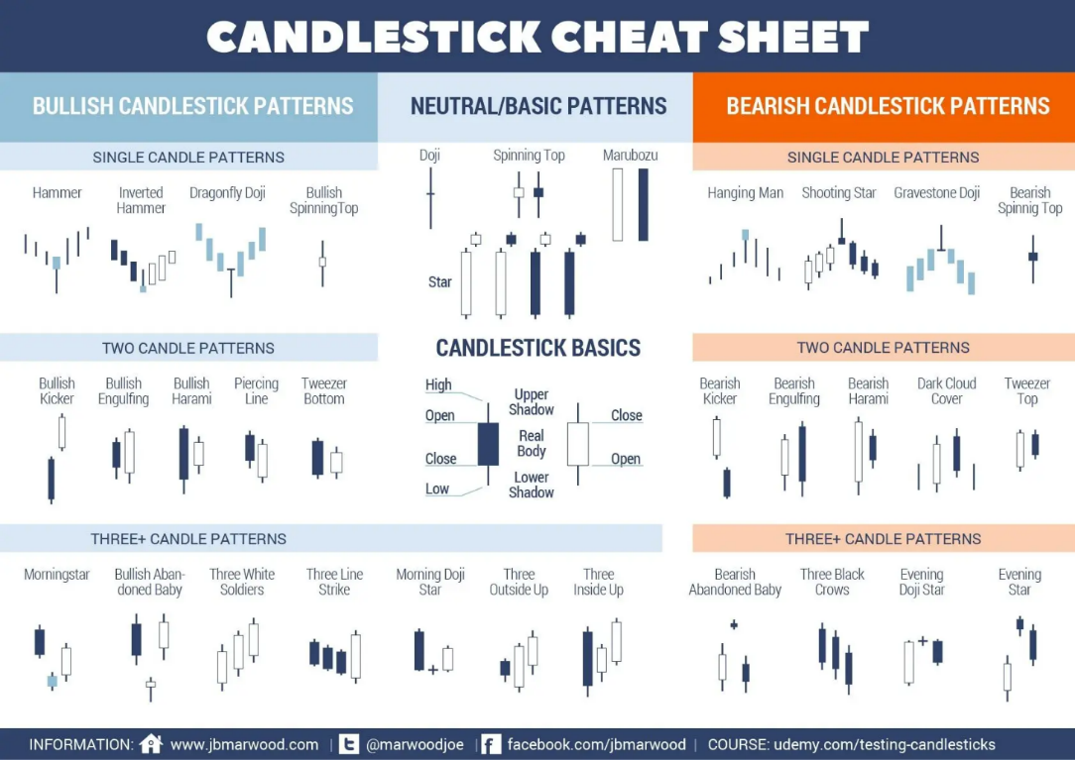
Candlesticks

Slide 15

Simple Return, Cumulative Return
Percentage change is a way to calculate the degree of change in a stock over a specific period of time using simple arithmetic. This metric is useful to investors, who use it to compare stocks with different price movements.
$$r_{t}=\frac{p_{t}}{p_{t−1}}−1$$
In the formula, pt denotes the price of an asset time t . Thus, rt is the profit rate of holding the asset from time t−1 to t . From here we can define rt+1 as the one period gross return, which is the ratio of the new market value at the end of the holding period over the initial market value.
The cumulative return is the total change in the investment price over a set time—an aggregate return, not an annualized one. (https://www.investopedia.com/terms/c/cumulativereturn.asp#:~:text=The%20cumulative%20return%20is%20the,investment%20impacts%20its%20cumulative%20return).
$$c_{t}=\left(1+r_{t}\right)c_{t−1}$$

Slide 16
Volatility

Slide 17
GARCH
Let Xt denote the observed financial data series; in our case, these are the log returns of the prices of the respective cryptocurrencies. Then, GARCH models can be specified as:
Xt=μt+σtZt,
where μt denotes the conditional mean and σt denotes a volatility process.
The standard GARCH model (Bollerslev (1986)), denoted by SGARCH (1, 1), has:
σ2t=ω+α1Z2t−1+β1σ2t−1
for α1>0, β1>0 and ω>0. The main feature of this and other models is that they capture volatility clustering in the data. The “persistence” parameter (which accounts for the amount of volatility clustering captured by the model) for this model is α1+β1. Weak stationarity holds if α1+β1<1.

Slide 18
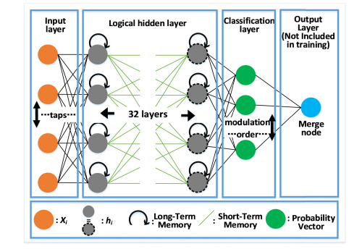
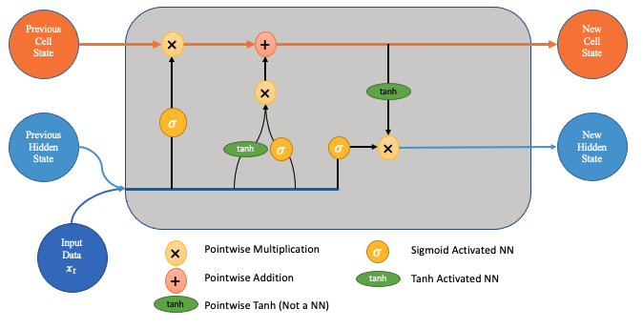
LSTM to predict the CUMULATIVE RETURNS
Time-series forecasting models are the models that are capable to predict future values based on previously observed values. Long short-term memory (LSTM) is an artificial recurrent neural network (RNN) architecture used in the field of deep learning. Unlike standard feedforward neural networks, LSTM has feedback connections. It can not only process single data points (e.g. images), but also entire sequences of data (such as speech or video inputs).

Slide 19
Hybrid Model
Crypto prices
Garch (1, 1)
LSTM Architecture
Output

Slide 20
Steps to build the LSTM model
﻿Firstly, I split the dataset between training, validation and test set to avoid overfitting to the training set﻿ or overfitting to the test set. (functions)
Secondly, after each epoch, training the model on all observations while adjusting parameters, I compute the loss function on the training set and the validation﻿ set. Once the loss function calculated on the validation set predictions stops decreasing, the ﻿iteration stops and no more epochs are run. This process is called early stopping and makes sure that we do not overfit to the training observations and improves the performance on unseen data.
Thirdly, I use dropout regularization of 40% within the recurrent layer, in order to have an higher performance

Slide 21
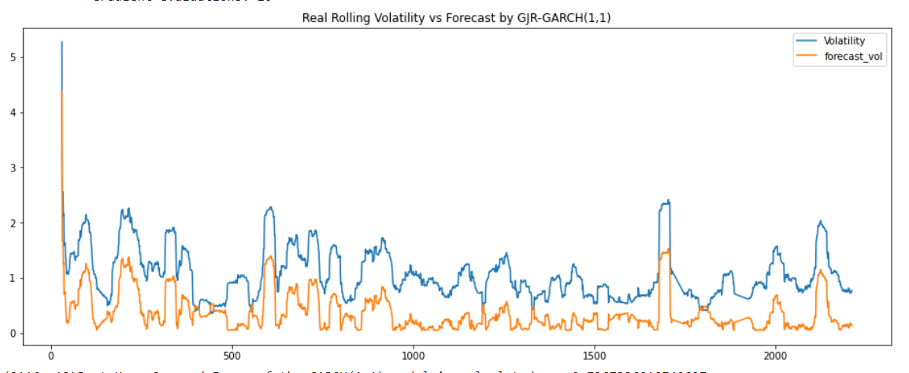
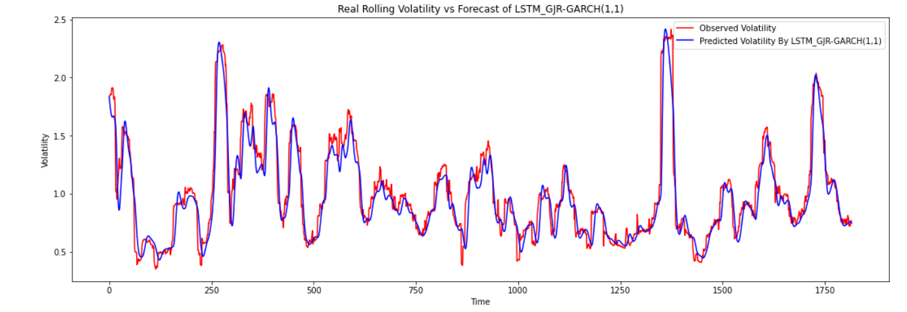
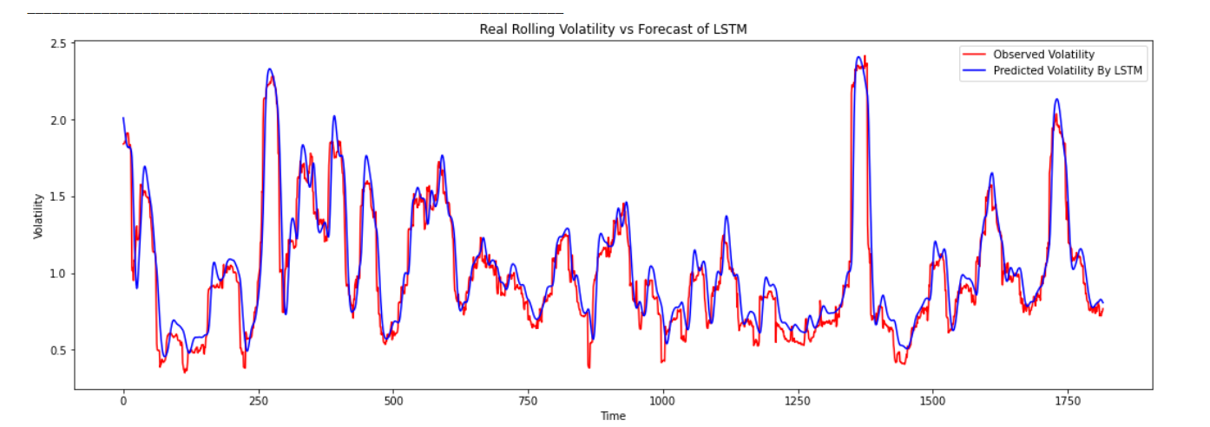

Slide 22

Evaluation
Model | MSE | RSME | Percentage change
GRR_GARCH(1, 1) | 0.5427764001303299 | 0.7367336018740627 | --
LSTM | 0, 336398643782 | 0.5799988308452648 | 27%
GRJ-GARCH + LSTM | 0,313922063036 | 0.5602874824910546 | 3, 4%
$$\%Change=(1−\frac{New RMSE}{Old RMSE} )×100$$

Slide 23

Conclusion
Objectives | Achieved or not?
Observe if Ethereum and Bitcoin time series are satisfiable for the use of a hybrid model
Implementing a rolling window approach to predict volatility by using the 3 models
Comparing the results of the 3 models and highlighting their significances
Notes:
The result is that the predictions of the model mimic the actual values of the sequence! LSTM networks have significant predictive properties far beyond the predictive methods we compare it to. I believe that while it might not be profitable to trade on the predictions alone, it can make a great tool for investment professionals to complement other trading strategies. The results obtained suggested that the hybrid model has the least error thus implying it is better suited hence answering the research question if a hybrid model of ANN-GARCH can provide significant improvement in predicting the price volatility with a answer as yes. But we cannot ignore the fact that, the hybrid model is just over 2% better than that of the traditional LSTM model. Which rises the question, if it is worth it. This might have caused due to the less amount of data for a heavy model like LSTM to be trained. Also the limitation of this research is, it only consists of the historical data, but totally ignores external factors affecting the pricing and volatility such as news outbreak, change in governance, imposition of new rules, etc. It may really be interesting to see the results of sentiment analysis on such new and volatile asset class.

Slide 24
Thank you for your attention!

Slide 25
References
Datasets Source Link
How to read candlesticks? Link
Asset Returns Link
MAE, MSE, RMSE, Coefficient of Determination, Adjusted R Squared — Which Metric is Better? Link
From the book “Blockchain 2021”, Nathan Real
GARCH Modelling of Cryptocurrencies, Link

Slide 26
Final Table
Cryptocurrencies | Test Score bs=16, lr=0.005 | Test Score bs=32, lr=0.005 | Test Score bs=16, lr=0.05 | Test Score bs=32, lr=0.05
Ethereum | 0.31846 MSE (0.56 RMSE)
Ripple | 0.05458 MSE (0.23 RMSE)
IOTA
Dogecoin | 0.11653 MSE (0.34 RMSE)
Litecoin | 0.06135 MSE (0.25 RMSE)

Slide 27
Not working iota

Slide 28
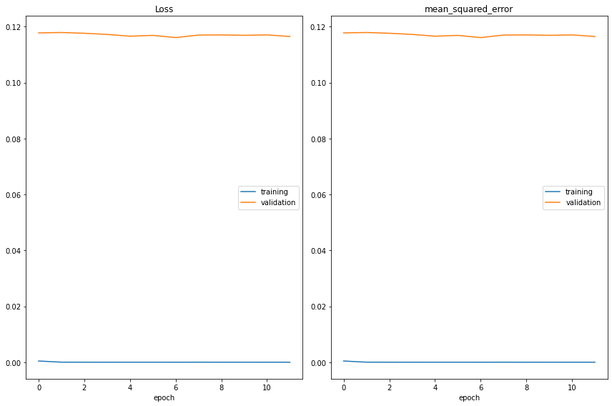
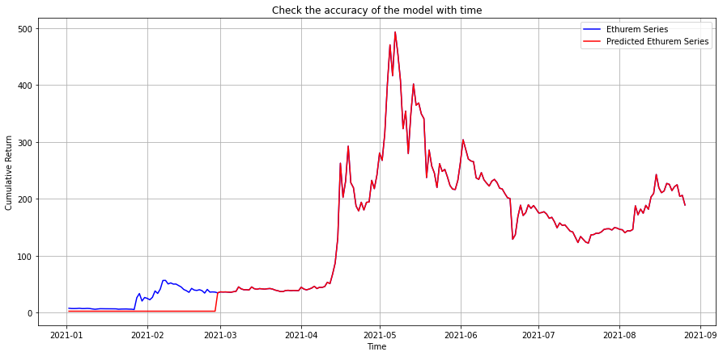
Epochs=20 and batch_size=16 Dogecoin
Epoch 00012: val_loss did not improve from 0.11613 61/61 [==============================] - 69s 1s/step - loss: 4.8938e-05 - mean_squared_error: 4.8938e-05 - val_loss: 0.1165 - val_mean_squared_error: 0.1165
Epoch 00012: early stopping 31/31 [==============================] - 12s 390ms/step - loss: 4.8120e-05 - mean_squared_error: 4.8120e-05
Train score: 0.00005 MSE(0.01 RMSE) 2/2 [==============================] - 1s 295ms/step - loss: 0.1165 - mean_squared_error: 0.1165
Test Score: 0.11653 MSE (0.34 RMSE)

Slide 29
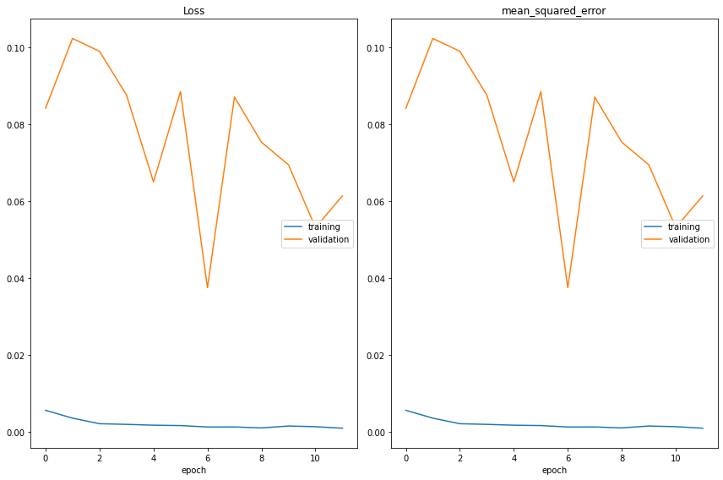
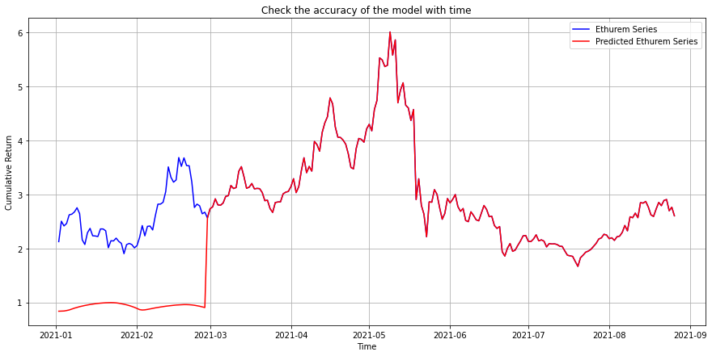
Epochs=20 and batch_size=16 Litecoin
Epoch 00012: val_loss did not improve from 0.03746 61/61 [==============================] - 72s 1s/step - loss: 8.9738e-04 - mean_squared_error: 8.9738e-04 - val_loss: 0.0613 - val_mean_squared_error: 0.0613
Epoch 00012: early stopping 31/31 [==============================] - 12s 399ms/step - loss: 5.8600e-04 - mean_squared_error: 5.8600e-04
Train score: 0.00059 MSE(0.02 RMSE) 2/2 [==============================] - 1s 294ms/step - loss: 0.0613 - mean_squared_error: 0.0613
Test Score: 0.06135 MSE (0.25 RMSE)

Slide 30
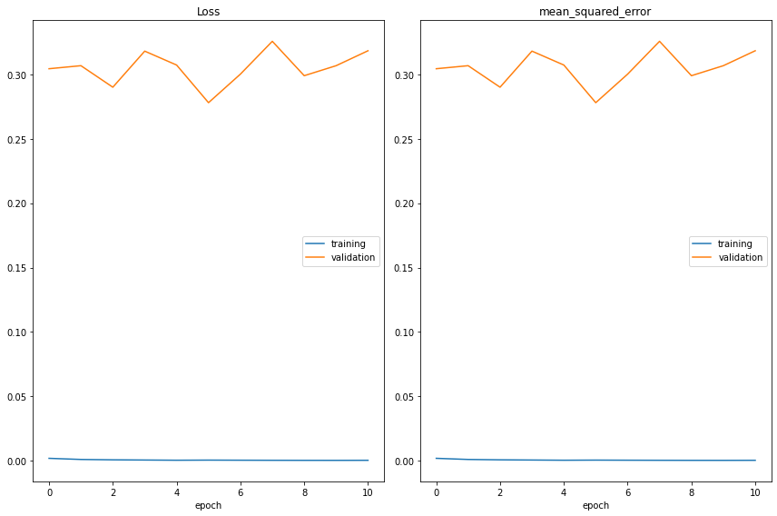
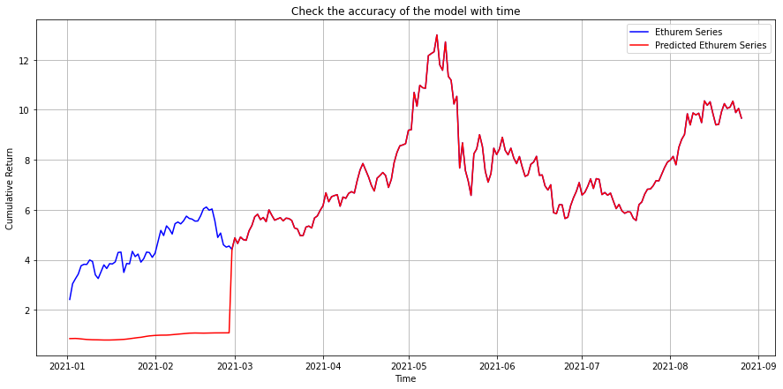
Epochs=20 and batch_size=16 Ethereum
Epoch 00011: val_loss did not improve from 0.27811
61/61 [==============================] - 68s 1s/step - loss: 2.6506e-04 - mean_squared_error: 2.6506e-04 - val_loss: 0.3185 - val_mean_squared_error: 0.3185 Epoch 00011: early stopping 3
1/31 [==============================] - 12s 393ms/step - loss: 1.4726e-04 - mean_squared_error: 1.4726e-04
Train score: 0.00015 MSE(0.01 RMSE)
2/2 [==============================] - 1s 311ms/step - loss: 0.3185 - mean_squared_error: 0.3185 Test Score: 0.31846 MSE (0.56 RMSE)

Slide 31
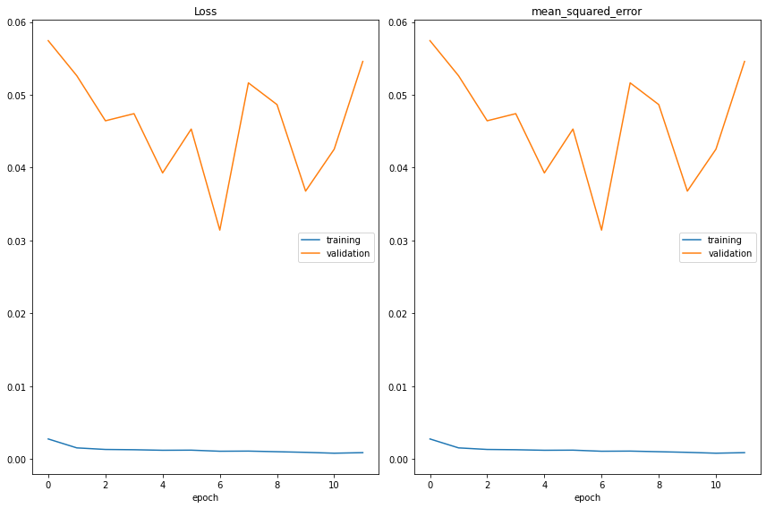
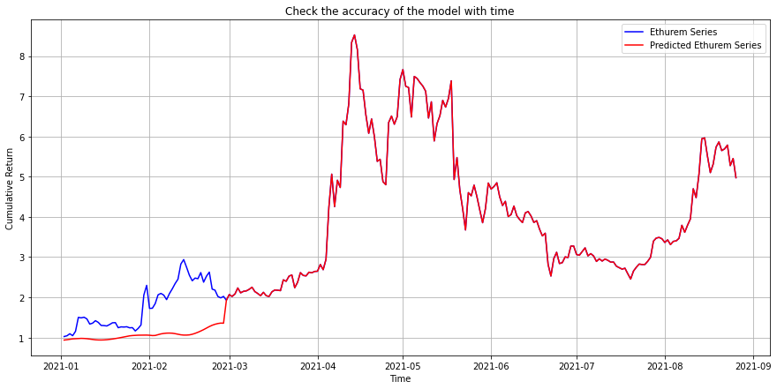
Epochs=20 and batch_size=16 Ripple
Epoch 00012: val_loss did not improve from 0.03142 61/61 [==============================] - 76s 1s/step - loss: 8.6573e-04 - mean_squared_error: 8.6573e-04 - val_loss: 0.0546 - val_mean_squared_error: 0.0546 Epoch 00012: early stopping
31/31 [==============================] - 13s 405ms/step - loss: 9.8039e-04 - mean_squared_error: 9.8039e-04
Train score: 0.00098 MSE(0.03 RMSE)
2/2 [==============================] - 1s 312ms/step - loss: 0.0546 - mean_squared_error: 0.0546
Test Score: 0.05458 MSE (0.23 RMSE)

