Slide 1

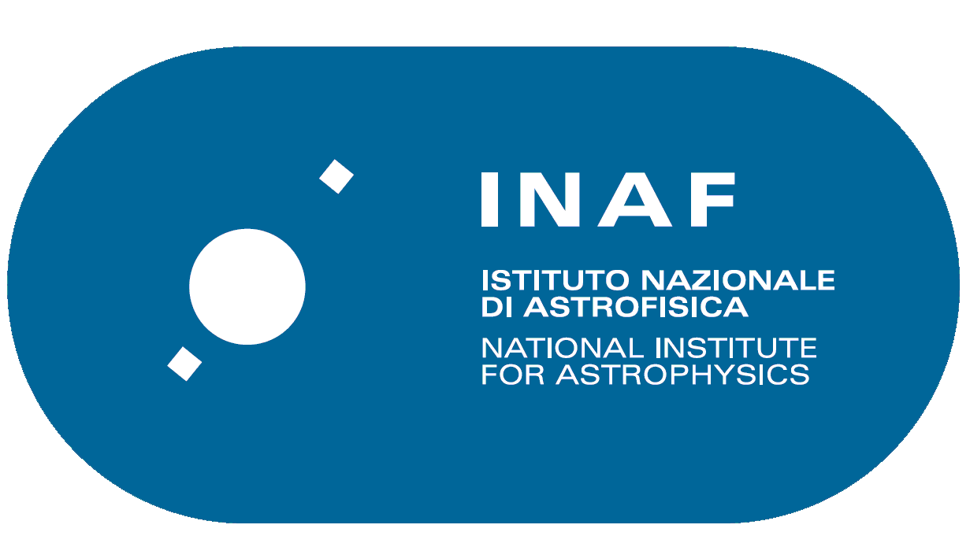
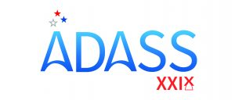
Science Platforms & Interoperability
Dave Morris – UEDIN & Marco Molinaro – INAF
@ Science Platorms: towards Data Science – ADASS XXIX BoF 8
Groningen, 9 October 2019

Slide 2
Disclaimers
Some content may be DAL biased or resource curation based
  a lot of our work is data/resource driven
We are NOT the IVOA
  We were asked to give a VO/interoperbaility view
We have a lot of QUESTIONS in here
  We don’t know the solutions yet
All of this has an attachment to our ESCAPE/EOSC involvement

Slide 3
Interoperability among Platforms
GOALS
enable direct re-use of data/service/code/workflow resources among standalone platforms
continue working on the ecosystem idea sitting behind the IVOA vision
  “ecosystem is better than monoculture”

Slide 4
VO within Science Platforms
PROS
not reinvent the wheel
interoperable data/service resources
metadata richness to enable science portal operations
long term sustainability of the effort to build a Science Platform
CONS
implementation may take more effort
cost of contributing to a standards community

Slide 5
Interoperability among Platforms
HURDLES
interoperable data resources
interoperable code resources
moving them around in a realistic and reasonable way

Slide 6
Interoperability among Platforms
STATUS & NEEDS
data discovery and access, open VO standards
interoperable AAI solutions (IVOA GWS working on it ... )
metadata to characterize network proximity
IVOA metadata EXIST for describing data, NEED to have them for code
  there probably already are some standards for this
  we should find/evaluate and adopt them rather than invent new ones

Slide 7



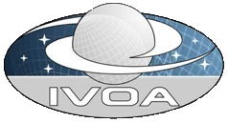

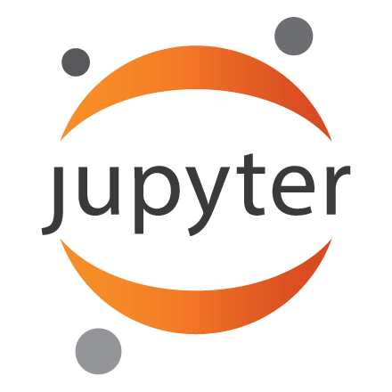

ASTERICS Technology Forum 2018/04/16
Can we model this as
membership of 'zones' ?
Level zero, the VO
Level two, national network, e.g. JANET
“your code”
Level one, European network
Level three, Edinburgh Uni
Level four,
Observatory
Level five,
data centre
D.Morris
Institute for Astronomy,
Edinburgh University
April 2018

Slide 8
A word on FAIRness
Findable, Accessible, Interoperable & Re-usable return of Science Platforms is potentially great, but Science Platforms need to be designed properly to allow it (don’t stay closed in your own realm).
See reproducibility talk: Bertocco @ IVOA Interop DCP session
(Friday @ 15:30 – Student Hotel splinter room)

Slide 9
Thank you!

