Slide 1

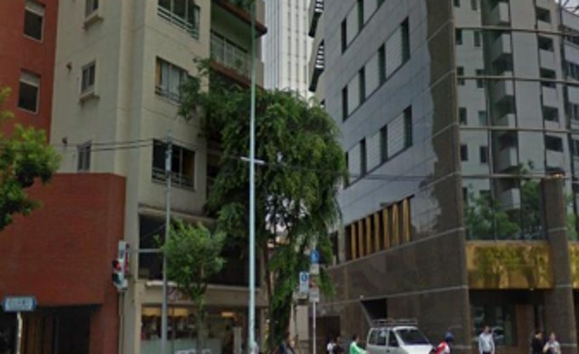
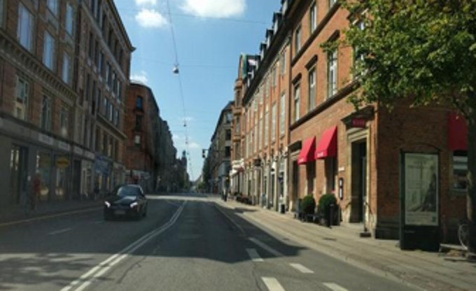
Trained
Training-free, prior work
Ours
train
or
or
Large labelled
training set
Environment-specific
features
Frozen patch
features
Codebook
Segmentation
CLS attention
Frozen patch
features
Within-image
Across-image
Prior-selected / aggregated features
Balanced, matchable patch evidence
A
Standard
Cross-env.
B
Standard
Cross-env.
C
Standard
Cross-env.
Training cost vs. performance
Performance on 17 benchmarks
VP-Air R@1 (cross-environment benchmark, %)
standard benchmarks
80
Ours
Pitts250k
70
Mid-Atlantic
100
Pitts30k
AnyLoc
SegVLAD-PreT
Laurel
Tokyo 24/7
60
EffoVPR-ZS
MegaLoc
Hawkins
60
MSLS-val
50
40
Nardo-Air R
20
Nordland
VLAD-BuFF
SAGE
30
SelaVPR
BoQ
CosPlace
Nardo-Air
St Lucia
20
SuperVLAD
MixVPR
CricaVPR
SALAD
CliqueM
VP-Air
Oxford
10
SFRS
R2Former
EigenPl
Gardens Point
AmsterTime
82
84
86
88
90
92
94
96
98
100
Baidu Mall
17 Places
Tokyo 24/7 R@1 (standard benchmark, %)
cross-environment benchmarks
D
ours (training-free)
training-free
trained
1 million images
5 million images
E
Ours
MegaLoc
AnyLoc

Slide 2
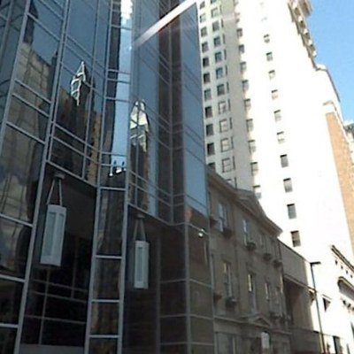
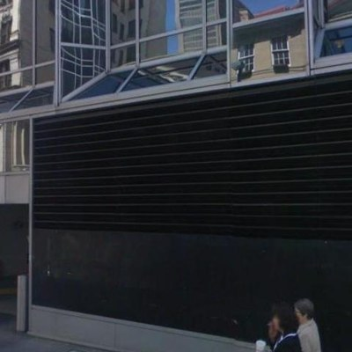
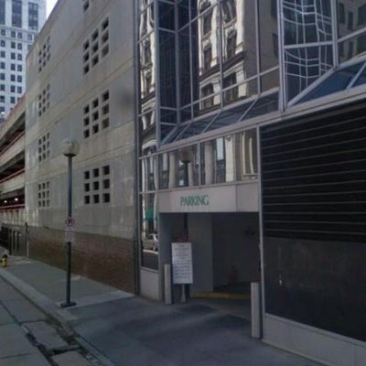
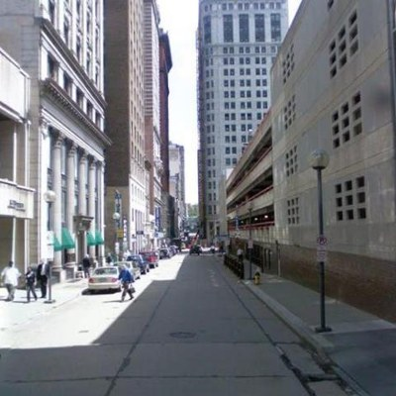
Coarse Ranking
Second-Moment Pooling (PS-2)
Query
query patches Q : N × C
query patches & w
F, w^{1/2}
W^{1/2} F
S_{C}(F) = FᵀW F
…
…
C
query descriptor g_{Q}
f₁
f₂
f₃
f_{N}
…
C
Patch Weighting via Self-Similarity (PS-1)
WPCA
S(F,F) = F Fᵀ
Ŝ = 𝟙 [S(F,F) > τ]
n_{i}
w_{i}
C
top-K
Vision
3
1/3
C
database descriptors g_{Dℓ}
Encoder
2
1/2
Storage
τ
1
1
N
3
1/3
❄
1
1
Database
2
1/2
3
1/3
Reranking
N
1
1
1
1
MaxSim Matching (PS-3)
S(Q, D_{ℓ}) = Q D_{ℓ}ᵀ
row max
m_{i}
gate
θ
weighted
sum s
…
D_{ℓ}
…
…
1
+
f₁
f₂
f_{N}
database patches & w
2
database patches D_{ℓ} : N × C,
ℓ = 1, …, M
3
+
Q
4
N
5
+
6
+
7
+
query patch
database patch
query channel
database channel
8
9
Ranked List
weight path
shade = weight w_{i}
below τ
below θ
N
for each top-K D_{ℓ}

