Slide 1

DNS CACHE POISONING ATTACK

Slide 2
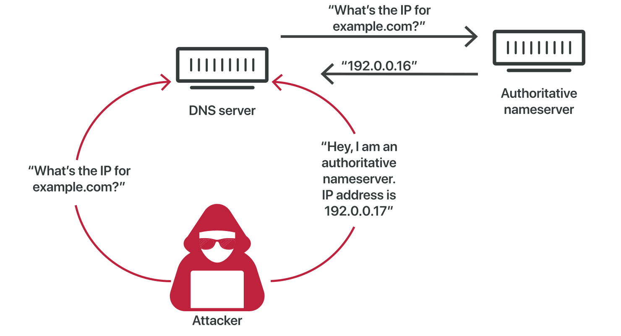
DNS cache poisoning attack :

Slide 3
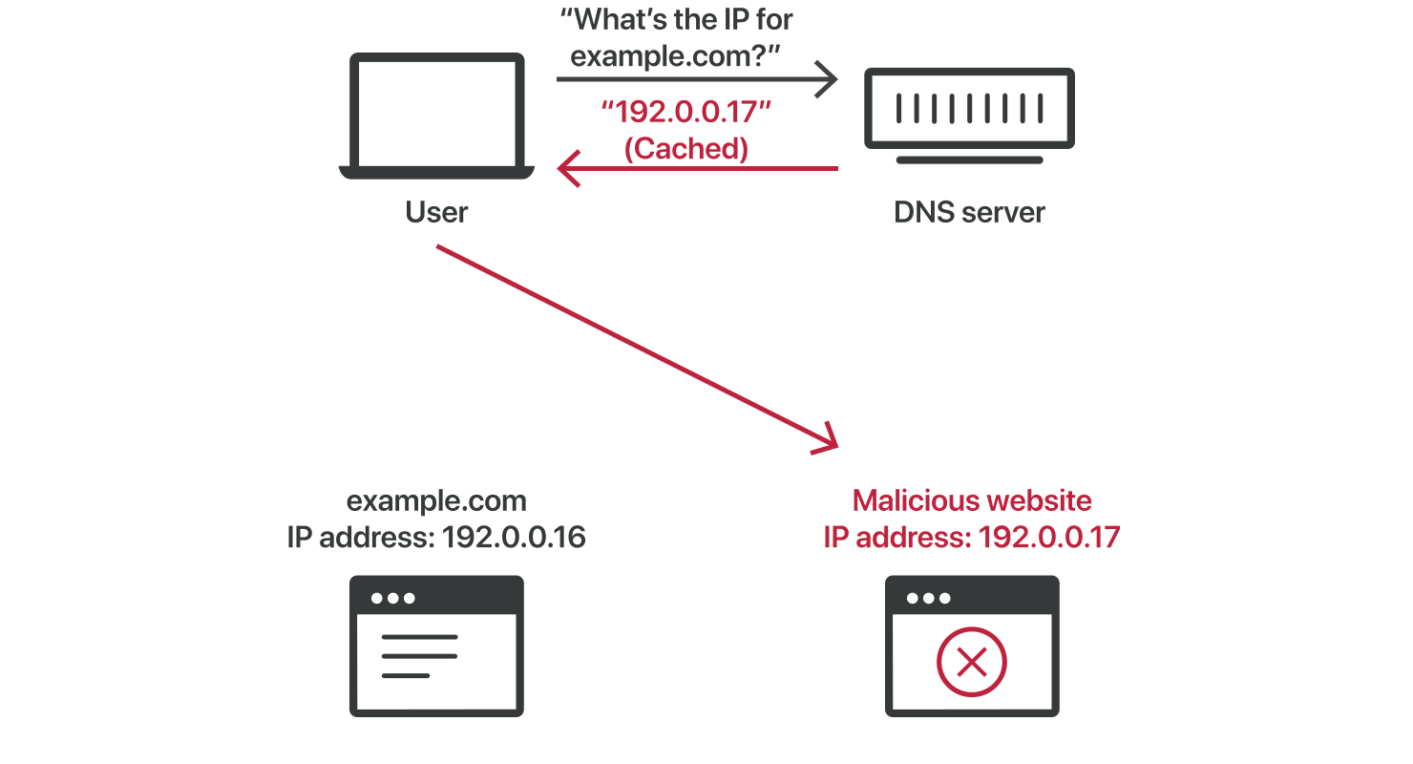
Result:

Slide 4

EXPERIMENT SECTION

Slide 5
Architecture Overview:
- Four containers: Client, DNS Server, Attacker, Root DNS
- All connected on custom Docker network
- Controlled IP assignments for deterministic routing
- Python-based DNS resolver and attack scripts

Slide 6
Docker Compose Structure:
Services:
• dns: resolver
• client: victim DNS requester
• attacker: sends spoofed replies
• root_dns: authoritative server
Network:
• Subnet 192.168.100.0/28
• Static IPs to ensure predictable communication

Slide 7
Network Layout:
192.168.100.2 – dns
192.168.100.3 – client
192.168.100.4 – attacker
192.168.100.5 – root_dns
Simple flat network for attack demonstration.

Slide 8
Attack Flow:
1. Client sends DNS query to resolver.
2. Resolver queries root_dns.
3. Attacker floods resolver with forged replies.
4. Resolver accepts malicious answer.
5. Client receives poisoned DNS record.

Slide 9
Demonstration Steps:
1. docker-compose build
2. docker-compose up
2. From attacker: Run attacker.py
3. From client: dig @dns google.com

Slide 10
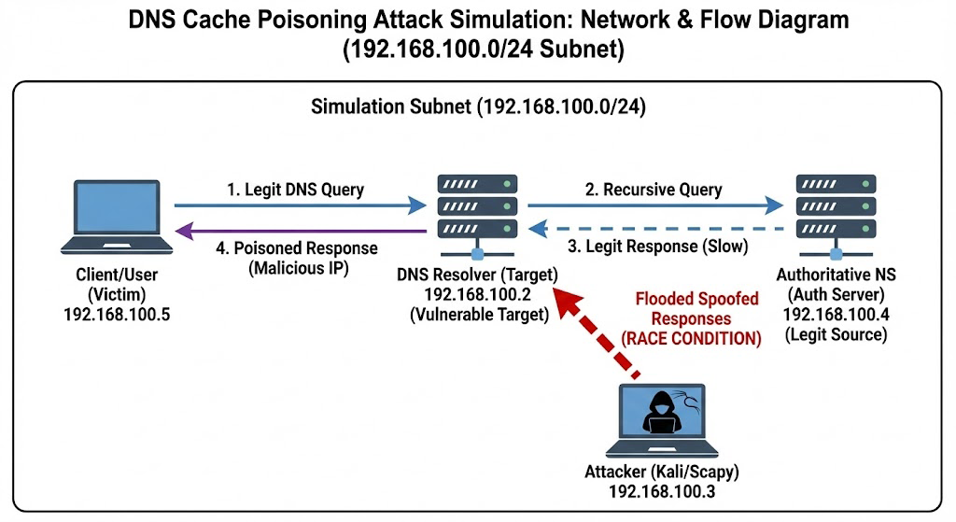
Network diagram:

Slide 11
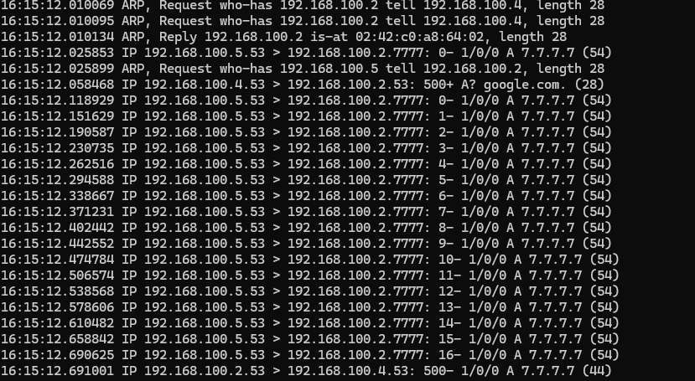
Attack in action:
We trigger an IP lookup for google.com on the target DNS server. We preemptively send a fake reply because we cannot predict exactly when the server will be ready to accept it.

Slide 12
Attack in action:
We flood the target DNS server with fake responses to beat the upstream DNS server. This successfully poisons the cache, redirecting all users to the malicious IP 7.7.7.7

Slide 13
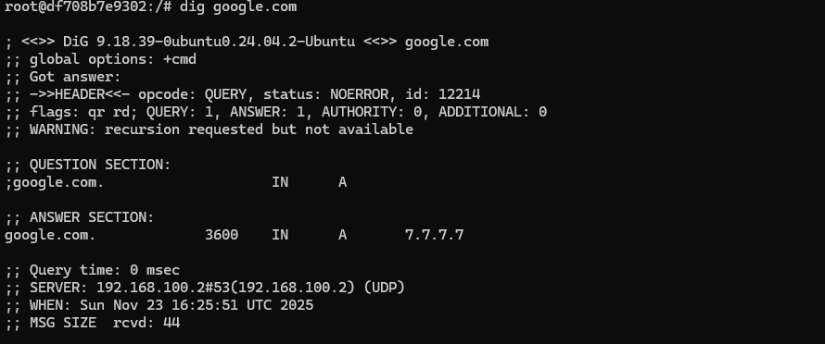
Result of the attack:
If the attack was successful, on any machine retrieving the IP from this DNS server, we can see that google.com resolves to the IP 7.7.7.7

Slide 14
Possible countermeasures:
Switching to DNSSEC (Domain Name System Security Extensions): adds a layer of security by attaching cryptographic signatures to DNS records. This ensures data integrity and origin authentication, allowing the resolver to verify that the response comes from the legitimate source. Consequently, it prevents cache poisoning attacks because any spoofed response (lacking a valid signature) is automatically rejected
Source Port Randomization: increases the entropy of the DNS transaction. Instead of using a fixed or predictable port for outgoing queries, the resolver selects a random ephemeral port for each request. To succeed, an attacker must now correctly guess both the 16-bit Transaction ID and the random 16-bit source port simultaneously. This expands the search space to over 4 billion combinations, making blind brute-force attacks computationally infeasible
DNS 0x20: Encoding uses mixed-case randomization in the domain name query (e.g., requesting GoOgLe.cOm instead of google.com). Since standard authoritative servers copy the query section exactly into their response, the resolver can verify that the casing in the reply matches the query perfectly. An attacker, unable to predict the specific randomization pattern, will likely send a response with incorrect casing (e.g., all lowercase), causing it to be rejected.

Slide 15
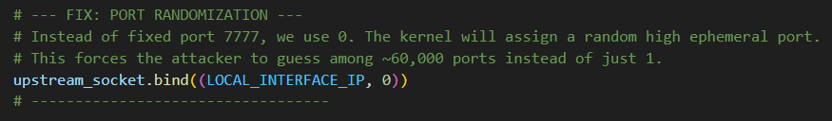
Source Port Randomization code example:

Slide 16
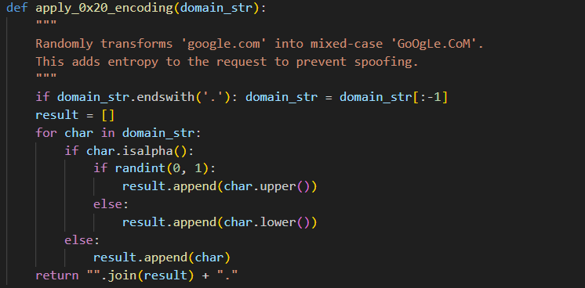
DNS 0x20 code example:

Slide 17
Sources:
Che cos'è il DNS cache poisoning? | DNS spoofing | Cloudflare
https://youtu.be/pFh1hmdRAoU?si=ayNj7a114_zaEpA2
https://youtu.be/7MT1F0O3_Yw?si=NpUvmqdFNvp4iDqV
My github repo:
Zartep/DNS_cache_poisoning_attack_simulation: Academic Project: DNS Cache Poisoning Simulation

