Slide 1
Agentic AI in Requirements Engineering
How a Four-Layer Hallucination Firewall transforms stakeholder narratives into formally verified, deployment-ready system specifications
SOFTWARE ENGINEERING RESEARCH
REQUIREMENTS ENGINEERING
AGENTIC AI

Slide 2
FOUNDATION
The Requirements Engineering Challenge
Requirements Engineering moves from eliciting stakeholder needs to analyzing and refining them, then specifying clear requirements and validating that they match intent. The four phases work together to turn informal goals into precise, testable system requirements.
01
02
Elicitation
Analysis
Capture stakeholder needs, goals, and constraints.
Refine, resolve conflicts, and prioritize requirements.
03
04
Specification
Validation
Write clear, precise, testable requirements.
Confirm requirements match intent and are complete.

Slide 3
PROBLEM SPACE
Three Approaches, Three Critical Flaws
Traditional RE
Agile RE
Unguided LLM
Months of upfront analysis; requirements obsolete before deployment
Traceability rot strips original business rationale; refactoring becomes hazardous
Hallucinations, vague language, compliance blindspots

Slide 4
DEEP DIVE
Traditional RE: Rigorous but Slow
Unambiguous
Verifiable
Clear language reduces interpretation risk.
Requirements can be checked against measurable criteria.
Traditional requirements engineering emphasizes formal discipline, structured language, and verifiable statements to reduce ambiguity. It often uses standards like EARS and ISO/IEC quality criteria to improve consistency and traceability. The result is high-confidence requirements that are easier to review and validate. But the upfront analysis can take months or years, turning rigor into a velocity problem in fast-moving domains.
Traceable
Consistent
Links back to business goals and source needs stay intact.
Standardized structure supports review and governance.

Slide 5
DEEP DIVE
Agile RE and Unguided LLMs: Two More Failure Modes
Agile RE: Fast but Forgetful
Unguided LLM: The Hallucination Problem
Continuous discovery in short iterations
Business rationale fades over time
Invents unrequested features
Produces vague, untestable language
Refactoring becomes harder to justify
Can miss security and compliance issues

Slide 6
SOLUTION
Agentic Workflow: The Self-Defending Requirement
A system that wraps LLMs in structural constraints, transforming probabilistic language models into deterministic engineering tools.
Four-Layer Hallucination Firewall
Requirements as Compiled Code
Best of Both Worlds
Combines Agile velocity with Traditional rigor and adds compliance safety that neither approach delivers alone
Each layer intercepts a distinct failure mode before it can propagate downstream into implementation
Treated as validated artifacts, not passive templates. Every requirement is linted, schema-validated, and source-anchored

Slide 7
ARCHITECTURE
The Four-Layer Hallucination Firewall
Each layer addresses a distinct class of LLM failure, so no single safeguard has to do all the work.
Semantic Grounding
Schema Constraints
Automated Linting
Ties requirements to source evidence so claims stay anchored in real documentation. This reduces invented details before they enter the workflow.
Enforces EARS grammar and required structure at the point of authoring. Invalid patterns are blocked before they can become part of the requirement set.
Checks every save or commit for structural errors and inconsistencies. It catches problems continuously instead of waiting for a late-stage review.
Human-in-the-Loop
Directs expert attention to the highest-risk requirements only. Review time goes where judgment matters most.

Slide 8
ARCHITECTURE
Layers 1, 2, and 3: From Source to Schema to CI/CD
Semantic Grounding
Schema Constraints
Automated Linting
Every requirement links to an immutable source transcript with line ranges and verbatim evidence quotes. The agent operates under zero-trust and does not draw from general training data.
JSON schema enforces EARS grammar structure and requires the "shall" keyword. It also maintains a banned-word list that blocks vague adjectives before generation completes.
A Python linter validates every save by checking EARS patterns, scanning for forbidden adjectives, and verifying quotes against the source. The deterministic CI/CD pipeline aborts commits when even a single-character discrepancy is found.

Slide 9
ARCHITECTURE
Layer 4: Human-in-the-Loop Worst-First Gate
The final layer preserves human judgment precisely where it matters most, while eliminating review overhead for requirements that have already earned high confidence scores.
Risk Scoring
Focused Review
Smooth Baselining
Automated metrics score every requirement on confidence level and assumption count
Human reviewers direct 90% of their effort toward low-confidence, high-assumption specifications
High-confidence requirements pass through the gate without manual friction

Slide 10
EVIDENCE
Real-World Audit: SMS Dispatch Requirement
Unguided LLM Output
Agentic Workflow Output
"Send SMS 24 hours before appointment."
"WHEN appointment scheduled for next calendar day, THEN system SHALL send SMS confirmation by 18:00 local time of the appointment date."
Deadline is vague
No timezone specification
Untestable without extra interpretation
Trigger condition explicitly defined
Timezone anchored to local appointment time
Directly testable in one integration scenario

Slide 11
REAL-WORLD AUDIT
HIPAA Compliance Violation
Direct comparison of an unguided LLM and an agentic workflow on a patient-facing scheduling task.
Unguided LLM
Agentic Workflow
Shows the cancelled patient's name on a public reception monitor, violating HIPAA.
Shows only date, time, and slot duration, meeting the requirement securely.

Slide 12
PARADIGM SHIFT
Requirements as Code
1
Active, Self-Defending Specifications
2
Zero-Trust Pipeline
3
Fully Auditable, Fully Automated
The pipeline ensures traceability, resilience, and compliance.
Requirements become executable rules that check themselves.
Every step from transcript to test case is traceable and automated.

Slide 13
ARCHITECTURE
Repository Controls
Level 4: Deterministic Enforcement
1
Git hooks block unsafe changes before commit.
Level 3: Procedural Coordination
2
AGENTS.md defines multi-agent workflows.
Level 2: Path-Scoped Rules
3
.claude/rules/requirements.md loads for in-scope files.

Slide 14
SCHEMA
Requirements Metadata Schema
Mandatory Fields
Controlled Vocabularies
Categories: Functional, Non-Functional, Constraint, Domain Rule
Status: Pending_Review, Approved, Rejected
id — Unique requirement identifier
title — Short descriptive label
confidence — Numeric score 0.0 to 1.0
evidence_quote — Verbatim source citation

Slide 15
GRAMMAR
EARS Grammar Enforcement
Ubiquitous
1
The system shall response
Event-Driven
2
WHEN trigger, the system shall response
State-Driven
3
WHILE state, the system shall response
Unwanted Event
4
IF trigger, THEN the system shall response

Slide 16
LINTING
Banned Vague Words Dictionary
Prohibited Terms by Category
Category | Banned Terms | Replace With
Performance | fast, slow, quickly, extremely | ms, s
Usability | user-friendly, intuitive, easy | workflow metrics

Slide 17
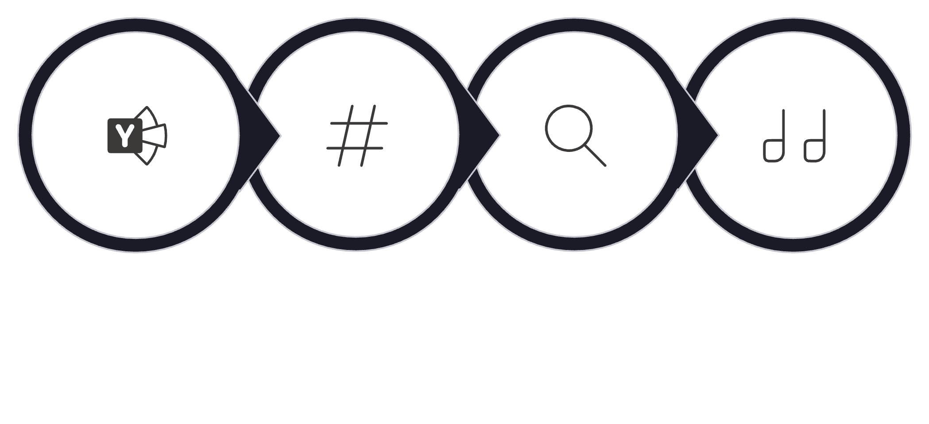
QUALITY GATE
The Automated Quality Gate: Python Linter
Validate YAML
Check EARS 'shall'
Scan for Vague Adjectives
Verify Evidence Quotes

Slide 18
VERIFICATION
Dynamic Grounding Verification
01
02
03
Open Source
Compare
Abort or Seal
Open the transcript and extract the cited line range.
Normalize whitespace and encoding, then compare quote to source.
Abort on any mismatch; otherwise create an immutable audit trail.

Slide 19
PROTECTION
Pre-Tool Interception Hook
Bash Script Guard
Hard Abort: Exit Code 2
.claude/hooks/protect-evidence.sh runs before every agent tool execution targeting the evidence folder.
Exit code 2 stops execution immediately with no override.

Slide 20
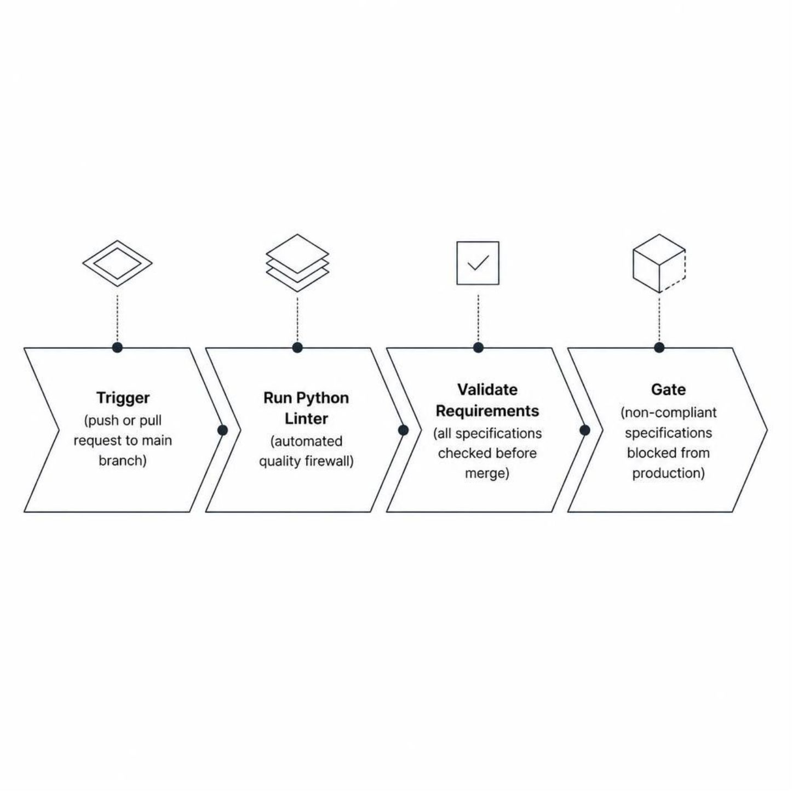
CI/CD
GitHub Actions CI/CD Workflow
Python linter runs as the automated quality firewall
All requirements validated before merge is permitted
Non-compliant specifications never reach production

Slide 21


AUDIT 1 OF 4
SMS Dispatch Requirement
A single word separates an operational system from one that crashes on same-day schedules. Here is what the two approaches produce.
Unguided LLM
Agentic Workflow
Vague Deadline
Operationally Precise
Requirement produced:
Requirement produced:
Send SMS 24 hours before appointment.
WHEN appointment is scheduled for the next calendar day, THEN send SMS by 18:00 local time on the day prior.
The phrase "24 hours before" is ambiguous. Does it mean midnight? The appointment hour minus 24? Systems implement this differently, and same-day appointments booked after the 24-hour window receive no SMS at all, wasting slots.
The trigger is deterministic. The deadline is clock-bound. Any scheduler, QA engineer, or on-call team member can verify compliance without ambiguity. Slot waste is eliminated.

Slide 22
AUDIT 2 OF 4
Patient SMS Cancellation
The word "immediately" is the most dangerous word in a software requirement. It sounds precise but is entirely untestable.
Unguided LLM Requirement
Three Actions, No Atomicity
Agentic Workflow Requirement
Quantifiable and Atomic
Upon receiving a cancellation reply, update appointment status, release the slot, and send confirmation immediately.
The three steps are listed but not bound. A partial failure leaves status updated but slot unreleased, creating phantom bookings and double-occupancy errors.
WHEN patient replies CANCEL, THEN mark appointment cancelled AND release slot AND send confirmation, all within 30 seconds.
The 30-second SLA is measurable in any test harness. The AND binding enforces atomicity: all three actions must succeed together or roll back together.

Slide 23



AUDIT 3 OF 4
Front-Desk Notification Requirement
Displaying a cancelled patient's name on a public reception screen is a PHI exposure event. One approach creates this risk; the other eliminates it by design.
Unguided LLM
Agentic Workflow
Compliance Win
Display freed slot date, time, practitioner name, and cancelled patient name on the front-desk screen.
Patient name is PHI. Visible in a shared reception area, this violates privacy regulations and institutional policy.
Display freed date, time, and slot duration only, within 60 seconds of cancellation.
No patient identity. No practitioner name. Staff see what they need to act; nothing more is exposed.
PHI is kept off public displays entirely. The 60-second SLA keeps the workflow responsive. Both correctness and privacy are enforced at the requirement level, not patched in later.

Slide 24
AUDIT 4 OF 4
Workstation Session Security
Unguided LLM
Agentic Workflow
60-Minute Max Session
15-Minute Idle Timeout
8-Hour Session Window
30-Minute Idle + PIN
Half the idle window of the unguided approach, cutting the exposure period dramatically during busy periods.
Hard session cap reduces the blast radius of any unattended or compromised workstation to a single clinical hour.
Thirty minutes of idle time is long enough to expose patient records. A PIN can be observed by a bystander, leaving shoulder-surfing as a viable attack.
A session lasting eight hours spans an entire clinical shift. Any unattended workstation during that window is a live, authenticated entry point.
RFID Badge Re-Auth
Physical badge re-authentication eliminates shoulder-surfing. The credential cannot be observed or replicated by a bystander. Institutional compliance is built into the requirement, not retrofitted.

Slide 25
Conclusion: The Power of Agentic Workflow
Precision. Measurability. Compliance.
Agentic Workflow transforms vague, untestable requirements into operationally precise, measurable, and compliant specifications. This is not a nice-to-have; it is foundational engineering for robust systems, as demonstrated across our audits:
Prevents Crashes
Ensures Atomicity
By eliminating ambiguities in critical dispatch schedules, ensuring system stability.
By binding multiple actions into single, verifiable operations, preventing partial failures.
Protects PHI
Hardens Security
By designing privacy into notification requirements, avoiding sensitive data exposure.
By enforcing strict session management and secure re-authentication protocols.

Slide 26
(Optional)
Claude setup

Slide 27
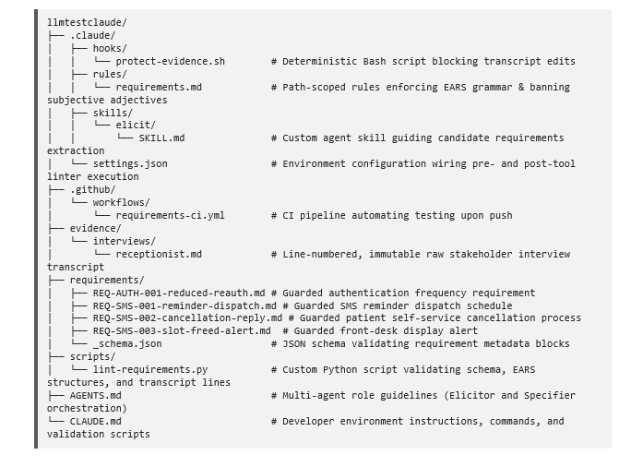

Slide 28
File-by-File Functional Breakdown
• protect-evidence.sh:
A deterministic PreToolUse Bash hook. It intercepts editing commands on the 'evidence/' directory and terminates the transaction with an error. This prevents agents from silently modifying the raw transcripts to resolve citation failures.
• requirements.md:
A path-scoped rules config. It restricts edits under 'requirements/**/*.md' to ensure that every requirement file is automatically structured around the five logical EARS patterns and lacks non-verifiable adjectives.
• SKILL.md:
An agentic procedure file defining candidate elicitation routines. It forces the model to ignore interviewer prompts and extract potential requirements backed strictly by verbatim human quotes.

Slide 29
• settings.json:
Integrates environment control hooks. It registers 'protect-evidence.sh' to trigger before tool executions and triggers the Python validation script instantly after any markdown changes are written.
• requirements-ci.yml:
An automated integration pipeline executing on GitHub Actions. It acts as a final repository firewall, compiling the requirements and terminating the build if a developer pushes a requirements file containing untestable adjectives, mismatched citations, or broken structures.
• receptionist.md:
A line-numbered, read-only markdown file hosting the transcript of the interview with senior receptionist R. Malik. It serves as the immutable audit source of truth for the entire specification suite.
• _schema.json:
A rigorous draft-07 JSON schema. It restricts the metadata block of requirement markdown files to prevent agents from skipping mandatory tracking properties such as IDs, confidence ratings, and source ranges.

Slide 30
• lint-requirements.py:
A robust Python testing script. It extracts frontmatter metadata, validates it against the JSON schema, enforces strict modal parameters, checks for duplicate IDs, and performs a character-by-character regex audit to prove that every quoted transcript reference matches the raw source on disk.
• AGENTS.md:
Sets up operational contracts dividing requirements engineering between an 'Elicitor Agent' (focused on citation harvesting and quote verification) and a 'Specifier Agent' (focused on formal EARS compiling).
• CLAUDE.md:
The project developer environment guide, establishing the command definitions for building, testing, linting, and running automated requirements checks.

Slide 31
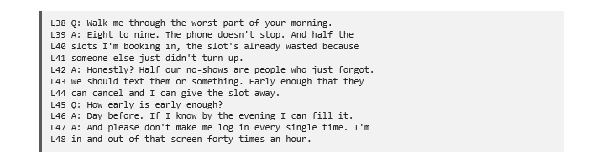
EXAMPLE:
The Raw Immutable Stakeholder Interview

Slide 32
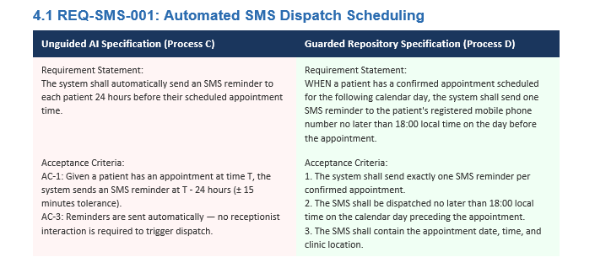
UNGUIDED LLM VS AGENTIC RE:
Side-by-Side Comparative Audits

Slide 33
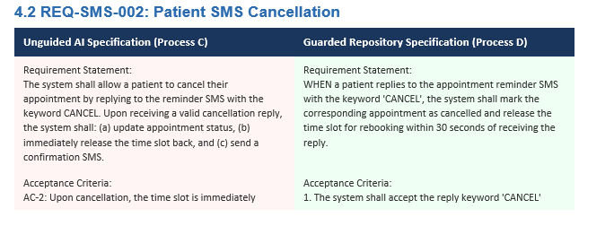

Slide 34
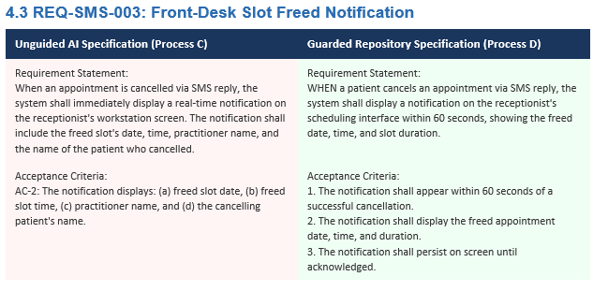

Slide 35
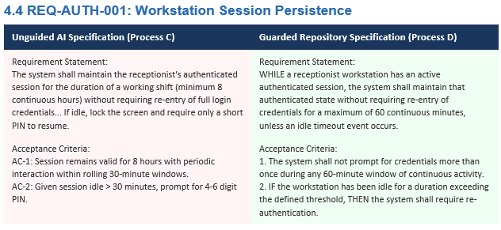

Slide 36
Summary & Engineering Conclusion
Unguided Generative AI) acts as a text synthesizer.
It writes clean-looking specifications that hide logical contradictions, severe security loopholes, HIPAA privacy leaks, and same-day scheduling crashes under structured markdown tables.
• Guarded Agentic Workspace treats requirements as code.
By using a strict YAML metadata schema, enforcing formal EARS templates, and establishing an automated Python validation script (lint-requirements.py) that regex-checks cited text directly against raw transcript lines before Git accepts the commit, we turn our specification folder into an unbreakable, self-defending software asset.

