Slide 1


Slide 2

Section 2
SASS
QWEB
JS Framework
Create Widget

Slide 3

What is SASS ?
SASS (Syntactically Awesome Stylesheets) is a CSS preprocessor that enhances the management and optimization of CSS code. It provides powerful and flexible features that plain CSS does not have, such as variables, loops, functions, inheritance, and more, making writing CSS code easier and more maintainable.

Slide 4
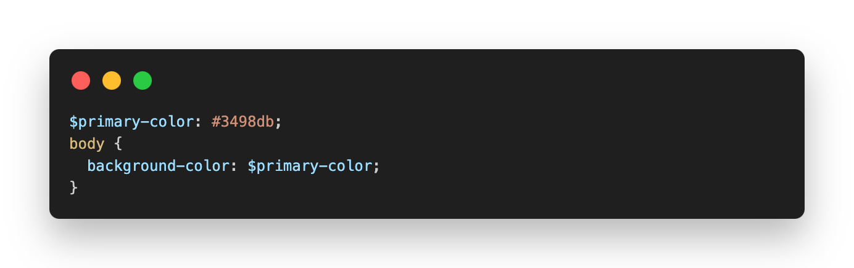
Key features
Variables: Allows storing values such as colors, sizes, fonts, etc., and reusing them throughout the stylesheet.

Slide 5
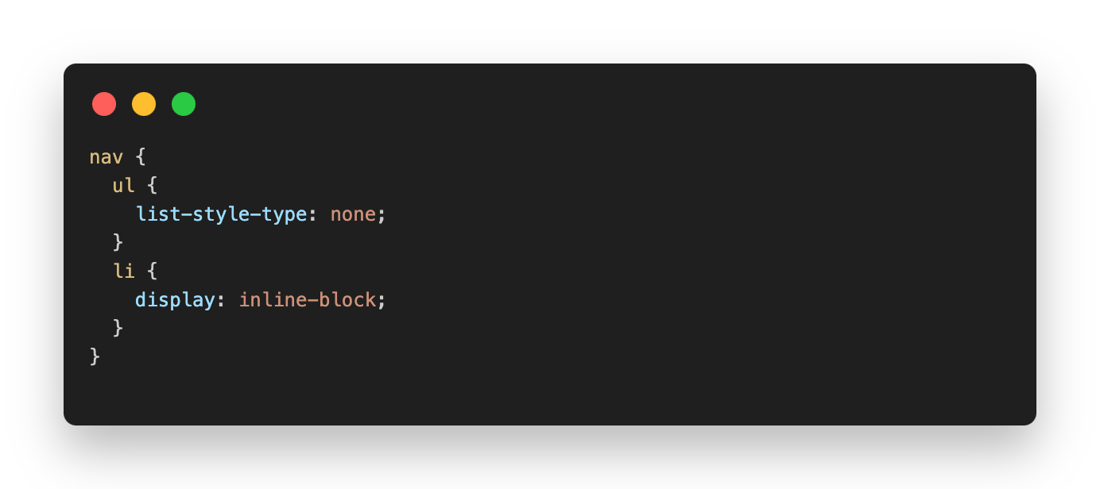
Key features
Nesting: SASS allows nesting selectors, making the code more organized and easier to understand.

Slide 6
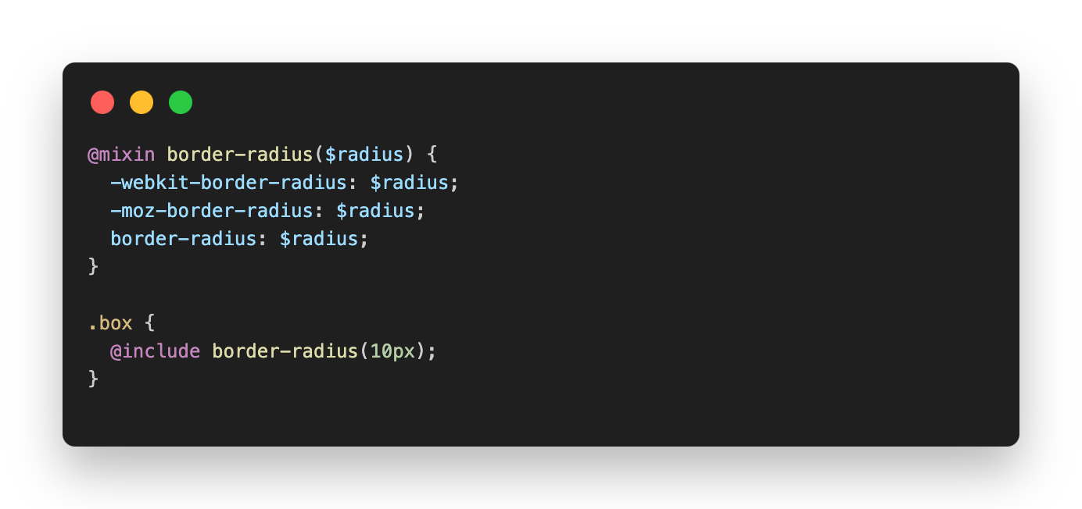
Key features
Mixins: Groups of CSS properties that can be reused multiple times, similar to functions in programming.

Slide 7
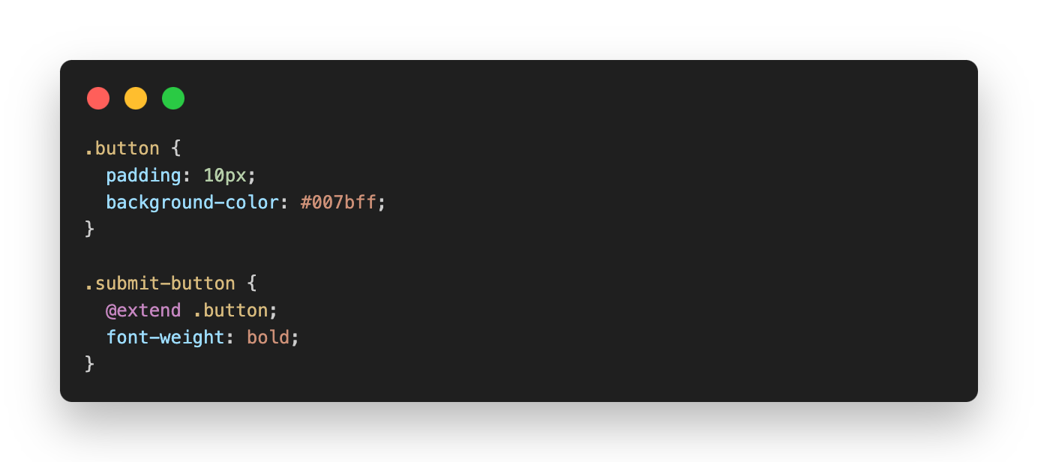
Key features
Inheritance: Allows sharing properties between selectors without having to rewrite the code.

Slide 8
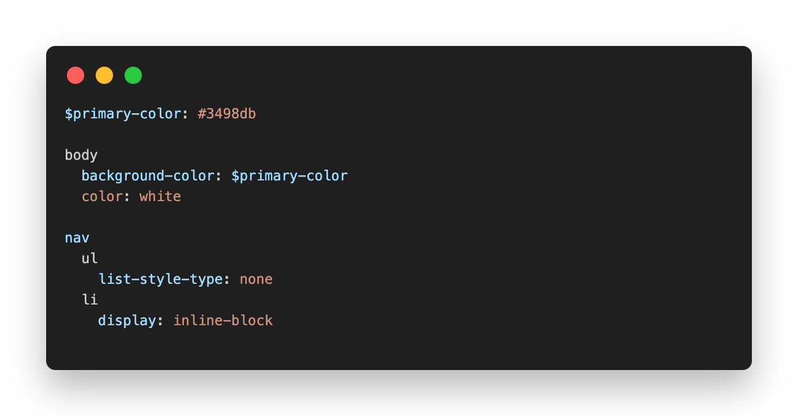
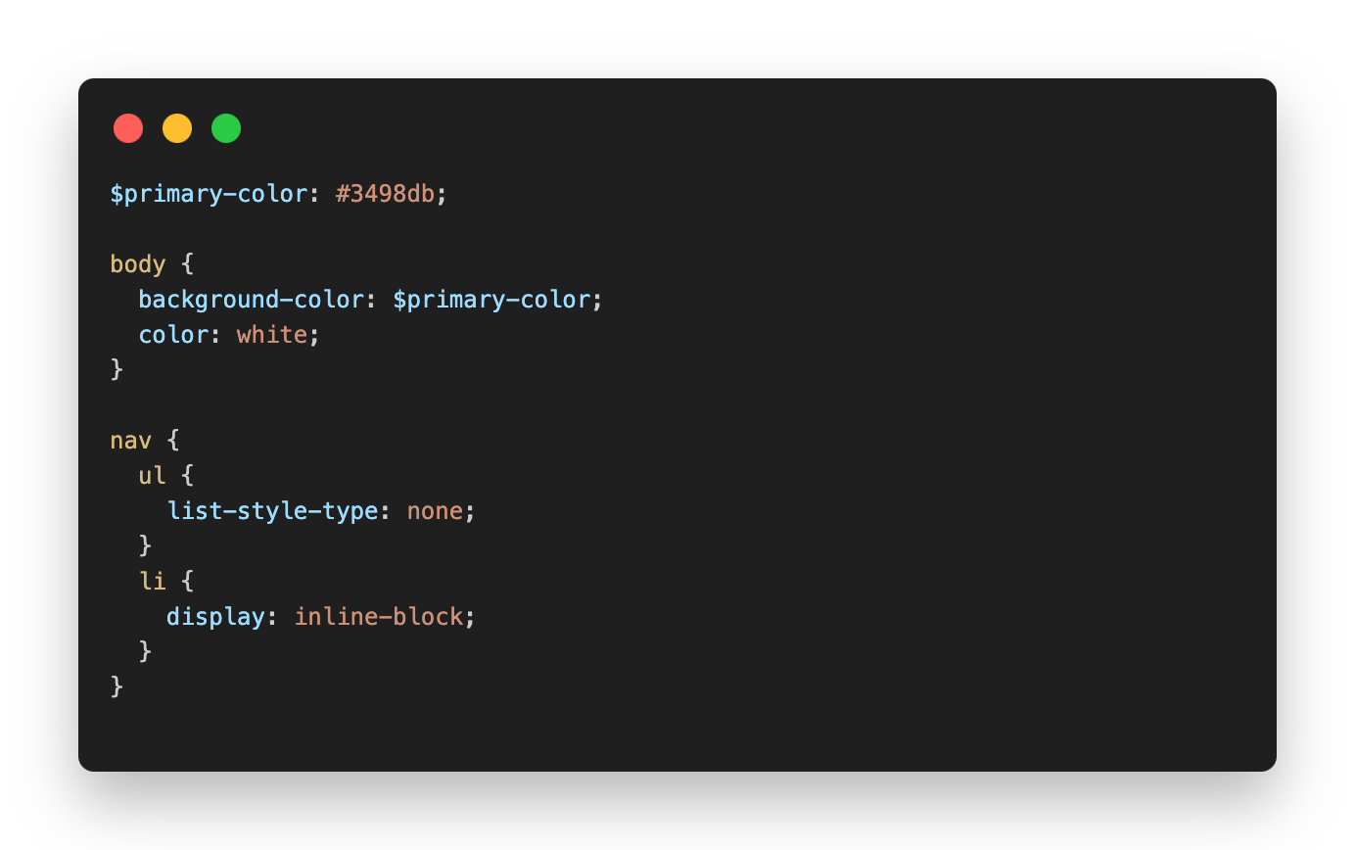
SASS - SCSS
SASS
SCSS
Feature | SASS (Indented Syntax) | SCSS (Sassy CSS)
Syntax Style | No curly braces {} or semicolons ; | Uses curly braces {} and semicolons ;
Indentation | Relies on indentation (spaces or tabs) | Uses explicit curly braces and semicolons
Compatibility with CSS | No direct compatibility (more compact) | Fully compatible with CSS, easier to integrate
Readability | More minimalistic, can be harder to debug | More explicit, more familiar to CSS users

Slide 9
Qweb in Odoo
QWeb in Odoo is a template engine used for rendering HTML and XML, primarily for creating reports and user interfaces. It allows you to design UI elements and reports using XML code, where you can embed Python expressions to work with data.

Slide 10
JS Framework
Odoo uses JavaScript frameworks to enhance the client-side experience of its web interface, focusing on interactivity and dynamic content loading

Slide 11
Overview of web client JS Code
boot.js: this is the file that defines the module system. It needs to be loaded first.
core/: this is a collection of lower level building blocks. Notably, it contains the class system, the widget system, concurrency utilities, and many other class/functions.
chrome/: in this folder, we have most large widgets which make up most of the user interface.
chrome/abstract_web_client.js and chrome/web_client.js: together, these files define the WebClient widget, which is the root widget for the web client.
chrome/action_manager.js: this is the code that will convert an action into a widget (for example a kanban or a form view)
chrome/search_X.js all these files define the search view (it is not a view in the point of view of the web client, only from the server point of view)
fields: all main view field widgets are defined here
views: this is where the views are located

Slide 12
Main bundles
web.assets_common: this bundle contains most assets which are common to the web client, the website, and also the point of sale. This is supposed to contain lower level building blocks for the odoo framework. Note that it contains the boot.js file, which defines the odoo module system.
web.assets_backend: this bundle contains the code specific to the web client (notably the web client/action manager/views)
web.assets_frontend: this bundle is about all that is specific to the public website: ecommerce, forum, blog, event management, …

Slide 13
Create a simple widget

Slide 14
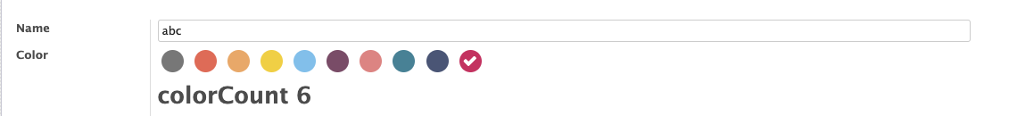

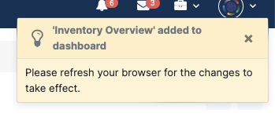
Exercise
1
2. Widget date format (mm/yyyy)
3. Create button
>

Slide 15
Documents
SASS: https://sass-lang.com/styleguide/brand/
JS Odoo: https://www.odoo.com/documentation/14.0/developer/reference/javascript/javascript_cheatsheet.html

