Slide 1

QuizMatch Oct. 9th, 2018
Project Release Plan
PMT
Kevin Wen - Project Leader
Anthony Chian - Developer
Richard Torres - Developer
Dennis Nguyen - Scrum Master

Slide 2
QuizMatch
Project Release Plan
High Level Goals:
Provide a safe, fun, and simple service for Users to match up with each other based on personality quizzes
Provide a personality questionnaire to match Users with a Pokemon as starting template
Provide a simple chatting functionality
Very High Level Goal:
Let users make and take each others quizzes, with questions and classification written by the user.

Slide 3
QuizMatch Sprint 1
Project Release Plan – User Stories
As a regular user, I want a user profile and login so that I can keep track of my information and matches.
As a visually oriented user, I want a functioning UI so that there is an additional incentive for me to log in.

Slide 4
QuizMatch Sprint 2
Project Release Plan – User Stories
As a romantically interested individual, I want a functioning matchmaking system so that I can romantically interact with them.
As a romantically uninterested person, I want the matchmaking to match me with similar people so that I have commonalities to casually chat with them about.

Slide 5
QuizMatch Sprint 3
Project Release Plan – User Stories
As a fan of BuzzFeed style quizzes, I want a fun Pokemon representation of who I am so that I can show it to my friends
As a Pokemon Mystery Dungeon Game Fan, I want to see what Pokemon I embody so that I can be entertained.

Slide 6
QuizMatch Sprint 4
Project Release Plan – User Stories
As a mobile oriented user, I want a mobile friendly web app and mobile app so that I can use it on the go.
As a interaction based user, I want a chat feature so that I can communicate with my matches.
If We Have Time:
As a creative user, I want to be able to create my own version of a quiz and have other users take it so that I can make my own content on the app.

Slide 7
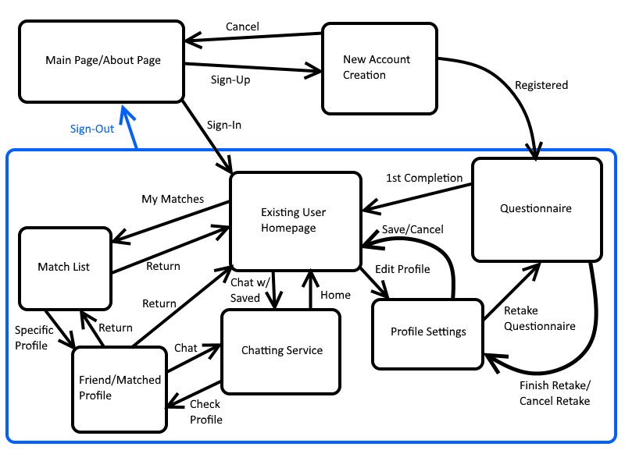
QuizMatch
Project Release Plan – Architecture

Slide 8
QuizMatch
Project Release Plan – Challenges/Risks
Challenges/Risks
Develop a secure profile database
Determining the personality questions
Designing an algorithm to categorize users
Getting the whole team familiar with the technology

Slide 9
QuizMatch
Project Release Plan – Technologies
Technologies
Languages: Javascript, HTML, PHP
Web Framework: Express.JS

