Slide 1

PokeMatch Oct. 9th, 2018
Project Release Plan
PMT
Kevin Wen – Project Leader
Anthony Chian
Richard Torres
Dennis Nguyen - Scrum Master
Shant Narkizian

Slide 2
PokeMatch
Project Release Plan
Provide a safe, fun, and simple service for users to match up with others
Provide a personality questionnaire to allow users to
Provide a chatting functionality for the users

Slide 3
PokeMatch
Project Release Plan – User Stories
As a romantic interested individual, I want to meet other romantically interested individuals.
As a romantically uninterested person, I want to meet other people to be my friends.
As a lonely person, I want to meet other people to hang out and/or to chat with.
As a Pokemon Mystery Dungeon Game Fan, I want to see what Pokemon I enspirit as.
As a person who wants to have fun, I want to enjoy myself with the app.

Slide 4
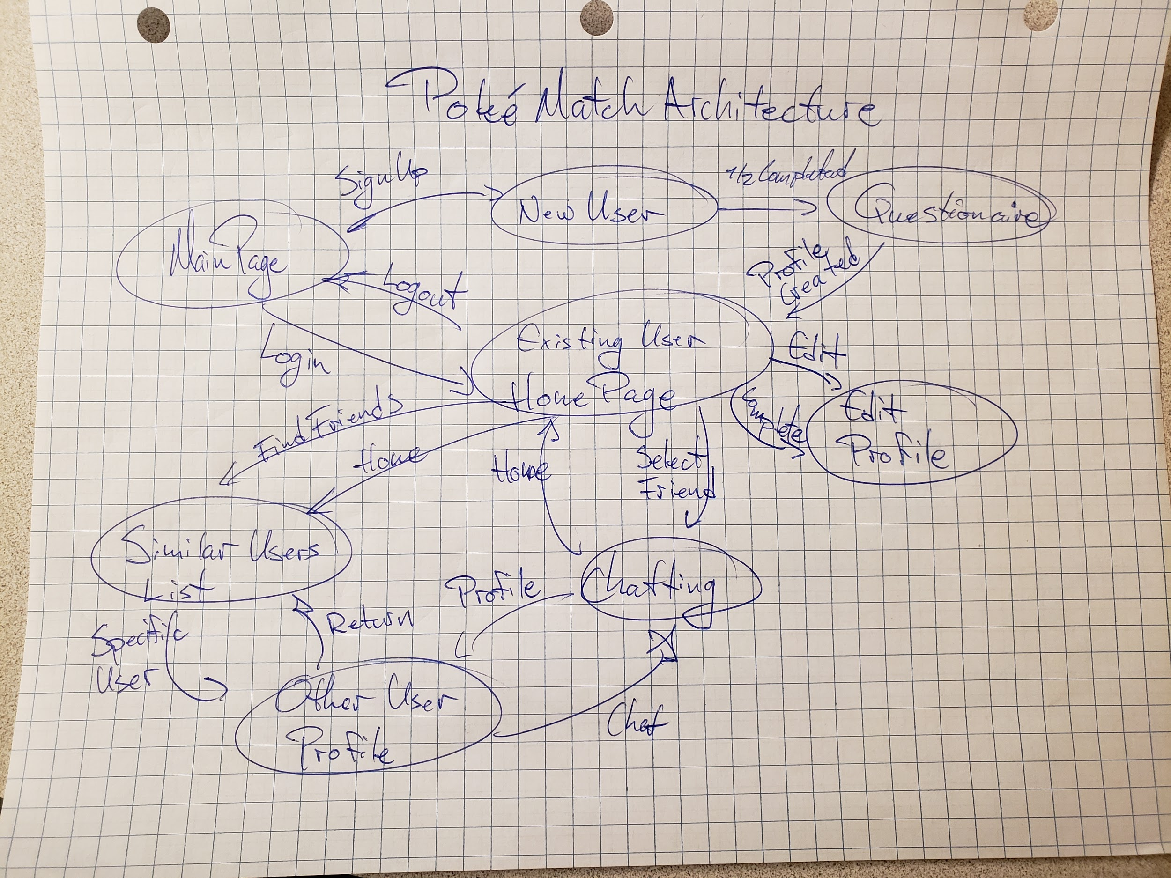
PokeMatch
Project Release Plan – Architecture

Slide 5
PokeMatch
Project Release Plan – Challenges/Risks
Challenges/Risks
Develop a secure profile database
Determining the personality questions
Getting the whole team familiar with the technology

Slide 6
PokeMatch
Project Release Plan – Technologies
Technologies
Languages: Javascript, HTML, PHP
Web Framework: Express.JS

