Slide 1

Software Testing: From Practice to Research
Marcelo d'Amorim
Rio Cuarto, Argentina, February 2020
https://star.cin.ufpe.br

Slide 2
Software Testing
Activity of finding bugs in Software

Slide 3
Software Testing
Activity of finding bugs in Software
But, what is a bug in software? Code that violates software spec.

Slide 4
Software Testing
Activity of finding bugs in Software
But, what is a bug in software? Code that violates software spec.
But, what is a spec? Definition of what a system should (and should not) do.

Slide 5
It is highly popular and expensive!
Highly used in industry (code inspection also popular)
It is expensive *
Human: Writing test cases is time consuming
Computation: Running test cases is time consuming
* NIST Report 2002: http://www.nist.gov/director/planning/upload/report02-3.pdf

Slide 6
Goals of this course
Demonstrate popular concepts and tools used in industry (80%)
Discuss problems in Software Testing research (20%)
…
https://github.com/damorim/testing-cin-minicourse

Slide 7
Requirements
Have basic knowledge of RCS (e.g., Git)
Took some programming classes and projects
…
We use multiple languages to demonstrate concepts.

Slide 8
GitHub Repository
https://tinyurl.com/s4emvrg

Slide 9
Preliminaries

Slide 10
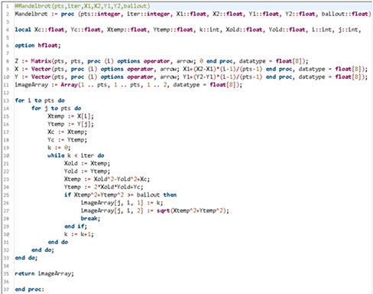
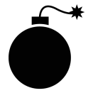



The lifecycle of a bug
FAULT
Developer introduces a bug in the program
BUG
FAILURE
J. Voas, PIE: A Dynamic Failure-Based Technique, IEEE Transactions on Software Engineering. 1992

Slide 11
The lifecycle of a bug
FAULT
Developer introduces a bug in the program
Execution touched the buggy code and state got infected
BUG
FAILURE
J. Voas, PIE: A Dynamic Failure-Based Technique, IEEE Transactions on Software Engineering. 1992

Slide 12
The lifecycle of a bug
FAULT
Developer introduces a bug in the program
Execution touched the buggy code and state got infected
BUG
Infection propagated to other parts of the state
FAILURE
J. Voas, PIE: A Dynamic Failure-Based Technique, IEEE Transactions on Software Engineering. 1992

Slide 13
The lifecycle of a bug
FAULT
Developer introduces a bug in the program
Execution touched the buggy code and state got infected
BUG
Infection propagated to other parts of the state
Infection was observed.
FAILURE
J. Voas, PIE: A Dynamic Failure-Based Technique, IEEE Transactions on Software Engineering. 1992

Slide 14
The lifecycle of a bug
FAULT
BUG
Focus of Testing
FAILURE
J. Voas, PIE: A Dynamic Failure-Based Technique, IEEE Transactions on Software Engineering. 1992

Slide 15
The lifecycle of a bug
FAULT
BUG
Focus of Debugging
Focus of Testing
FAILURE
J. Voas, PIE: A Dynamic Failure-Based Technique, IEEE Transactions on Software Engineering. 1992

Slide 16
The lifecycle of a bug
FAULT
Scientific Debugging:
1. Observation (e.g., failure)
2. Build Hypothesis
3. Predict behavior based on 2
4. Make an experiment
5. Observation
6. If hypothesis inconsistent
then goto 2 (revise)
else fix code
BUG
Focus of Debugging
Focus of Testing
FAILURE
J. Voas, PIE: A Dynamic Failure-Based Technique, IEEE Transactions on Software Engineering. 1992

Slide 17
Anatomy of a typical test case (to catch a bug)
aTest():
1.
2.
3.
4.
operation
oracle
5.
6.
Oracle compares expectation with observation

Slide 18
Anatomy of a typical test case (to catch a bug)
Typically, test functions declare no parameters
aTest():
1.
2.
3.
4.
operation
oracle
5.
6.
Oracle compares expectation with observation

Slide 19
Example: Calculator (with Java JUnit)
public class Calc {
public static int add(int a, int b) {
return a + b;
}
public static int sub(int a, int b) {
return a - b;
}
}
import org.junit.*;
public class CalcTest {
@Test
public void testCancel() {
int x = 5, y = 10;
int res = sub(add(x, y), y);
Assert.assertEquals(res, x);
}
}
operation
Automated test case (aka test script)
oracle

Slide 20
Test Automation
+ Reduces time to execute tests (*)
+ Improves reproducibility
- Needs to maintain code of the test case
- Inadequate for testing usability, for example
Although manual testing is important (e.g., exploratory testing), it is rare not to see automated tests in serious software today.

Slide 21
Characterization of Software Testing
Based on the objective of the testing effort
Functional (Testing), Load, Performance, Security, Usability, etc.
Based on the object tested
System (Testing), Integration, and Unit
Based on code visibility
Black-box (Testing), White-box
Testing is a very general concept—applicable in a variety of contexts

Slide 22
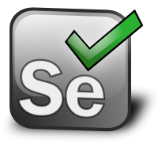
Characterization of Software Testing
Based on the objective of the testing effort
Functional (Testing), Load, Performance, Security, Usability, etc.
Based on the object tested
System (Testing), Integration, and Unit
Based on code visibility
Black-box (Testing), White-box
Example: UI Testing with Selenium
Testing is a very general concept—applicable in a variety of contexts

Slide 23
Internal versus External Software Quality
Internal Quality is concerned with quality of the code artifact
E.g., modularity (e.g., cohesion and coupling), legibility, etc.
External Quality is concerned with externally observable aspects
E.g., security, performance, functionality, etc.

Slide 24
Internal versus External Software Quality
Internal Quality is concerned with quality of the code artifact
E.g., modularity (e.g., cohesion and coupling), legibility, etc.
External Quality is concerned with externally observable aspects
E.g., security, performance, functionality, etc.
Software Testing focuses on External Quality

Slide 25
Software Testing Process

Slide 26
When to Start Writing Test Cases?
Top-down: As soon as you know your requirements
Test-Driven Development (TDD)
Downside--writing auxiliary code
Bottom-up: As soon as you develop code
Unit -> Integration -> System

Slide 27
When to Start Writing Test Cases?
Observation 1: Your tests should reflect your requirements (functional or not) even if they are implemented afterwards
Top-down: As soon as you know your requirements
Test-Driven Development (TDD)
Downside--writing auxiliary code
Bottom-up: As soon as you develop code
Unit -> Integration -> System

Slide 28
When to Start Writing Test Cases?
Observation 1: Your tests should reflect your requirements (functional or not) even if they are implemented afterwards
Top-down: As soon as you know your requirements
Test-Driven Development (TDD)
Downside--writing auxiliary code
Bottom-up: As soon as you develop code
Unit -> Integration -> System
Observation 2: No need to wait until the last function of the system is implemented to implement system and integration tests. Use mock libraries!

Slide 29
When to Start Writing Test Cases?
Top-down: As soon as you know your requirements
Test-Driven Development (TDD)
Downside--writing auxiliary code
Bottom-up: As soon as you develop code
Unit -> Integration -> System
Decision of when to start writing unit/integration/system tests varies with the project and team.

Slide 30
Regression Testing
Regression is the observation that a feature/functionality that used to work is malfunctioning
Regression testing is the activity of running automated tests regularly with the goal of detecting regressions

Slide 31
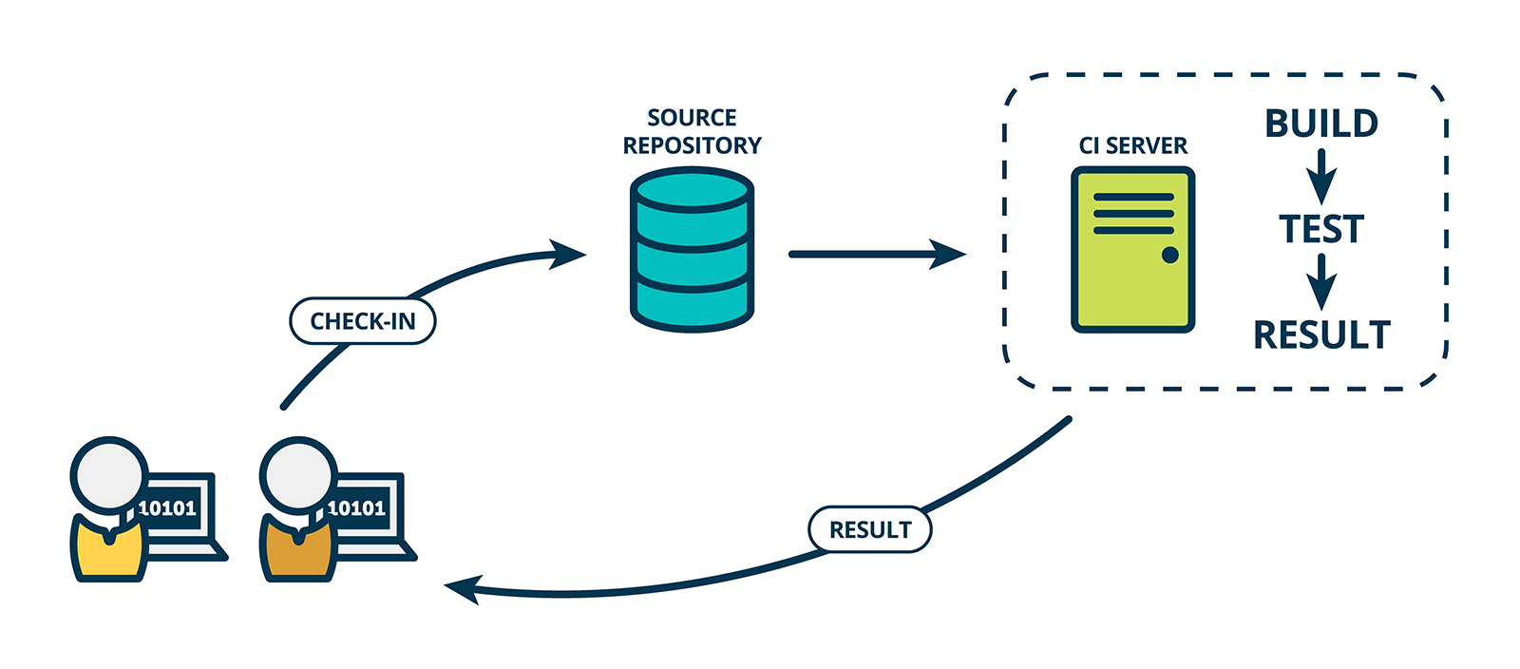
Continuous Integration (CI)
Solution to automate Regression Testing

Slide 32
To Remember

Slide 33
To Remember 1: Testing cannot prove correctness
“Program testing can be used to show the presence of bugs, but never to show their absence!” --Edsger Dijkstra
It is important to assess “how good” you test suite is!
(There are techniques for that. We will see.)

Slide 34
To Remember 2: There is no Silver Bullet
Various other aspects are important to assure external quality
Internal Quality
Choice of Language and Tools
Development Process
(Trained and Motivated) People

Slide 35
Brief on Software Specification

Slide 36
Software Specification
Definition of what a system should (and should not) do
Implementation is the realization of a specification

Slide 37
Assume-Guarantee Contract
Form of specification of a software module (e.g., a function)
It consists of a set of constraints describing
Assumptions on how the module will be used
Guarantees that the module provides

Slide 38
What can happen if pow is called with negative y?
Example: Power
int pow(int x,int y)
{
int r = 1;
while(y > 1) {
if (y % 2 == 1) {
r = x * r;
}
x = x * x;
y = y / 2;
}
return r * x;
}

Slide 39
What can happen if pow is called with negative y?
Example: Power
int pow(int x,int y)
{
int r = 1;
while(y > 1) {
if (y % 2 == 1) {
r = x * r;
}
x = x * x;
y = y / 2;
}
return r * x;
}
Consider x = 2, y = -2
2^-2 = 1/(2^2) = 1/4
So, pow should return 0 (note integer arithmetic)
Instead, it returns 1 * 2 = 2

Slide 40
What can happen if pow is called with negative y?
Example: Power
int pow(int x,int y)
{
int r = 1;
while(y > 1) {
if (y % 2 == 1) {
r = x * r;
}
x = x * x;
y = y / 2;
}
return r * x;
}
Consider x = 2, y = -2
2^-2 = 1/(2^2) = 1/4
So, pow should return 0 (note integer arithmetic)
Instead, it returns 1 * 2 = 2
Is this a bug?

Slide 41
Imposing Precondition
int pow(int x,int y)
//@requires y >= 0;
{
int r = 1;
while(y > 1) {
if (y % 2 == 1) {
r = x * r;
}
x = x * x;
y = y / 2;
}
return r * x;
}
There are no guarantees on what to expect from pow if precondition is not satisfied!

Slide 42
Promising a Postcondition
int pow(int x, int y)
//@requires y >= 0;
//@ensures \result == RPOW(x,y);
{
int r = 1;
while(y > 1) {
if (y % 2 == 1) {
r = x * r;
}
x = x * x;
y = y / 2;
}
return r * x;
}
int RPOW (int x,int y)
//@requires y >= 0;
{
if(y == 0)
return 1;
else
return x * RPOW (x, y-1);
}

Slide 43
Promising a Postcondition
int pow(int x, int y)
//@requires y >= 0;
//@ensures \result == RPOW(x,y);
{
int r = 1;
while(y > 1) {
if (y % 2 == 1) {
r = x * r;
}
x = x * x;
y = y / 2;
}
return r * x;
}
int RPOW (int x,int y)
//@requires y >= 0;
{
if(y == 0)
return 1;
else
return x * RPOW (x, y-1);
}
Assume-Guarantee contract for function pow.

Slide 44
Exercise
Specify contract (i.e., pre and postcondition) for function sort.
void sort(int[] ar)
The expression \old(var) denotes the value of var at the entry of the function call.

Slide 45
Solution
Specify contract (i.e., pre and postcondition) for function sort.
void sort(int[] ar)
//@requires ar != null
//@ensures ASC(ar) && PERM(ar, \old(ar))
boolean ASC(int[] ar) // returns true iff contents of array are in ascending order
boolean PERM(int[] ar1, int[] ar2) // returns true iff ar1 and ar2 are
// permutations of the same set

Slide 46
(Take Home) Exercise
Specify contracts for the functions of a stack data structure.
class Stack<T> {
int size();
void push(T t);
T pop()
}

Slide 47
Software Specification
Definition of what a system should (and should not) do
Implementation is the realization of a specification
Writing specs is expensive
It is rare for developers to fully specify a system
However, it is common to partially specify systems (e.g., test assertions)

Slide 48
Quiz
Is it possible to use testing to demonstrate that there are no bugs in code?
From what observation software debugging typically starts?
Name one benefit of using automated tests.
What is a regression?
What is regression testing?
What is continuous integration?

Slide 49
Practice!
“For the things we have to learn before we can do them, we learn by doing them.” --Aristotle, The Nicomachean Ethics

Slide 50
Agenda
Test frameworks
Build systems
Coverage
Mutation testing
Combinatorial testing
UI testing
Behavior-Driven Development (BDD)
Fuzzing
Test Infrastructure (to create and run tests)
Test adequacy
System testing
Test design
Test input generation

Slide 51
Test Infrastructure

Slide 52
Test Frameworks
Tools that enable developers to write automated tests
Available in most modern languages
For example: Java’s JUnit, Python’s unittest, C#’s NUnit, Ruby’s rspec
There are multiple frameworks for these programming languages

Slide 53
Example of functionalities in Java’s JUnit
Test fixtures to configure the system before/after running the test
Customizable test runners
Rich library of assertion functions (e.g., assertNull(var))
Ability to group test differently (e.g., slow/fast) for selective execution
…

Slide 54
Example of functionalities in Java’s JUnit
Test fixtures to configure the system before/after running the test
Customizable test runners
Rich library of assertion functions (e.g., assertNull(var))
Ability to group test differently (e.g., slow/fast) for selective execution
…
Other test frameworks offer very similar functionality

Slide 55
Example of functionalities in Java’s JUnit
Test fixtures to configure the system before/after running the test
Customizable test runners
Rich library of assertion functions (e.g., assertNull(var))
Ability to group test differently (e.g., slow/fast) for selective execution
…
Practice – Section 1 in our repo

Slide 56
Exercise 1
Introduce an exception ElementNotFoundException to indicate element not found in the binary search

Slide 57
Exercise 2
Change the method setup in BinarySearchTest to create an array with 100K elements and enforce each test to finish in no more than 1s.

Slide 58
(Take Home) Exercise
Log every test that executed for more than .5 s
Hint: use listeners. See org.junit.runner.notification.RunListener

Slide 59
Build Systems
Automate common tasks during the development process
E.g., compile, execute test suites, assemble, deploy, generate reports
Various implementations
E.g., make, ant, maven, gradle

Slide 60
Build Systems
Automate common tasks during the development process
E.g., compile, execute test suites, assemble, deploy, generate reports
Various implementations
E.g., make, ant, maven, gradle
Practice – Section 2 in our repo

Slide 61
Exercise 1
Add the following snippet to your build.gradle script. Then, run the command $> gradle printClasspath
## add this to build.gradle to print classpath
task printClasspath {
doLast {
configurations.testRuntimeClasspath.each { println it }
}
}

Slide 62
Exercise 2
Follow the tutorial at the link below to configure your build.gradle file to generate test execution logs.
Tutorial: https://tinyurl.com/uyy3blb

Slide 63
(Take Home) Exercise 3
Create a repo on GitHub with some tiny application containing test cases. Then, configure your repo to use Travis CI.
Tutorial: https://tinyurl.com/s722a4p

Slide 64
Test Adequacy

Slide 65
Test Adequacy Criterion
Important to determine how satisfactory a test suite is
Recall that Testing cannot prove correctness!
General idea:
Define test requirements
Measure how many of these requirements are fulfilled (or covered)
Assumption is that the more requirements covered the better, i.e., the higher the chances to capture faults.

Slide 66
Examples: statement, line, basic-block, branch, function, acyclic paths, etc.
Test Adequacy Criterion
Various approaches to measure coverage
Structural coverage measures amount of code elements covered by the test suite
Logical coverage: measures extent to which conditionals are covered
Dataflow coverage: measures extent to which data flows are covered
Mutation coverage measures amount of (injected) faults covered by the test suite
…

Slide 67
Examples: basic conditions, compound conditions, and MC/DC.
Test Adequacy Criterion
Various approaches to measure coverage
Structural coverage measures amount of code elements covered by the test suite
Logical coverage: measures extent to which conditionals are covered
Dataflow coverage: measures extent to which data flows are covered
Mutation coverage measures amount of (injected) faults covered by the test suite
…

Slide 68
Examples: definitions, uses, def-uses (aka all-pairs), and def-use paths.
Test Adequacy Criterion
Various approaches to measure coverage
Structural coverage measures amount of code elements covered by the test suite
Logical coverage: measures extent to which conditionals are covered
Dataflow coverage: measures extent to which data flows are covered
Mutation coverage measures amount of (injected) faults covered by the test suite
…

Slide 69
Test Adequacy Criterion
Various approaches to measure coverage
Structural coverage measures amount of code elements covered by the test suite
Logical coverage: measures extent to which conditionals are covered
Dataflow coverage: measures extent to which data flows are covered
Mutation coverage measures amount of (injected) faults covered by the test suite
…
Mutation testing is a technique that intentionally inject faults (mutants) in the code and measure ability of test suites to capture them.

Slide 70
Test Adequacy Criterion
Various approaches to measure coverage
Structural coverage measures amount of code elements covered by the test suite
Logical coverage: measures extent to which conditionals are covered
Dataflow coverage: measures extent to which data flows are covered
Mutation coverage measures amount of (injected) faults covered by the test suite
…
Practice – Sections 3 and 4 in our repo

Slide 71
Exercise 1
Try to maximize branch coverage of the test suite for doublelinkedlist
Please, add coherent test oracles to your test cases

Slide 72
Exercise 2
Try to maximize mutation coverage of the test suite for triangle
Please, add coherent test oracles to your test cases

Slide 73
System Testing

Slide 74
System Testing
The entire system is the object tested (not the units or their integration)
Critical to validate requirements with stakeholders
Acceptance tests

Slide 75
Functional Testing
Models entire system as a function
Simplistic Example: Testing configurations of a mobile App
Orientation | landscape, portrait
Size | 1080x1920, 750x1334, 720x1280
OS | iPhone, Android

Slide 76
Functional Testing
Models entire system as a function
Simplistic Example: Testing configurations of a mobile App
Orientation | landscape, portrait
Size | 1080x1920, 750x1334, 720x1280
OS | iPhone, Android
How many configurations would be required to test the phone exhaustively?

Slide 77
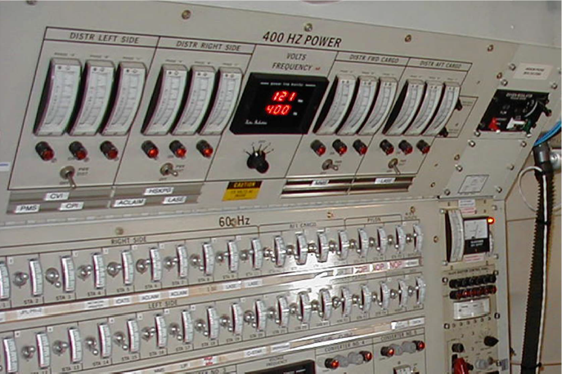
* https://personal.utdallas.edu/~ewong/SE6367/03-Lecture/29-A-Combinatorial-Testing-by-Kuhn.pdf
Combinatorial Interaction Testing (CIT) *
Combining all values can be daunting for large number of params/values!
34 switches =
2^32 combinations of inputs =
1.7 x 10^10 inputs/tests

Slide 78
* https://personal.utdallas.edu/~ewong/SE6367/03-Lecture/29-A-Combinatorial-Testing-by-Kuhn.pdf
Combinatorial Interaction Testing (CIT) *
Combining all values can be daunting for large number of params/values!
CIT is a technique to mitigate combinatorial explosion from exhaustive/combinatorial testing

Slide 79
* https://personal.utdallas.edu/~ewong/SE6367/03-Lecture/29-A-Combinatorial-Testing-by-Kuhn.pdf
CIT – Pairwise Testing
All combinations of values across pairs of parameters are tested
Reveals most (50-90%) of the faults in configurable software

Slide 80
* https://personal.utdallas.edu/~ewong/SE6367/03-Lecture/29-A-Combinatorial-Testing-by-Kuhn.pdf
CIT – Pairwise Testing
Orientation | landscape, portrait
Size | 1080x1920, 750x1334, 720x1280
OS | iPhone, Android
Orientation | Size | OS
landscape | 1080x1920 | iPhone
landscape | 750x1334 | Android
landscape | 720x1280 | Android
portrait | 1080x1920 | Android
portrait | 750x1334 | iPhone
portrait | 720x1280 | iPhone

Slide 81
* https://personal.utdallas.edu/~ewong/SE6367/03-Lecture/29-A-Combinatorial-Testing-by-Kuhn.pdf
CIT – Pairwise Testing
6 combinations as opposed to 12 combinations for exhaustive testing
Orientation | landscape, portrait
Size | 1080x1920, 750x1334, 720x1280
OS | iPhone, Android
Orientation | Size | OS
landscape | 1080x1920 | iPhone
landscape | 750x1334 | Android
landscape | 720x1280 | Android
portrait | 1080x1920 | Android
portrait | 750x1334 | iPhone
portrait | 720x1280 | iPhone

Slide 82
* https://personal.utdallas.edu/~ewong/SE6367/03-Lecture/29-A-Combinatorial-Testing-by-Kuhn.pdf
CIT – Pairwise Testing
6 combinations as opposed to 12 combinations for exhaustive testing
Orientation | landscape, portrait
Size | 1080x1920, 750x1334, 720x1280
OS | iPhone, Android
Practice – Section 5 in our repo
Orientation | Size | OS
landscape | 1080x1920 | iPhone
landscape | 750x1334 | Android
landscape | 720x1280 | Android
portrait | 1080x1920 | Android
portrait | 750x1334 | iPhone
portrait | 720x1280 | iPhone

Slide 83
Exercise 1
Use the ACTS tool to produce test inputs for the problem presented previously of testing mobile apps. Are the outputs identical? Why?
Hint: Use the GUI
$> java –jar acts_cmd.jar

Slide 84
(Take Home) Exercise
Model a problem of your interest with various parameters/values and use the ACTS tool (with t=2) to generate test inputs.

Slide 85
UI Testing
Approach to test software through the User Interface
+ Requires low technical background
+ Very intuitive
- Can be difficult to maintain
- Can be slow to execute
- Requires special environment (e.g., cloud)

Slide 86
UI Testing
Approach to test software through the User Interface
+ Requires low technical background
+ Very intuitive
- Can be difficult to maintain
- Can be slow to execute
- Requires special environment (e.g., cloud)
Practice – Section 6 in our repo

Slide 87
Exercise 1
Create a test on the Mercury tours website using Selenium (http://demo.guru99.com/test/newtours/)

Slide 88
Exercise 2
Create a test on the Address book website using watir (http://a.testaddressbook.com)

Slide 89
Test Design

Slide 90
Test Design
Activity of creating test cases from specifications. Typically requires some domain knowledge.
Formal models, when exist (it is rare), could be used to derive test cases (Model-based Testing)

Slide 91
Behavior-Driven Development
Way of writing test cases that focuses on collaboration to clarify requirements across teams/stakeholders
Uses natural language to describe test cases
Typical focus is acceptance (system) tests

Slide 92
Behavior-Driven Development
Way of writing test cases that focuses on collaboration to clarify requirements across teams/stakeholders
Uses natural language to describe test cases
Typical focus is acceptance (system) tests
Practice – Section 7 in our repo

Slide 93
Exercise 1
Implement the skipped scenario

Slide 94
Exercise 2
Create and implement a new scenario (after login)

Slide 95
Fuzzing
Technique to automatically generate test inputs to find crashes
Modifies given input of a program
Various approaches
Black-box (e.g., Radamsa), White-box (e.g., KLEE), Grey-box (e.g., AFL)
Grammar-based or not

Slide 96
Fuzzing
Technique to automatically generate test inputs to find crashes
Modifies given input of a program
Various approaches
Black-box (e.g., Radamsa), White-box (e.g., KLEE), Grey-box (e.g., AFL)
Grammar-based or not
Practice – Section 8 in our repo

Slide 97
(Take home) Exercise
Run AFL on an executable of your choice

Slide 98
Final Quiz
Cite one benefit of using automated tests?
Why developers use build systems?
Why test adequacy is important?
Is it correct to say that no more testing is necessary for a test suite with 100% branch coverage?
What is a mutant?

Slide 99
Final Quiz
When pairwise testing produces the same number of inputs as exhaustive testing?
Cite one benefit of using automated tests?
Why UI tests can be problematic to maintain?
Why BDD-style tests are easy to explain to non-technical personnel?
What kinds of bugs gray-box fuzzing are good to capture?

Slide 100
Recent Research Projects

Slide 101
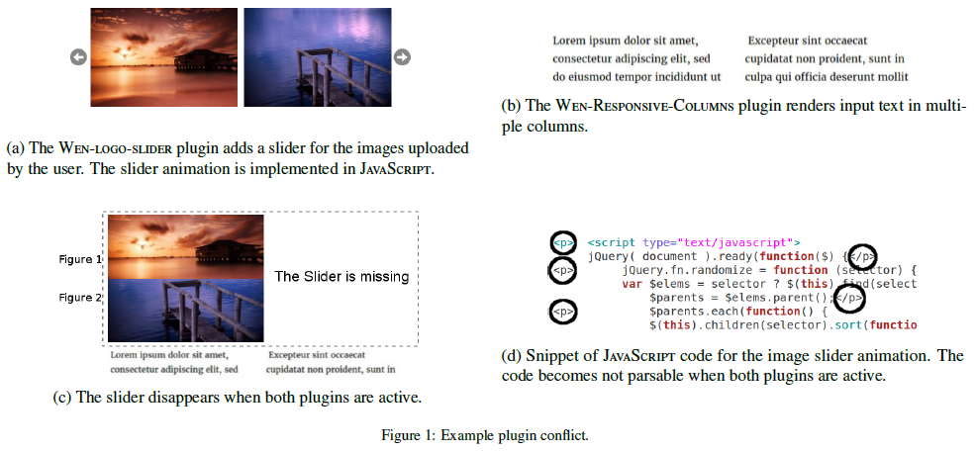
Detection of Plugin Conflicts in CMS
[Information and Software Technology, Feb. 2020]

Slide 102
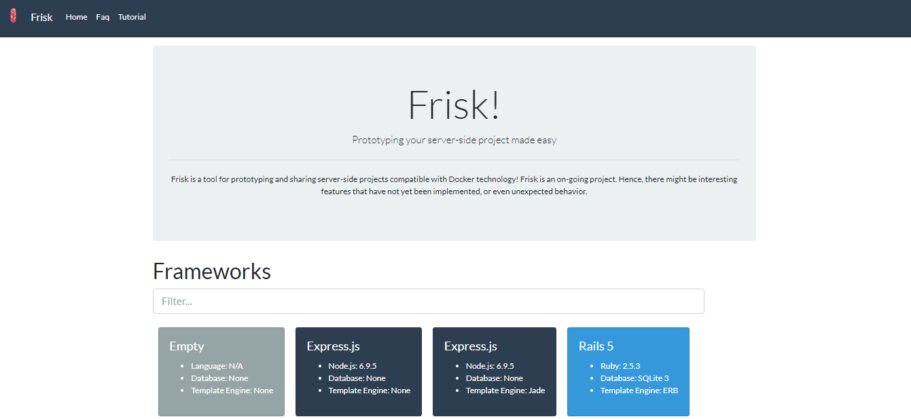
Using Docker to Reproduce StackOverflow Posts
[IEEE Transactions on Software Engineering, Dec. 2019]

Slide 103
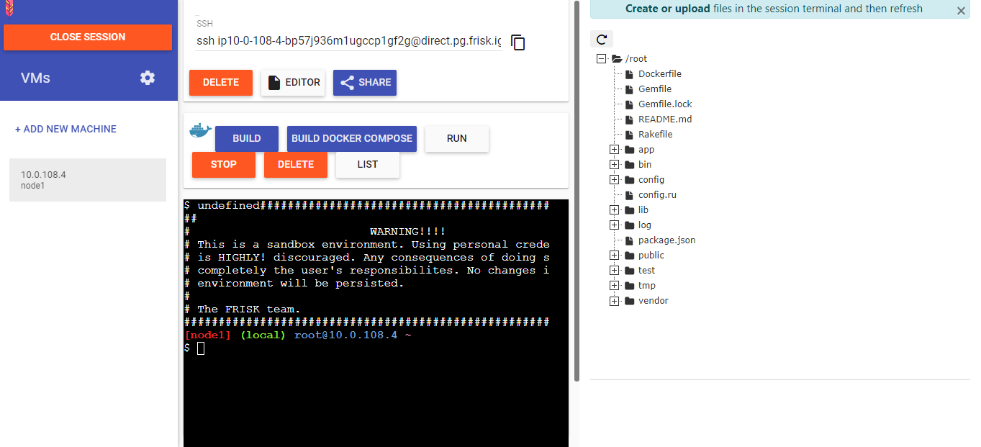
Using Docker to Reproduce StackOverflow Posts
[IEEE Transactions on Software Engineering, Dec. 2019]

Slide 104
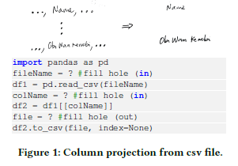
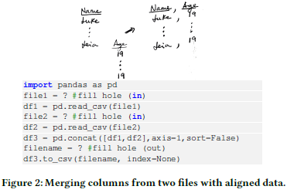
Visual Sketching
[ICSE-NIER 2020]

Slide 105
Test Diversity to Find Bugs in JavaScript Engines
[under review]
Two techniques:
Transplantation—Used tests from one engine into another
Differential testing—Generated JS inputs and run them on multiple engines
Found over 50 bugs across 4 main JS engines

Slide 106
Detecting Flaky Tests with Machine Learning
[under review]
Flaky tests are tests that non-deterministically pass/fail based on the environment. E.g., tests with Thread.sleep
Very common and problematic
Approach: use ML to learn patterns from large base of previously found flaky tests

Slide 107
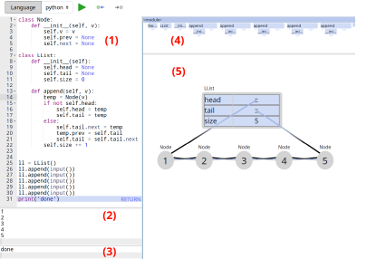
Willow--a visualization tool to teach programming
https://github.com/pedro00dk/willow/
http://34.73.147.9/

Slide 108
Other projects
Synthesis of Network Intrusion Detection Rules
Grey-box Combinatorial Interaction Testing
Black-box Differential Generation of Adversarial Inputs for ML Classifiers

Slide 109
Software Testing: From Practice to Research
Marcelo d'Amorim
damorim@cin.ufpe.br
Rio Cuarto, Argentina, February 2020
https://star.cin.ufpe.br/

Slide 110
Considering to Visit (or do a MS/PhD with us)?

Slide 111
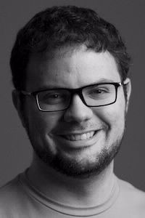
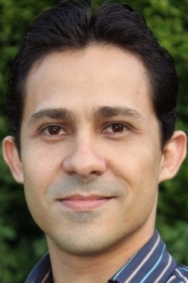
STAR (Software Testing and Analysis Research)
Interested in preventing, discovering, diagnosing, and repairing software bugs
Faculty: Breno, Leopoldo, and Marcelo
Web: http://star.cin.ufpe.br
Leopoldo Teixeira
Breno Miranda

Slide 112
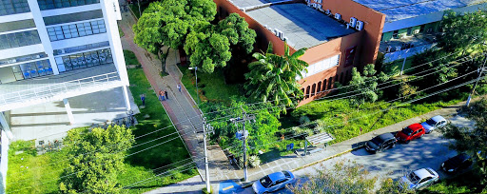
Center of Informatics at UFPE

Slide 113
Center of Informatics at UFPE
With 5 other programs, CIn-UFPE holds the highest classification of a PhD program in Brazil (7/7).
According to csindexbr.org CIn-UFPE is 1st in number of *selected* publications in the area of SE.
~90 faculty, ~10 faculty in SE, 6 SE faculty in SPG+STAR.

Slide 114
Informatics at UFPE
2x4-story buildings like this. Grad student’s offices, classrooms, and admin offices.
Faculty offices, undergrad labs, and facilities of partners (Apple, Samsung, Motorola, and OKI).

Slide 115
If you are curious…
Short video about our department -> https://tinyurl.com/wl68cvx
Short video about our group -> https://tinyurl.com/u3ytuls
More info:
Email: damorim@cin.ufpe.br
Web: http://www.cin.ufpe.br/~damorim

Slide 116
Considering working with us?
1st entry
NOV
MAR
application
2nd entry
MAY
JUL
enrollment
About fellowship
Sources: Program pays (student ranks in the top-20s) XOR state agency pays (advisor needs to prepare proposal to state agency) XOR project pays
Stipend ~R$2,600 free of taxes. OKish for living close to the University.
Complements of funding
Lots (really) of different opportunities for summer internships abroad
Being a Teaching Assistant in a Professional Masters course (Once a year it pays ~2 salaries for a two-week job of work)

Slide 117
If you are still undecided… ☺

Slide 118

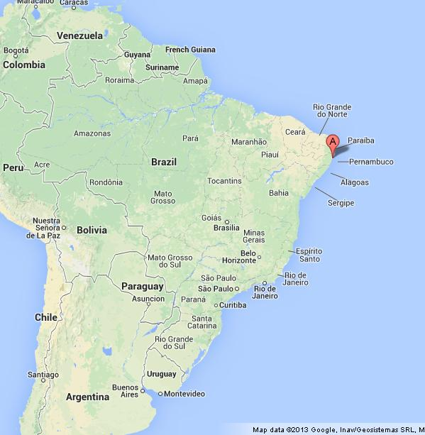
Recife
~2 million people (metropolitan area)
International flights from/to big cities worldwide
straight flight Cordoba <-> Recife (once a week)
Temperature: 22-32C

Slide 119

Porto de Galinhas
1h drive by car
shuttle options from airport
venue of ICST 2021
https://icst2021.icmc.usp.br/

Slide 120

Muro Alto
Natural Pool
1Km to the south of Porto de Galinhas

Slide 121


Maracaípe
More isolated
1Km to the north of Porto de Galinhas

Slide 122
Informatics at UFPE
Hope to see you soon!

