Slide 1

Software Testing: From Practice to Research
Marcelo d'Amorim
Rio Cuarto, Argentina, February 2020
https://star.cin.ufpe.br

Slide 2
Software Testing
Activity of finding bugs in Software

Slide 3
Software Testing
Activity of finding bugs in Software
But, what is a bug in software? Code that violates software spec

Slide 4
Software Testing
Activity of finding bugs in Software
But, what is a bug in software? Code that violates software spec
But, what is a spec? Definition of what a system should (and should not) do

Slide 5
It is highly popular and expensive!
Highly used in industry (code inspection also popular)
It is expensive *
Human: Writing test cases is time consuming
Computation: Running test cases is time consuming
* NIST Report 2002: http://www.nist.gov/director/planning/upload/report02-3.pdf

Slide 6
Goals of this course
Demonstrate popular concepts and tools used in industry (80%)
Discuss problems in Software Testing research (20%)
…
https://github.com/damorim/testing-cin-minicourse

Slide 7
Requirements
Have basic knowledge of RCS (e.g., Git)
Took some programming classes and projects
…
We use multiple languages to demonstrate concepts.

Slide 8
Preliminaries

Slide 9
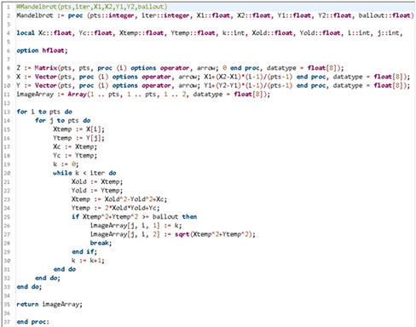
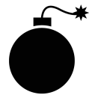



The lifecycle of a bug
FAULT
Developer introduces a bug in the program
BUG
FAILURE
J. Voas, PIE: A Dynamic Failure-Based Technique, IEEE Transactions on Software Engineering. 1992

Slide 10
The lifecycle of a bug
FAULT
Developer introduces a bug in the program
Execution touched the buggy code and state got infected
BUG
FAILURE
J. Voas, PIE: A Dynamic Failure-Based Technique, IEEE Transactions on Software Engineering. 1992

Slide 11
The lifecycle of a bug
FAULT
Developer introduces a bug in the program
Execution touched the buggy code and state got infected
BUG
Infection propagated to other parts of the state
FAILURE
J. Voas, PIE: A Dynamic Failure-Based Technique, IEEE Transactions on Software Engineering. 1992

Slide 12
The lifecycle of a bug
FAULT
Developer introduces a bug in the program
Execution touched the buggy code and state got infected
BUG
Infection propagated to other parts of the state
Infection was observed.
FAILURE
J. Voas, PIE: A Dynamic Failure-Based Technique, IEEE Transactions on Software Engineering. 1992

Slide 13
The lifecycle of a bug
FAULT
BUG
Focus of Testing
FAILURE
J. Voas, PIE: A Dynamic Failure-Based Technique, IEEE Transactions on Software Engineering. 1992

Slide 14
The lifecycle of a bug
FAULT
BUG
Focus of Debugging
Focus of Testing
FAILURE
J. Voas, PIE: A Dynamic Failure-Based Technique, IEEE Transactions on Software Engineering. 1992

Slide 15
The lifecycle of a bug
FAULT
Scientific Debugging:
1. Observation (e.g., failure)
2. Build Hypothesis
3. Predict behavior based on 2
4. Make an experiment
5. Observation
6. If hypothesis inconsistent
then goto 2 (revise)
else fix code
BUG
Focus of Debugging
Focus of Testing
FAILURE
J. Voas, PIE: A Dynamic Failure-Based Technique, IEEE Transactions on Software Engineering. 1992

Slide 16
Anatomy of a typical test case (to catch a bug)
aTest():
1.
2.
3.
4.
operation
oracle
5.
6.
Oracle compares expectation with observation

Slide 17
Anatomy of a typical test case (to catch a bug)
Typically, test functions declare no parameters
aTest():
1.
2.
3.
4.
operation
oracle
5.
6.
Oracle compares expectation with observation

Slide 18
Example: Calculator (with Java JUnit)
public class Calc {
public static int add(int a, int b) {
return a + b;
}
public static int sub(int a, int b) {
return a - b;
}
}
import org.junit.*;
public class CalcTest {
@Test
public void testCancel() {
int x = 5, y = 10;
int res = sub(add(x, y), y);
Assert.assertEquals(res, x);
}
}
operation
Automated test case (aka test script)
oracle

Slide 19
Test Automation
+ Reduces time to execute tests (*)
+ Improves reproducibility
- Needs to maintain corresponding code
- Not adequate for testing usability, for example
Although manual testing is still important (e.g., exploratory testing), it is rare not to see automated tests in serious software today.

Slide 20
Characterization of Software Testing
Based on the objective of the testing effort
Functional (Testing), Load, Performance, Security, Usability, etc.
Based on the object tested
System (Testing), Integration, and Unit
Based on code visibility
Black-box (Testing), White-box
Testing is a very general concept—applicable in a variety of contexts

Slide 21
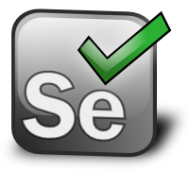
Characterization of Software Testing
Based on the objective of the testing effort
Functional (Testing), Load, Performance, Security, Usability, etc.
Based on the object tested
System (Testing), Integration, and Unit
Based on code visibility
Black-box (Testing), White-box
Example: UI Testing with Selenium
Testing is a very general concept—applicable in a variety of contexts

Slide 22
Internal versus External Software Quality
Internal Quality is concerned with quality of the code artifact
E.g., modularity (e.g., cohesion and coupling), legibility, etc.
External Quality is concerned with externally observable aspects
E.g., security, performance, functionality, etc.

Slide 23
Internal versus External Software Quality
Internal Quality is concerned with quality of the code artifact
E.g., modularity (e.g., cohesion and coupling), legibility, etc.
External Quality is concerned with externally observable aspects
E.g., security, performance, functionality, etc.
Software Testing focuses on External Quality

Slide 24
Software Testing Process

Slide 25
When to Start Writing Test Cases?
Top-down: As soon as you know your requirements
Test-Driven Development (TDD)
Downside--writing auxiliary code
Bottom-up: As soon as you develop code
Unit -> Integration -> System

Slide 26
When to Start Writing Test Cases?
Observation 1: Your tests should reflect your requirements (functional or not) even if they are implemented afterwards
Top-down: As soon as you know your requirements
Test-Driven Development (TDD)
Downside--writing auxiliary code
Bottom-up: As soon as you develop code
Unit -> Integration -> System

Slide 27
When to Start Writing Test Cases?
Observation 1: Your tests should reflect your requirements (functional or not) even if they are implemented afterwards
Top-down: As soon as you know your requirements
Test-Driven Development (TDD)
Downside--writing auxiliary code
Bottom-up: As soon as you develop code
Unit -> Integration -> System
Observation 2: No need to wait until the last function of the system is implemented to implement system and integration tests. Use mock libraries!

Slide 28
When to Start Writing Test Cases?
Top-down: As soon as you know your requirements
Test-Driven Development (TDD)
Downside--writing auxiliary code
Bottom-up: As soon as you develop code
Unit -> Integration -> System
Decision of when to start writing unit/integration/system tests various with the project and team.

Slide 29
Regression Testing
Regression is the observation that a feature/functionality of the system is malfunctioning
Regression testing is the activity of running automated tests regularly with the goal of detecting regressions

Slide 30
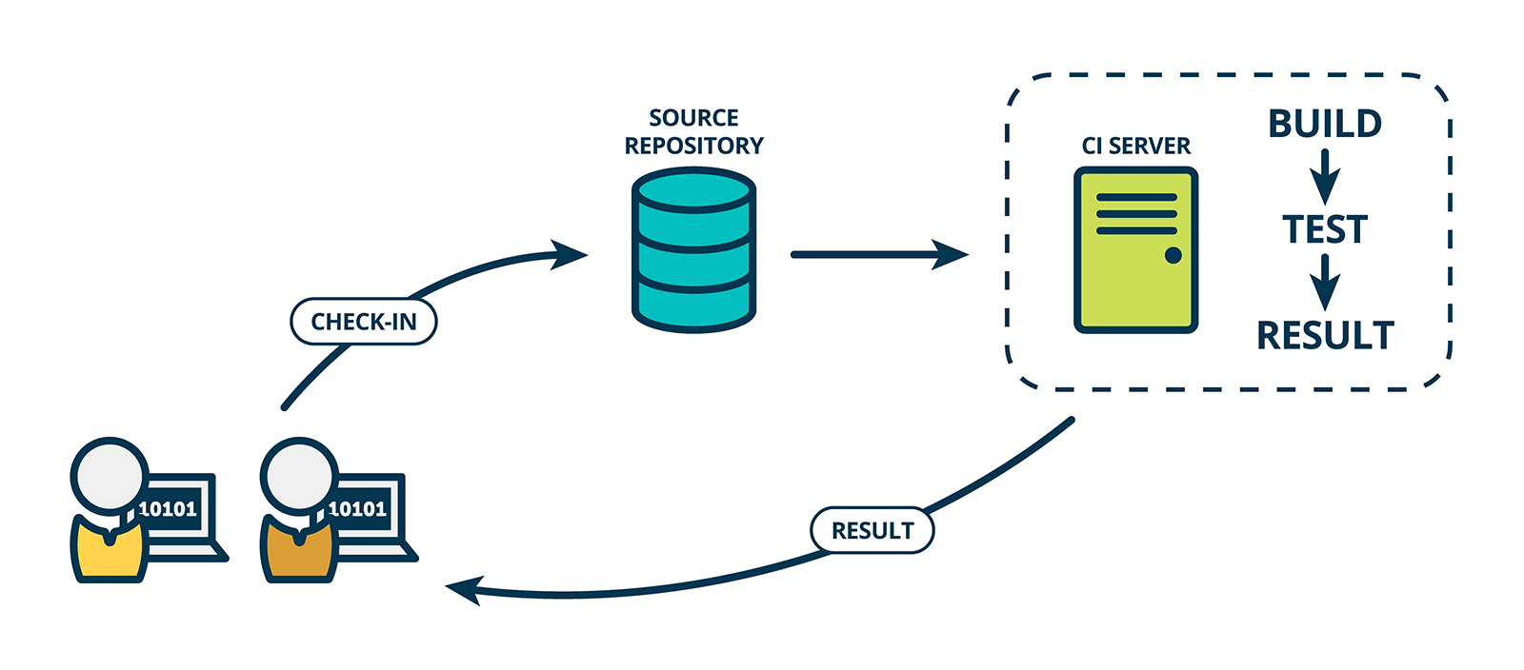
Continuous Integration (CI)
Solution to automate Regression Testing

Slide 31
To Remember

Slide 32
To Remember 1: Testing cannot prove correctness
“Program testing can be used to show the presence of bugs, but never to show their absence!” --Edsger Dijkstra
It is important to assess “how good” you test suite is!
(There are techniques for that. We will see.)

Slide 33
To Remember 2: There is no Silver Bullet
Various other aspects are important to assure external quality
Internal Quality
Choice of Language and Tools
Development Process
(Trained and Motivated) People

Slide 34
Brief on Software Specification

Slide 35
Software Specification
Definition of what a system should (and should not) do
Implementation is the realization of a specification

Slide 36
Assume-Guarantee Contract
Form of specification of a software module (e.g., a function)
It consists of a set of constraints describing
Assumptions on how the module will be used
Guarantees that the module provides

Slide 37
What can happen if pow is called with negative y?
Example: Power
int pow(int x,int y)
{
int r = 1;
while(y > 1) {
if (y % 2 == 1) {
r = x * r;
}
x = x * x;
y = y / 2;
}
return r * x;
}

Slide 38
What can happen if pow is called with negative y?
Example: Power
int pow(int x,int y)
{
int r = 1;
while(y > 1) {
if (y % 2 == 1) {
r = x * r;
}
x = x * x;
y = y / 2;
}
return r * x;
}
Consider x = y = 2
2^-2 = 1/(2^2) = 1/4
So, pow should return 1 (note integer arithmetic)
Instead, it returns 1 * 2 = 2

Slide 39
What can happen if pow is called with negative y?
Example: Power
int pow(int x,int y)
{
int r = 1;
while(y > 1) {
if (y % 2 == 1) {
r = x * r;
}
x = x * x;
y = y / 2;
}
return r * x;
}
Consider x = y = 2
2^-2 = 1/(2^2) = 1/4
So, pow should return 1 (note integer arithmetic)
Instead, it returns 1 * 2 = 2
Is this a bug?

Slide 40
Imposing Precondition
int pow(int x,int y)
//@requires y >= 0;
{
int r = 1;
while(y > 1) {
if (y % 2 == 1) {
r = x * r;
}
x = x * x;
y = y / 2;
}
return r * x;
}
There are no guarantees on what to expect from pow if precondition is not satisfied!

Slide 41
Promising a Postcondition
int pow(int x, int y)
//@requires y >= 0;
//@ensures \result == RPOW(x,y);
{
int r = 1;
while(y > 1) {
if (y % 2 == 1) {
r = x * r;
}
x = x * x;
y = y / 2;
}
return r * x;
}
int RPOW (int x,int y)
//@requires y >= 0;
{
if(y == 0)
return 1;
else
return x * RPOW (x, y-1);
}

Slide 42
Promising a Postcondition
int pow(int x, int y)
//@requires y >= 0;
//@ensures \result == RPOW(x,y);
{
int r = 1;
while(y > 1) {
if (y % 2 == 1) {
r = x * r;
}
x = x * x;
y = y / 2;
}
return r * x;
}
int RPOW (int x,int y)
//@requires y >= 0;
{
if(y == 0)
return 1;
else
return x * RPOW (x, y-1);
}
Assume-Guarantee contract for function pow.

Slide 43
Exercise
Specify contract (i.e., pre and postcondition) for function sort.
void sort(int[] ar)
The expression \old(var) denotes the value of var at the entry of the function call.

Slide 44
Solution
Specify contract (i.e., pre and postcondition) for function sort.
void sort(int[] ar)
//@requires ar != null
//@ensures ASC(ar) && PERM(ar, \old(ar))
boolean ASC(int[] ar) // returns true iff contents of array are in ascending order
boolean PERM(int[] ar1, int[] ar2) // returns true iff ar1 and ar2 are
// permutations of the same set

Slide 45
(Take Home) Exercise
Specify contracts for the functions of a stack data structure.
class Stack<T> {
int size();
void push(T t);
T pop()
}

Slide 46
Software Specification
Definition of what a system should (and should not) do
Implementation is the realization of a specification
Writing specs is expensive
It is rare for developers to fully specify a system
However, it is common to partially specify systems (e.g., test assertions)

Slide 47
Quiz
Is it possible to use testing to demonstrate that there are no bugs in code?
From what observation software debugging typically starts?
Name one benefit of using automated tests.
What is a regression?
What is regression testing?
What is continuous integration?

Slide 48
Practice!
“For the things we have to learn before we can do them, we learn by doing them.” --Aristotle, The Nicomachean Ethics

Slide 49
Agenda
Test frameworks
Build systems
Coverage
Mutation testing
Functional testing
UI testing
Behavior-Driven Development (BDD)
Fuzzing
Infrastructure to create and run tests
Test adequacy
System testing
Test design
Test input generation

Slide 50
Test Frameworks
Tools that enable developers to write automated tests
Available in most modern languages
For example: Java’s JUnit, Python’s unittest, C#’s NUnit, Ruby’s rspec
There are multiple frameworks for these programming languages

Slide 51
Example of functionalities in Java’s JUnit
Test fixtures to configure the system before/after running the test
Customizable test runners
Rich library of assertion functions (e.g., assertNull(var))
Ability to group test differently (e.g., slow/fast) for selective execution
…

Slide 52
Example of functionalities in Java’s JUnit
Test fixtures to configure the system before/after running the test
Customizable test runners
Rich library of assertion functions (e.g., assertNull(var))
Ability to group test differently (e.g., slow/fast) for selective execution
…
Other test frameworks offer very similar functionality

Slide 53
Example of functionalities in Java’s JUnit
Test fixtures to configure the system before/after running the test
Customizable test runners
Rich library of assertion functions (e.g., assertNull(var))
Ability to group test differently (e.g., slow/fast) for selective execution
…
Practice – Section 1 in our repo

Slide 54
Exercise 1
Introduce an exception ElementNotFoundException to indicate element not found in the binary search

Slide 55
Exercise 2
Change the method setup in BinarySearchTest to create an array with 100K elements and enforce each test to finish in no more than 1s.

Slide 56
(Take Home) Exercise
Log every test that executed for more than .5 s
Hint: use listeners. See org.junit.runner.notification.RunListener

Slide 57
Build Systems
Automate common tasks during the development process
E.g., compile, execute test suites, assemble, deploy, generate reports
Various implementations
E.g., make, ant, maven, gradle

Slide 58
Build Systems
Automate common tasks during the development process
E.g., compile, execute test suites, assemble, deploy, generate reports
Various implementations
E.g., make, ant, maven, gradle
Practice – Section 2 in our repo

Slide 59
Exercise 1
Add the following snippet to your build.gradle script. Then, run the command $> gradle printClasspath
## add this to build.gradle to print classpath
task printClasspath {
doLast {
configurations.testRuntimeClasspath.each { println it }
}
}

Slide 60
Exercise 2
Follow the tutorial at the link below to configure your build.gradle file to generate test execution logs.
https://medium.com/@wasyl/pretty-tests-summary-in-gradle-744804dd676c

Slide 61
Test Adequacy Criterion
Important to determine how satisfactory a test suite is
Recall that Testing cannot prove correctness!
General idea:
Define test requirements
Measure how many of these requirements are fulfilled (or covered)
Assumption is that the more requirements covered the better, i.e., the higher the chances to capture faults.

Slide 62
Examples: statement, line, basic-block, branch, function, acyclic paths, etc.
Test Adequacy Criterion
Various approaches to measure coverage
Structural coverage measures amount of code elements covered by the test suite
Logical coverage: measures extent to which conditionals are covered
Dataflow coverage: measures extent to which data flows are covered
Mutation coverage measures amount of (injected) faults covered by the test suite
…

Slide 63
Examples: basic conditions, compound conditions, and MC/DC.
Test Adequacy Criterion
Various approaches to measure coverage
Structural coverage measures amount of code elements covered by the test suite
Logical coverage: measures extent to which conditionals are covered
Dataflow coverage: measures extent to which data flows are covered
Mutation coverage measures amount of (injected) faults covered by the test suite
…

Slide 64
Examples: definitions, uses, def-uses (aka all-pairs), and def-use paths.
Test Adequacy Criterion
Various approaches to measure coverage
Structural coverage measures amount of code elements covered by the test suite
Logical coverage: measures extent to which conditionals are covered
Dataflow coverage: measures extent to which data flows are covered
Mutation coverage measures amount of (injected) faults covered by the test suite
…

Slide 65
Test Adequacy Criterion
Various approaches to measure coverage
Structural coverage measures amount of code elements covered by the test suite
Logical coverage: measures extent to which conditionals are covered
Dataflow coverage: measures extent to which data flows are covered
Mutation coverage measures amount of (injected) faults covered by the test suite
…
Mutation testing is a technique that intentionally inject faults (mutants) in the code and measure ability of test suites to capture them.

Slide 66
Test Adequacy Criterion
Various approaches to measure coverage
Structural coverage measures amount of code elements covered by the test suite
Logical coverage: measures extent to which conditionals are covered
Dataflow coverage: measures extent to which data flows are covered
Mutation coverage measures amount of (injected) faults covered by the test suite
…
Practice – Sections 3 and 4 in our repo

Slide 67
Exercise 1
Try to maximize branch coverage of the test suite for doublelinkedlist
Please, add coherent test oracles to your test cases

Slide 68
Exercise 2
Try to maximize mutation coverage of the test suite for triangle
Please, add coherent test oracles to your test cases

Slide 69
System Testing
The entire system is the object tested (not the units or their integration)
Critical to validate requirements with stakeholders
Acceptance tests

Slide 70
Functional Testing
Models entire system as a function
Simplistic Example: Testing configurations of a mobile App
Orientation | landscape, portrait
Size | 1080x1920, 750x1334, 720x1280
OS | iPhone, Android

Slide 71
Functional Testing
Models entire system as a function
Simplistic Example: Testing configurations of a mobile App
Orientation | landscape, portrait
Size | 1080x1920, 750x1334, 720x1280
OS | iPhone, Android
How many configurations would be required to test the phone exhaustively?

Slide 72
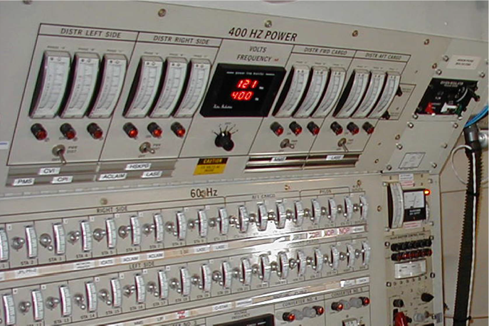
* https://personal.utdallas.edu/~ewong/SE6367/03-Lecture/29-A-Combinatorial-Testing-by-Kuhn.pdf
Combinatorial Interaction Testing (CIT) *
Combining all values can be daunting for large number of params/values!
34 switches =
2^32 combinations of inputs =
1.7 x 10^10 inputs/tests

Slide 73
* https://personal.utdallas.edu/~ewong/SE6367/03-Lecture/29-A-Combinatorial-Testing-by-Kuhn.pdf
Combinatorial Interaction Testing (CIT) *
Combining all values can be daunting for large number of params/values!
CIT is a technique to mitigate combinatorial explosion from exhaustive/combinatorial testing

Slide 74
* https://personal.utdallas.edu/~ewong/SE6367/03-Lecture/29-A-Combinatorial-Testing-by-Kuhn.pdf
CIT – Pairwise Testing
All combinations of values across pairs of parameters are tested
Reveals most (50-90%) of the faults in configurable software

Slide 75
* https://personal.utdallas.edu/~ewong/SE6367/03-Lecture/29-A-Combinatorial-Testing-by-Kuhn.pdf
CIT – Pairwise Testing
Orientation | landscape, portrait
Size | 1080x1920, 750x1334, 720x1280
OS | iPhone, Android
Orientation | Size | OS
landscape | 1080x1920 | iPhone
landscape | 750x1334 | Android
landscape | 720x1280 | Android
portrait | 1080x1920 | Android
portrait | 750x1334 | iPhone
portrait | 720x1280 | iPhone

Slide 76
* https://personal.utdallas.edu/~ewong/SE6367/03-Lecture/29-A-Combinatorial-Testing-by-Kuhn.pdf
CIT – Pairwise Testing
6 combinations as opposed to 12 combinations for exhaustive testing
Orientation | landscape, portrait
Size | 1080x1920, 750x1334, 720x1280
OS | iPhone, Android
Orientation | Size | OS
landscape | 1080x1920 | iPhone
landscape | 750x1334 | Android
landscape | 720x1280 | Android
portrait | 1080x1920 | Android
portrait | 750x1334 | iPhone
portrait | 720x1280 | iPhone

Slide 77
* https://personal.utdallas.edu/~ewong/SE6367/03-Lecture/29-A-Combinatorial-Testing-by-Kuhn.pdf
CIT – Pairwise Testing
6 combinations as opposed to 12 combinations for exhaustive testing
Orientation | landscape, portrait
Size | 1080x1920, 750x1334, 720x1280
OS | iPhone, Android
Practice – Section 2 in our repo
Orientation | Size | OS
landscape | 1080x1920 | iPhone
landscape | 750x1334 | Android
landscape | 720x1280 | Android
portrait | 1080x1920 | Android
portrait | 750x1334 | iPhone
portrait | 720x1280 | iPhone

Slide 78
UI Testing
fd

Slide 79
Behavior-Driven Development
fd

Slide 80
Fuzzing
fd

Slide 81

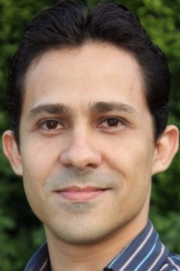
STAR (Software Testing and Analysis Research)
Interested in preventing, discovering, diagnosing, and repairing software bugs
Faculty: Breno, Leopoldo, and Marcelo
Web: http://star.cin.ufpe.br
Leopoldo Teixeira
Breno Miranda

Slide 82
Research Projects (1/3)
Detection of plugin conflicts in CMS
[Information and Software Technology, Feb. 2020]
Using Docker to reproduce StackOverflow posts
[TSE, Dec. 2019]

Slide 83
Research Projects (2/3)
Visual Sketching
[ICSE-NIER 2020]
Test diversity to find bugs in JavaScript engines
[under review]
ML detection of flaky tests [under review]

Slide 84
Research Projects (3/3)
Synthesis of Rules for NIDS (e.g., Suricata)
Grey-box Combinatorial Interaction Testing
Willow, a visualization tool to teach programming (http://34.73.147.9/)

Slide 85
Considering to Visit?

Slide 86
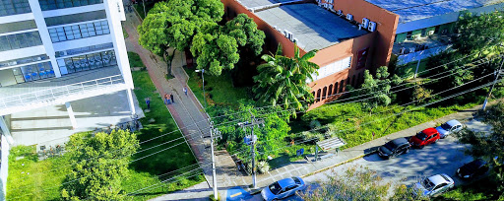
Informatics at UFPE
~90 faculty, ~10 faculty in SE, 6 SE faculty in SPG+STAR
Our group is highly-interested in recruiting good students

Slide 87

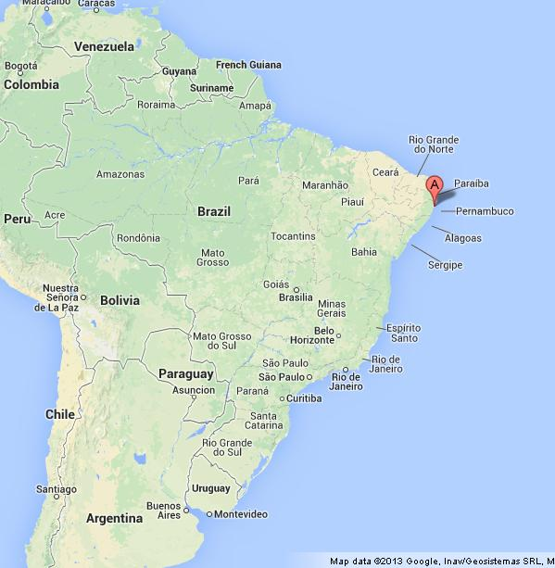
Recife
~2 million people (metropolitan area)
International flights from/to big cities worldwide
straight flight Cordoba <-> Recife (once a week)

Slide 88

Porto de Galinhas
1h drive by car
shuttle options from airport
venue of ICST 2021

Slide 89

Muro Alto
Natural Pool
1Km to the south of Porto de Galinhas

Slide 90


Maracaípe
More isolated
1Km to the north of Porto de Galinhas

Slide 91
Informatics at UFPE

Slide 92
Software Testing: From Practice to Research
Marcelo d'Amorim
Rio Cuarto, Argentina, February 2020
https://star.cin.ufpe.br/

