Slide 1

Software Testing: From Practice to Research
Marcelo d'Amorim
CACIC 2019, Rio Cuarto, Argentina, October 14-18
https://star.cin.ufpe.br/

Slide 2
Definition of Software Testing
Activity of finding bugs in Software

Slide 3
But, What’s is a software bug?
Erroneous code, i.e., code that violates some part of the spec

Slide 4
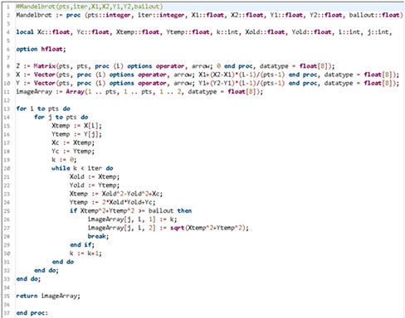




The lifecycle of a bug
FAULT
Execution touched the erroneous line of code and state was first infected
BUG
Infection propagated to other parts of the state
Infection was observed.
(It could have been missed)
FAILURE
J. Voas, PIE: A Dynamic Failure-Based Technique, IEEE Transactions on Software Engineering. 1992

Slide 5
The lifecycle of a bug
FAULT
Execution touched the erroneous line of code and state was first infected
BUG
Infection propagated to other parts of the state
Infection was observed.
(It could have been missed)
Goal of Software Testing is to create scenarios like this in-house to avoid bugs to escape to production
FAILURE
J. Voas, PIE: A Dynamic Failure-Based Technique, IEEE Transactions on Software Engineering. 1992

Slide 6
Important facts about Software Testing
It is highly popular in industry
It is expensive
Human: People can spend a lot of time testing uninteresting parts of code
Computation: Large software has large test suites, which can takes long time to run
NIST Report 2002: http://www.nist.gov/director/planning/upload/report02-3.pdf

Slide 7
Anatomy of a (typical) test case
Test_Something():
1.
2.
3.
4.
operation
oracle
5.
6.
Compares expectation (from specs, typically from humans) with observation

Slide 8
Example: Test to check resistance of a chair
Sequence of Operations
Add 200Kg to the chair
Wait for 48h
Check if there are cracks in the seat
Oracle

Slide 9
Big Picture

Slide 10
Various names exist for Software Testing…
Based on the objective of the testing effort
Functional (Testing), Load, Performance, Security, Usability, etc.
Based on the artifact
System (Testing), Integration, and unit
Based on code visibility
Black-box (Testing), white-box

Slide 11

Various names exist for Software Testing…
Based on the objective of the testing effort
Functional (Testing), Load, Performance, Security, Usability, etc.
Based on the artifact
System (Testing), Integration, and unit
Based on code visibility
Black-box (Testing), white-box
Example: Selenium WebDriver

Slide 12
Internal versus External Software Quality
Internal Quality is concerned with quality of the code artifact
E.g., modularity, legibility, etc.
External Quality is concerned with externally observable aspects
E.g., security, performance, functionality, etc.

Slide 13
Internal versus External Software Quality
Internal Quality is concerned with quality of the code artifact
E.g., modularity, legibility, etc.
External Quality is concerned with externally observable aspects
E.g., security, performance, functionality, etc.
Testing focuses on External Quality Assurance

Slide 14
No Silver Bullet
Various aspects affect External Software Quality…
…other than Testing
Internal Quality
Development Process
Choice of Language and Tools
People

Slide 15
Outline
https://github.com/damorim/testing-cin-minicourse
Practice Module
Testing Framework
Build System
Coverage
Capture-Replay
Test-Driven Development
Research Module
…

