Slide 1

Software Testing: From Practice to Research
Marcelo d'Amorim
Rio Cuarto, Argentina, February 2020
https://star.cin.ufpe.br/

Slide 2
Software Testing
Activity of finding bugs in Software

Slide 3
Software Testing
Activity of finding bugs in Software
But, what is a bug in software? Code that violates software spec

Slide 4
Software Testing
Activity of finding bugs in Software
But, what is a bug in software? Code that violates software spec
But, what is a spec? Definition of what a system should (and should not) do

Slide 5
It is highly popular and expensive!
Highly used in industry (code inspection also popular)
It is expensive *
Human: Writing test cases is time consuming
Computation: Running test cases is time consuming
* NIST Report 2002: http://www.nist.gov/director/planning/upload/report02-3.pdf

Slide 6
Goals of this course
Demonstrate popular concepts and tools used in industry (80%)
Discuss problems in Software Testing research (20%)
…
https://github.com/damorim/testing-cin-minicourse

Slide 7
Preliminaries

Slide 8
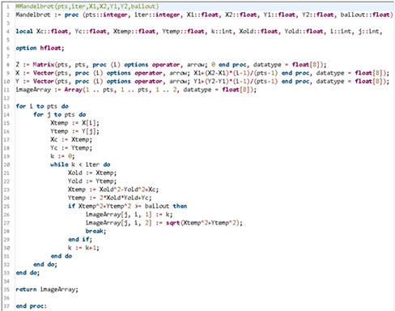
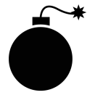



The lifecycle of a bug
FAULT
Developer introduces a bug in the program
BUG
FAILURE
J. Voas, PIE: A Dynamic Failure-Based Technique, IEEE Transactions on Software Engineering. 1992

Slide 9
The lifecycle of a bug
FAULT
Developer introduces a bug in the program
Execution touched the erroneous line of code and state was first infected
BUG
FAILURE
J. Voas, PIE: A Dynamic Failure-Based Technique, IEEE Transactions on Software Engineering. 1992

Slide 10
The lifecycle of a bug
FAULT
Developer introduces a bug in the program
Execution touched the erroneous line of code and state was first infected
BUG
Infection propagated to other parts of the state
FAILURE
J. Voas, PIE: A Dynamic Failure-Based Technique, IEEE Transactions on Software Engineering. 1992

Slide 11
The lifecycle of a bug
FAULT
Developer introduces a bug in the program
Execution touched the erroneous line of code and state was first infected
BUG
Infection propagated to other parts of the state
Infection was observed.
(It could have been missed)
FAILURE
J. Voas, PIE: A Dynamic Failure-Based Technique, IEEE Transactions on Software Engineering. 1992

Slide 12
The lifecycle of a bug
FAULT
BUG
Focus of Testing
FAILURE
J. Voas, PIE: A Dynamic Failure-Based Technique, IEEE Transactions on Software Engineering. 1992

Slide 13
The lifecycle of a bug
FAULT
BUG
Focus of Debugging
Focus of Testing
FAILURE
J. Voas, PIE: A Dynamic Failure-Based Technique, IEEE Transactions on Software Engineering. 1992

Slide 14
The lifecycle of a bug
FAULT
Scientific Debugging:
1. Observation (e.g., failure)
2. Build Hypothesis
3. Predict behavior based on 2
4. Make an experiment
5. Observation
6. If hypothesis inconsistent
then goto 2 (revise)
else fix code
BUG
Focus of Debugging
Focus of Testing
FAILURE
J. Voas, PIE: A Dynamic Failure-Based Technique, IEEE Transactions on Software Engineering. 1992

Slide 15
Anatomy of a typical test case (to catch a bug)
aTest():
1.
2.
3.
4.
operation
oracle
5.
6.
Oracle compares expectation with observation

Slide 16
Anatomy of a typical test case (to catch a bug)
Typically, test functions declare no parameters
aTest():
1.
2.
3.
4.
operation
oracle
5.
6.
Oracle compares expectation with observation

Slide 17
Example: Checking resistance of a chair
Sequence of Operations
Add 200Kg to the chair
Wait for 48h
Check if there are cracks in the seat
Oracle

Slide 18
Another Example: Calculator (with Java JUnit)
public class Calc {
public static int add(int a, int b) {
return a + b;
}
public static int sub(int a, int b) {
return a - b;
}
}
import org.junit.*;
public class CalcTest {
@Test
public void testCancel() {
int x = 5, y = 10;
int res = sub(add(x, y), y);
Assert.assertEquals(res, x);
}
}
operation
oracle

Slide 19
Characterization of Software Testing
Based on the objective of the testing effort
Functional (Testing), Load, Performance, Security, Usability, etc.
Based on the object tested
System (Testing), Integration, and Unit
Based on code visibility
Black-box (Testing), White-box
Testing is a very general concept—applicable in a variety of contexts

Slide 20

Characterization of Software Testing
Based on the objective of the testing effort
Functional (Testing), Load, Performance, Security, Usability, etc.
Based on the object tested
System (Testing), Integration, and Unit
Based on code visibility
Black-box (Testing), White-box
Example: UI Testing with Selenium
Testing is a very general concept—applicable in a variety of contexts

Slide 21
Internal versus External Software Quality
Internal Quality is concerned with quality of the code artifact
E.g., modularity (e.g., cohesion and coupling), legibility, etc.
External Quality is concerned with externally observable aspects
E.g., security, performance, functionality, etc.

Slide 22
Internal versus External Software Quality
Internal Quality is concerned with quality of the code artifact
E.g., modularity (e.g., cohesion and coupling), legibility, etc.
External Quality is concerned with externally observable aspects
E.g., security, performance, functionality, etc.
Software Testing focuses on External Quality

Slide 23
Software Testing Process

Slide 24
When to start writing test cases?
Top-down: As soon as you know your requirements
Test-Driven Development (TDD)
Downside--writing auxiliary code
Bottom-up: As soon as you develop code
Unit -> Integration -> System

Slide 25
When to start writing test cases?
Top-down: As soon as you know your requirements
Test-Driven Development (TDD)
Downside--writing auxiliary code
Bottom-up: As soon as you develop code
Unit -> Integration -> System
No definite answer on what approach fits best your needs or what is the ideal balance of unit/integration/system testing

Slide 26
Regression Testing
Regression is the observation that a feature/functionality of the system is malfunctioning
Regression testing is the activity of running tests regularly with the goal of detecting regressions

Slide 27
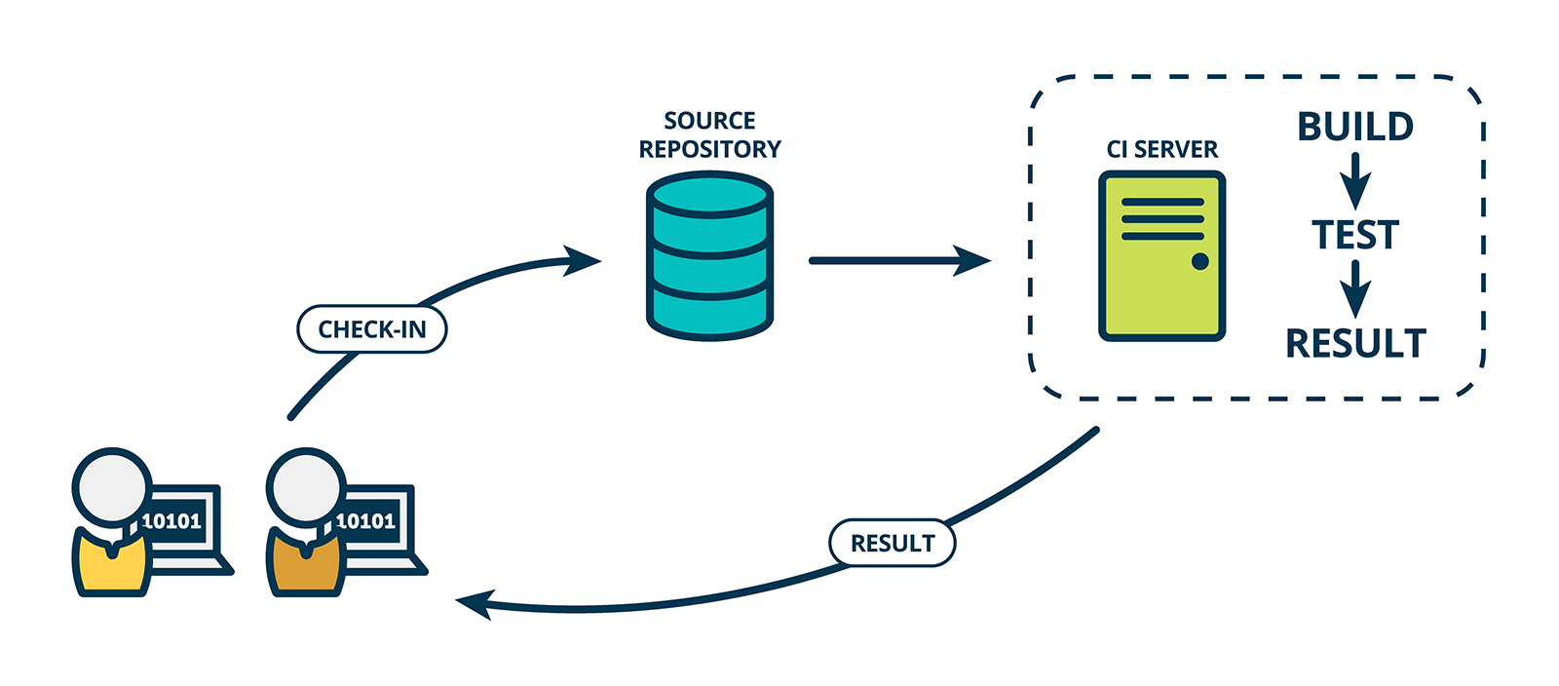
Continuous Integration (CI)
Solution to automate Regression Testing

Slide 28
To Remember

Slide 29
To Remember 1: Testing cannot prove correctness
“Program testing can be used to show the presence of bugs, but never to show their absence!” --Edsger Dijkstra
It is important to assess “how good” you test suite is!
(There are techniques for that. We will see.)

Slide 30
To Remember 2: There is no Silver Bullet
Various other aspects are important to assure external quality
Internal Quality
Choice of Language and Tools
Development Process
(Trained and Motivated) People

Slide 31
Brief on Software Specification

Slide 32
Software Specification
Definition of what a system should (and should not) do
Implementation is the realization of a specification

Slide 33
Assume-Guarantee Contract
Form of specification of a software module (e.g., a function)
It consists of a set of constraints describing
Assumptions on how the module will be used
Guarantees that the module provides

Slide 34
What can happen if pow is called with negative y?
Example: Power
int pow(int x,int y)
{
int r = 1;
while(y > 1) {
if (y % 2 == 1) {
r = x * r;
}
x = x * x;
y = y / 2;
}
return r * x;
}

Slide 35
What can happen if pow is called with negative y?
Example: Power
int pow(int x,int y)
{
int r = 1;
while(y > 1) {
if (y % 2 == 1) {
r = x * r;
}
x = x * x;
y = y / 2;
}
return r * x;
}
Consider x = y = 2
2^-2 = 1/(2^2) = 1/4
So, pow should return 1 (note integer arithmetic)
Instead, it returns 1 * 2 = 2
Is this a bug?

Slide 36
What can happen if pow is called with negative y?
Example: Power
int pow(int x,int y)
{
int r = 1;
while(y > 1) {
if (y % 2 == 1) {
r = x * r;
}
x = x * x;
y = y / 2;
}
return r * x;
}
Consider x = y = 2
2^-2 = 1/(2^2) = 1/4
So, pow should return 1 (note integer arithmetic)
Instead, it returns 1 * 2 = 2

Slide 37
Imposing Precondition
int pow(int x,int y)
//@requires y >= 0;
{
int r = 1;
while(y > 1) {
if (y % 2 == 1) {
r = x * r;
}
x = x * x;
y = y / 2;
}
return r * x;
}
There are no guarantees on what to expect if precondition is not satisfied

Slide 38
Promising a Postcondition
int pow(int x, int y)
//@requires y >= 0;
//@ensures \result == RPOW(x,y);
{
int r = 1;
while(y > 1) {
if (y % 2 == 1) {
r = x * r;
}
x = x * x;
y = y / 2;
}
return r * x;
}
int RPOW (int x,int y)
//@requires y >= 0;
{
if(y == 0)
return 1;
else
return x * RPOW (x, y-1);
}

Slide 39
Promising a Postcondition
int pow(int x, int y)
//@requires y >= 0;
//@ensures \result == RPOW(x,y);
{
int r = 1;
while(y > 1) {
if (y % 2 == 1) {
r = x * r;
}
x = x * x;
y = y / 2;
}
return r * x;
}
int RPOW (int x,int y)
//@requires y >= 0;
{
if(y == 0)
return 1;
else
return x * RPOW (x, y-1);
}
Assume-Guarantee contract for function pow.

Slide 40
Exercise
Specify contract (i.e., pre and postcondition) for function sort.
void sort(int[] ar)
The expression \old(var) denotes the value of var at the entry of the function call.

Slide 41
Solution
Specify contract (i.e., pre and postcondition) for function sort.
void sort(int[] ar)
//@requires ar != null
//@ensures ASC(ar) && PERM(ar, \old(ar))
boolean ASC(int[] ar) // returns true iff contents of array are in ascending order
boolean PERM(int[] ar1, int[] ar2) // returns true iff ar1 and ar2 are
// permutations of the same set

Slide 42
Exercise (take home)
Specify contracts for the functions of a stack data structure.
class Stack<T> {
int size();
void push(T t);
T pop()
}

Slide 43
Software Specification
Definition of what a system should (and should not) do
Implementation is the realization of a specification
Writing specs is expensive
It is rare for developers to fully specify a system
However, it is common to partially specify systems (e.g., test assertions)

Slide 44
Let us practice!
“For the things we have to learn before we can do them, we learn by doing them.” --Aristotle, The Nicomachean Ethics

Slide 45
Agenda
Test frameworks
Build systems
Coverage tools
Mutation testing
UI testing
Behavior-Driven Development (BDD)
Fuzzing

Slide 46
Test Frameworks
Tools that enable developers to write automated tests
Most programming languages offer at least one option

Slide 47
Example of functionalities in Java’s JUnit
Test fixtures to configure the system before/after running the test
Customizable test runners
Rich library of assertion functions (e.g., assertNull(var))
Ability to group test differently (e.g., slow/fast) for selective execution
…

Slide 48
Practice – Section 1 in our repo

Slide 49
Build Systems
fd

Slide 50
Coverage Tools
fd

Slide 51
Mutation Testing
fd

Slide 52
UI Testing
fd

Slide 53
Behavior-Driven Development
fd

Slide 54
Fuzzing
fd

Slide 55
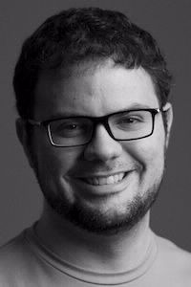
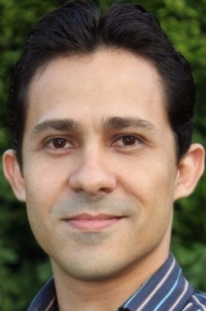
STAR (Software Testing and Analysis Research)
Interested in preventing, discovering, diagnosing, and repairing software bugs
Faculty: Breno, Leopoldo, and Marcelo
Web: http://star.cin.ufpe.br
Leopoldo Teixeira
Breno Miranda

Slide 56
Research Projects (1/3)
Detection of plugin conflicts in CMS
[Information and Software Technology, Feb. 2020]
Using Docker to reproduce StackOverflow posts
[TSE, Dec. 2019]

Slide 57
Research Projects (2/3)
Visual Sketching
[ICSE-NIER 2020]
Test diversity to find bugs in JavaScript engines
[under review]
ML detection of flaky tests [under review]

Slide 58
Research Projects (3/3)
Synthesis of Rules for NIDS (e.g., Suricata)
Grey-box Combinatorial Interaction Testing
Willow, a visualization tool to teach programming (http://34.73.147.9/)

Slide 59
Considering to Visit?

Slide 60
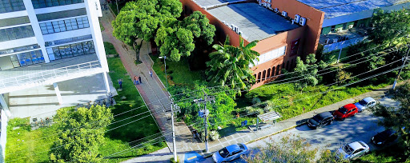
Informatics at UFPE
~90 faculty, ~10 faculty in SE, 6 SE faculty in SPG+STAR
Our group is highly-interested in recruiting good students

Slide 61

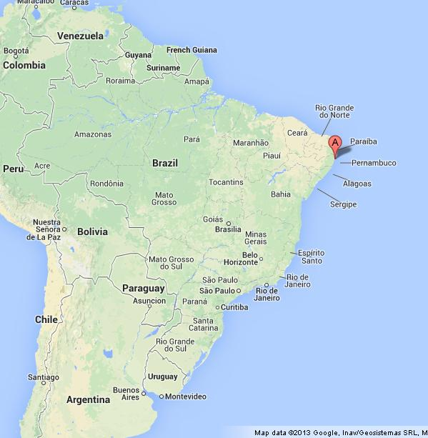
Recife
~2 million people (metropolitan area)
International flights from/to big cities worldwide
straight flight Cordoba <-> Recife (once a week)

Slide 62

Porto de Galinhas
1h drive by car
shuttle options from airport
venue of ICST 2021

Slide 63

Muro Alto
Natural Pool
1Km to the south of Porto de Galinhas

Slide 64


Maracaípe
More isolated
1Km to the north of Porto de Galinhas

Slide 65
Informatics at UFPE

Slide 66
Software Testing: From Practice to Research
Marcelo d'Amorim
Rio Cuarto, Argentina, February 2020
https://star.cin.ufpe.br/

