Slide 1

Software Testing: From Practice to Research
Marcelo d'Amorim
CACIC 2019, Rio Cuarto, Argentina, October 14-18
https://star.cin.ufpe.br/

Slide 2
Definition of Software Testing
Activity of finding bugs in Software

Slide 3
But, What’s is a software bug?
Erroneous code, i.e., code that violates some part of the spec

Slide 4
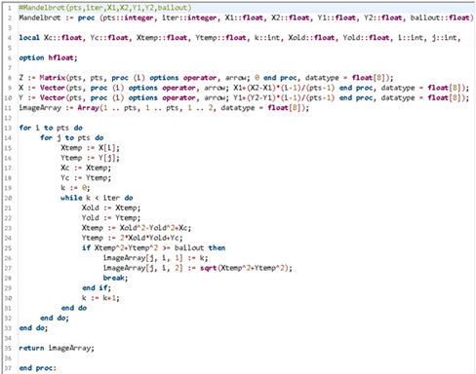
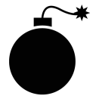



The lifecycle of a bug
FAULT
Execution touched the erroneous line of code and state was first infected
BUG
Infection propagated to other parts of the state
Infection was observed.
(It could have been missed)
FAILURE
J. Voas, PIE: A Dynamic Failure-Based Technique, IEEE Transactions on Software Engineering. 1992

Slide 5
The lifecycle of a bug
FAULT
Execution touched the erroneous line of code and state was first infected
BUG
Infection propagated to other parts of the state
Infection was observed.
(It could have been missed)
Goal of Software Testing is to create scenarios like this in-house to avoid bugs to escape to production
FAILURE
J. Voas, PIE: A Dynamic Failure-Based Technique, IEEE Transactions on Software Engineering. 1992

Slide 6
Important facts about Software Testing
It is highly popular in industry
It is expensive
Human: People can spend a lot of time testing uninteresting parts of code
Computation: Large software has large test suites, which can takes long time to run
NIST Report 2002: http://www.nist.gov/director/planning/upload/report02-3.pdf

Slide 7
Anatomy of a (typical) test case
Test_Something():
1.
2.
3.
4.
operation
oracle
5.
6.
Compares expectation (from specs, typically from humans) with observation

Slide 8
Example: Test to check resistance of a chair
Sequence of Operations
Add 200Kg to the chair
Wait for 48h
Check if there are cracks in the seat
Oracle

Slide 9
Big Picture

Slide 10
Various names exist for Software Testing…
Based on the objective of the testing effort
Functional (Testing), Load, Performance, Security, Usability, etc.
Based on the artifact
System (Testing), Integration, and unit
Based on code visibility
Black-box (Testing), white-box

Slide 11
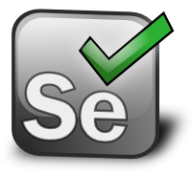
Various names exist for Software Testing…
Based on the objective of the testing effort
Functional (Testing), Load, Performance, Security, Usability, etc.
Based on the artifact
System (Testing), Integration, and unit
Based on code visibility
Black-box (Testing), white-box
Example: Selenium WebDriver

Slide 12
Internal versus External Software Quality
Internal Quality is concerned with quality of the code artifact
E.g., modularity, legibility, etc.
External Quality is concerned with externally observable aspects
E.g., security, performance, functionality, etc.

Slide 13
Internal versus External Software Quality
Internal Quality is concerned with quality of the code artifact
E.g., modularity, legibility, etc.
External Quality is concerned with externally observable aspects
E.g., security, performance, functionality, etc.
Testing focuses on External Quality Assurance

Slide 14
No Silver Bullet
Various aspects affect External Software Quality…
…other than Testing
Internal Quality
Development Process
Choice of Language and Tools
People

Slide 15
Outline
https://github.com/damorim/testing-cin-minicourse
Practice Module
Testing Framework
Build System
Coverage
Capture-Replay
Test-Driven Development
Research Module
…

Slide 16
References
Lecture Notes of Frank Pfenning on Contracts http://www.cs.cmu.edu/~15122/handouts/01-contracts.pdf
Java Modelling Language (JML) http://www.eecs.ucf.edu/~leavens/JML/index.shtml
JavaMOP
Syntax: http://fsl.cs.illinois.edu/index.php/JavaMOP4_Syntax
PropertyDB: https://runtimeverification.com/monitor/propertydb/
How to Specify Java Language API http://fsl.cs.illinois.edu/FSL/papers/2012/lee-jin-meredith-rosu-2012-tr/lee-jin-meredith-rosu-2012-tr-public.pdf

Slide 17
Software Used - JavaMOP
Installation
http://fsl.cs.illinois.edu/index.php/JavaMOP4
Online interface
http://www.kframework.org/tool/run/javamop

Slide 18
Software Specification
Definition of what a system should (and should not) do

Slide 19
Software Specification
Definition of what a system should (and should not) do
Implementation is the realization of a specification

Slide 20
Observations
Writing specs is expensive ~> It is rare to fully specify a system
However, it is very common to partially write specs (e.g., test assertions).

Slide 21
Contract
A specification of a software module (e.g., a function).
A set of constraints describing:
What a given module guarantees to implement (given that 2 is fulfilled)
What users of that module need to provide (for 1 to be fulfilled)

Slide 22
Example: Power
int pow(int x,int y)
{
int r = 1;
while(y > 1) {
if (y % 2 == 1) {
r = x * r;
}
x = x * x;
y = y / 2;
}
return r * x;
}

Slide 23
Imposing Precondition
int pow(int x,int y)
//@requires y >= 0;
{
int r = 1;
while(y > 1) {
if (y % 2 == 1) {
r = x * r;
}
x = x * x;
y = y / 2;
}
return r * x;
}
What would happen if pow is called with negative y?

Slide 24
Promising a Postcondition
int pow(int x,int y)
//@requires y >= 0;
//@ensures \result == RPOW(x,y);
{
int r = 1;
while(y > 1) {
if (y % 2 == 1) {
r = x * r;
}
x = x * x;
y = y / 2;
}
return r * x;
}
int RPOW (int x,int y)
//@requires y >= 0;
{
if(y == 0)
return 1;
else
return x * RPOW (x, y-1);
}

Slide 25
Promising a Postcondition
int pow(int x,int y)
//@requires y >= 0;
//@ensures \result == RPOW(x,y);
{
int r = 1;
while(y > 1) {
if (y % 2 == 1) {
r = x * r;
}
x = x * x;
y = y / 2;
}
return r * x;
}
int RPOW (int x,int y)
//@requires y >= 0;
{
if(y == 0)
return 1;
else
return x * RPOW (x, y-1);
}
Assume-Guarantee contract for function pow.

Slide 26
Exercise
Specify contract (i.e., pre and postcondition) for function sort.
void sort(int[] ar)

Slide 27
Exercise
Specify contracts for the functions of a stack data structure.
class Stack<T> {
int size();
void push(T t);
T pop()
}

Slide 28
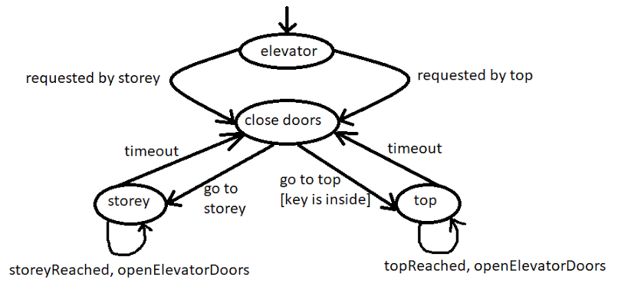
State versus Sequence constraints
So far, we only restricted constraints on state (pre and post) of the program
Sometimes, we need to restrict the order in which operations occur
Finite State Machine

Slide 29
Specification Languages
Various formalisms for specifying constraints. For example:
Finite State Machine (FSM)
Regular Expression (RE)
Linear Temporal Logic (LTL)

Slide 30
Runtime Verification (RV)
Technique [1, 2] that monitors formally-specified software properties
Developer writes spec in some language (e.g., FSM)
Compiler adds monitors into the code
Property violation indicates presence of bug in the code or in the spec
[1] F. Chen and G. Rosu, “MOP: An Efficient and Generic Runtime Verification Framework”, OOPSLA 2007
[2] JavaMOP4, “http://fsl.cs.illinois.edu/index.php/JavaMOP4 ”

Slide 31
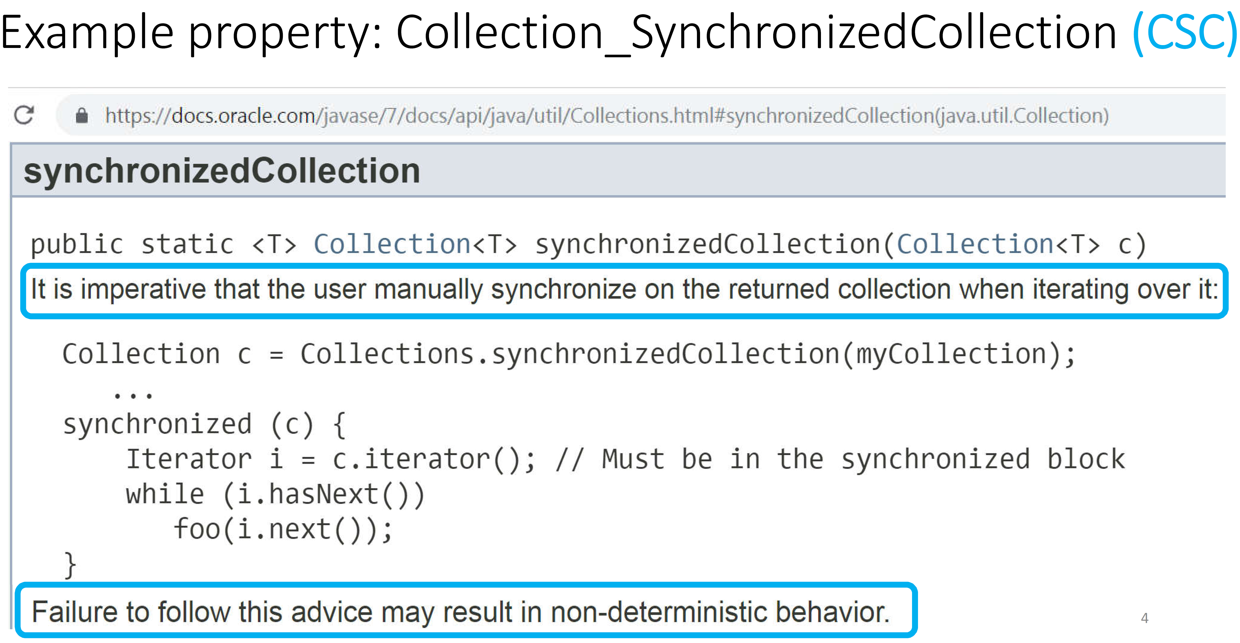

Slide 32
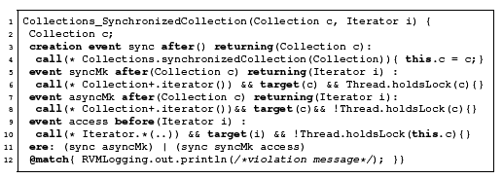
JavaMOP Example
Property about synchronized collection objects, from java.util.Collections [1]
[1] C. Lee, D. Jin, F. Chen, and G. Rosu, “Towards Categorizing and Formalizing the JDK API”, U. of Illinois TR 2012

Slide 33
JavaMOP Example
Event definitions

Slide 34
JavaMOP Example
Specification

Slide 35
JavaMOP Example
Handler

Slide 36
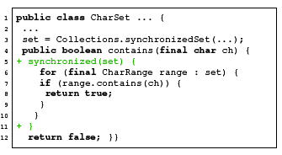
JavaMOP Example
Code from Apache Commons Lang Library
Violation! Attempt to iterate through a synchronized set without proper synchronization

Slide 37
JavaMOP Example
Code from Apache Commons Lang Library
Fix

Slide 38
Exercise
Specify that the number of calls to pop cannot exceed the number of calls to push on any given Stack
class java.util.Stack<T> ... {
void push(T t);
T pop()
}
PropertyDB: https://runtimeverification.com/monitor/propertydb/

Slide 39
Exercise
Implement your own stack
Implement methods that violate our spec (see previous exercise)
Define spec in JavaMOP (see installation instructions)
Check if spec is violated as expected

