Slide 1



Gender Neutrality and Inclusion
Name: Avijeet Ranawat

Slide 2
Problem Statement
XyX corporation recruits employees for fixed Job Codes every year. Basis the applications received last year for each job code profile, a ‘fitment %’ percentage was determined based on selections made. XyX followed a fair and equitable approach by personally looking at all parameters and determining the right fit. This year the number of applicants has multiplied and they are looking at an ML model to predict the ‘fitment %’ for the applications received maintaining a fair and equitable approach.

Slide 3
Tasks
Build a model that calculates the ‘fitment %’ & detects the factor that influences relevancy and making sure that factor does not introduce inequality and/or bias in the’ fitment %’ by appropriate feature re-engineering.

Slide 4
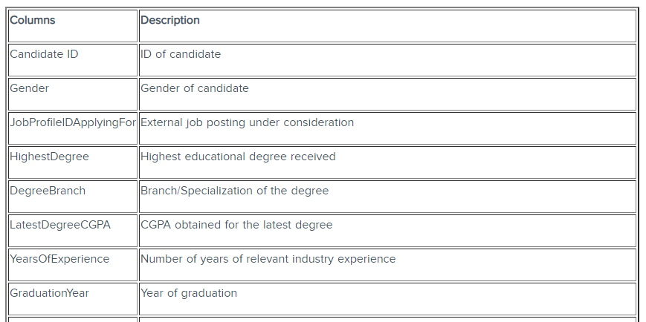
Data

Slide 5
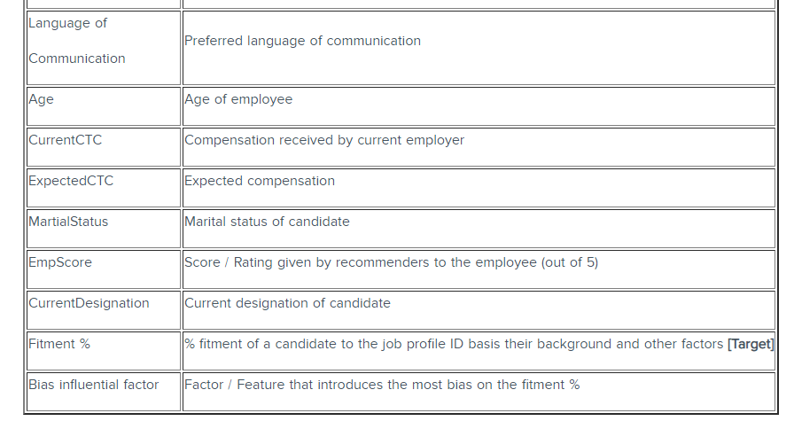
Data

Slide 6
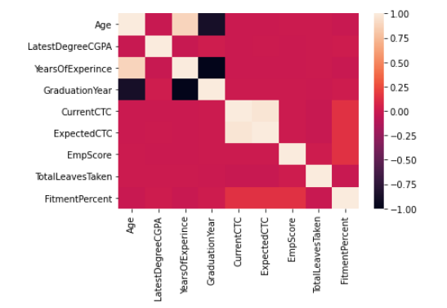
Correlation chart
Certain features were redundant due to their correlation, they are not considered further. Ex: GraduationYear with Age, Expected CTC with Current CTC

Slide 7
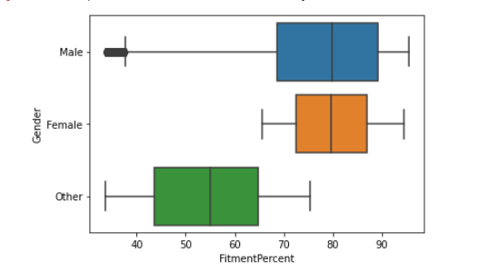
Gender Bias
The ‘Other’ class gender are seen to have been less in terms of fitment according to stats of previous year.

Slide 8
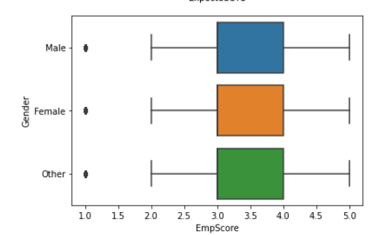
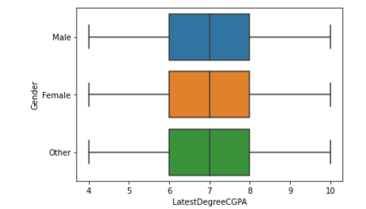
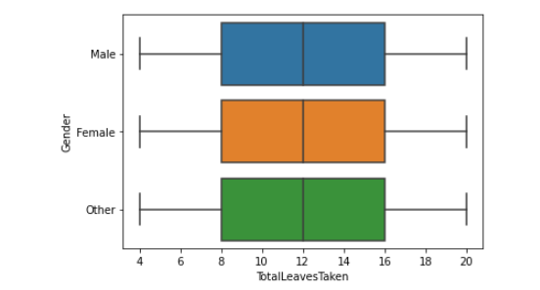
Though the ‘Other’ class is equally qualified in terms of LatestDegreeCGPA, or EmpScore, or the TotalLeavesTaken.

Slide 9
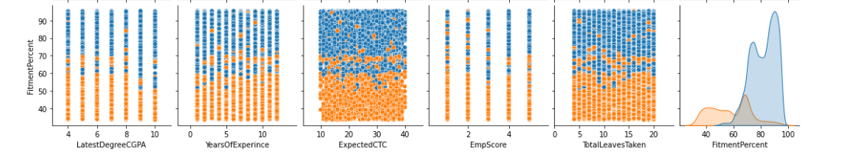
Unknown Data for Bias
The data without any identified bias has a huge drop in fitment indicated by the orange part below.

Slide 10
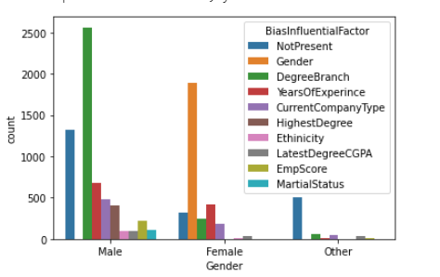
Data Insights
For IT professionals with degree in 'Computer Science’, 'Information Technology’, 'Artificial Intelligence’ different gender had different main reasons for their selection.
Like for ‘Male’ candidates their Degree Branch made them stand out.
While for ‘Female’ candidates their gender also contributed majorly in selection.

Slide 11
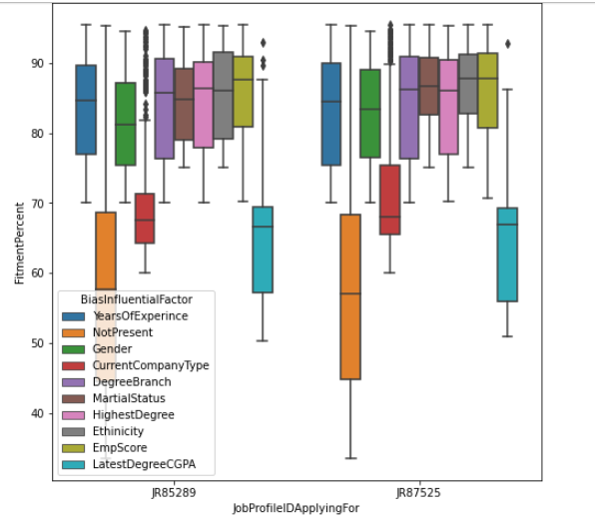
For certain Job ID’s we can see that the hiring was done on based on ‘Latest Degree CGPA’ and ‘Current Company Type’ but they turned out to be not that good factor in fitment.

Slide 12
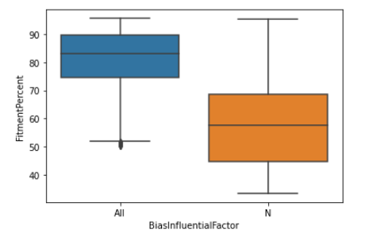
The unknown Bias values were having large difference in fitment score compared to known bias.
Even if all the other values were remain constant, for the same “Emp score” and “Current company type”, the fitment scores vary between the ‘Unknown’(Orange in figure) and all other bias(Blue in figure). Below figure signifies the same.

Slide 13

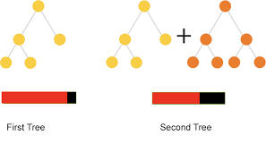
Classifier Model
For predicting the “Bias Influential Factors” a classification model was created.
Multiclass CatBoost Classifier model was created for this task.

Slide 14
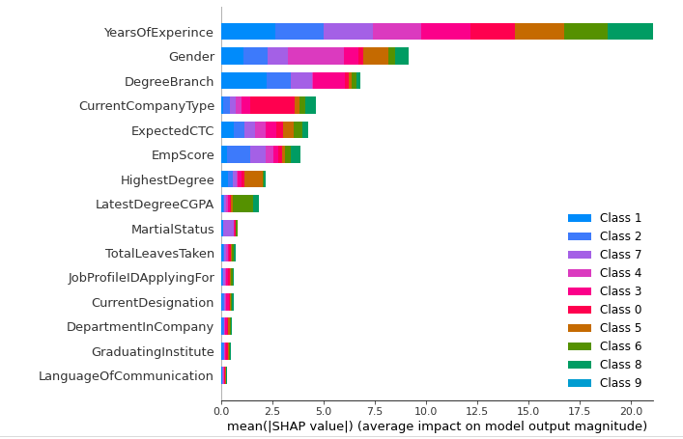
Bias Insights
Top 3 features which were recognized as the important features by our model were:
Experience, Gender, Degree Branch for the candidates.

Slide 15
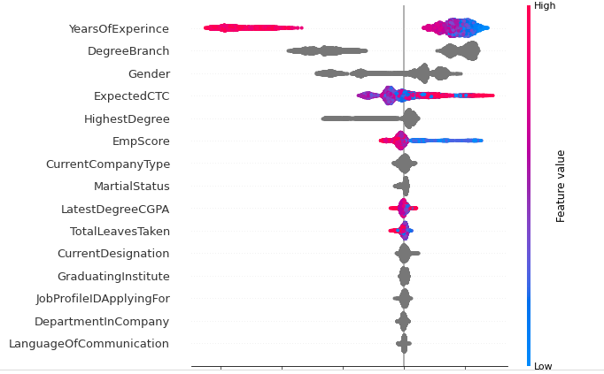
The Bias values which were blank in data and not identified previously, were mainly influenced by below top features.

Slide 16
Regression Model
For predicting the ‘Fitment %’ of the candidates a regression model was created.
CatBoost Regression model was created for this task.

Slide 17
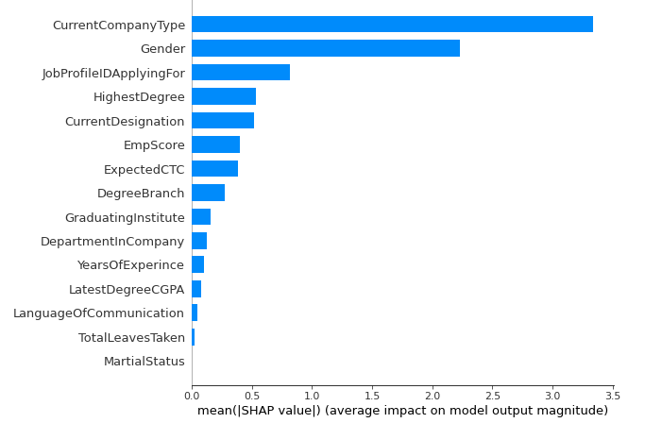
Fitment Insights
Top 2 features which were recognized as the important features by our model were:
Current company type and Gender. Surprisingly Experience was way low in it.

Slide 18
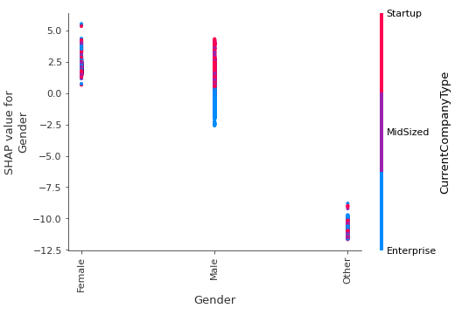
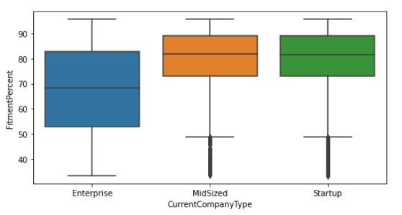
The “Current company type” feature was dominant in our fitment criteria, and mainly it indicated that ‘Enterprise’ candidates were not having good fitment. (Left Figure)
And because the Gender class ‘Other’ were mainly in the ‘Enterprise’ they were having less fitment scores. (Right Figure)

Slide 19
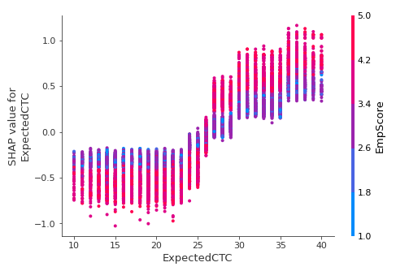
Other Insights
Employees who got high score by their recommender, Demand more Expected CTC.
So to get the quality candidates, company would need to give a higher CTC, as what also happens generally.

Slide 20
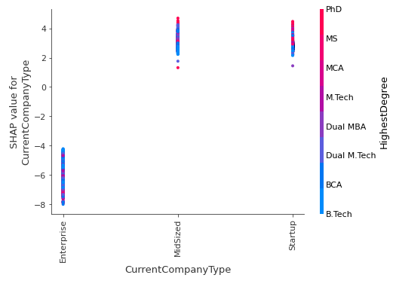
The Higher degree was mainly absent from the candidates with ‘Enterprise’ as current company type.
This may be the reason for their less fitment %
Also ‘Other’ class gender candidates are mainly from enterprise, they also lack the Higher degree. Leading to less fitment.

Slide 21
Thanks!!

