Slide 1
Digital Twins Pegatron Backend RestFul Testing
黃昱叡

Slide 2


System Structure
response
main
request
FastAPI Web Project
http://127.0.0.1:8080/docs
Routes
Services
Models
Swagger

Slide 3
RESTFUL API
POST | @router.post(“/users”) | Add New User
GET | @router.get(“/users”) | Get User List
DELETE | @router.delete(“/users/{username}”) | Delete User
POST | @router.post(“/users/upload”) | Upload the CSV File and Add New User
GET | @router.get(“/users/average”) | Calculate the average of each group

Slide 4
Post Add New User
Case | Request | Response Message | Response Status Code | Comment
Case 1 | User(str: “User”, int : 10) | Add User Successfully | 200 | Normal Case
Case 2 | User(str: “User”, int : “10”) | Add User Successfully | 200 | Age is number (string type)
Case 3 | User(str: “User”, int : “ab”) | Input should be a valid integer | 422 | Age is not number
Case 4 | User(str: “User”, int : -1) | Age must be greater than 0 | 422 | Age <= 0

Slide 5
Post Add New User
Case | Request | Response Message | Response Status Code | Comment
Case 5 | User(str: “ User ”, int : 10) | Add User Successfully | 200 | There are spaces before or after the Name
Case 6 | User(str: “”, int : 12) | Name cannot be Empty | 200 | Name is Empty
Case 7 | User(str: “ ”, int : 12) | Name cannot be Empty | 422 | Name is Empty
Case 8 | User(str: 123, int : 12) | Input Should be a valid String | 422 | Name is not string
Case 9 | User(str: “User”, int : 12) | Add User Successfully | 200 | If “User” already exists in the user List, then update the age.

Slide 6
Post Add New User
Case | Request | Response Message | Response Status Code | Comment
Case 10 | User(X, int : 10) | Field required | 422 | Name Field doesn't exist
Case 11 | User(str: “”, X) | Field required | 422 | Age Field doesn't exist
Case 12 | User(X, X) | Field required | 422 | Neither the name nor the age field exists

Slide 7
Get User List
Case | Request | Response Message | Response Status Code | Comment
Case 1 | X | X | 200 | Get User List

Slide 8
Delete User
Case | Request | Response Message | Response Status Code | Comment
Case 1 | Username = ‘User’ | Delete User Successfully | 200 | “User” exist in the User List
Case 2 | Username = ‘User’ | User does not exist | 200 | “User” does not exist in the User List

Slide 9
Test Files
test_NotAllAgeIsValid.csv
Name | Age
Alice | ab
Bob | 11
Charlie | 12
test_InvalidDataMix.csv
Name | Age
Alice | ab
 | 11
John
Charlie | -5
“ “ | 3
User | 30
backend_users.csv
test_NotAllAgeIsValid.csv
test_NotAllNameIsValid.csv
test_InvalidDataMix.csv
test_onlyNameField.csv
test_NoLabelData.csv
test_emptyFile.csv
test_PDF.pdf
test_NotAllNameIsValid.csv
Name | Age
Alice | 13
 | 11
Charlie | 12
“ “ | 25
test_onlyNameField.csv
Name
Alice
Bob
test_NoLabelData.csv
Alice | ab
Bob | 11
Charlie | 12
test_emptyFile.csv

Slide 10
Upload CSV and Add User
Case | Request | Response Message | Response Status Code | Comment
Case 1 | backend_users.csv | Add Users From CSV Successfully | 200 | All Valid Data in CSV File
Case 2 | test_NotAllAgeIsValid.csv | Add Users From CSV Successfully | 200 | Only Store Valid Data
Case 3 | test_NotAllNameIsValid.csv | Add Users From CSV Successfully | 200 | Only Store Valid Data
Case 4 | test_InvalidDataMix.csv | Add Users From CSV Successfully | 200 | Only Store Valid Data

Slide 11
Upload CSV and Add User
Case | Request | Response Message | Response Status Code | Comment
Case 5 | test_emptyFile.csv | No columns to parse | 422 | Empty CSV File
Case 6 | test_onlyNameField.csv | Age | 422 | Age Label is not in CSV
Case 7 | test_NoLabelData.csv | Name | 422 | No Label in CSV
Case 8 | test_PDF.pdf | Only CSV files are allowed | 400 | Not CSV File

Slide 12
Calculate Average of each group
Case | Request | Response Result | Response Status Code | Comment
Case 1 | backend_users.csv | {…} / 14 groups | 200 | Group and calculate the average
Case 2 | test_NotAllAgeIsValid.csv | {…} / 2 groups | 200 | Group and calculate the average (only valid data)
Case 3 | test_NotAllNameIsValid.csv | {…} / 2 groups | 200 | Group and calculate the average (only valid data)
Case 4 | test_InvalidDataMix.csv | {…} / 1 groups | 200 | Group and calculate the average (only valid data)

Slide 13
Calculate Average of each group
Case | Request | Response Result | Response Status Code | Comment
Case 5 | test_emptyFile.csv | {} / 0 groups | 200 | No any data
Case 6 | test_onlyNameField.csv | {} / 0 groups | 200 | No Age Data
Case 7 | test_NoLabelData.csv | {} / 0 groups | 200 | No Label in CSV
Case 8 | test_PDF.pdf | {} / 0 groups | 200 | Not CSV File

Slide 14


Coverage Report
Test Statements
Project Statements
279
82
Test Cases
Code Coverage
31
100 %

Slide 15
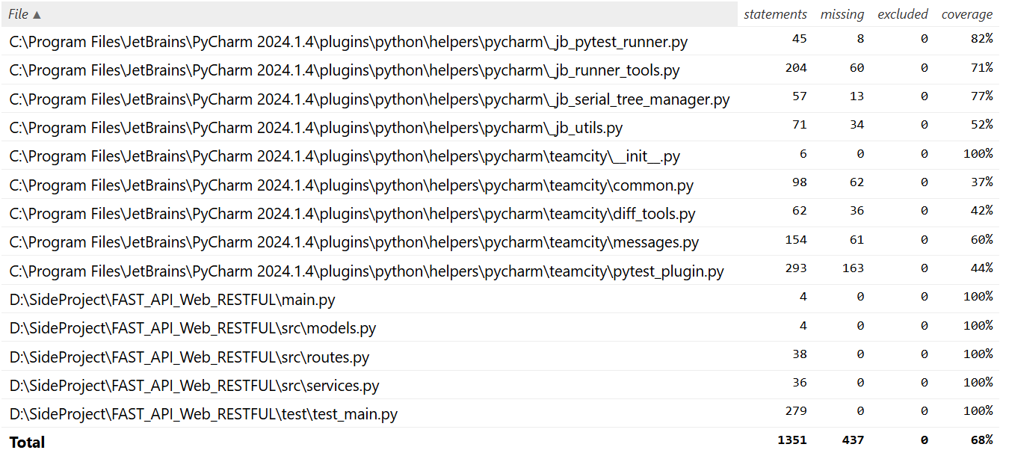
Coverage Report

Slide 16
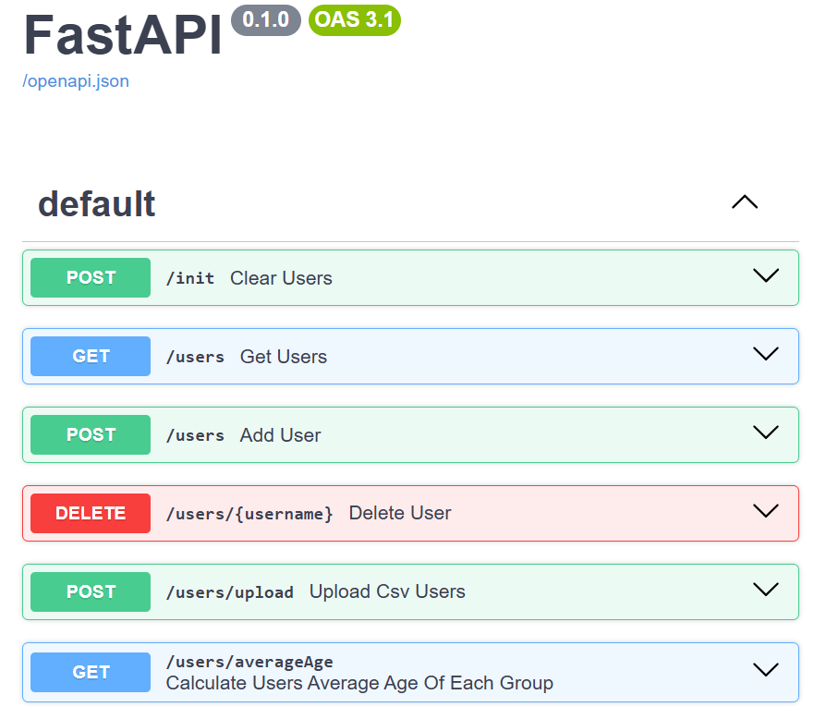
Swagger RESTFUL API

Slide 17
Reference
https://fastapi.tiangolo.com/
https://linyencheng.github.io/2021/10/08/python-fast-api/
https://swagger.io/tools/swagger-ui/
https://medium.com/seaniap/python%E6%96%B0%E6%89%8B%E7%9A%84fastapi%E4%B9%8B%E6%97%853-fastapi%E5%BB%BA%E6%A7%8B%E8%B7%AF%E7%94%B1-dd02c002ef65
https://developer.mozilla.org/en-US/docs/Web/HTTP/Guides/MIME_types/Common_types

Slide 18
Thank you for Listening

