Slide 1
Digital Twins Pegatron Backend RestFul Testing
黃昱叡

Slide 2
Requirement
A POST API to create a user with “name” and “age” fields.
A DELETE API to delete a specific user.
A GET API to get a list of users who have been added.
A POST API to add multiple users from CSV file. 1. The CSV file should be uploaded in API request. 2. Refer to the attached CSV file: backend_users.csv
A GET API to calculate average age of each group of users. 1. Please use Pandas package to render it. 2. Group by the first character of the usernames.
Please live demonstrate your API specifications by using Swagger.

Slide 3



System Structure
response
main
request
http://127.0.0.1:8080/docs
FastAPI Web Project
Routes
Services
Models
Swagger

Slide 4
Improvement
【DELETE】Set the Status code 404 (Not Found) if user name doesn’t exist in the user list.
【POST】Test Age Field (Float Number / String Number with Space)
【POST】If user name already exist in the user list, return the status code 409 (conflict)
【PUT】Add PUT API to update the age of user name

Slide 5
RESTFUL API
POST | @router.post(“/users”) | Add New User
GET | @router.get(“/users”) | Get User List
DELETE | @router.delete(“/users/{username}”) | Delete User
POST | @router.post(“/users/upload”) | Upload the CSV File and Add New User
GET | @router.get(“/users/average”) | Calculate the average of each group
PUT | @router.put(“/users) | Update the age of username

Slide 6
POST - Add New User
Case | Request (JSON) | Response Message | Response Status Code | Comment
Case 1 | User(str: “User”, int : 10) | Add User Successfully | 200 | Normal Case
Case 2 | User(str: “User”, int : “10”) | Add User Successfully | 200 | Age is number (string type)
Case 3 | User(str: “User”, int : “ab”) | Input should be a valid integer | 422 | Age is not a number
Case 4 | User(str: “User”, int : -1) | Age must be greater than 0 | 422 | Age <= 0

Slide 7
POST - Add New User
Case | Request (JSON) | Response Message | Response Status Code | Comment
Case 5 | User(str: “ User ”, int : 10) | Add User Successfully | 200 | There are spaces before or after the Name
Case 6 | User(str: “”, int : 12) | Name cannot be Empty | 422 | Name is Empty
Case 7 | User(str: “ ”, int : 12) | Name cannot be Empty | 422 | Name is Empty (Multiple Space)
Case 8 | User(str: 123, int : 12) | Input Should be a valid String | 422 | Name is not string
Case 9 | User(str: “User”, int : 12) | Add User Successfully | 200 | If “User” already exists in the user List, then update the age.

Slide 8
POST - Add New User (V2)
Case | Request (JSON) | Response Message | Response Status Code | Comment
Case 9 | User(str: “User”, int : 12) | Add User Successfully | 200 | If “User” already exists in the user List, then update the age.
Case 9 | User(str: “User”, int : 12) | User already exist | 409 | “User” already exists in the user List

Slide 9
POST - Add New User
Case | Request (JSON) | Response Message | Response Status Code | Comment
Case 10 | User(X, int : 10) | Field required | 422 | Name Field doesn't exist
Case 11 | User(str: “User”, X) | Field required | 422 | Age Field doesn't exist
Case 12 | User(X, X) | Field required | 422 | Neither the name nor the age field exists

Slide 10
POST - Add New User (V2)
Case | Request (JSON) | Response Message | Response Status Code | Comment
Case 13 | User(str:”User”, float:10.0) | Add User Successfully | 200 | Age is float (Integer) number
Case 14 | User(str:”User”, float:10.5) | Input should be a valid integer | 422 | Age is float (Not Integer) number
Case 15 | User(str:”User”,str:” 10 “) | Add User Successfully | 200 | There are spaces before or after the Age.
Case 16 | User(str:”User”, str:” 1 0 “) | Input should be a valid integer | 422 | There are spaces in the middle

Slide 11
PUT – Update the age of username (V2)
Case | Request (Name) | Response Message | Response Status Code | Comment
Case 1 | User(“User”, 30) | Update User Successfully | 200 | “User” already exist in the User List
Case 2 | User(“User”, 30) | User does not exist | 404 | “User” does not exist in the User List

Slide 12
GET - Get User List
Case | Request | Response Result | Response Status Code | Comment
Case 1 | client.get("/users") | [….] | 200 | Get User List

Slide 13
POST - Clear User List
Case | Request | Response Message | Response Status Code | Comment
Case 1 | client.post("/init") | Clear User List Successfully | 200 | Clear User List

Slide 14
DELETE - Delete User (V2)
Case | Request (Name) | Response Message | Response Status Code | Comment
Case 1 | Username = ‘User’ | Delete User Successfully | 200 | “User” exist in the User List
Case 2 | Username = ‘User’ | User does not exist | 404 | “User” does not exist in the User List

Slide 15
Test Files
test_NotAllAgeIsValid.csv
Name | Age
Alice | ab
Bob | 11
Charlie | 12
test_InvalidDataMix.csv
Name | Age
Alice | ab
 | 11
John
Charlie | -5
“ “ | 3
User | 30
backend_users.csv
test_NotAllAgeIsValid.csv
test_NotAllNameIsValid.csv
test_InvalidDataMix.csv
test_onlyNameField.csv
test_NoLabelData.csv
test_emptyFile.csv
test_PDF.pdf
test_NotAllNameIsValid.csv
Name | Age
Alice | 13
 | 11
Charlie | 12
“ “ | 25
test_onlyNameField.csv
Name
Alice
Bob
test_NoLabelData.csv
Alice | ab
Bob | 11
Charlie | 12
test_emptyFile.csv

Slide 16
POST - Upload CSV and Add User
Case | Request (File) | Response Message | Response Status Code | Comment
Case 1 | backend_users.csv | Add Users From CSV Successfully (34/34) | 200 | All Valid Data in CSV File
Case 2 | test_NotAllAgeIsValid.csv | Add Users From CSV Successfully (2/3) | 200 | Only Store Valid Data
Case 3 | test_NotAllNameIsValid.csv | Add Users From CSV Successfully (2/4) | 200 | Only Store Valid Data
Case 4 | test_InvalidDataMix.csv | Add Users From CSV Successfully (1/6) | 200 | Only Store Valid Data

Slide 17
POST - Upload CSV and Add User
Case | Request (File) | Response Message | Response Status Code | Comment
Case 5 | test_emptyFile.csv | No columns to parse | 422 | Empty CSV File
Case 6 | test_onlyNameField.csv | Age | 422 | Age Label is not in CSV
Case 7 | test_NoLabelData.csv | Name | 422 | No Label in CSV
Case 8 | test_PDF.pdf | Only CSV files are allowed | 400 | Not CSV File

Slide 18
GET - Calculate Average of each group
Case | Request | Response Result | Response Status Code | Comment | Test File
Case 1 | client.get("/users/averageAge") | {…} / 14 groups | 200 | Group and calculate the average (all valid data) | backend_users.csv
Case 2 |  | {…} / 2 groups | 200 | Group and calculate the average (only valid data) | test_NotAllAgeIsValid.csv
Case 3 |  | {…} / 2 groups | 200 | Group and calculate the average (only valid data) | test_NotAllNameIsValid.csv
Case 4 |  | {…} / 1 groups | 200 | Group and calculate the average (only valid data) | test_InvalidDataMix.csv

Slide 19
GET - Calculate Average of each group
Case | Request (File) | Response Result | Response Status Code | Comment | Test File
Case 5 | client.get("/users/averageAge") | {} / 0 groups | 200 | No any data | test_emptyFile.csv
Case 6 |  | {} / 0 groups | 200 | No Age Data | test_onlyNameField.csv
Case 7 |  | {} / 0 groups | 200 | No Label in CSV | test_NoLabelData.csv
Case 8 |  | {} / 0 groups | 200 | Not CSV File | test_PDF.pdf

Slide 20


Coverage Report
Test Statements
Project Statements
337
105
Test Cases
Code Coverage
38
100 %

Slide 21
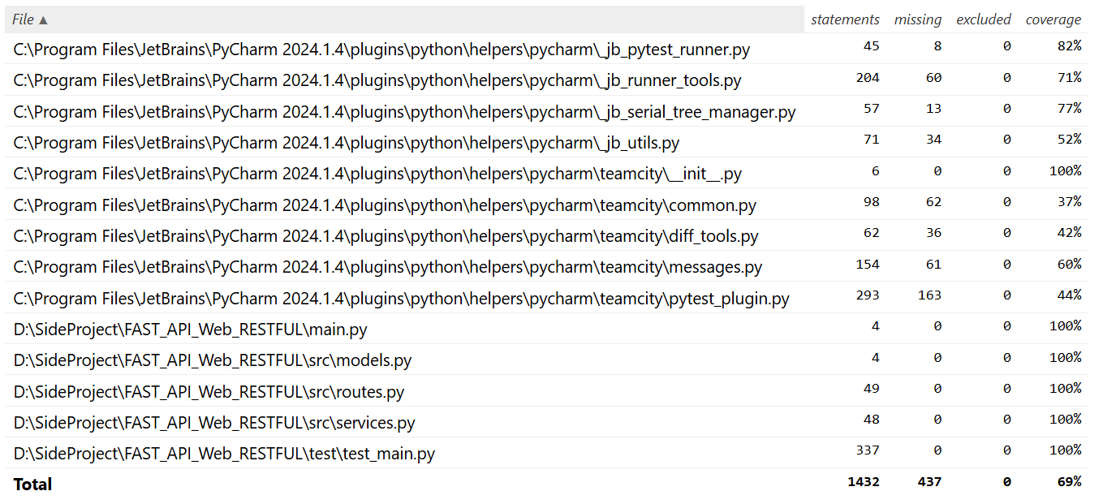
Coverage Report

Slide 22
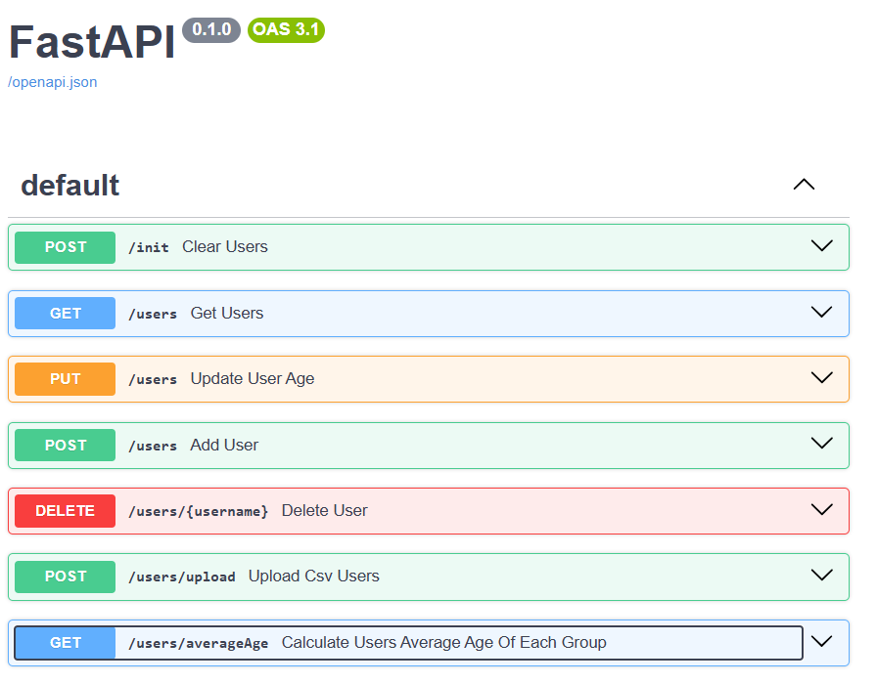
Swagger RESTFUL API

Slide 23
Reference
https://fastapi.tiangolo.com/
https://linyencheng.github.io/2021/10/08/python-fast-api/
https://swagger.io/tools/swagger-ui/
https://medium.com/seaniap/python%E6%96%B0%E6%89%8B%E7%9A%84fastapi%E4%B9%8B%E6%97%853-fastapi%E5%BB%BA%E6%A7%8B%E8%B7%AF%E7%94%B1-dd02c002ef65
https://developer.mozilla.org/en-US/docs/Web/HTTP/Guides/MIME_types/Common_types

Slide 24
Thank you for Listening

