Slide 1
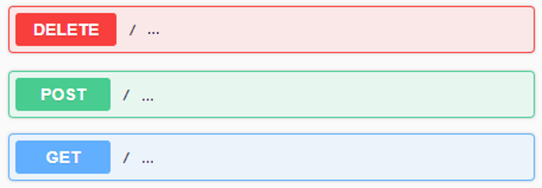
Practice
Create a web application with following RESTful APIs:
A POST API to create a user with “name” and “age” fields.
A DELETE API to delete a specific user.
A GET API to get a list of users who have been added.
A POST API to add multiple users from CSV file.
The CSV file should be uploaded in API request.
Refer to the attached CSV file: backend_users.csv
A GET API to calculate average age of each group of users.
Please use Pandas package to render it.
Group by the first character of the usernames.
Write unittest to validate your codes
Calculate test coverage
Example
Note
Please live demonstrate your API specifications by using Swagger.
You can use any libraries or frameworks to render it.
An explanation of your code structure is necessary.

