Slide 1
Logging

Slide 2
Objectives
To enable consistent logging within a service
To enable sending of transaction Id and PF across services

Slide 3
Current Issues
Logging is not consistent
Less logging statements for new code
Difficult to enforce
Traditional logging methods
Code Tangling: Business logic mixed with logging calls. This makes the core logic harder to read and understand.
Code Scattering: The same logging code is repeated across all methods.
High Maintenance Cost: If you need to change the logging format or contents, you have to find and modify every single method.

Slide 4
AOP Logging
Allows you to separate your logging code from your core business logic
Simply define "advice" (the logging code) and "pointcuts" (where the advice should be applied) in a central, reusable module called an "aspect".

Slide 5
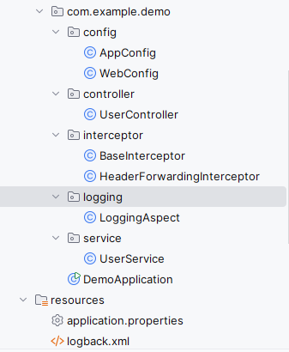
Setup for Logging
3) Register BaseInterceptor and endpoint path pattern
2) Retrieve/define tx ID and PF and add to MDC
1) Define log message and where to apply logging
4) Define log format and placeholders for MDC data

Slide 6
Setup for Header Forwarding
2) Adds Header Interceptor to RestTemplate, which makes the outbound call
1) Kicks in before the outbound call and adds MDC data to the request header.

