Slide 1
Decentralised Voting System
Presented by Group 2

Slide 2
Decentralised Voting System - Presented by Group 2
About Project
A decentralized
voting application built with a Solidity smart contract
on Ethereum,
a Python/FastAPI backend,
and a JavaScript/Web3 frontend.

Slide 3
Decentralised Voting System - Presented by Group 2
Purpose of the Project
To demonstrate
how blockchain can make voting
tamper-proof and transparent,
removing the need for a central authority to count or validate votes.

Slide 4
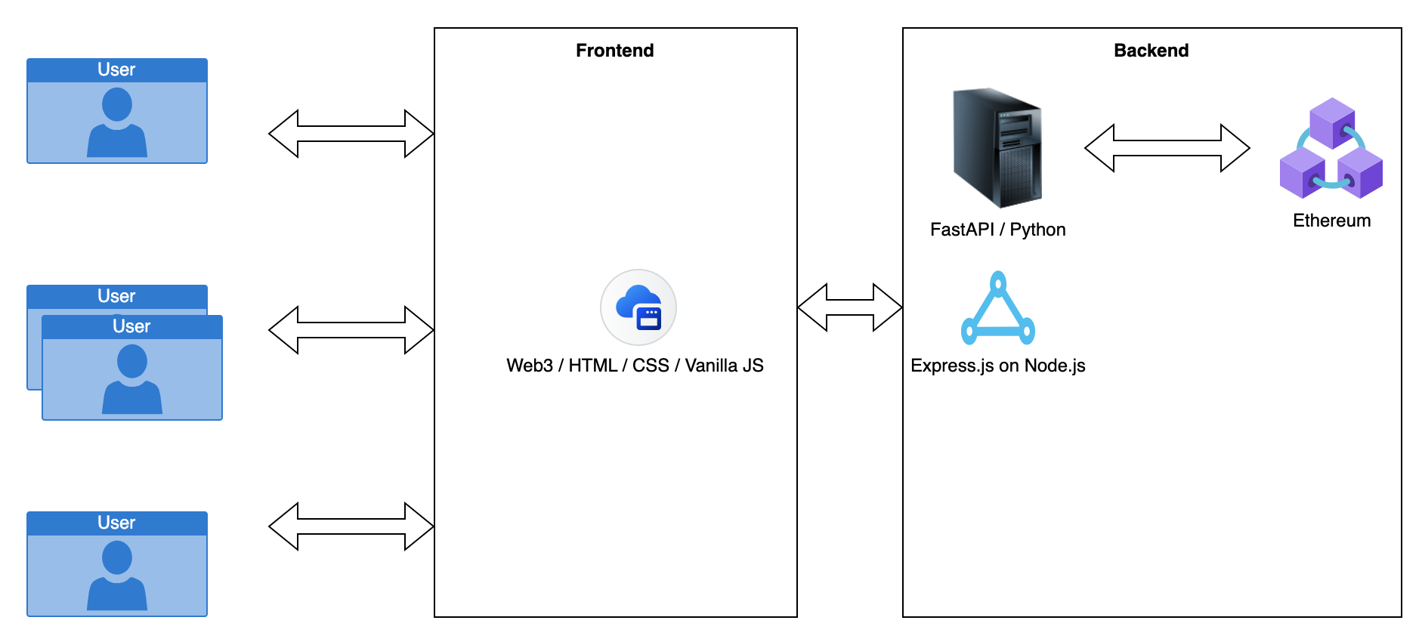
Decentralised Voting System - Presented by Group 2
Technical stack

Slide 5
Decentralised Voting System - Presented by Group 2
Issues
Passing passwords in plain text
Storing passwords in plain text
Bearer token needs review
No access control in the contract implementation

Slide 6
Decentralised Voting System - Presented by Group 2
Improvements
Project structure
Enhancing security

Slide 7
Decentralised Voting System
Thank You !!!
Presented by Group 2

