Slide 1

Data Analysis
ON
FITNESS APP USERS
Presented by Zaw Min Tun

Slide 2
About Data
About Fitness App Users
200 records
8 features
User ID
Age
Gender
Workouts per week
Average session duration (min)
Steps per day
Subscription Type
Churned
Null check: OK
Duplication check: OK
Data anomaly check: 1 record has negative value for Average session duration (minutes)

Slide 3
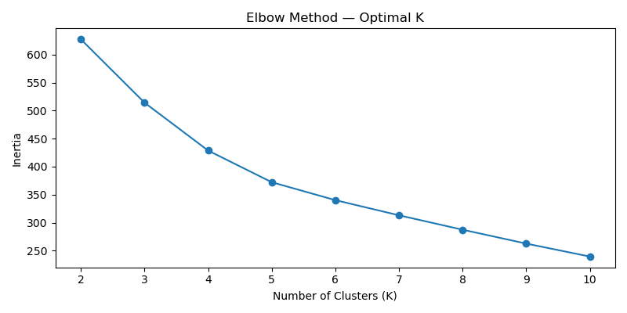
K-MEANS Clustering
Finding K
3

Slide 4

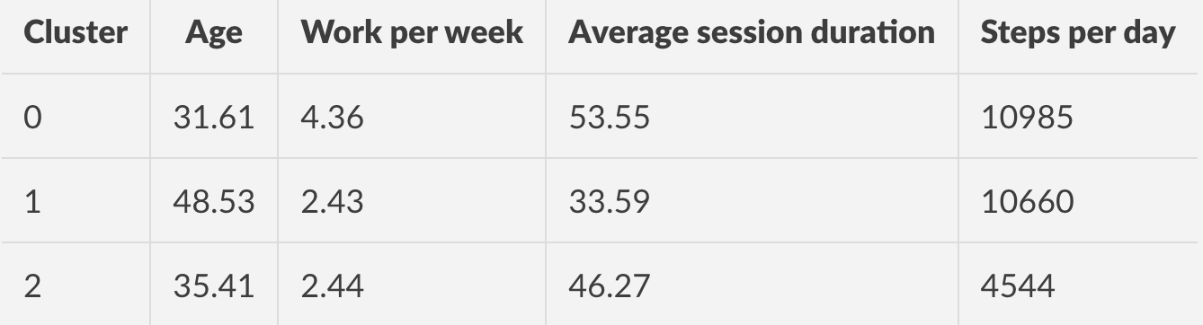
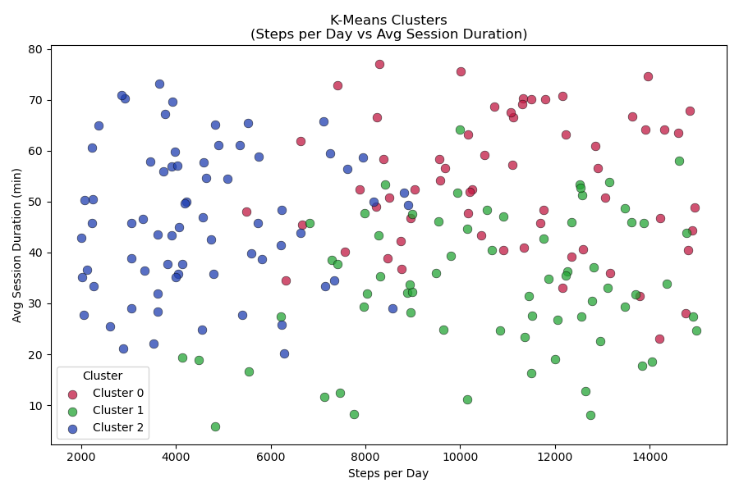
K-MEANS Clustering
Outcome
61 Active Adults
68 Active Mature
70 Easy Adults

Slide 5
Data Analysis
THANK
YOU
THANK
YOU
THANK
YOU
THANK
ON
FITNESS APP USERS
Thank You !!!
Presented by Zaw Min Tun

