Slide 1
Analysis on Wellbeing Data (NZ)
Presented by Zaw Min Tun

Slide 2
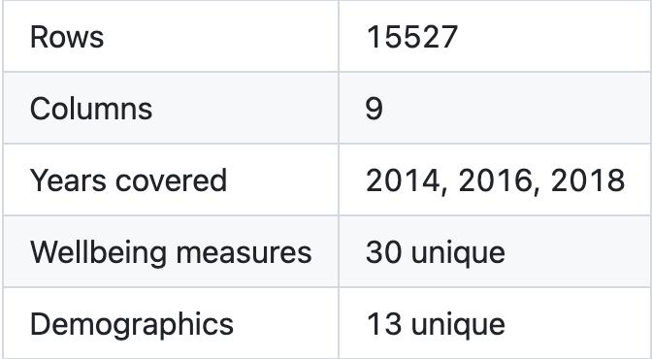
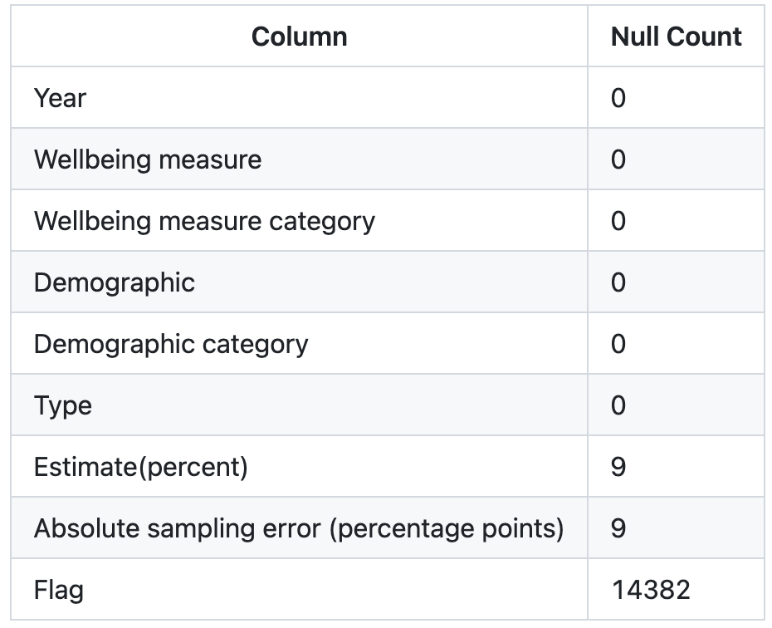
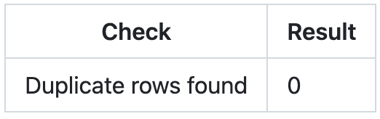
About Data

Slide 3
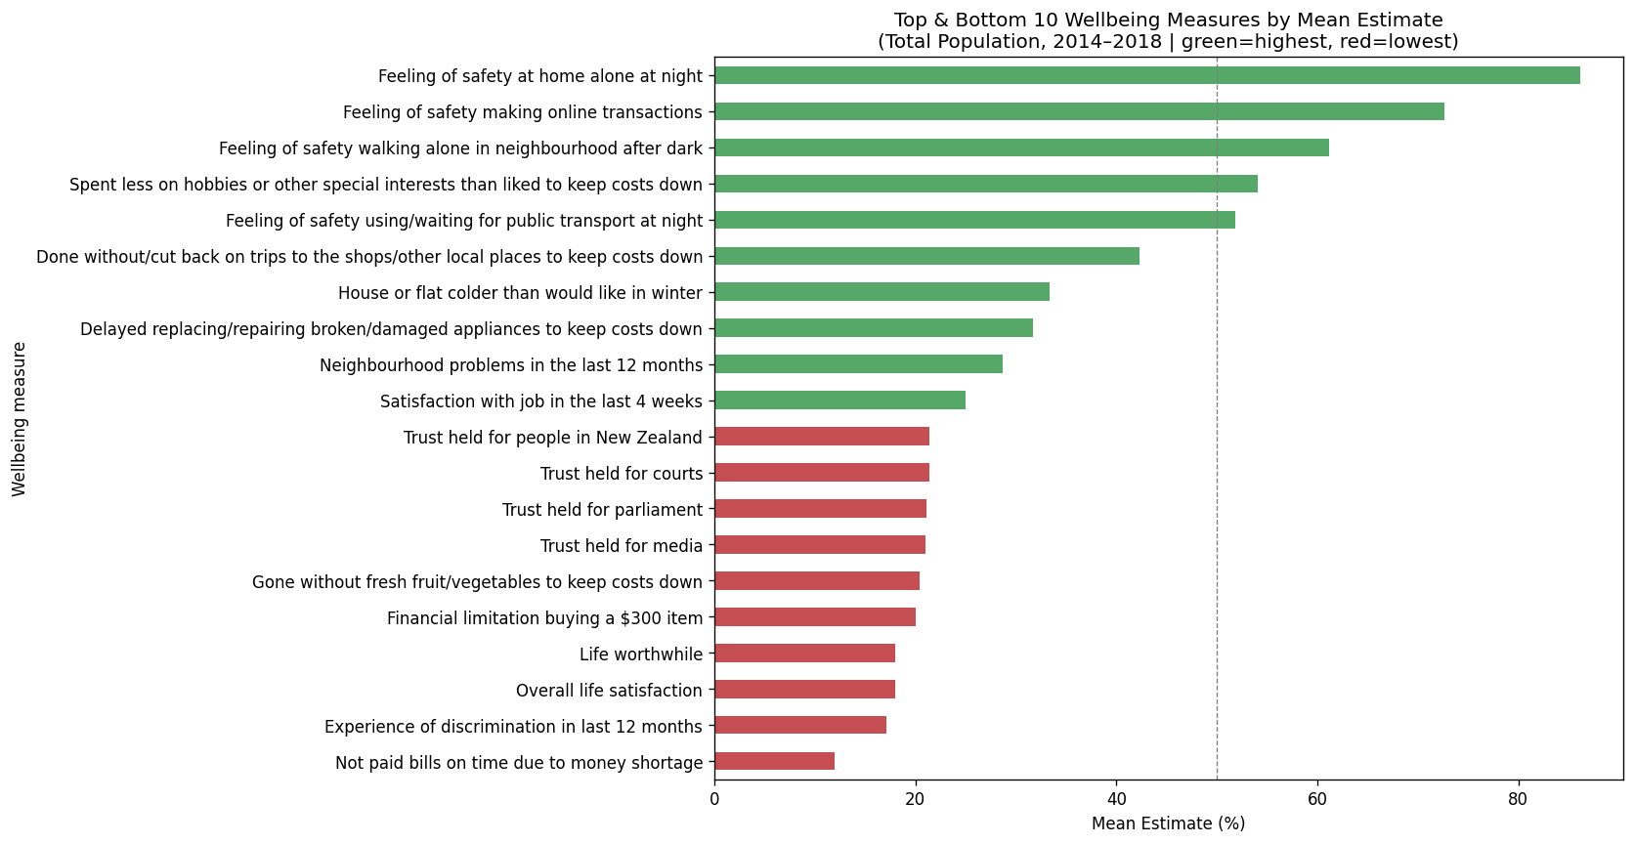
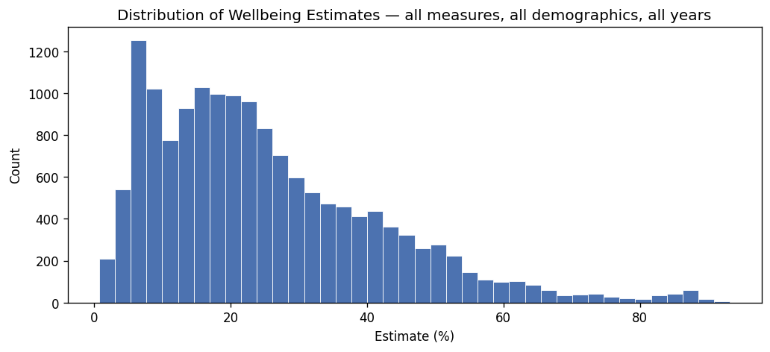
EDA: Wellbeing Estimates — Distribution
Right-skewed: most estimates concentrate in the 5–25% range
Sharp peak at 5–8%: many hardship measures affect a small minority
Sparse right tail (60–90%): only a few safety measures reach this range
Shape is driven by more negatively-framed measures than positive ones

Slide 4
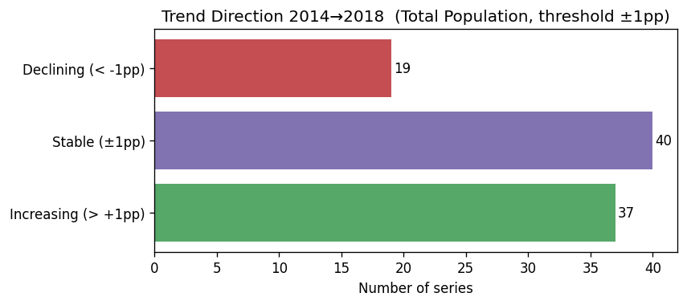
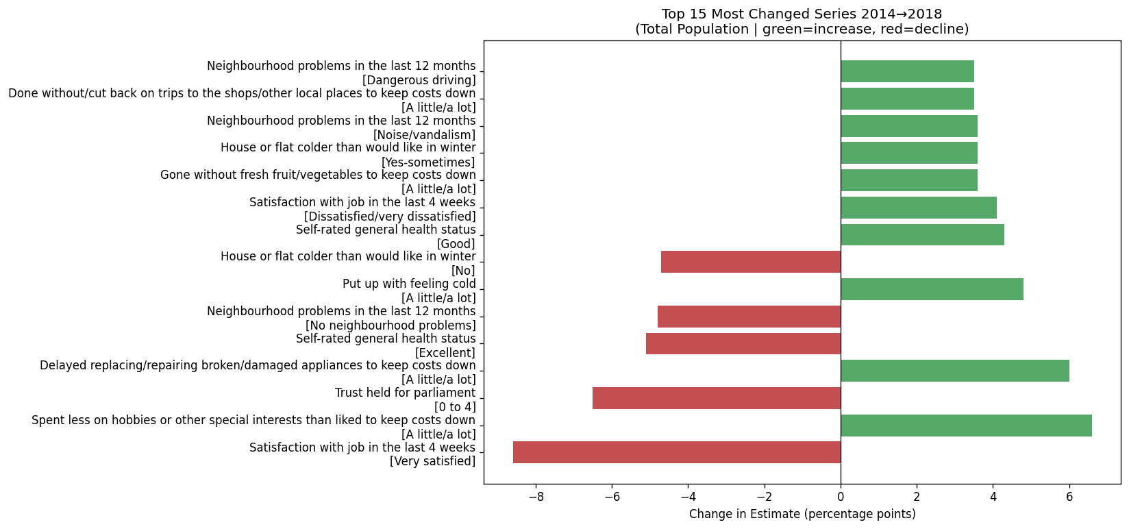
EDA: Trend Direction & Most Changed Series (2014→2018)
• 37 increasing, 40 stable, 19 declining — looks broadly positive
• BUT the largest movers are mostly hardship indicators going up
• Job satisfaction (Very satisfied) fell by 9pp — biggest single drop
• Cost-cutting behaviours (hobbies, repairs, food) rose 5–6.5pp
• Stability in chart 2 masks a real deterioration in quality of life

Slide 5
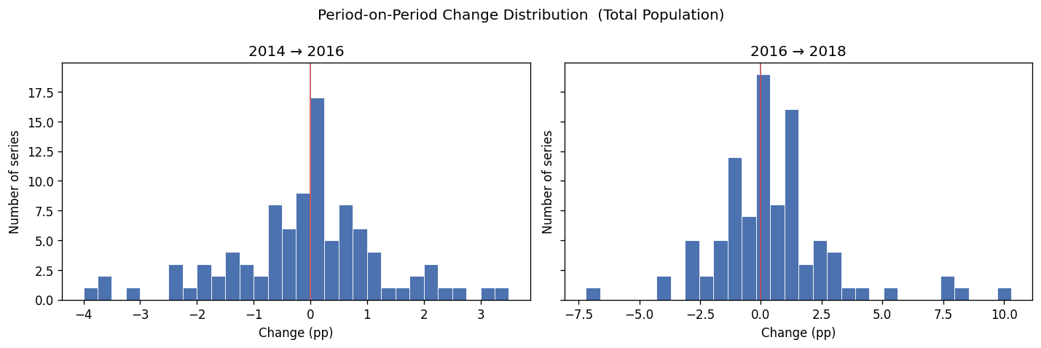
EDA: Period-on-Period Change Distribution (Total Population)
• 2014→2016: narrow spread (within ±2pp) — a calm, stable period
• Most series still clustered near 0 in both periods
• 2016→2018: much wider spread (up to ±10pp) — significantly more volatile
• Rising volatility means 2020 forecasts carry greater uncertainty than a linear trend would suggest

Slide 6
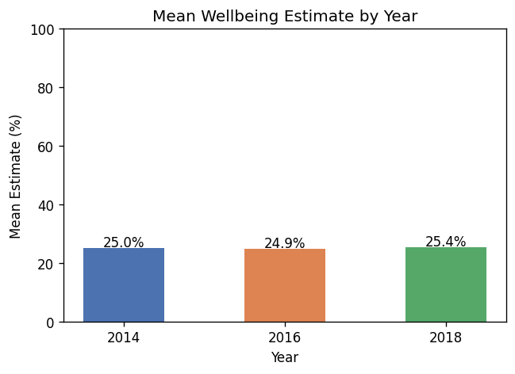
EDA: Overall Wellbeing Trend 2014–2018
• Mean estimate is virtually flat: 25.0% → 24.9% → 25.4%
• Aggregate NZ wellbeing appears stable over this period
• Averaging across all measures cancels out individual trends
• A flat mean does not mean nothing changed — it masks opposing movements
• Measure framing matters: for negative measures, 25% means 75% are unaffected

Slide 7
Analysis on Wellbeing Data (NZ)
Thank You !!!
Presented by Zaw Min Tun

