Slide 1
Data Analysis on Credit Fraud
Presented by Zaw Min Tun

Slide 2
Dataset
About: Credit card transactions
284807 Records
31 Features
Time (Elapsed time from the first transaction)
Amount
Class (1: Fraud, 0: Legit)
The remaining 28 features are values transformed with PCA (For confidentiality)
Data source: https://www.kaggle.com/datasets/mlg-ulb/creditcardfraud
No NULL value
Duplicate records: 1081 (Cleaned up)
Data Analysis on Credit Fraud - presented by Zaw Min Tun

Slide 3
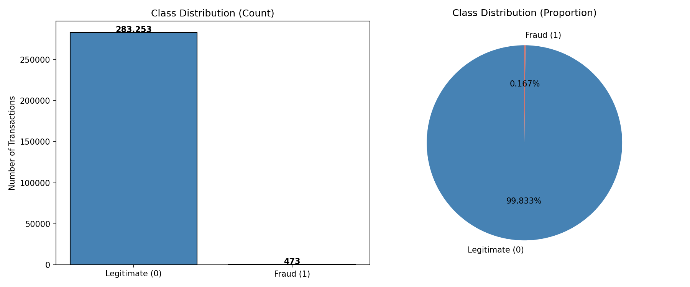
EDA 1 - Class Distribution
Data Analysis on Credit Fraud - presented by Zaw Min Tun

Slide 4
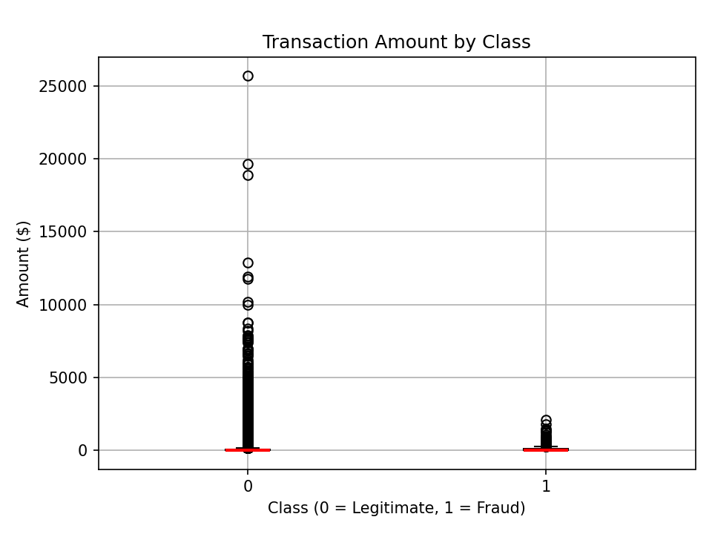
EDA 2 - Boxplot - Amount by Class
Data Analysis on Credit Fraud - presented by Zaw Min Tun
Most transactions are small amount
Many transactions with significantly large amounts are legit
Fraud transactions happen mostly on small amount
Fraud transactions happen up to about 3000 (amount)

Slide 5
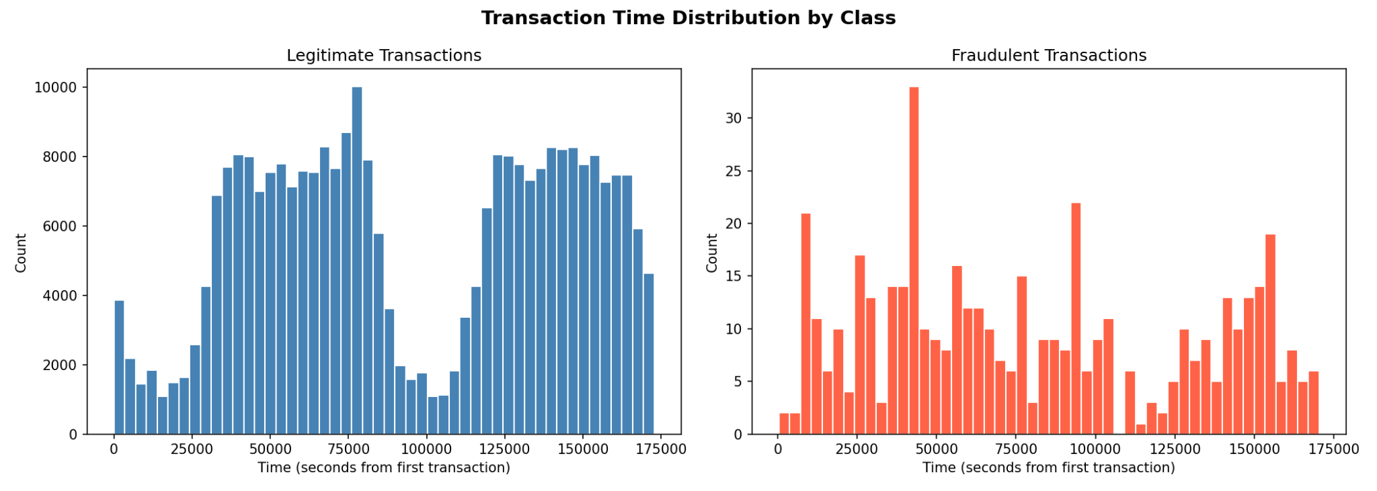
EDA 3 - Time Distribution by Class
FRAUD HAPPENS THROUGHOUT ALMOST THE WHOLE TIME
Data Analysis on Credit Fraud - presented by Zaw Min Tun

Slide 6
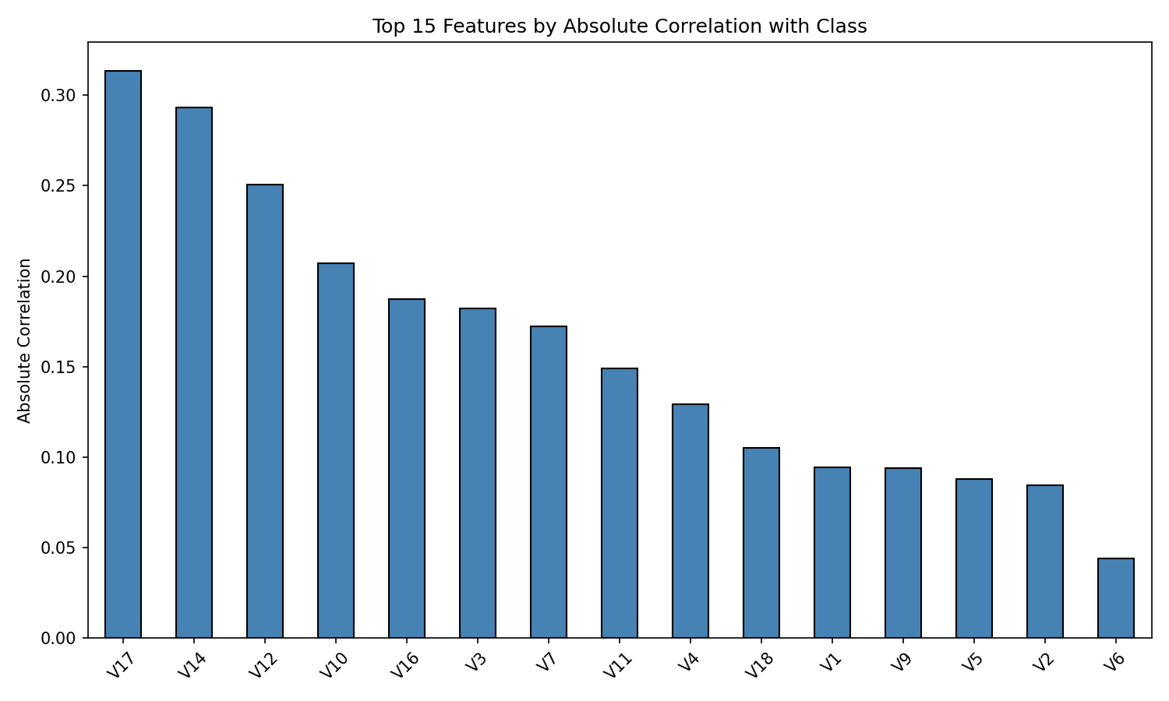
EDA 4 - Top 15 Features (Absolute Correlation with Class)
Data Analysis on Credit Fraud - presented by Zaw Min Tun

Slide 7
ML Model Development
Training / Testing Percentage: 80 / 20
Algorithm: SVM
Method: LinearSVC (Reason: Dataset is large) Class weight: ‘balanced’ (Reason: The Class ratio is highly imbalanced)
Max iteration: 2000
Data Analysis on Credit Fraud - presented by Zaw Min Tun

Slide 8
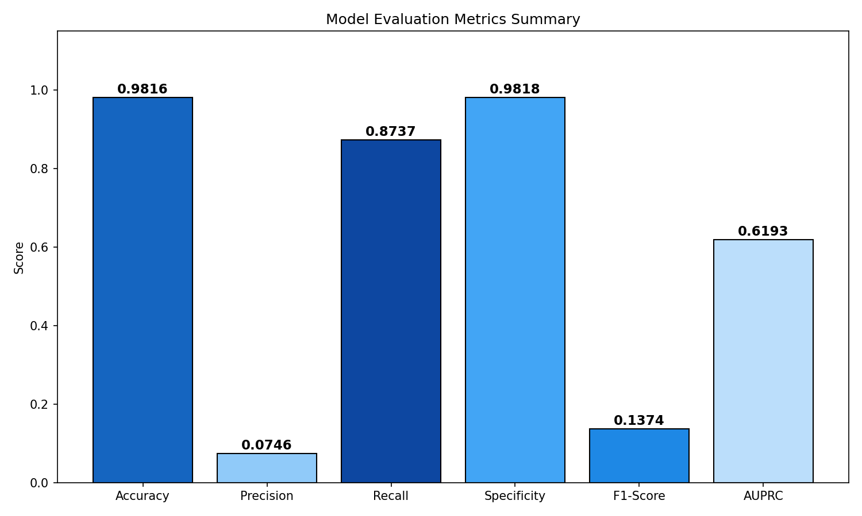
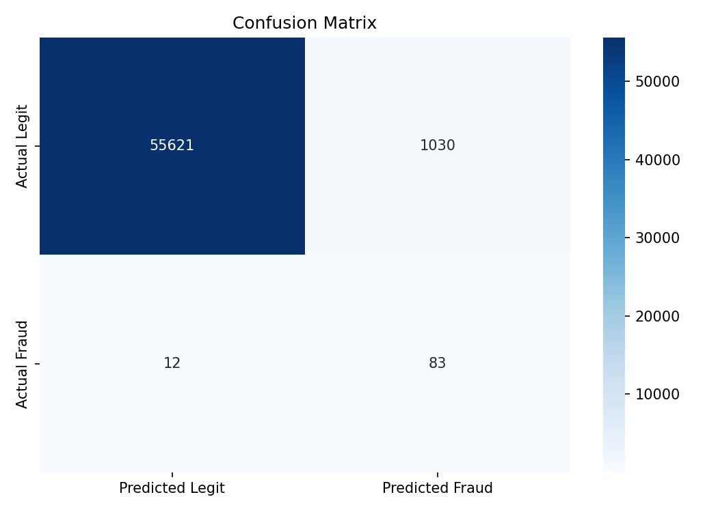
Evaluation Metrics
Data Analysis on Credit Fraud - presented by Zaw Min Tun

Slide 9
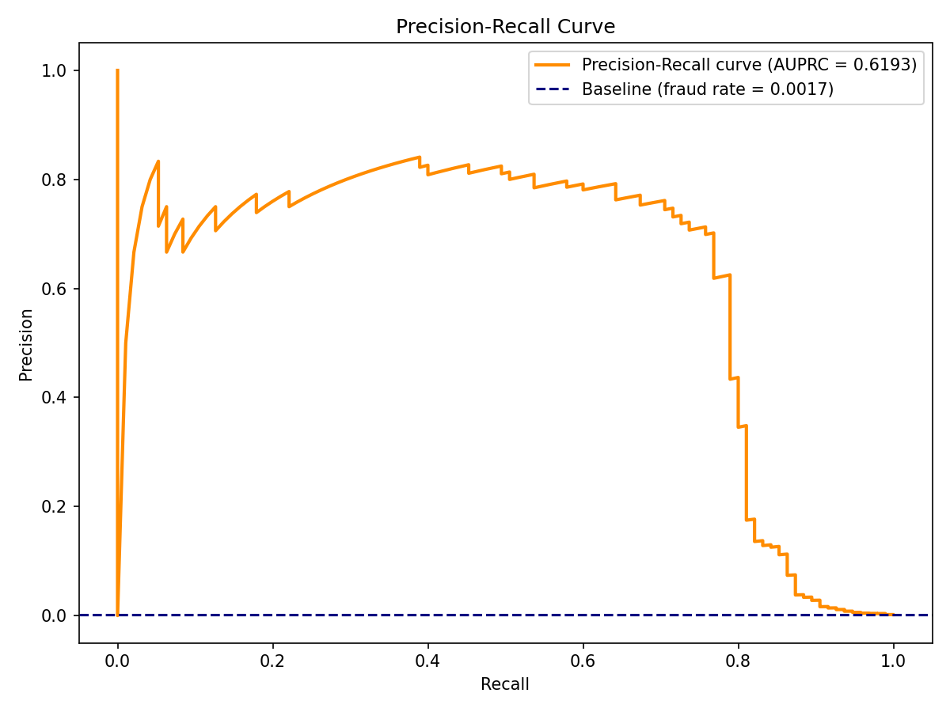
Findings & Future Improvements
Random guess: 0.0017
With ML Model: 0.6193
Recommended: 0.75 - 0.85
Data Analysis on Credit Fraud - presented by Zaw Min Tun

Slide 10
Data Analysis on Credit Fraud
Presented by Zaw Min Tun
Thank You !!!

