Slide 1
Flight Passengers Data Analysis
Presented by Zaw Min Tun

Slide 2
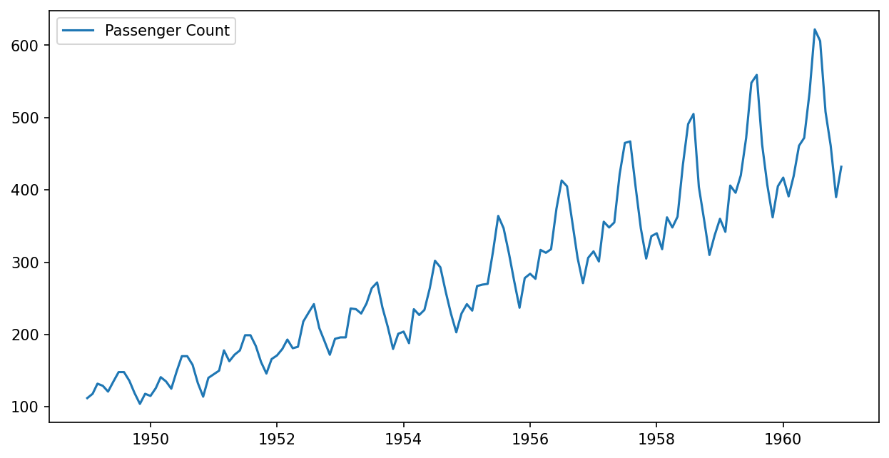
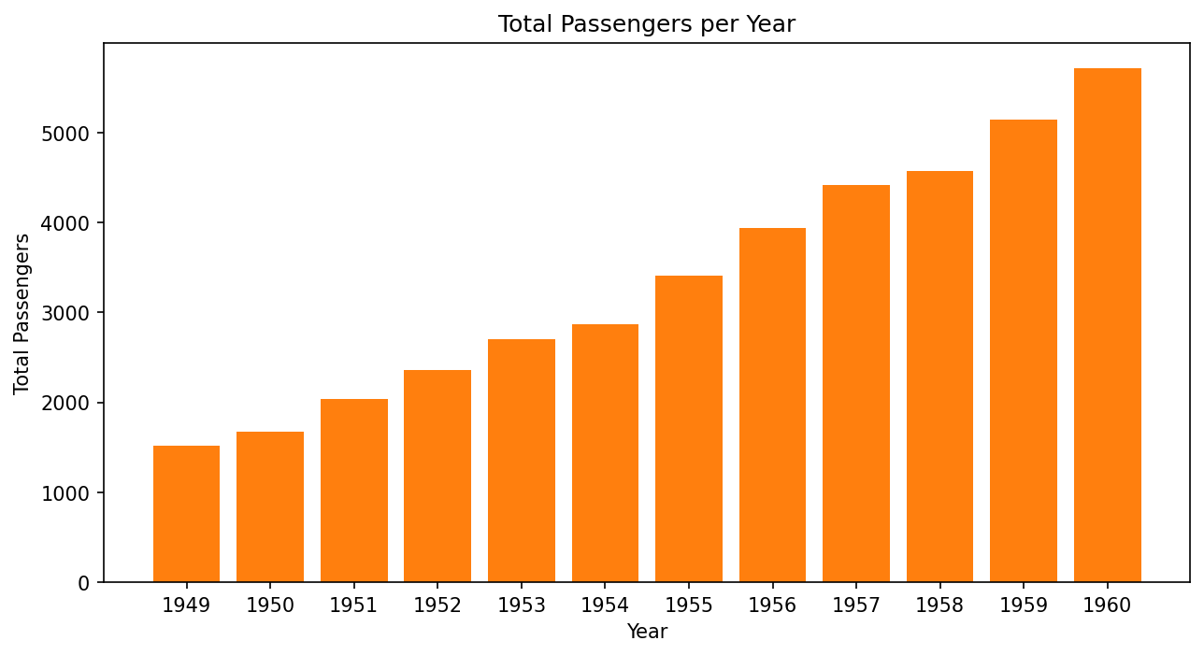
Monthly Airline Passengers Over Time

Slide 3
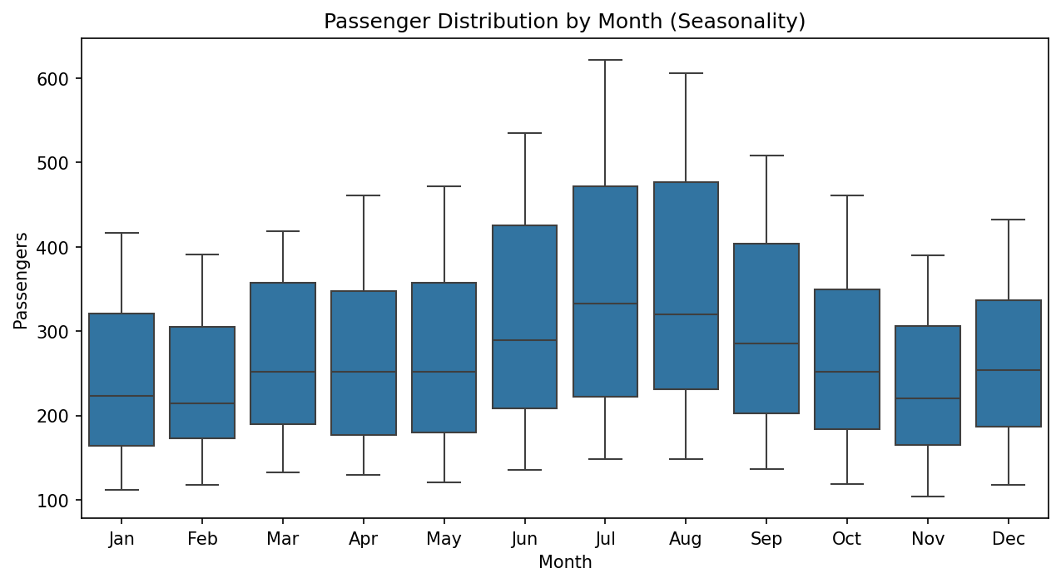
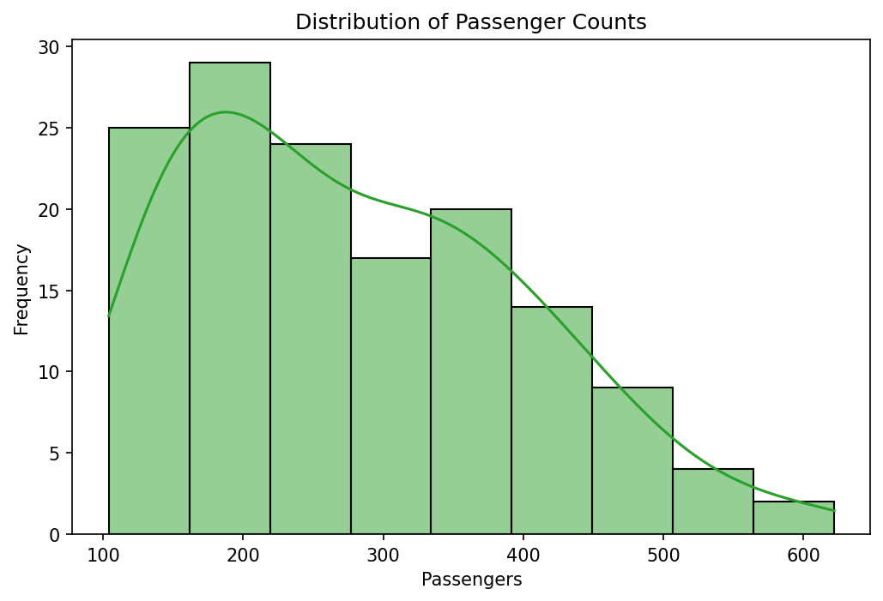
Passenger Distribution

Slide 4
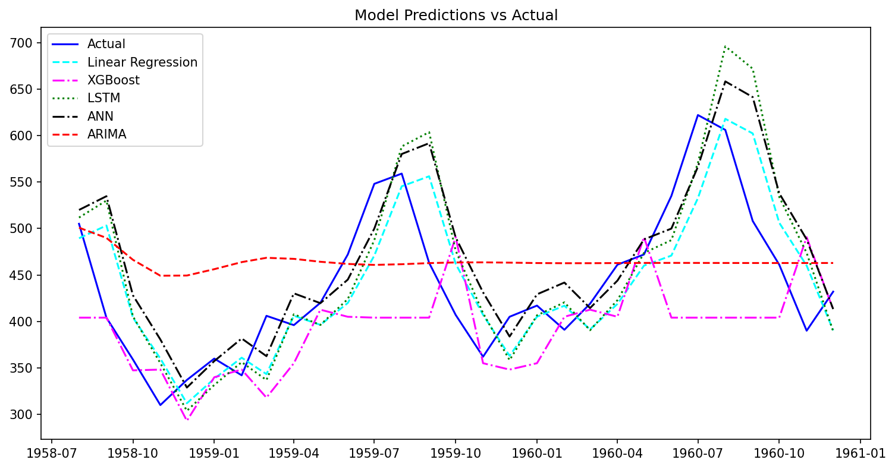
Performance Comparison of Algorithms

Slide 5
Flight Passengers Data Analysis
Thank You !!!
Presented by Zaw Min Tun

